Slide 1
While you’re waiting, think about this question:
What makes a lesson learner-centered?
We’ll share responses later in the session.

Slide 2
Developing Learner-Centered Lessons
Melanie Ruda
Senior Instructional Designer
Seward Incorporated
March 17, 2010

Slide 3
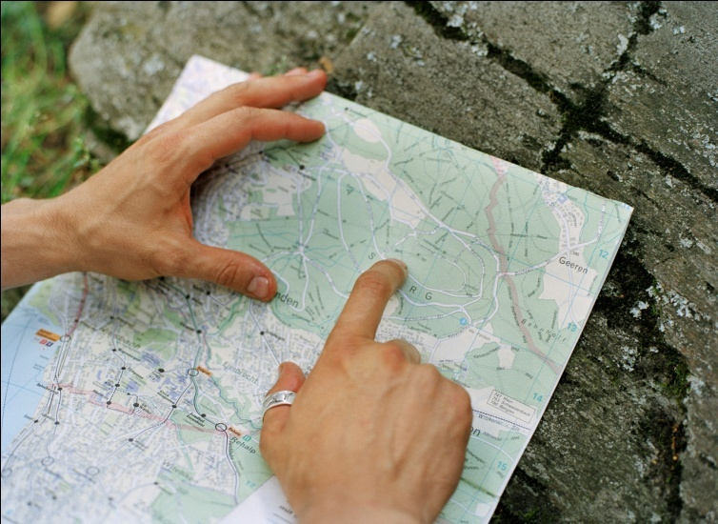
During This Session
Gather collective knowledge
Reflection
Explore topics
of your choosing
Pair Share

Slide 4
1: Gather Collective Knowledge
What makes a lesson learner-centered?

Slide 5
2: Reflection
If you are experienced...
1. Which aspect is the easiest for you to accomplish?
2. Which aspect would you like to improve upon?
3. What barrier is holding you back?
If you are new...
1. Which aspect will be easiest for you to accomplish?
2. Which aspect will be most challenging?
3. What barrier will make it challenging?

Slide 6
3: Explore Topics
To develop learner-centered lessons:
Focus on the learners
Enable students to own their learning
Mediate instruction
Make learning engaging, active, social, and contextual
Promote deep understanding
Provide time for reflection
Use a variety of assessment methods

Slide 7
4: Pair Share
If you are experienced...
1. Which aspect is the easiest for you to accomplish?
2. Which aspect would you like to improve upon?
3. What barrier is holding you back?
If you are new...
1. Which aspect will be easiest for you to accomplish?
2. Which aspect will be most challenging?
3. What barrier will make it challenging?
4. With your partner, discuss how you might overcome the barrier.

Slide 8
Resources for Overcoming Barriers
Your colleagues!
Learner-Centered Teaching
by Maryellen Weimer (2002),
published by Jossey-Bass
Navigating the Bumpy Road to Student-Centered Instruction
by Richard Felder and Rebecca Brent (1996)
http://www4.ncsu.edu/unity/lockers/users/f/
felder/public/Papers/Resist.html

Slide 9
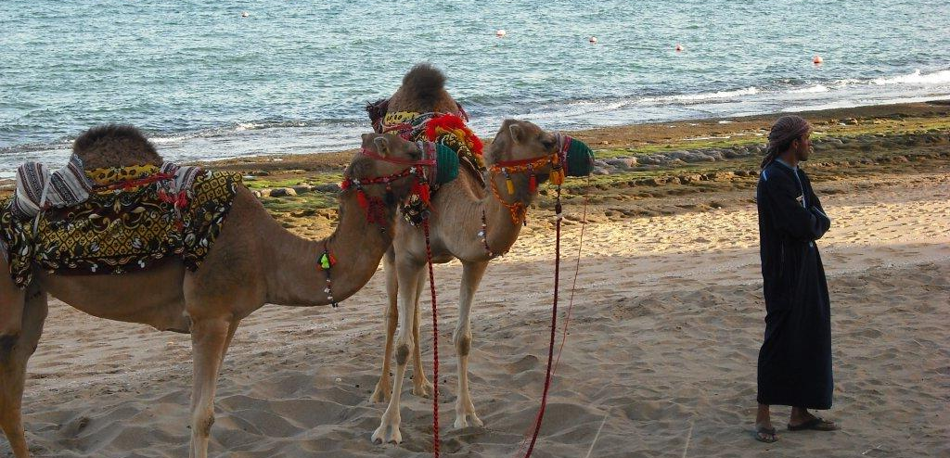
Good teaching is a journey,
not a destination.
Notes:
Map out where you’d like to go.
Make the changes a bit at a time.
Set realistic expectations for success.

Slide 10
For More Information
BOOKS
Learner-Centered Teaching by Maryellen Weimer (2002), published by Jossey-Bass
The Learner-Centered Classroom and School by Barbara L. McCombs and Jo Sue Whisler (1997) published by Jossey-Bass
Active Learning: 101 Strategies to Teach Any Subject by Mel Silberman (1996) published by Allyn and Bacon
ARTICLES
Navigating the Bumpy Road to Student-Centered Instruction
by Richard Felder and Rebecca Brent (1996)
http://www4.ncsu.edu/unity/lockers/users/f/felder/public/Papers/Resist.html
Mind over Matter : Transforming Course Management Systems into Effective Learning Environments by Colleen Carmean and Jeremy Haefer (2002) http://net.educause.edu/ir/library/pdf/erm0261.pdf
Teaching Learners to be Self-Directed by Gerald Grow (1996)
http://www.longleaf.net/ggrow/SSDL/SSDLIndex.html
Collaborative Learning: Group Work and Study Teams by Barbara Gross Davis (1993)
http://teaching.berkeley.edu/bgd/collaborative.html
WEB SITES
The Learner-Centered Teaching Series, University of Oregon
http://tep.uoregon.edu/workshops/teachertraining/learnercentered/learnercentered.html
Professional Development Module on Active Learning, Texas Collaborative for Teaching Excellence
http://www.texascollaborative.org/activelearning.htm

Slide 11
Developing Learner-Centered Lessons
Thank you for attending!
Melanie Ruda
mruda@sewardinc.com

Slide 12
Focus on the Learners
Prior Knowledge
Experiences
Abilities
Learning styles
Interests
Notes:
Our goal as educators is to guide students from their current knowledge and skill level to a new place of competence, and we have to do it in such a way that the learning tasks are neither too easy nor too difficult. Doing this requires knowing about student’s prior knowledge, experiences, and their abilities: intellectual, interpersonal, and ability to work independently.
Making the lessons motivating and engaging for students also requires understanding on our part about their interests and their learning styles.

Slide 13

Focus on the Learners
Gerald Grow’s
Stages of Self-Direction Learning Model
Stage 1
Dependent
Stage 2
Interested
Stage 3
Involved
Stage 4
Self-directed
Teacher’s purpose: to match the learner’s stage and prepare the learner to advance to higher stages
Notes:
If we’re to successfully convert courses that are teacher-directed into courses that are learner-centered, we need to be honest about our students willingness and ability to change where they are.
Gerald Grow has developed a stages of self-direction model.
Stage 1 learners – need explicit directions on what to do, how to do it, and when. They respond best to coaching. Give them specific, identifiable tasks and set standards beyond what they think they can do, and then do whatever it takes to get them to succeed. You’re trying to overcome deficiencies and resistance.
Stage 2 learners are interested and receptive. They respond to enthusiasm and motivational techniques. They are willing to do assignments that they can see the purpose of, so be sure to explain how the assignment will help them. At this stage, begin training students in basic skills such as goal setting. You’re trying to lead them from being externally motivated to internally motivated. It is especially important to tie the subject to the learners’ interest.
Stage 3 learners have skills and knowledge and see themselves as participants in their own their own education, and they are ready to explore a subject with a good guide. These learners benefit from learning more about how they learn are more conscious of using learning strategies. Do well with group projects. Students and teachers share in decision making. The teacher’s goal is to help students develop the skills necessary to be lifelong learners.
Stage 4 learners set their own goals, with or without the help of experts. They take responsibility for their learning, direction, and productivity. Internship, dissertation.

Slide 14
Enable Students to
Own Their Learning
Give students a choice.
Give students a voice.
Hold students accountable.
Scaffold students in their growth toward independence.

Slide 15
Mediate Instruction
“From sage on the stage to guide on the side”
Do learning tasks less
Resist the temptation to tell: Allow students to discover for themselves
Encourage students to learn from each other
Notes:
Developing learner centered lessons requires a role change.
Try to think of yourself more as a mediator, and less as the person with all the answers.
Move from being “the sage on the stage to the guide on the side.” (Alison King, 1993)
Do learning tasks less
In your classroom, who organizes the content, asks questions, answers questions, solves problems, generates examples, and summarizes what has been said?
Is it you, or is it the students? These are all learning tasks. Include the students in on some of this work. In the Methods course, we put students into teams. They had to compile their notes with two other students and then publish it as a Wiki for instructors to read.
You might also ask students to use a concept map or a matrix to organize content.
Resist the temptation to tell: Allow students to discover for themselves
Experimenting, interpreting data, interviewing, problem-based learning are all methods that allow students to discover for themselves.
Simple example: If a student asks you a question, can you direct them to the answer, rather than tell them.
Encourage students to learn from each other
Social interaction introduces multiple perspectives on learning.
Have students work collaboratively on a problem or project.
Group prep for exam.
Ask them to contribute to discussion forums.

Slide 16
Make Learning Engaging
Engage students from the start
Coming In activities
Icebreakers
Poll or a survey
Think, Pair, Share

Slide 17

Passive Learning
In one ear…
and out the other.

Slide 18
Make Learning Active
Sketch a flowchart
Give examples
Make a poster
Make predictions
Brainstorm
Solve a problem
Interpret data
Panel discussion
Critique
Role play
Summarize
Try to talk no more than 10 minutes
before changing the action.

Slide 19
Make Learning Social
Face-to-Face
Groups
Online
Wikis
Peer teaching
Interviews
Role plays
Discussion Forum
Chat
Good group learning experiences
do not happen automatically!
Notes:
People learn through dialog, both by having to construct responses and by considering others points of view. Researchers report that, regardless of the subject matter, students working in small groups tend to learn more of what is taught and retain it longer than when the same content is presented in other instructional formats.
Face-to-face activities
Group work
Group work
Informal: temporary, ad hoc clusterings – turn to a neighbor – solve a problem, check understanding, answer a question, apply what they’re learning
Formal: teams established to complete a specific task – carry out a project, prepare a position paper. These groups may complete their work in a single class session or over several weeks.
Study groups: long term groups whose primary responsibility is to provide members with support, encouragement, and assistance in completing assignments or studying for tests.
Peer teaching
Interviews
Role plays
Online activities
Wikis
Threaded discussion
Email
Good group learning experiences do not happen automatically!
When doing group work:
Provide structure and clear objectives for the groups.
Explain how the groups will operate and how they will be graded.
Assign group tasks that allow for a fair division of labor.
Recognize that you may have to spend considerable time on the fundamentals of group process.
In the Methods class, students formed groups of 3 to compile their notes. At their initial meeting, they exchanged some information about their interests, read and reacted to a short story about responsibility, and then used that story as a guide for setting up rules about group interaction.

Slide 20
Make Learning Contextual
Make learning contextual through the use of:
Case studies
Task-based learning
Problem-based learning
Place the content in a real world context.
Give the students real problems to solve.

Slide 21
Promote Deep Understanding
Evaluation
Appraise, argue, assess, conclude, criticize, justify, interpret, prove, rate, validate
Synthesis
Combine, compose, create, design, generate, integrate, make, organize, plan, synthesize
Analysis
Analyze, compare, contrast, differentiate, diagram, distinguish, examine, separate
Application
Adapt, apply, demonstrate, modify, produce, relate, show, solve, use
Comprehension
Knowledge
Bloom’s Taxonomy

Slide 22
Provide Time for Reflection
Activities
Minute papers
Learning logs
Guided reflection
Free writing
Use open-ended questions:
What did you learn?
Why do you believe that now?
How has your knowledge changed?

Slide 23
Use a Variety of
Assessment Methods
Evaluation
Synthesis
Analysis
Application
Comprehension
Knowledge
Bloom’s Taxonomy

Slide 24
Use a Variety of
Assessment Methods
Performance assessment
Teacher observations
Peer assessment
Self-assessment
Conferencing
Portfolios, digital and nondigital
Rubrics:
A set of criteria defining performance at various levels

