Slide 1
Designing a Learner-centered Course
Greg Sales
Melanie Ruda
Matt Finholt-Daniel
May 15, 2010

Slide 2
Day 2
Day 3
Day 1
Day 4
Day 5
Summer
Fall

Slide 3
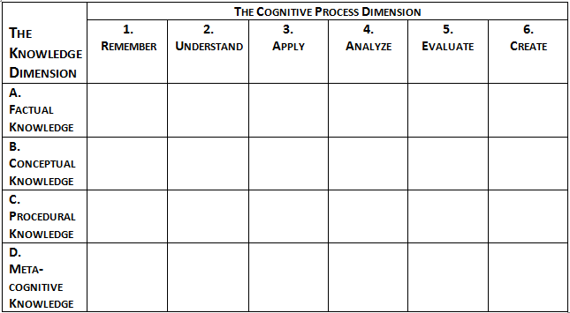
Taxonomy
From page 28 of the book Taxonomy for Learning, Teaching, and Assessing, edited by Lorin W. Anderson and David R. Krathwohl, © 2001 by Addison Wesley Longman, Inc.

Slide 4

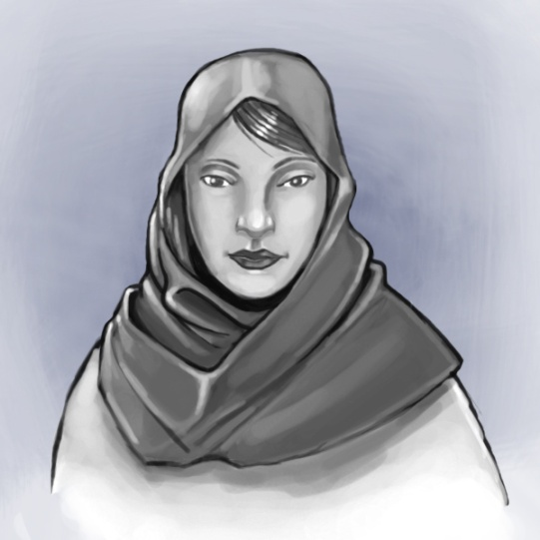
Course Goal
Individual, 10 minutes, Page 4
Imagine one of your students
six years from now…
Write the course goal.
Team, 10 minutes
Come to consensus about the goal. Record your response in the Design Document.

Slide 5

CUTM 4012 Structure
Micro teaching
Instruction by students
Evaluation
Outcomes
Instruction approach
Self-assessment
Assessment method
Peer assessment
Instructor critique
Two lessons
One game or station
Pre-class planning
Theoretical Session
Pre-class
Class
Post-class
Readings
Forum
Quiz
Group wiki
Coming-in activity
Group
work
Video vignettes
Reflection

Slide 6
CUTM 4012 and
Learner-Centered Instruction
Large group, 15 minutes
In what ways was CUTM 4012 learner-centered?
What were its strengths?
How could it have been improved?
Team, 10 minutes
How will the new course be learner-centered? Record your conclusions in the Design Document.
LCI

Slide 7
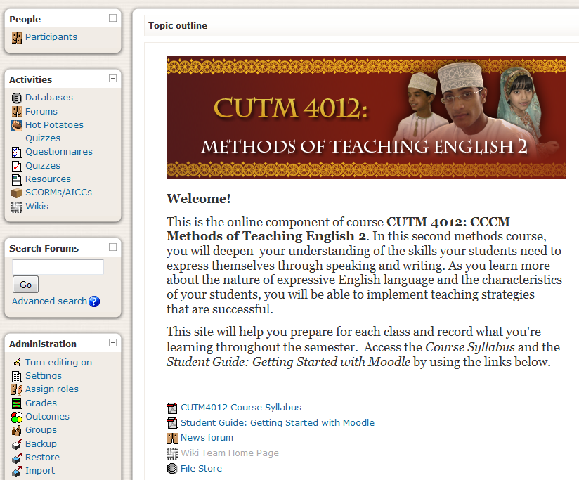
Moodle
Large group, 10 minutes
Moodle use in CUTM 4012
What worked well?
What could be improved?
Team, 10 minutes
How will Moodle be used in the new course? Record your response in the Design document.

Slide 8
Learner Analysis
Individual, 5 minutes, Page 5
Rate your students on their skills.
Team, 15 minutes
Draw conclusions about current skills and growth areas. Record your conclusions in the Design Document.

Slide 9
Break until 10:30

Slide 10
Taxonomy
From page 28 of the book Taxonomy for Learning, Teaching, and Assessing, edited by Lorin W. Anderson and David R. Krathwohl, © 2001 by Addison Wesley Longman, Inc.

Slide 11

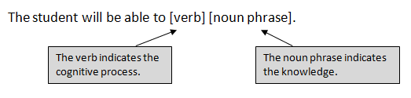
Course Objectives
Individual, 15 minutes, Page 6
Using your course goal, results of analysis, and old course materials, write a first draft of the objectives, using this format:
Team, 60 minutes
Share with your team and revise.
Categorise objectives in the Taxonomy on page 7.
Revise as necessary. Fill in the course objectives in the Design Document.

Slide 12
Lunch break until 1:00

Slide 13
Course Organization
& Lesson Objectives
Team, 40 minutes, Page 11
Drawing on the old course and new course objectives, organize your course into lessons, with a main theme for each lesson.
Divide the lessons up among the team members. Decide who will write which lessons.
Individual, 20 minutes, Page 11
Write a rough draft of some lesson objectives, and then correlate with the course objectives to be sure you’re on track.

Slide 14
Tasks and Plan for May 16-18
Large group and teams, 20 minutes
See page 14 for tasks.
Decide on a time each day when most of your department can meet with Seward.
During May 16-18 Seward is available for individual for consultation on topics of your choosing.

Slide 15
Evaluation and Reflection
Individual, 10 minutes
Complete the Evaluation and Reflection form for Day 1.
Turn in the first page to Seward, and keep the second page for yourself.

Slide 16
Contact Information
Greg Sales
gsales@sewardinc.com
Melanie Ruda
mruda@sewardinc.com
Matt Finholt-Daniel
mfinholt@sewardinc.com

Slide 17
End

