Slide 1
How to pitch to investors

Slide 2
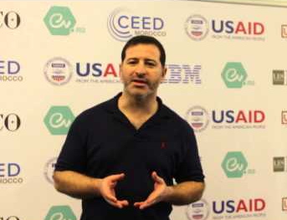
Speaker
Nadir Eythrib

Slide 3
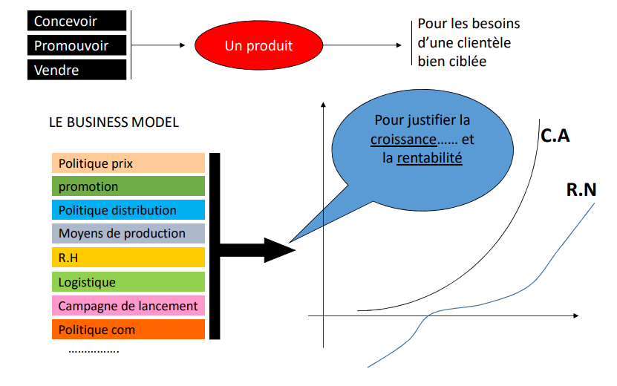

Slide 4
Nail your elevator speech
Your elevator speech is a 30 second or less summary of what you do. It should explain everything someone would need to know when they first meet you.
This should tell them everything they need to know even if they have no background knowledge about your company.
The goals of your elevator speech are to be able to succinctly describe your idea or product and get the other person interested enough to ask follow-up questions.
Here are the three main things your elevator speech needs to cover:
What you do.
Keep it short!
What problem you solve.
Again, keep it short, but be descriptive about what problem your product solves for its target customer.
Why you’re different.
Why should the person you’re talking to use your product or service over your competition?
Your product may have a feature no one else does, or maybe it’s just easier to use. Whatever your key differentiator is, you need to know it.
After your speech, make sure to connect with the person listening.

Slide 5
Use realistic data (and be able to back it up)
When you’re pitching to investors, you need to provide solid data.
Investors care about what you’ve already accomplished and how that can make them a profit in the future.
There are many ways to calculate the value of a startup, some of them more controversial than others.
This is because the value of a start-up is often created before they’ve even made a profit. The numbers behind it are driven by speculation of how good the company could perform, hypothetically.
Some startups have higher valuations than their publicly traded peers.

Slide 6
Tell an engaging story
It’s no secret that storytelling sells.
Brands who effectively use storytelling in their marketing consistently outperform those who don’t, sometimes by up to 64%!

Slide 7
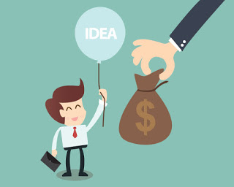
Being honest builds trust and credibility. Investors know how tough business is and they won’t trust someone who comes in and says, “I’ve got it all figured out!”

Slide 8
Thank you for your attention

