Slide 1
New Media for the Networked NGO
Agenda and Networking Exercise
Facilitator: Beth Kanter
E-Mediat is funded by the Middle East Partnership Initiative of the United States Department of State with support from Microsoft Corporation and craigslist Charitable Fund and administrated by the Institute of International Education
Notes:
IIE and publicly acknowledge funding by the U.S. Department of State Middle East Partnership Initiative (MEPI).
Networking Exercise: 11:00 – 11:30 a.m.

Slide 2
Day One: Learning Objectives
To provide an opportunity for NGOs from different countries to network with each other and inspire them to continue networking after the conference
To understand some simple techniques about content curation and how to develop engaging content to integrate across channels and specific tips for Facebook, Twitter and Blogging
To understand useful techniques for fundraising efforts and improving branding efforts that will make social media use more impactful
To provide an introduction to Wikipedia-related efforts in the region
Notes:
This are the learning objectives for today.
You’ll notice that we’re encouraging as much networking as possible – slightly longer breaks, small group exercises, “share pairs” – and other opportunities for everyone to get to know each other and hopefully continue to learn form one another after our time together over the next two days.

Slide 3
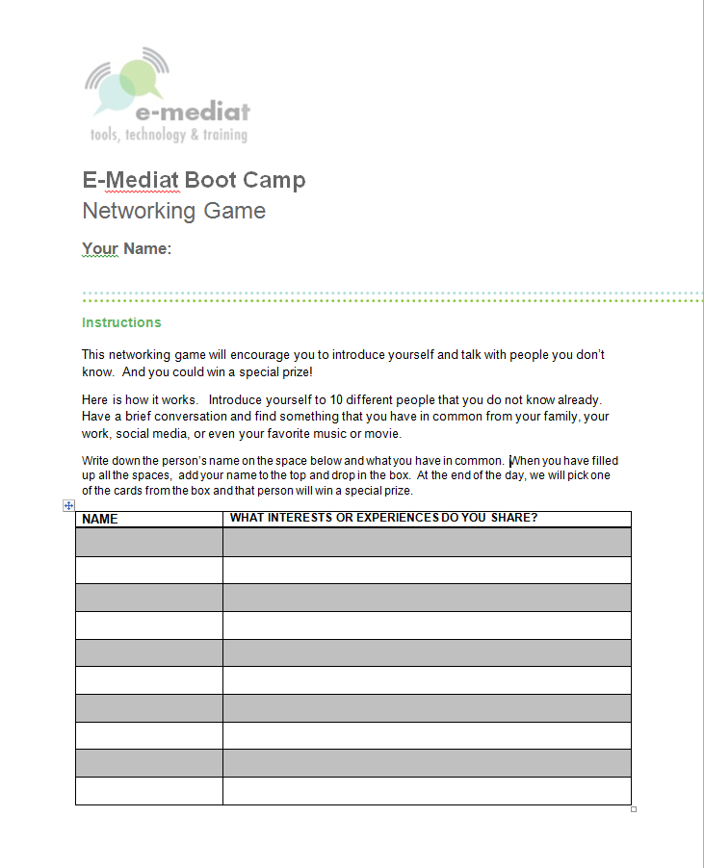
Logistics
Laptops Up and Laptops Down
Wifi Login
Use of Wifi: Social Media Breaks
Use Twitter hashtag #emediat
Rules about posting photos to FB or Internet
Networking Game Cards
Other
Spreadsheet Aerobics
Notes:
This networking game will encourage you to introduce yourself and talk with people you don’t know. And you could win a special prize!
Here is how it works. Introduce yourself to 10 different people that you do not know already. Have a brief conversation and find something that you have in common from your family, your work, social media, or even your favorite music or movie.
Write down the person’s name on the space below and what you have in common. When you have filled up all the spaces, add your name to the top and drop in the box. At the end of the day, we will pick one of the cards from the box and that person will win a special prize.

Slide 4
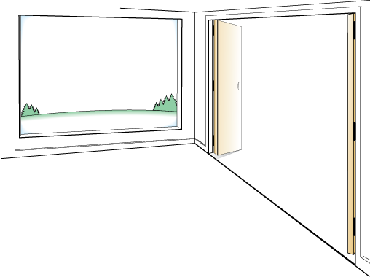
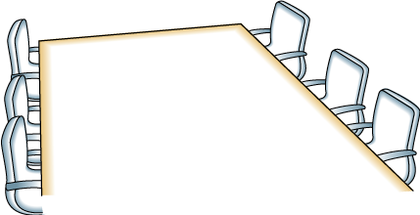
Day One: Jordan
AGENDA
OUTCOMES
Networking Exercise
Principles of Successful Networked NGOs
Lunch
Wikipedia Presentation
Content Curation
Train the Trainer
Evening: Networking Activity
Make connections to people that can help you move your social media work forward
Be ready to apply at least one or two things you learned to you make your social media more effective
FRAMING
Balance of peer learning & expert sharing
Modeling interactive training
Ask Questions, Use Sticky Notes
Fun! Don’t Be Shy!

Slide 5
Day One: Morocco
AGENDA
OUTCOMES
Networking Exercise
Principles of Successful Networked NGOs
Lunch
Wikipedia Presentation
Content Curation
World Café
Evening: Train the Trainers
Make connections to people that can help you move your social media work forward
Be ready to apply at least one or two things you learned to you make your social media more effective
FRAMING
Balance of peer learning & expert sharing
Modeling interactive training
Ask Questions, Use Sticky Notes
Fun! Don’t Be Shy!

Slide 6
Networking Activity

Slide 7
Networking Activity: Share Pair #1
Find a partner
Share a social media success story (5 minutes)

Slide 8
Networking Activity: Share Pair #2
Find a partner
Share a social media challenge (5 minutes)

Slide 9
Networking Activity: Pair Share Pair
Find another Pair – 4 people
Each person takes 2 minutes to share their burning question and what social media knowledge they can share

Slide 10
Networking Activity: Full Group Share
What were some of the themes that came up around success stories?
What are some of the common challenges?

