Slide 1
Workshop 4: Storytelling with Digital Video
Day 1: Storytelling with digital video
Day 2: Creating, sharing and distributing videos
This project is managed by Institute for International Institute for Education (IIE) Sponsored by the U.S. Department of State Middle East Partnership Initiative (MEPI)
Notes:
State that the program is managed by IIE and publicly acknowledge funding by the U.S. Department of State Middle East Partnership Initiative (MEPI).
Workshop 4: Storytelling with Digital Video
Day 1: Storytelling with Digital Video
Day 2: Creating, sharing and distributing videos

Slide 2
Program Overview
Notes:
Give a verbal overview of the program
http://www.emediat.org/main/program-overview/
The program outcomes are:
Increase CSO/NGO knowledge, access and skills to use new media effectively to advance their unique missions and strengthen their organizations
Improve communication between CSO/NGO leaders and key stakeholders and between CSO/NGOs and their communities of peers around the world
Improve communication between CSO/NGOs and governments in the MENA region
The five-workshop agenda is an intense schedule and a lot to cover and implement in a very short time frame. While you will be exposed to many tools and techniques, it is not an expectation that every organization will implement all tools presented in the workshops at the deepest level to reach the above outcomes.

Slide 3
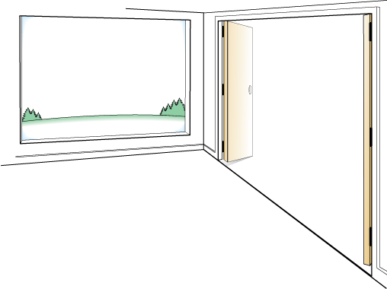
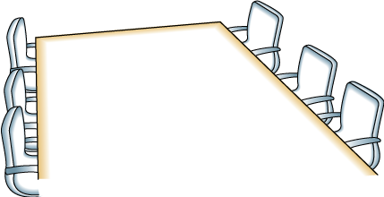
Day One: Agenda
AGENDA
OUTCOMES
Using videos – Best practices
Storytelling framework for effective videos
Creating your video
Leave the room ready to create videos.
FRAMING
Creating framework for your video
Hands-on time: how to use flip camera
Notes:
This template is from Grove Consulting.

Slide 4
Day One: Learning Objectives
To introduce frameworks for digital storytelling for NGOs
To understand what makes a good NGO video and the process of creating one
To introduce basic shooting techniques and practice with Flip camera

Slide 5
Day 1: Trainer Introductions
Day One: Trainer Introductions
Insert your photos and names here
Notes:
Give a brief introduction

Slide 6
Icebreaker
Share Pairs:
What is one thing you already know or want to learn about using video for your NGO?
Notes:
9:00-9:30 Introduction and Review Agenda
Share pairs: Do a share pair. Ask people to find a partner in the room and share the answers. Tell them that if they see you raise your hand, it is the signal to stop talking and be quiet and raise their hands.
What is one thing you already know or want to learn about using video?

Slide 7
Field Team video
Notes:
Play the video that your team has already recorded for introducing the agenda of Workshop 4.

Slide 8
Why Use Videos
Red Cross – Be A Hero
Global Rights – Maghreb Team
Notes:
9:30 – 11:00 Why Videos? Best practices from NGOs
Videos can communicate your organization’s message to large audiences in more personalized ways. You can make an emotional connection with your sponsors, target audience and potential volunteers. Images and music in a video help you to transcend language barriers and connect to a global audience. Once you upload your organization’s video on a sharing site like YouTube your message will reach to millions; even if they can’t comprehend your languages they will be able to comprehend the emotion in the video.

Slide 9
How can videos help NGOs
Putting face on the cause
Sharing fun
Notes:
Putting face on the cause: NGOs usually communicate their cause through mission statements which are abstract and text heavy; videos put a face on the cause.
Sharing fun: Many online viewers aren’t interested in watching videos about social causes on YouTube. Instead, they want to laugh and be entertained; share more entertaining videos

Slide 10
How can videos help NGOs
Saying thank you
Advocacy
Notes:
Saying thank you: Videos are a great way to show appreciation for your supporters and donors.
Advocacy: There are several examples of using videos to advocate support for social issues.

Slide 11
How can videos help Videos
Public service announcements
Animation
Notes:
PSA: Nonprofits work to raise awareness of an issue, affect public attitudes and stimulate action through public service announcements.
Animation: Many nonprofits use animation to simplify complex messages. Use of animation with text and/or audio helps to capture attention and deliver the message in subtle ways.

Slide 12
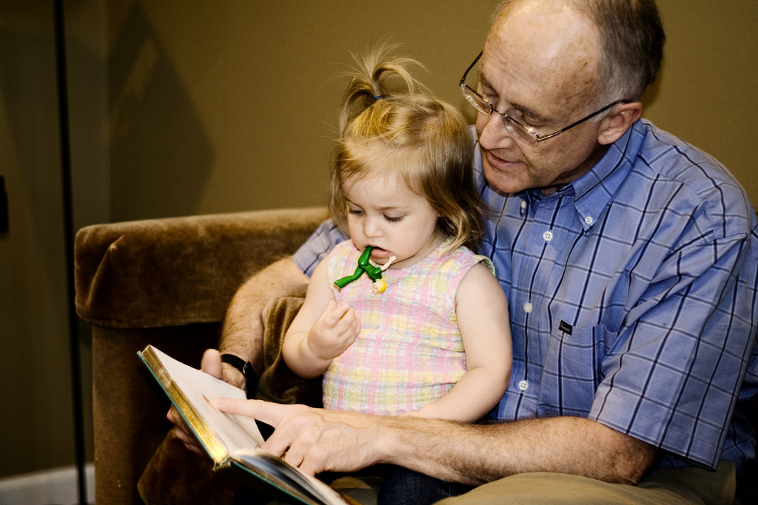
Why NGOs should tell stories?
Stories are a great marketing tool used by for-profit and non-profit organizations.
Why do most of us effortlessly remember many television commercials? Because the commercial tells stories that we can identify with.
Notes:
11:15 – 12:15 Using Videos fro storytelling
Why is storytelling important?
Telling a story is the easiest way to get out the message and attract a larger audience. Stories help to make connections and leave lasting impressions.

Slide 13
Storytelling 2.0
Listen
Scan and monitor with keywords
Engage
Ask questions related to your story
Refine
Use feedback to refine stories
Use feedback to discover other ways to tell story
Encourage people to share their related story
Share
Share supporters stories on other channels
Create Your Video Story

Slide 14
Types of Stories
The story of self (organization) – this is the story about the organization’s mission, objectives, strategy or accomplishments.
The story of us (community) – this is the story of the target group with/for whom the organization is working – women, youth, children, civil society, journalists or people with health problems.
The story of now (change the world) – this is the story of your cause. This helps to connect your organization’s work to similar efforts across the globe.

Slide 15
Digital Storytelling
You can amplify the impact of your story by creating a video and distributing it widely.
Storytelling 2.0 incorporates best principles of good storytelling and also effectively leveraging social media.
Social media makes creating, remixing, and sharing stories between nonprofits and their stakeholders easy and fluid.

Slide 16
Tips for Digital Storytelling
Choose a story and video genre
Keep it short and simple
Be genuine
Add audio – music or narration
Check legal issues
Respect privacy and security
Give credit
Notes:
Before producing anything, decide what your narrative is. What is the message you are trying to deliver?
Powerful videos are often under 2 minutes long, at most no longer than 3 minutes.
It isn’t just making the video; it is also about sparking conversation.
Audio adds emotion.
You have to abide by legal issues and get permission in writing to take a photo or video of someone and post them on the Internet
If you use an image or resource created by someone else, give credit and link to the original creator

Slide 17
How to use Flip Camera
Notes:
1:15 – 1:30 How to use your flip camera
Show video introducing basic features of flip camera: :
http://www.youtube.com/watch?v=mh6s9gNoFro

Slide 18
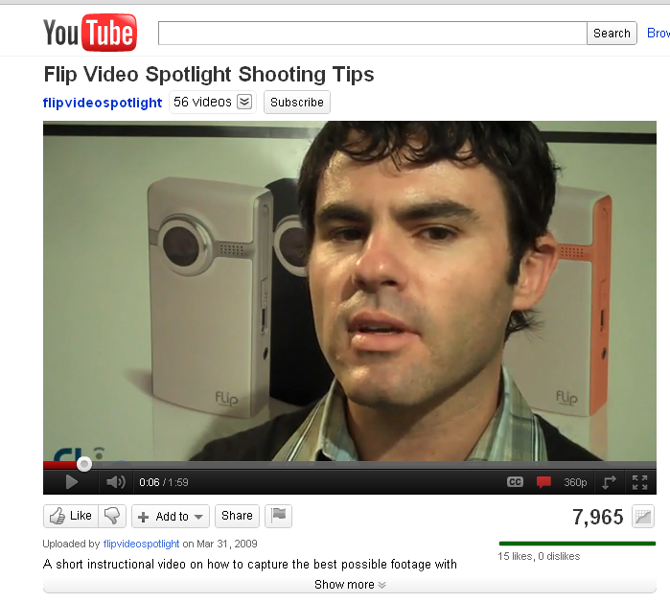
Shooting Tips for the FLIP Camera
Notes:
1:30 – 2:45 Hands-on time: shooting your video
Resources:
http://witnesstraining.wordpress.com/2-equip/equipment-101/flip-cameras/
http://www.youtube.com/watch?v=NG1LKJ_ZRrk&feature=player_embedded

Slide 19
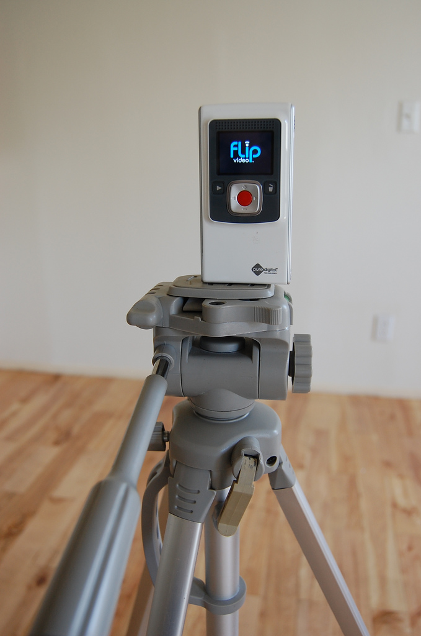
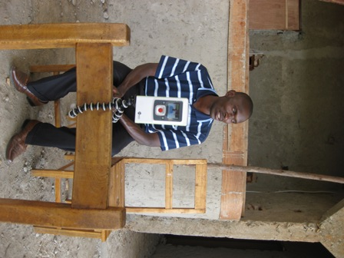
Use A Tripod
Notes:
Use a tripod if possible to avoid camera shake.
There is a traditional tripod mount on the bottom of the flip camera, also you can get an inexpensive tripod and attach a chair
No tripod? You can your hand, but support it with your hand attached it at your elbow.

Slide 20
Five Types of Framing
Type | Description
Wide | Shows the audience scale and space of an area.
Long Shot | Shows the person from head to two
Mid Shot | Shows the person from the waist up
Close Up | From mid-chest up. Ideal for interviews
Tight Close Up | Person’s head. Ideal for FLIP camera to get good sound.
Notes:
Framing:
Framing your shot well is very important. Good framing will largely go unnoticed by your audience but a badly framed shot is instantly recognizable. Trust your eye on this as almost everyone has a natural ability to compose a well-framed shot really without trying.

Slide 21
Hand-on time: shooting your video
Participants will work to record short (2-3mins.) movies using their flip camera.
Choose from the following themes:
Introduce your Organization: Talk about your organization’s mission statement, number of people involved, current projects, target groups and geographical reach
Speak about the cause that your organization supports: Talk about the significance of cause that your organization supports. For example, you can focus on women’s empowerment, environmental protection, workforce development, education etc.
Highlight a successful project/program of your organization: You can talk about a any recent/ongoing project that highlights your organization’s accomplishments
Share your experience of E-Mediat Workshops: Feel free to share your experience of E-Mediat training workshops Optional
Thank you videos
Options for the video themes can be localized

Slide 22
How to transfer video from Flip to computer
Insert camera USB into computer
Save file from camera to computer
Add Title
Notes:
3:00 – 4:45 Make simple edits and share videos
Steps for transferring video from flip camera to your computer:
Insert camera USB into computer
Save file from camera to computer
Add Title

Slide 23
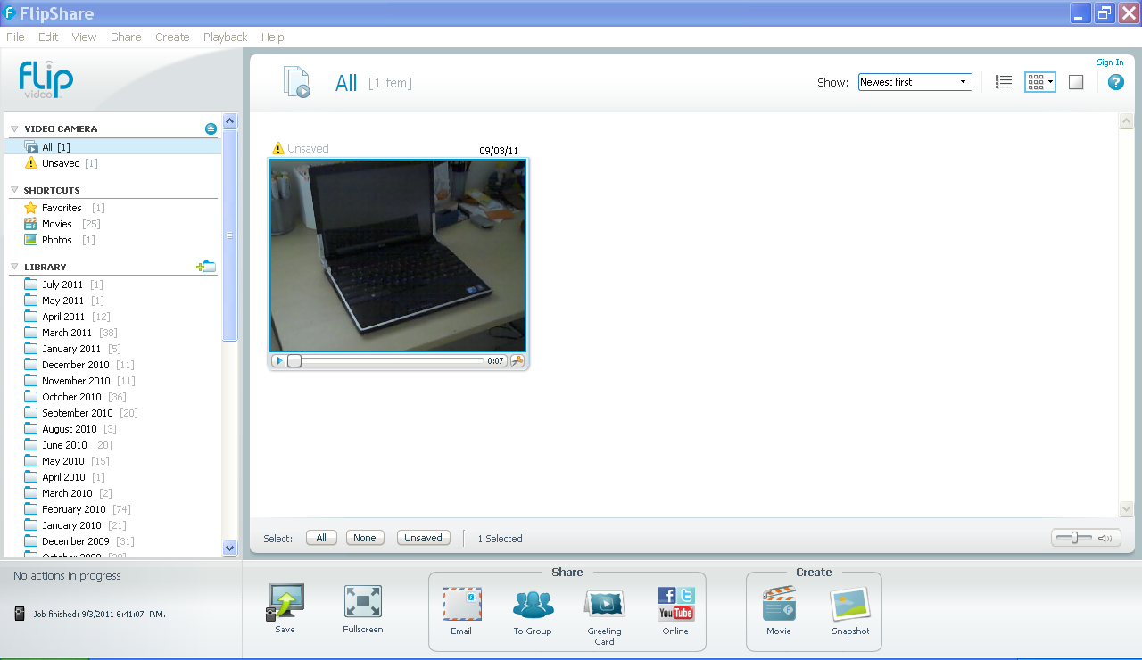
From Camera to Computer
Notes:
Highlight the files you want to save – they turn blue
Click on save

Slide 24
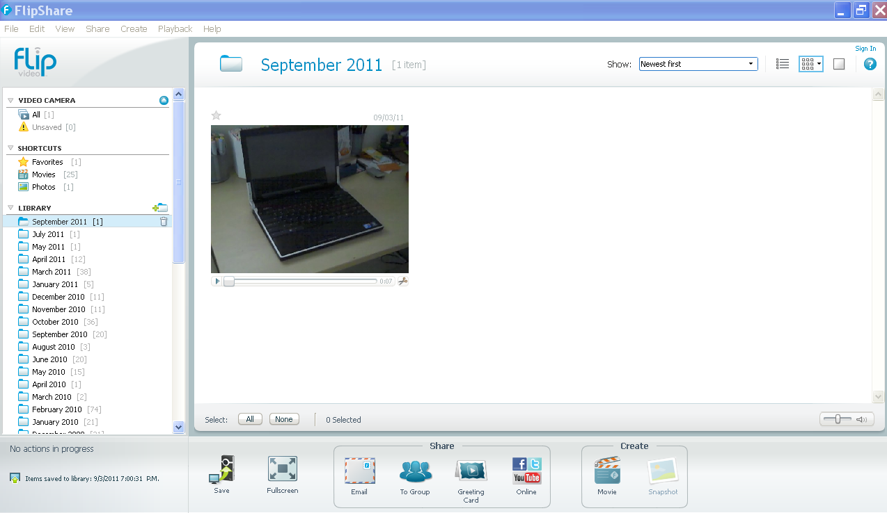
From Camera to Computer
Notes:
It is now in the monthly file

Slide 25
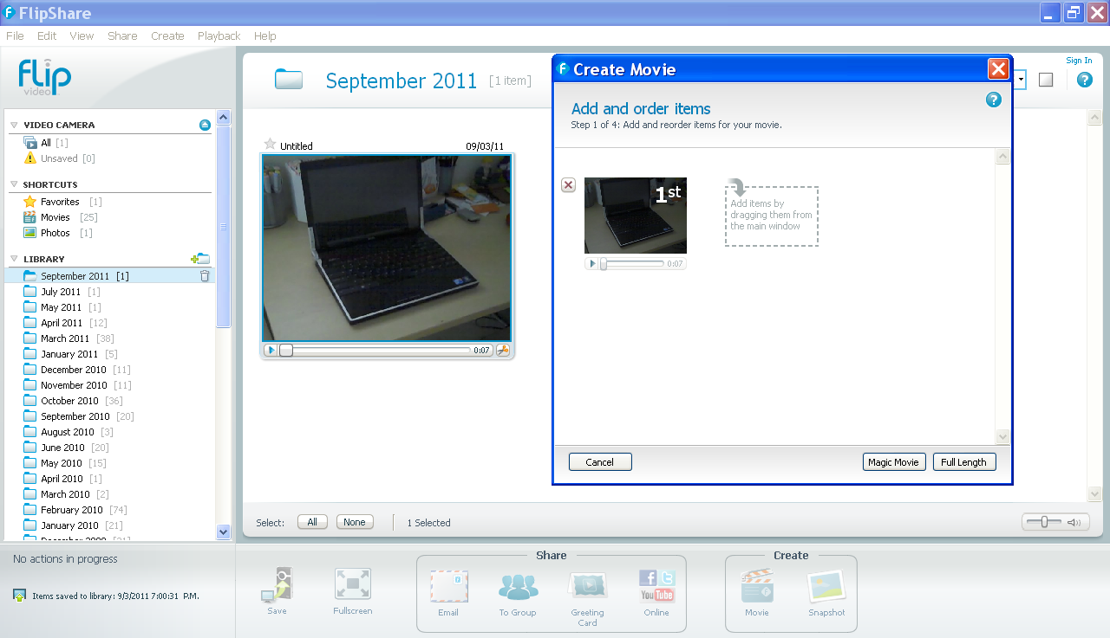
Create Movie
Notes:
Click create movie
Drag your clip into the “create movie” screen
Click full length

Slide 26
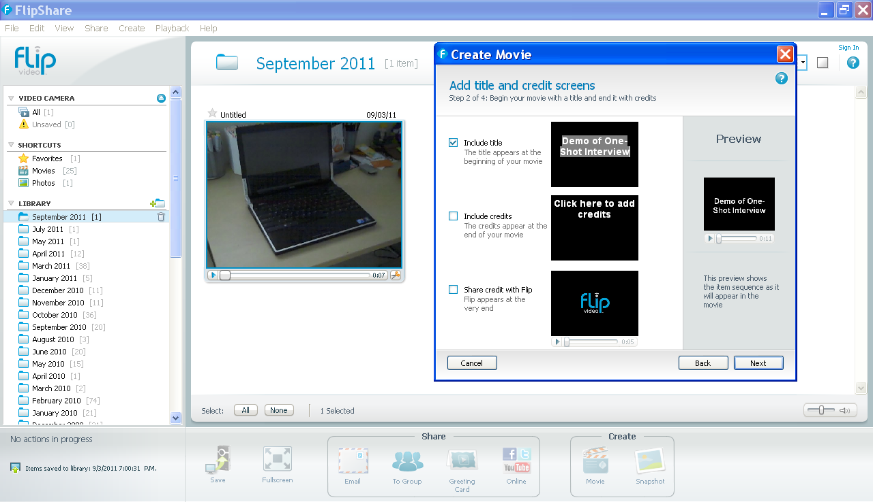
Add Titles
Notes:
Check “include title”

Slide 27
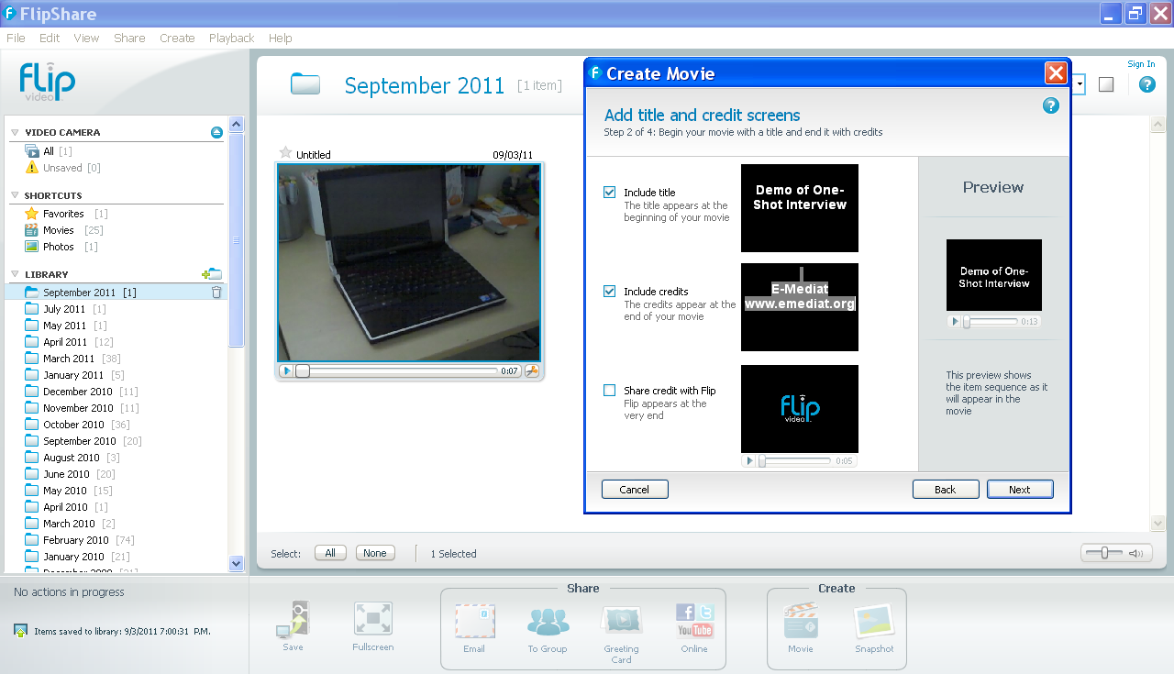
Include Credits
Notes:
Check the “include credits”

Slide 28
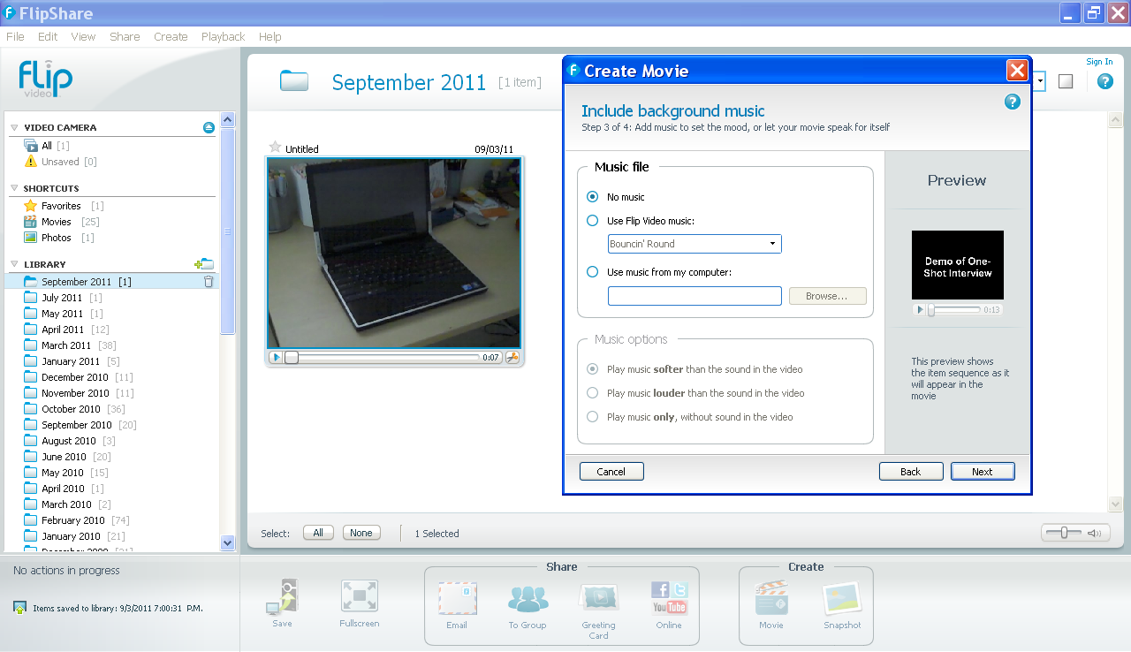
Include Background Music
Notes:
You can add music files to your video
Note: We shall work with more sophisticate editing tools on Day 2

Slide 29
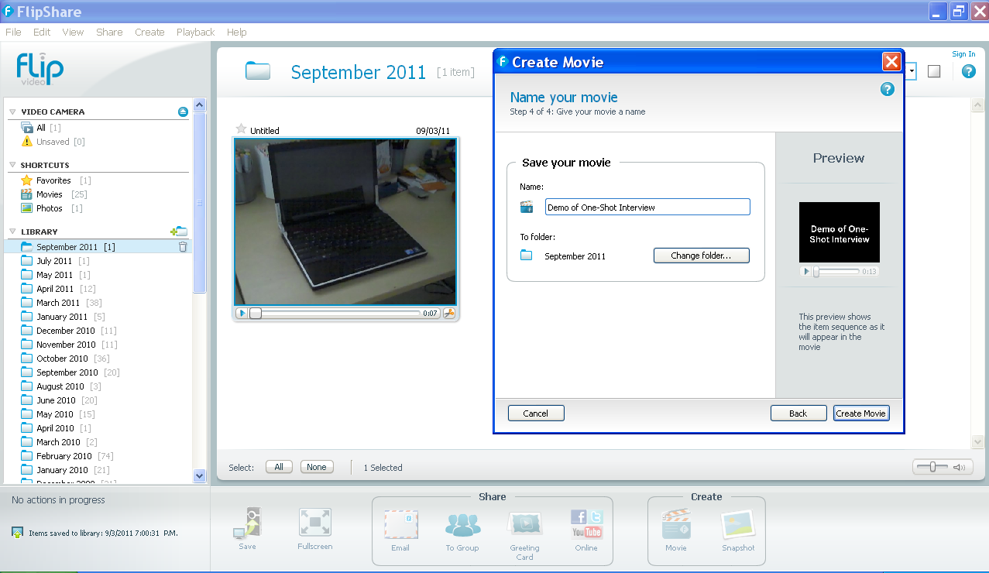
Name and Save Your Movie
Notes:
The default is to save it in your monthly folder

Slide 30
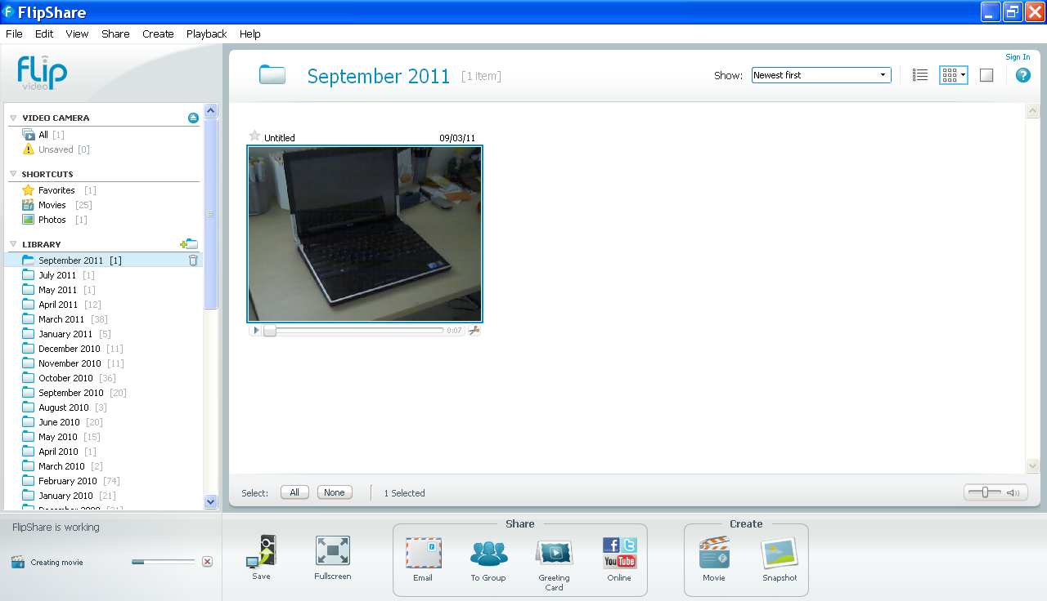
Flip Software creates your movie
Notes:
The bar indicates that it is making the movie

Slide 31
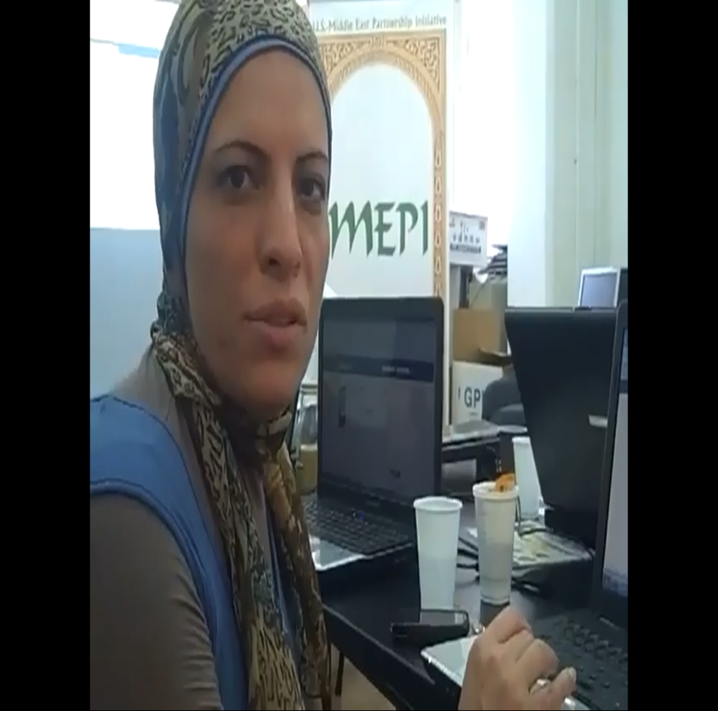
Share participant videos
Notes:
All participants upload their newly created videos from previous session to their computers
Ask the participants to play their videos and share what changes they made after the test video

Slide 32
Reflection and Closing
What did you learn today?
What is still not clear?
What do you need to move forward?
What is the most important thing you want to learn tomorrow?
Notes:
4:45 – 5:00 Reflection exercise
Do a series of “Share Pairs” where people ask and answer these questions:
What did you learn today?
What is still not clear?
What do you need to move forward?
What is the most important thing you want to learn tomorrow?
Then gather in a circle, and have everyone share one word about how they are feeling and why.

Slide 33
Day Two: Agenda
OUTCOMES
AGENDA
Leave the room ready to set up YouTube accounts and share videos.
Overview of creative process
Edit video on Movie Maker
Sharing & distributing videos
Reflection
FRAMING
Edit your videos
Market your videos
Notes:
This template is from Grove Consulting.

Slide 34
Day Two: Learning Objectives
To learn to use moviemaker
To understand the basics of setting and using a YouTube Channel

Slide 35
Overview of Creative Process
Strategy
Production Plan
Shooting
Editing
Publish and Share
Notes:
9:00 9:30 Overview of creative process
1. Strategy: It is important to align your videos to your social media plan. Link video to SMART objectives Worksheet will help participants to do so. Participants should be encouraged to think through how they will use the video to support the organization’s social media and communication objectives, identify potential stories, how they might package them – a series or stand alone, where to cross post, and think about the last step – sharing.
2. Shooting: This is what you did using your flip camera on day 1. While shooting you will have to keep in mind issues like framing, lighting, audio quality and lightning.
3. Editing: Whether you are using the simple software with the Flip camera or fancy software, you will need to some editing. With the flip camera, it is best to do “in-camera editing” – that you only shoot what you’ll actually use.
4. Publish and share: Publishing is about uploading a video on YouTube. Set your videos free – publish to more than one location. You also need to think about your ladder of engagement - how you will cross post your stories to other channels and get people excited about the video and share with others.
5. Listen: Don’t just focus on your story, encourage your network to share their stories about your organization’s work. Encourage responses and invest time in the feedback loop through blog and Facebook comments.

Slide 36
Introduction to Movie Maker
Notes:
9:30 – 11:30 Introduction to Movie Maker
The contents pane shows clips, effects, or transitions you're working with while you create your movie, depending on the view you're working with. You can change the view to show thumbnails or details. You can drag clips, transitions, or effects from the contents pane or a collection from the collections pane to the storyboard/timeline for your current project.
The storyboard is the default view in Windows Movie Maker. You can use the storyboard to look at the sequence or ordering of the clips in your project and easily rearrange them, if necessary. This view also lets you see any video effects or video transitions that have been added.
The timeline view provides a more detailed view of your movie project and allows you to make finer edits. Using the timeline view you can trim video clips, adjust the duration of transitions between clips, and view the audio track.

Slide 37
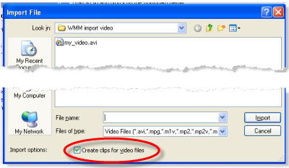
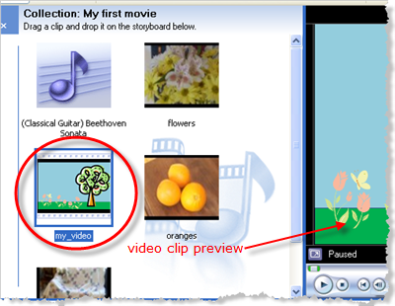
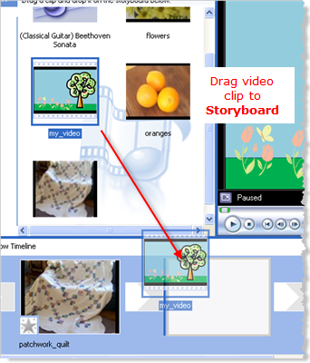
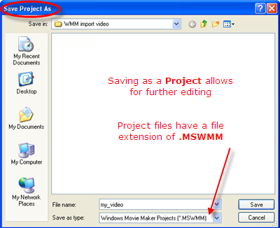
Import video clip into Movie Maker
1
2
3
5
4
Notes:
Import video
Locate the video clip that you want to import
Preview the video clip in Movie Maker
Drag imported video clip to Movie Maker Storyboard
Save the Movie Maker Project

Slide 38
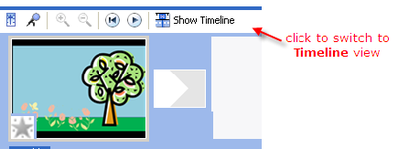
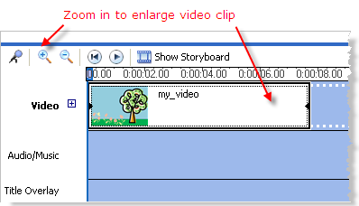
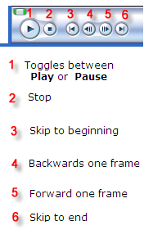
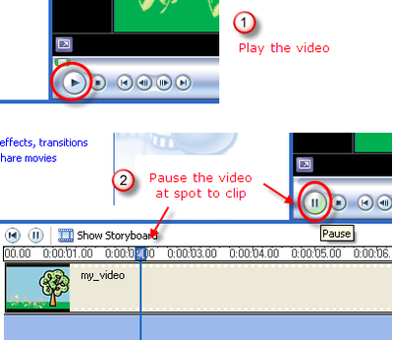
Edit video clips
1
2
3
4
Notes:
Switch to timeline view
Zoom in for better editing
Preview screen buttons
Pause the video to edit the clip

Slide 39
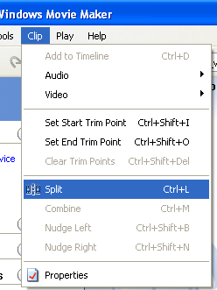
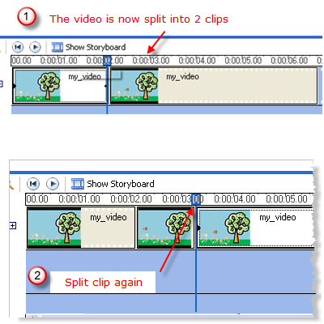
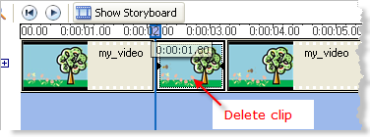
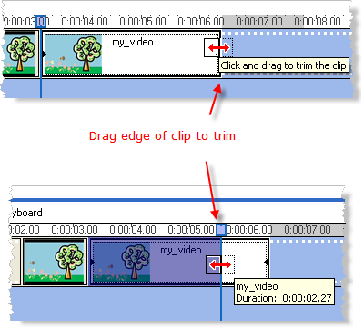
Edit video clips
5
6
7
8
Notes:
5. Split video clips
6. Repeat clipping if required
7. Delete video clips that you don’t want
8. Trim the video clips as you desire

Slide 40
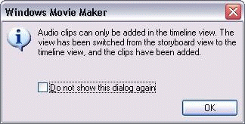
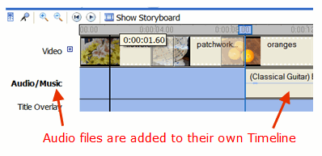
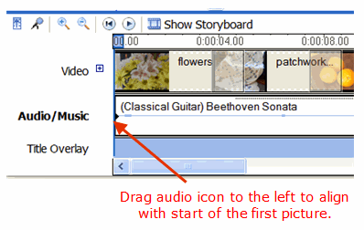
Adding music and sounds
1
2
3
4
Notes:
Importing audio file
Audio clips can only be added in the Timeline view
Audi files have their own Timeline
Align audio with first picture

Slide 41
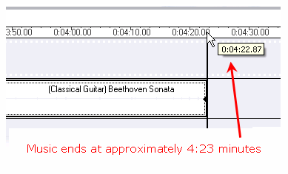
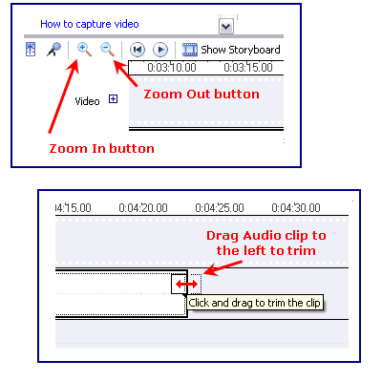
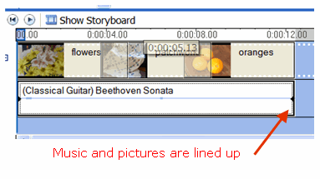
Adding music and sounds
5
6
7
Notes:
5. Timeline view of audio clip
6. Shorten an audio clip
7. Music and pictures are lined up

Slide 42
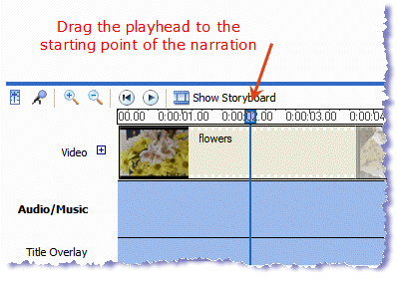
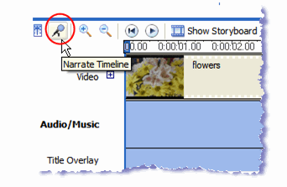
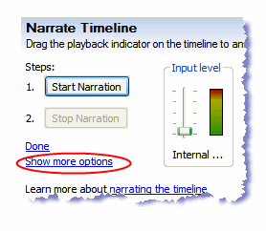
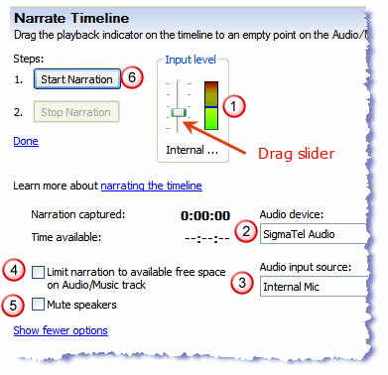
Adding Narration
1
2
4
3
Notes:
Find the starting place for narration
Click the microphone icon in the Timeline pane
Show more narration options
Additional options for narration

Slide 43
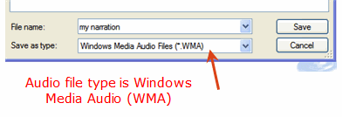
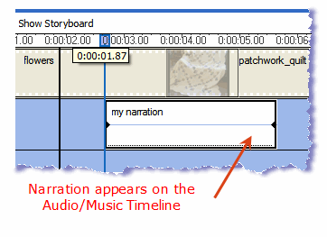
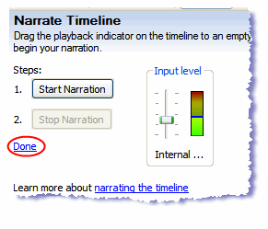
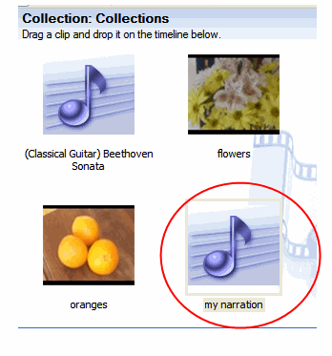
Adding Narration
5
6
7
8
Notes:
5. Save the narration in Movie Maker
6. Narration audio clip is added to Timeline
7. Return to main Movie Maker window
8. Narration clip added to collection window

Slide 44
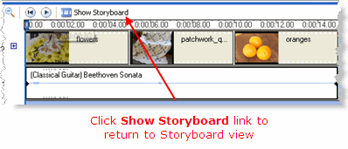
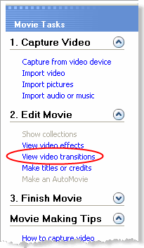
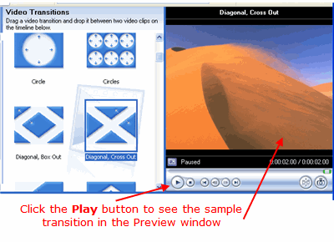
Adding video transitions and video effects
1
2
3
Notes:
Change to Storyboard view
Use the Menu to access video transitions
Select a video transition

Slide 45
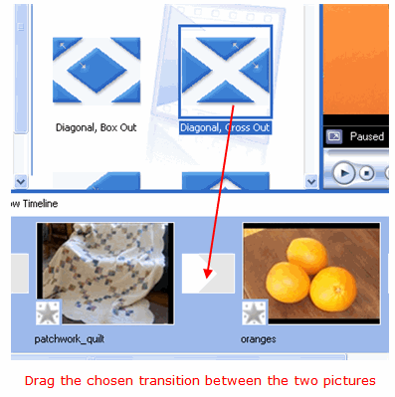
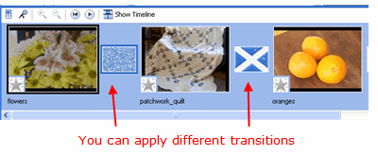
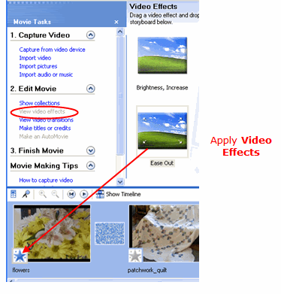
Adding video transitions and video effects
4
5
6
Notes:
4. Apply the selected video transition
5. Apply video transitions to all pictures
6. Add video effects

Slide 46
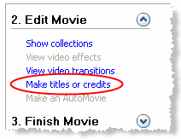
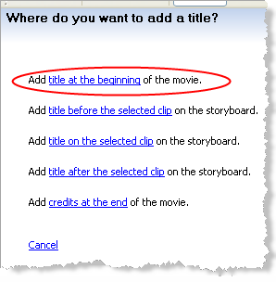
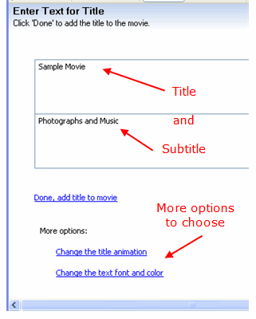
Adding video transitions and video effects
1
2
3
Notes:
Choose Title and Credits from Menu
Place your Titles and Credits
Enter a Title and Subtitle for the Movie

Slide 47
Hand-on time: upload & edit video on Movie Maker- Part I
Notes:
11:45 – 12:45 Hand on time: upload and edit video on Movie Maker Part I
Participants can upload their videos from day 1 to the movie maker
They might also add supplemental photos to the video, add music or special effects
Allow participants to play with the various features of Movie Maker to edit and improve their video quality

Slide 48
Hand-on time: upload & edit video on Movie Maker – Part II
Notes:
11:45 – 12:45 Hand on time: upload and edit video on Movie Maker Part I
Allow time for further editing

Slide 49
YouTube
YouTube exceeds 2 billion views a day. This is nearly double the prime-time audience of all 3 major U.S. broadcast networks combined.
Average Person Spends 15 minutes a day on YouTube
70% of YouTube’s traffic comes from outside of the U.S.
Over 3 million people are connected and auto-sharing to at least one social network.
YouTube videos are showing up in Google first-page results
Notes:
2:45 – 3:15 Creating YouTube account and uploading videos

Slide 50
Setting up your YouTube Account
Click on Create Account
Notes:
Go to http://tinyurl.com/6xurk3l to set up your YouTube

Slide 51
Setting up your YouTube Account
Click on Create Account
Enter Password
Provide Location
Provide Word Verification
Accept Terms and click on Create Account
Notes:
Steps for setting up a YouTube account
Go to YouTube.com and click the Sign Up link
Enter your e-mail address and a password
Fill in the Re-type Password and Username fields
In the Location drop down list, select the country where you live
Enter your postal code
Click to select your gender
Type the characters from the colored box into the Word Verification filed
Check the terms of Use, Privacy Policy box after you read all the legal terms.
Click the Create My Account button

Slide 52
Uploading Videos on YouTube
Notes:
Show video on uploading to YouTube: http://www.youtube.com/watch?v=9w-gQAwS2uc
Steps for uploading video on YouTube
Click the Upload link at the top of the YouTube page
Click the Upload video button to browse for the video file you’d like to upload to the site. Select the file you want to upload and click Open
As the video file is uploading, enter as much information about your video as possible in the relevant files (including Title, description, Tags and Category). You’re not required to provide specific information, but the more information you include, the easier it is for users to find your video
Click the save changes button to save the updates you’ve made to the video file
You can upload up to 10 video files in a single uploading session

Slide 53
Share and Distribute Videos
Notes:
3:30 – 4:45 Share and distribute videos
Encourage participants to tweet about their video, add it on their organization’s Facebook account and websites.
Participants should comment on each other’s videos and suggest improvements.
Field teams can upload some videos on their Facebook page.

Slide 54
Reflection & Closing
Share Pairs
Circle Closing
Notes:
4:45 – 5:00 Reflection exercise
Do a series of “Share Pairs” where people ask and answer the following questions:
What did you learn today?
What is still isn’t clear?
What do you need to move forward?
What is the most important thing you want to learn tomorrow?
Then gather in a circle, and have everyone share one word about they are feeling and why.

Slide 55
Rules For Using This Content
Creative Commons Attribution License
You are free to use this work as long you attribute
The E-Mediat Project.

