Slide 1
Media Outreach
Civil Society Laws: Experiences and Expertise 24 - 25 May 2008
The International Center for Not-for-Profit Law
المركز الدولي لقانون المنظمات غير هادفة الربح

Slide 2
Why Do We Need the Media?
To get your message out to the widest possible audience
To recruit new volunteers and members
To bring your message and agenda into the national consciousness
To influence the government

Slide 3
Effective Media Outreach
Consider all possibilities: radio, TV, print, internet, other media sources
Aim pieces toward people who are undecided or know little about the issue.
Use uncomplicated language; keep the story relevant, current, and interesting
Plan media appearances to control outcomes and direction
Emphasize visual aspects
Time the release of materials to coincide with media deadlines
Notes:
Quantifying monetary value of non-profit work can help spark media interest
Language and format are essential – insider jargon not useful for public
Translate between technical and nontechnical language
Can be frustrating when reporters are trying to dig up negative stories. It is helpful to have another person in the room to redirect questions
Ongoing relationships help

Slide 4
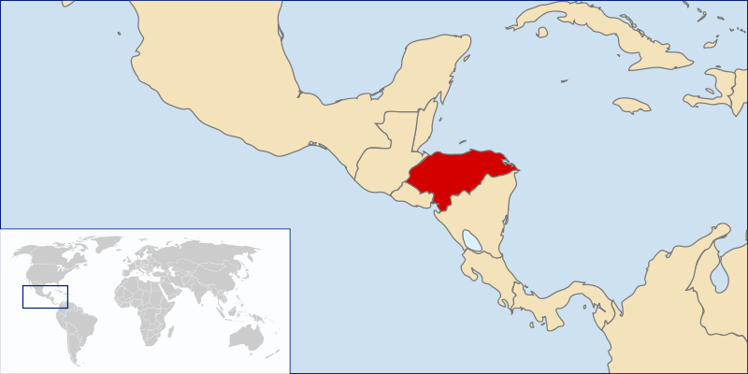
Media Outreach Case Study: Honduras
Small country surrounded by civil war and instability
Heavy repression during civil war years; peace accords signed in 1991 led to opening of political sector
5 political parties; 2 dominate every election
NGO leaders wanted to pass a new civil society law
Notes:
Sound familiar to Bahrain??

Slide 5
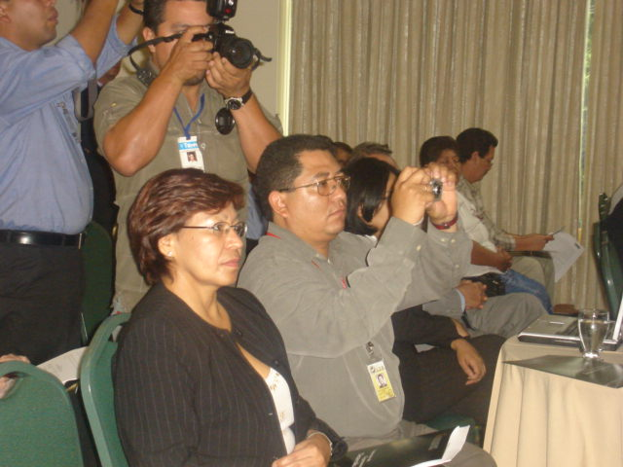
Media Outreach Case Study: Honduras
Began in 2006 with a press conference. TV, newspaper, and radio representatives invited
Invited the heads of the five political parties to speak. This gave the media a reason to cover the event.
NGO leaders put the political leaders on the spot and asked them whether or not they supported the law. Even though some said no, media coverage allowed the issue to enter into public consciousness
Notes:
Press conference began with a discussion of the contribution and importance of CSOs – very important framing device – forced opponents on the defensive or keep a low profile. Important of framing the debate!

Slide 6
Media Outreach Case Study: Honduras
Campaign continued with radio call-in program; people from around Honduras called to ask questions. Radio was more effective because there were not many TVs in the country yet.
Letters to the Editor: supporters sent letters once a week to newspapers and had their letters published, attracting more attention
Op-Eds: The most credible and articulate supporters were asked to write opinion pages in the newspaper; this eventually led to the newspapers endorsing the new law!
Notes:
Sound familiar to Bahrain??

Slide 7
Media Outreach Case Study: Honduras
Became friendly with journalists by offering support on other issues and questions; this support led to the journalists covering the issue for the NGOs many times
Had private meetings with heads of every party saying that the members of their NGOs would vote for the party that endorsed the law – when one party agreed, the others did as well for fear of losing votes
Law is not passed yet but it’s getting close…
Notes:
Sound familiar to Bahrain??

Slide 8
Other Creative Media Ideas: Afghanistan
Movie – An entertaining movie starring one of Afghanistan’s most popular actors was created to discuss civil society, law, and gender issues. The 55 minute movie will be broadcast on national TV and sold as a DVD in film stores.
Mobile Movie – Because Afghanistan is a rural country, a “mobile cinema” in a van was designed to drive from town to town and show the movie to villagers.
Radio and TV programs – A debate between those in favor and those against a law was held; both were satisfied because they had their message get out to the public!
Notes:
NB: Mobile movie is a super creative idea, but was scrapped at the last second b/c of security situation.
Radio/TV idea used in Yemen as well.

Slide 9
Other Creative Media Ideas: Bulgaria
Soap opera – NGO leaders got the writer of the show to have the main character fall in love with a woman working for a non-profit, and they explored several NGO legal obstacles through the story.
Journalist study tour – NGO leaders invited journalists to tour parts of the city to see the work NGOs were doing; journalists learned about the value of civil society and were then more likely to serve as advocates for lobbying at the right time

Slide 10
Effective Use of Media: Kosovo
Petition letter to Municipal Assembly: Average citizens and NGO leaders signed a statement endorsing the law and publicly sent it to the Municipal Assembly, creating a lot of media attention
Met individually with Assembly Members: NGO allies from each Assembly Member’s district met with their representative to ask him or her to vote for the law
Prepared “talking points” so that all NGO members would be prepared to deliver the message if asked
Popular media: Youth program called “No Misunderstanding” agreed to air a special report on the law several days before the Assembly met to vote

Slide 11
Effective Use of Media: Russia
International Press: Russian NGOs organized major international campaign to fight against law around the world – placed enormous pressure on Russian government and eventually the government changed the draft law!

