Slide 1
Designing a Learner-centered Course
Greg Sales
Melanie Ruda
Matt Finholt-Daniel
May 19, 2010

Slide 2
Day 5

Slide 3
Agenda
8:30-8:45 Coffee and snacks
8:45-10:15 Taxonomy
Objectives
Assessment methods
10:15 – 10:30 Break
10:30 – 12:00 Assessment and grading
Instructional activities
12:00 – 1:00 Lunch
1:00 – 2:00 Final questions
Summary of D & D process
Evaluation and reflection

Slide 4
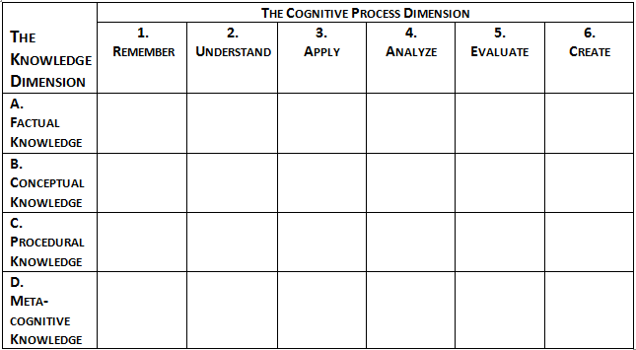
Taxonomy
From page 28 of the book Taxonomy for Learning, Teaching, and Assessing, edited by Lorin W. Anderson and David R. Krathwohl, © 2001 by Addison Wesley Longman, Inc.

Slide 5
Knowledge Dimension
MacBeth unit - Scenario A
Which Knowledge Dimension?
Teacher A believes students should know the names of the characters in the play and the readily apparent relationships between them. Students should know the details of the plot, and they should know which characters said what, to the point that they can recite certain passages by memory.
Factual
Conceptual
Procedural
Metacognitive

Slide 6
Knowledge Dimension
MacBeth unit - Scenario B
Which Knowledge Dimension?
Teacher B believes that MacBeth enables students to learn about important concepts such as ambition, tragic hero, and irony. She is also interested in having her students know how these ideas are related to one another. For example, what role does ambition play in the development of a tragic hero?
Factual
Conceptual
Procedural
Metacognitive

Slide 7
Knowledge Dimension
MacBeth unit - Scenario C
Which Knowledge Dimension?
Teacher C believes MacBeth is one of many plays that could be included in the school curriculum. His goal is to teach students how to think about plays in general. To this end, he has developed a general approach that he wants students to use as they read a play. The approach begins by having the class discuss the plot, then examine the relationships among the characters, then discern the messages being conveyed by the playwright, and finally consider the way the play was written and its cultural context.
Factual
Conceptual
Procedural
Metacognitive

Slide 8
Knowledge Dimension
MacBeth unit - Scenario D
Which Knowledge Dimension?
Like Teacher C, Teacher D sees MacBeth as one of but many plays that students will encounter during school. She also wants her students to learn a set of tools they can use when they study, understand, appreciate, and analyze other plays. However, she is also concerned that students do not apply these skills in a rote fashion. She wants her students to think about what they are doing as they do it. For example, she wants to students to note any problems they have in using the procedures.
Factual
Conceptual
Procedural
Metacognitive

Slide 9
Using the Taxonomy
recall
Objective 1: The student will be able to name the characteristics of a task.
1
From page 28 of the book Taxonomy for Learning, Teaching, and Assessing, edited by Lorin W. Anderson and David R. Krathwohl, © 2001 by Addison Wesley Longman, Inc.

Slide 10
Using the Taxonomy
Objective 2: The student will be able to classify given activities as exercises or tasks.
1
2
From page 28 of the book Taxonomy for Learning, Teaching, and Assessing, edited by Lorin W. Anderson and David R. Krathwohl, © 2001 by Addison Wesley Longman, Inc.

Slide 11
Using the Taxonomy
generate
Objective 3: The student will be able to develop a task from an exercise.
1
2
3
From page 28 of the book Taxonomy for Learning, Teaching, and Assessing, edited by Lorin W. Anderson and David R. Krathwohl, © 2001 by Addison Wesley Longman, Inc.

Slide 12
Using the Taxonomy
Objective: x
X
From page 28 of the book Taxonomy for Learning, Teaching, and Assessing, edited by Lorin W. Anderson and David R. Krathwohl, © 2001 by Addison Wesley Longman, Inc.

Slide 13
Using the Taxonomy
Objective:
X
From page 28 of the book Taxonomy for Learning, Teaching, and Assessing, edited by Lorin W. Anderson and David R. Krathwohl, © 2001 by Addison Wesley Longman, Inc.

Slide 14
Using the Taxonomy
Objective:
X
From page 28 of the book Taxonomy for Learning, Teaching, and Assessing, edited by Lorin W. Anderson and David R. Krathwohl, © 2001 by Addison Wesley Longman, Inc.

Slide 15
Objectives and Assessment
Objective |  | Assessment
Recall the characteristics of a task |  | Given an exercise, the student will convert it to a task.
Classify activities as exercises or tasks |  | The student will respond to the question, “What are the characteristics of a task?”
Generate a task from an exercise |  | Given examples of tasks and exercises, the student will label each one as an “exercise” or a “task”.

Slide 16

In Work Groups
On page 6 of the Design Document, write objectives for one lesson, if you haven’t already done so.
Correlate your lesson objectives with your course objectives.
Classify the objectives on the Taxonomy.
Write assessment items. See p. 15 in the Packet for ideas.
Repeat the cycle above
for as many lessons
as you have time for.

Slide 17
Break until 10:30

Slide 18
Grading and Assessment
What can you do to ensure that the midterm and final adequately assess student gains from the instruction?
Must the Final be 40% of the grade?
If so, what alternative methods are possible?

Slide 19
Objectives, Assessment, and Instructional Activities
Objective | Assessment | Instruction
Recall the characteristics of a task | The student will respond to the question, “What are the characteristics of a task?”
Classify activities as exercises or tasks | Given examples of tasks and exercises, the student will label each one as an “exercise” or a “task”.
Generate a task from an exercise | Given an exercise, the student will convert it to a task.
Students will recall the characteristics of a task as part of their class notes wiki.
Give each student an exercise and a task. Student identifies the task or exercise and justifies their work to a study partner.
Have students find an exercise in the MoE materials and convert it to a task

Slide 20
Instructional Activities
  Large group
  Brainstorm a list of activities.
  Small group
  Decide on instructional activities for your objectives.

Slide 21
Lunch break until 1:00

Slide 22

Lesson Structure
MOODLE BEFORE CLASS ACTIVITIES
Login to Moodle
Read Text Chapter
See Weekly Assignment
Read Addt'l Topic Reading
View Video Clips & Assoc. Assignment – e.g. Forum, Survey, Wrksht
Complete Pre-class QUIZ
Work individually or as a group to decide
how you will structure your class.

Slide 23
In Closing
Final questions and comments?
Checklist summary on page 18 of the packet

Slide 24
Evaluation and Reflection
Complete the Evaluation and Reflection form for Day 5.
Turn in the first page to Seward, and keep the second page for yourself.

Slide 25
Contact Information
Greg Sales
gsales@sewardinc.com
Melanie Ruda
mruda@sewardinc.com
Matt Finholt-Daniel
mfinholt@sewardinc.com

Slide 26
End

