Slide 1
Coalition-Building
Civil Society Laws: Experiences and Expertise 24 - 25 May 2008
The International Center for Not-for-Profit Law
المركز الدولي لقانون المنظمات غير هادفة الربح

Slide 2
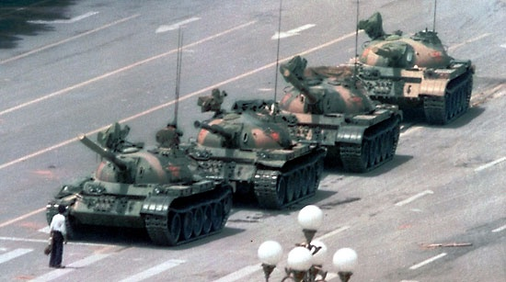
Who Would You Rather Be?

Slide 3
What is a coalition? Why partner with others?
A group of people/organizations trying to achieve one goal?
Trying to achieve their own goals by helping each other?
A coalition might consist of:
The core group of initiators -- those who would be hurt or helped the most by proposed changes;
Sympathetic people and organizers who can influence decision-makers and help to achieve the goals; and
Sympathizing government officials.
Coalitions are far more powerful and more skilled than any single organization acting alone
As the geographic size and complexity of an issue expands, the need to consider forming a coalition increases

Slide 4
Forming a Coalition
Identify other groups who share your interest or objective
Sometimes, the most powerful coalitions are those which combine groups that are traditionally on opposite sides of most issues – when they put aside their differences to work together on their common interest, they send a powerful signal to governments and the general public.
It can be difficult to ask for help, but no one can succeed without working together with others!
Notes:
A group that promotes women’s rights and a group that is against women’s rights both share an interest in a good civil society law.
But sometimes this cannot work, as for example when you are trying to pass a domestic violence law.

Slide 5
Coalitions require compromise!
No two organizations think exactly alike. But if you can agree to work together, you will increase your strength and increase the probability of achieving law reform
However, the number of NGOs involved is not always relevant.
Open protests and “mass advocacy campaign” are not the only means and might not be appropriate (especially for human rights issues)
Coalitions are not forever.
It is natural that they dissolve once the goal is achieved.
However, working in coalitions is a valuable skill which will help the next time the need arises.
Notes:
A group that promotes women’s rights and a group that is against women’s rights both share an interest in a good civil society law.
But sometimes this cannot work, as for example when you are trying to pass a domestic violence law.

Slide 6
Examples of Effective Coalition Building
Venezuela
2006 Law on International Cooperation
Built internal coalition of interested organizations
Discrete use of foreign assistance
Development of arguments under domestic law as well as under the ICCPR and the Inter-American convention
Outreach to global CSO community through media and conferences
Advocacy before Parliament

Slide 7
Examples of Effective Coalition Building
Honduras
Law on Nongovernmental Organizations
Build outreach to NGO community into initial project assessment – individually surveyed 100 NGO leaders
Recruited prominent lawyer to help with drafting
Partnered with international experts
Socialized law any time there were major changes through regional networks
Enlisted parliamentary champions
Advocated before interested Ministries
Educated Parliamentary committee
Reached out to opinion leaders

Slide 8
Examples of Effective Coalition Building
Yemen
Law on Associations and Foundations
Informal meetings to hear NGO positions on law reform took place all across the country, and groups that provided their input eventually joined a large nationwide coalition for law reform
Participatory process ensured cooperation and greater ability to advocate (although there was a temporary split in the NGO coalition)
International attention focused by foreign-funded conferences in the capital, Sana’a
Partnered with international experts (including ICNL) for technical assistance in drafting proposal and promoting reform
Large television, print, and radio campaigns across the country
Worked with allies in Parliament and even opponents in the Ministry of Labor and Social Affairs

