Slide 1
New Media for the Networked NGO
Keynote Address by Beth Kanter, co-author of The Networked Nonprofit, author of Beth’s Blog and E-Mediat Master Trainer
E-Mediat is funded by the Middle East Partnership Initiative of the United States Department of State with support from Microsoft Corporation and craigslist Charitable Fund and administrated by the Institute of International Education
Notes:
Keynote Address: 10:00- 10:15 a.m.

Slide 2
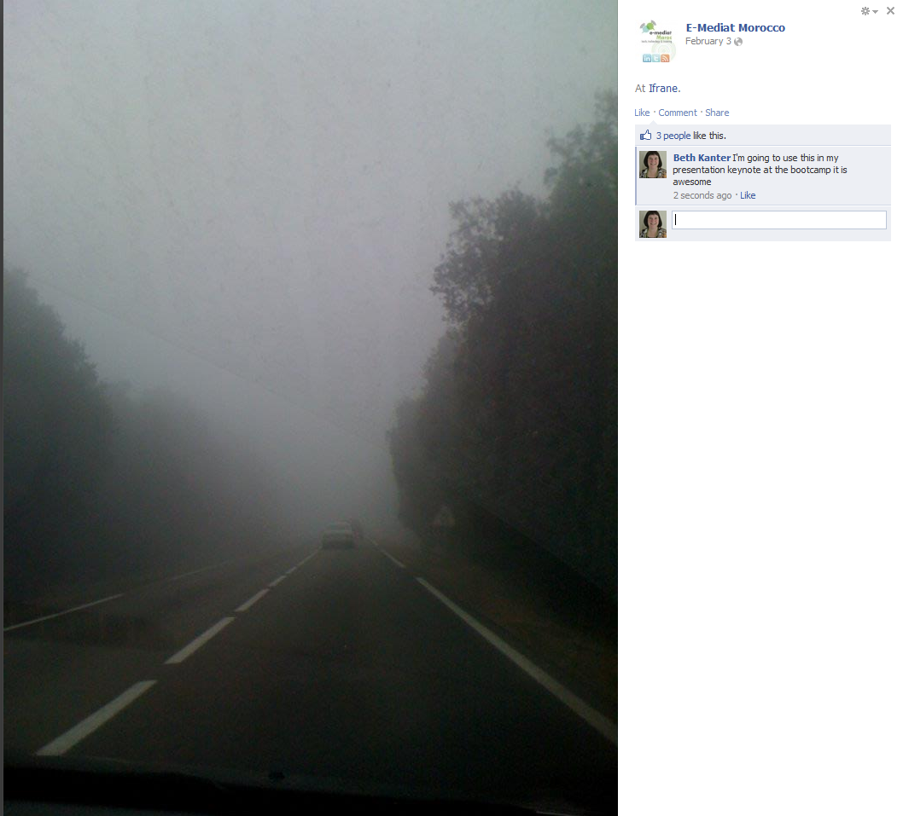
Social media success is a combination of passion and taking small steps to get to your destination.
Notes:
I saw this wonderful photo shared on Facebook from the E-Mediat group in Morocco. It is a simple photograph of the road to they take to the training center in Azrou. It inspired this talk … because you need passion to get on the road early or in the fog – and by taking small steps, keep moving forward to you reach your destination …
What are you passionate about in your work?

Slide 3
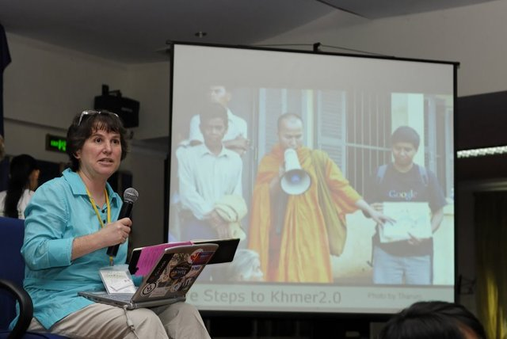
I am passionate about teaching NGOs to use the Internet
Photo by Steve Goodman
Notes:
I’ve been working in the NGO sector for over 32 years. In 1992, I started helping NGOs use the Internet to support their missions and discovered that I’m passionate about that … and my desire for learning about how NGOs can use the Internet and later social media has taken me all over the world to places like Cambodia …

Slide 4
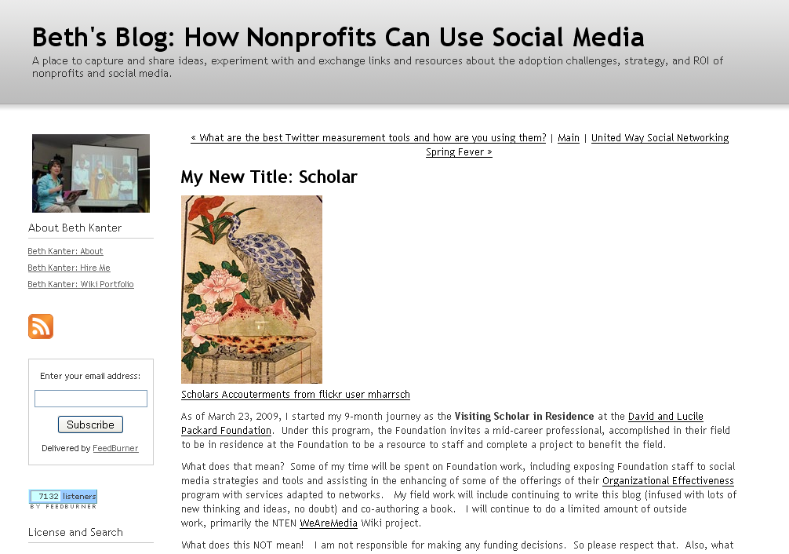
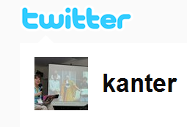
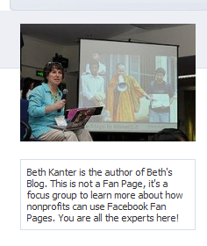
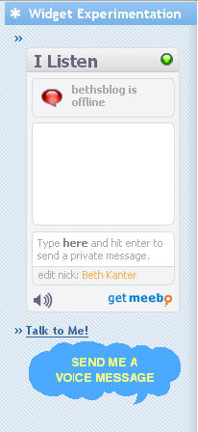
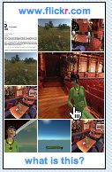
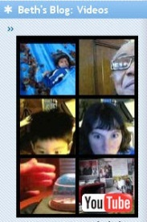
I am passionate about blogging
Engaging
Content in
many places
Crowdsourcing
network
Sharing
Conversations
Fundraising
Learning and content creation
Notes:
I started my first blog in 2003 as a way to write down what I was learning about social media and share it with people who work in the NGO sector. I wrote that blog just for me, I started with very small steps – my first blog posts was not more than a few sentences. But after blogging every day, I got better at it – and faster.

Slide 5
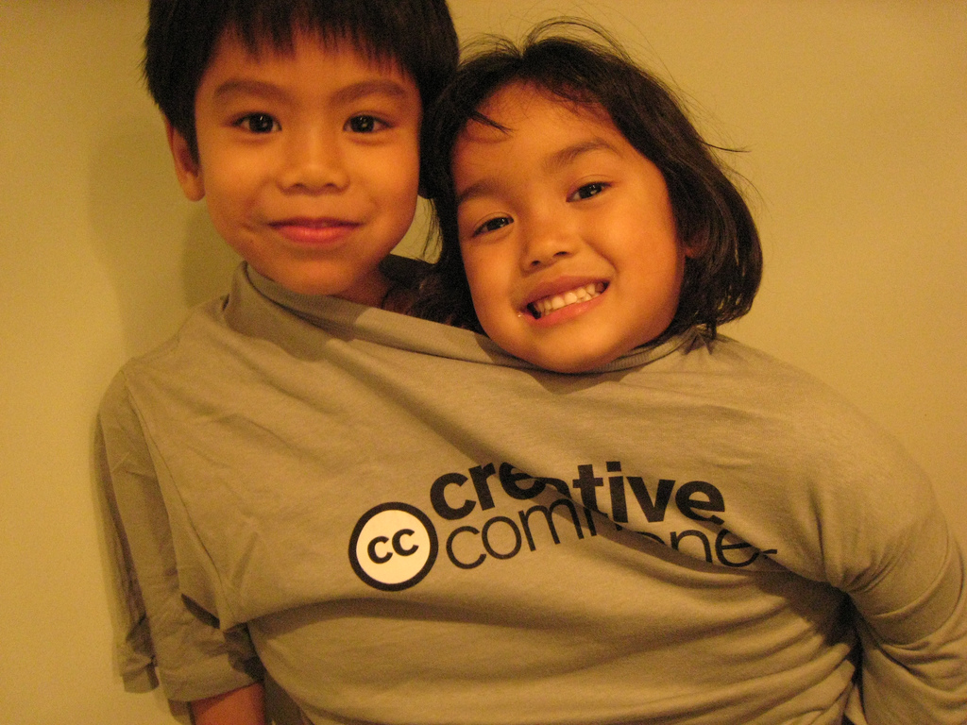
I am passionate about sharing knowledge
Notes:
One of the things I discovered is that if I took small steps, reflected on what I learned and shared it – I would learn more!
I found a way to combine my passion for social media with personal interests …
My kids were adopted from Cambodia – and ..

Slide 6
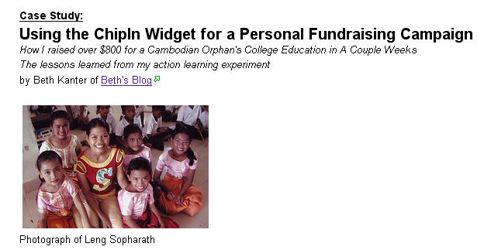
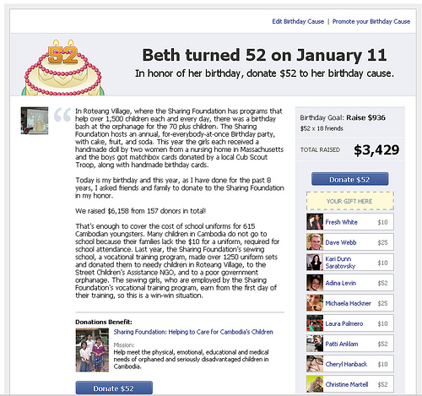
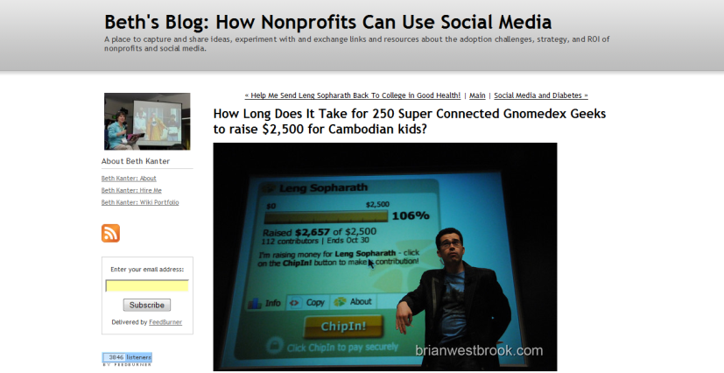
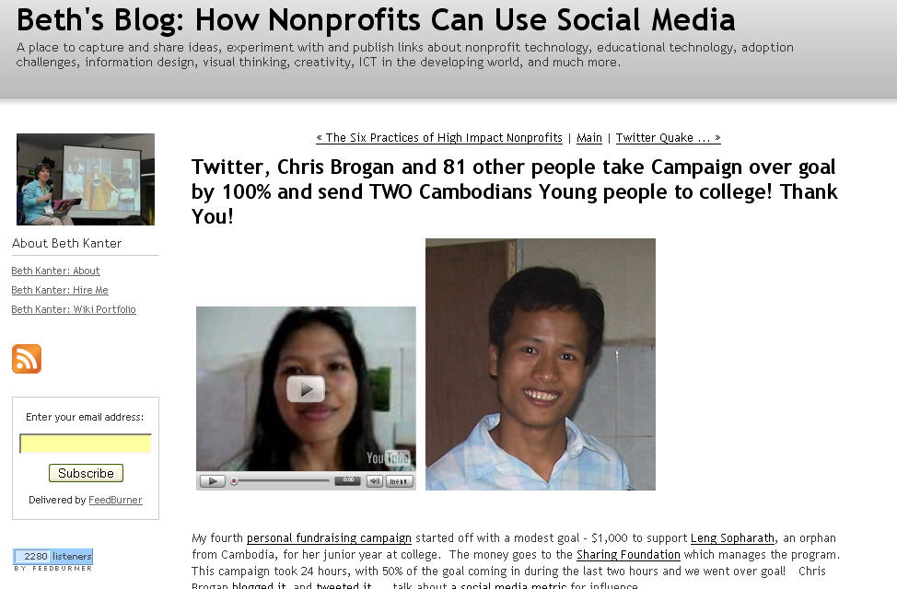
I am passionate about Cambodia
Notes:
That’s why I’m passionate about Cambodia! I learned how to do “social fundraising” – to help raise lots of money to support children in Cambodia.

Slide 7
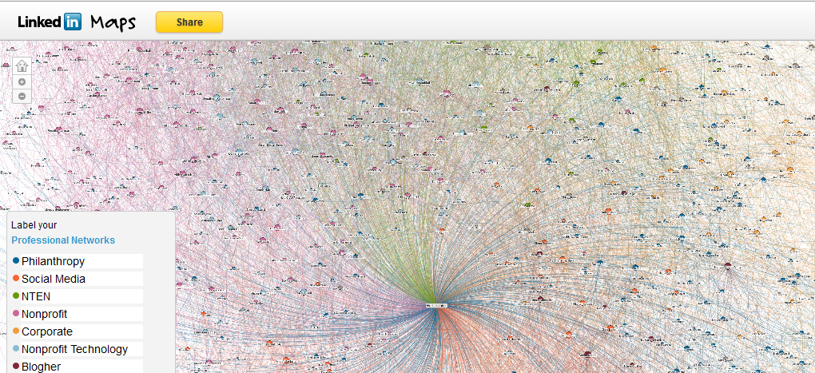
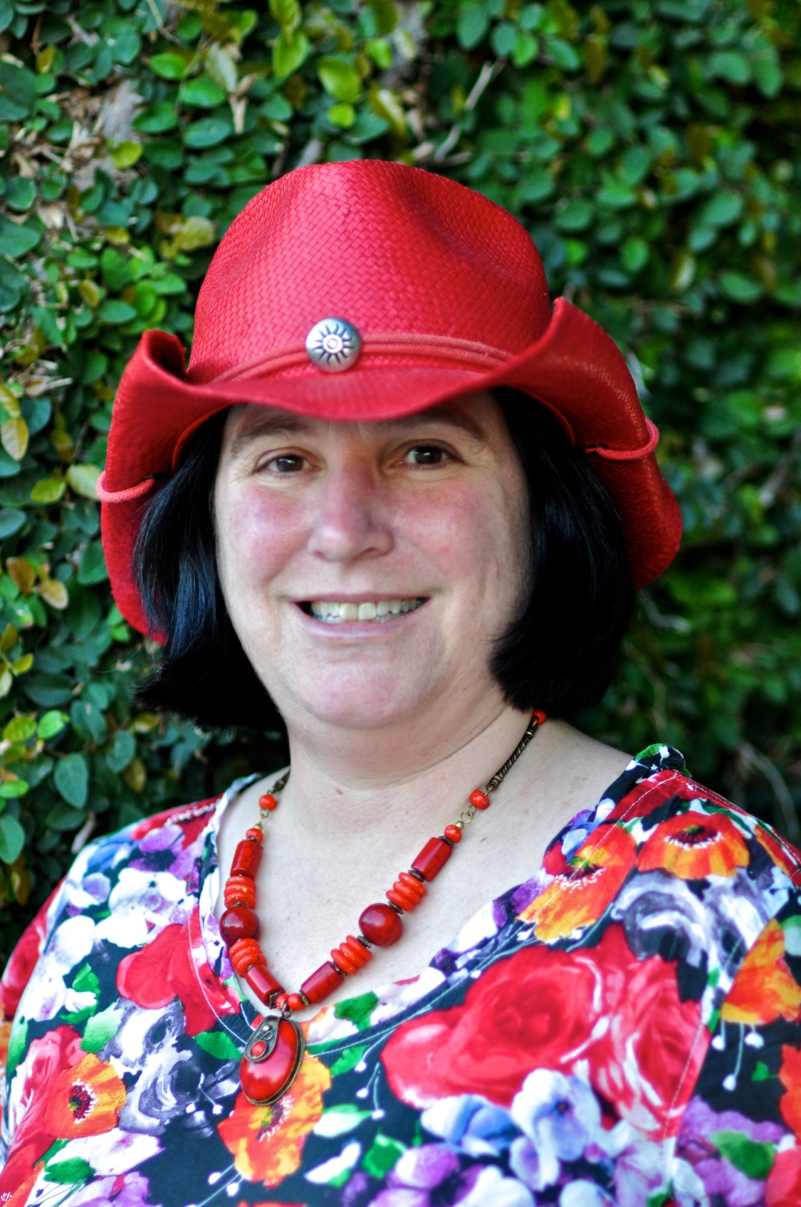
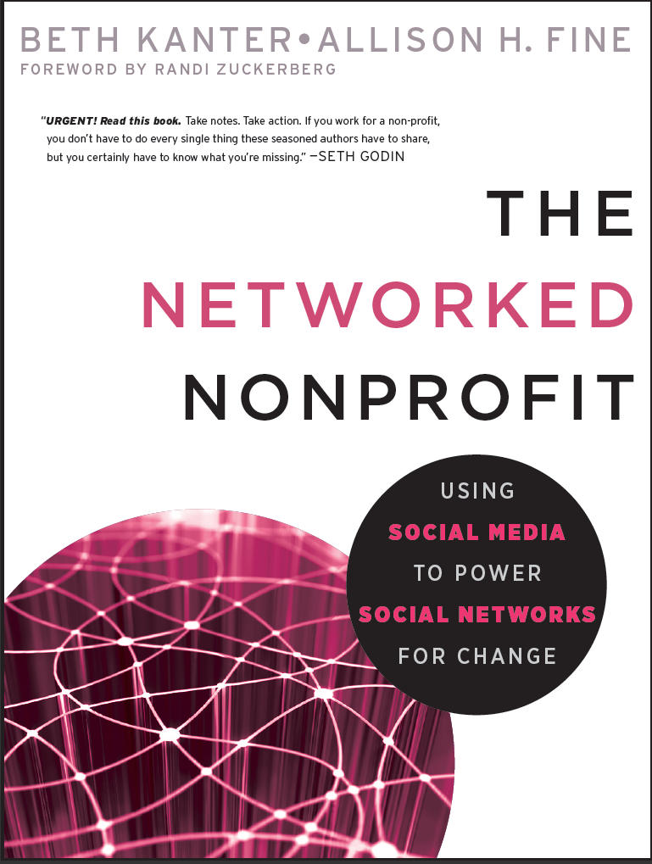
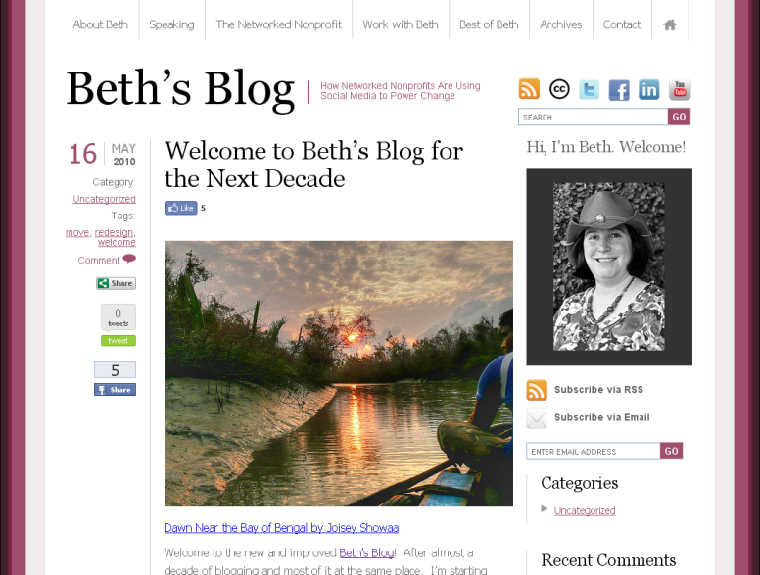
I am passionate about networking
Notes:
Today, my blog is one of the largest nonprofit and social media blogs .. I’ve written a book “The Networked Nonprofit” – and through social media I have been able to connect and build relationships with people who work for NGOs around the world. I am passionate about networking and social media helps me do that …

Slide 8
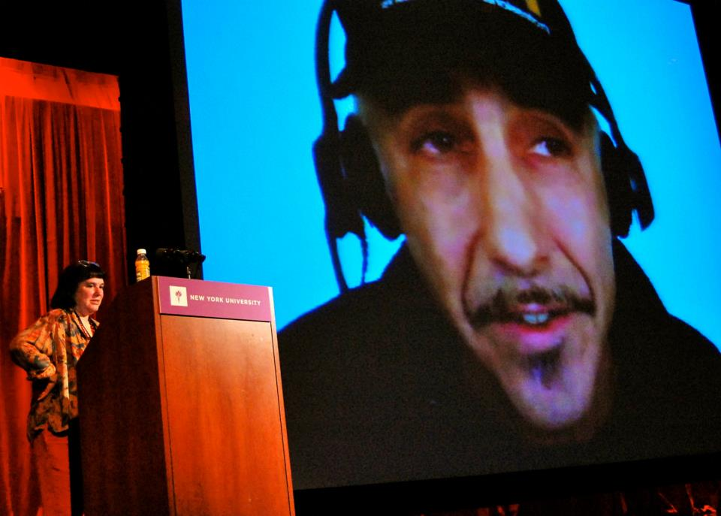
Notes:
For example, I wanted to learn more about content curation and did this presentation in the US by brought in Robin Good, the world’s expert in content curation to share his tips with 300 nonprofits in NY. I’ll be sharing what I learned from him with you this afternoon!

Slide 9
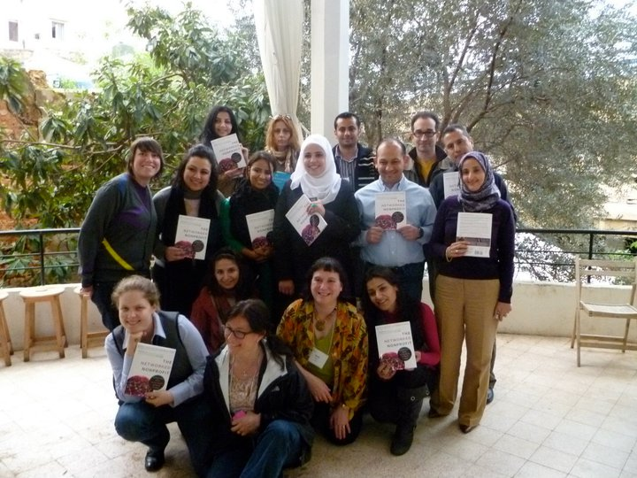
E-Mediat One Year Ago!
Notes:
One of the most exciting experiences I’ve had teaching and learning about social media and NGOs, was the opportunity to do the Train the Trainers session in Beirut last year that launched the E-Mediat program.

Slide 10
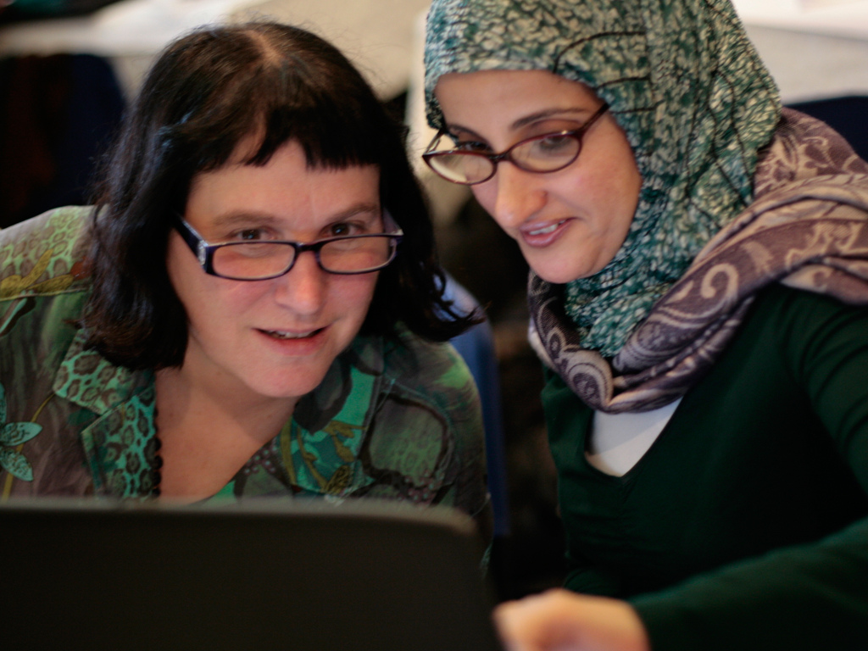
Photo by SMEX Beirut
Notes:
Here I am with Lina, the Country Director for E-Mediat Yemen – and for me the train the trainers was a fantastic opportunity for peer learning about how to design and deliver trainings for social media that are fun and interactive….

Slide 11
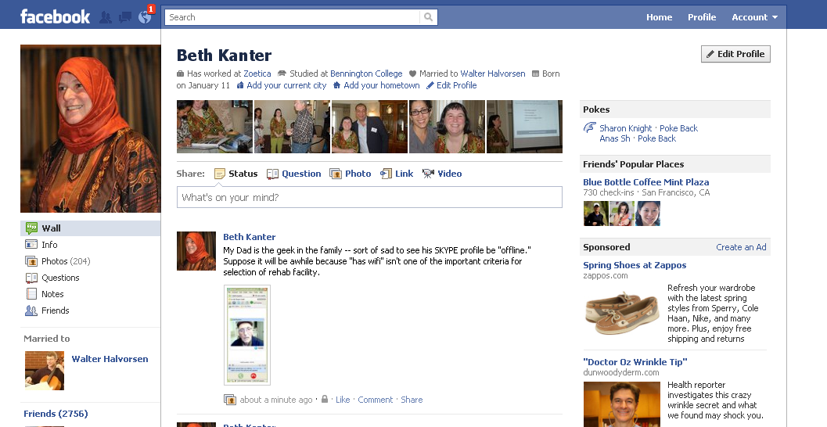
Notes:
I also learned about your culture….

Slide 12
The Networked NGO
BE | DO
Understand Networks | Work with Free Agents
Create Social Culture | Work with Crowds
Listen, Engage, and Build Relationships | Learning Loops
Trust Through Transparency | Friending or Funding
Simplicity | Govern through Networks
Notes:
Also, we were able to explore how the concepts of the Networked NGO and if they translate or not in your part of the world …

Slide 13
Notes:
I was also thrilled to discover a great example of a Networked NGO -- SHABAKAT - a mission of having youth integrate information and communication technologies in the day-to-day lives of their communities to positively transform families, education, businesses, environment and community. Rami Al-Karmi , E-Mediat Strategic Adviser for the E-Mediat and the founder of this organization.
Shabakat Al Ordon trains young people in technical, professional and facilitation skills who then go out and create programs to train people in their communities. Rami shared how his organization works in a transparent way, open sourcing its program materials and processes. They also work many different partners to spread the program so that his organization isn’t doing everything. They’ve simplified and focused on what they do best.

Slide 14
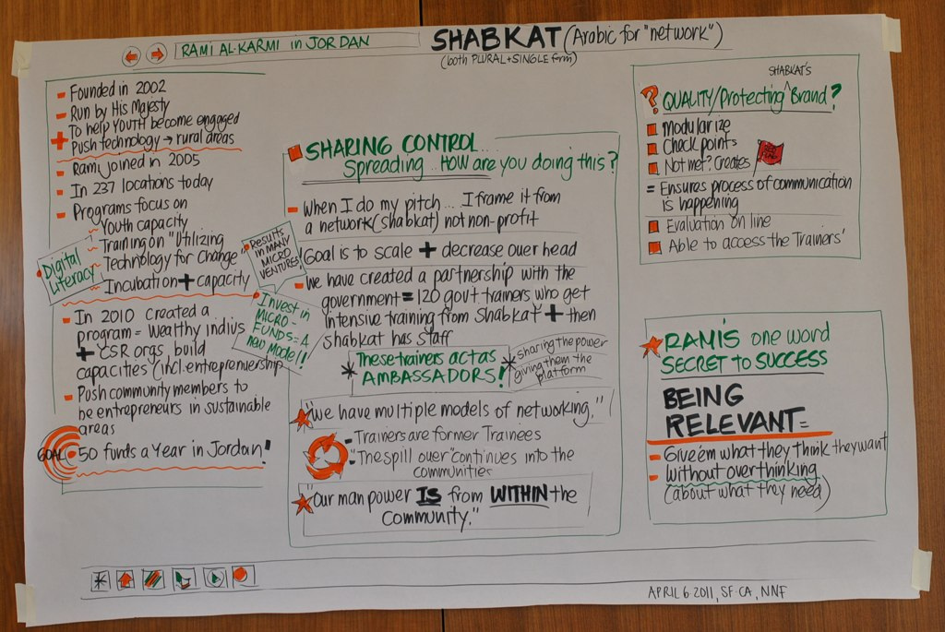
Notes:
Later back in the US, I invited RAMI to Skype in to a session and share the story of how NGO and why it is a networked NGO.
One of the things he said that day about networked NGOs was that being relevant was the key to success. That by giving your audience what they want, you unlock the key to success.

Slide 15
Not all nonprofits are born as Networked NGOs with an agility to use social media effectively ….

Slide 16
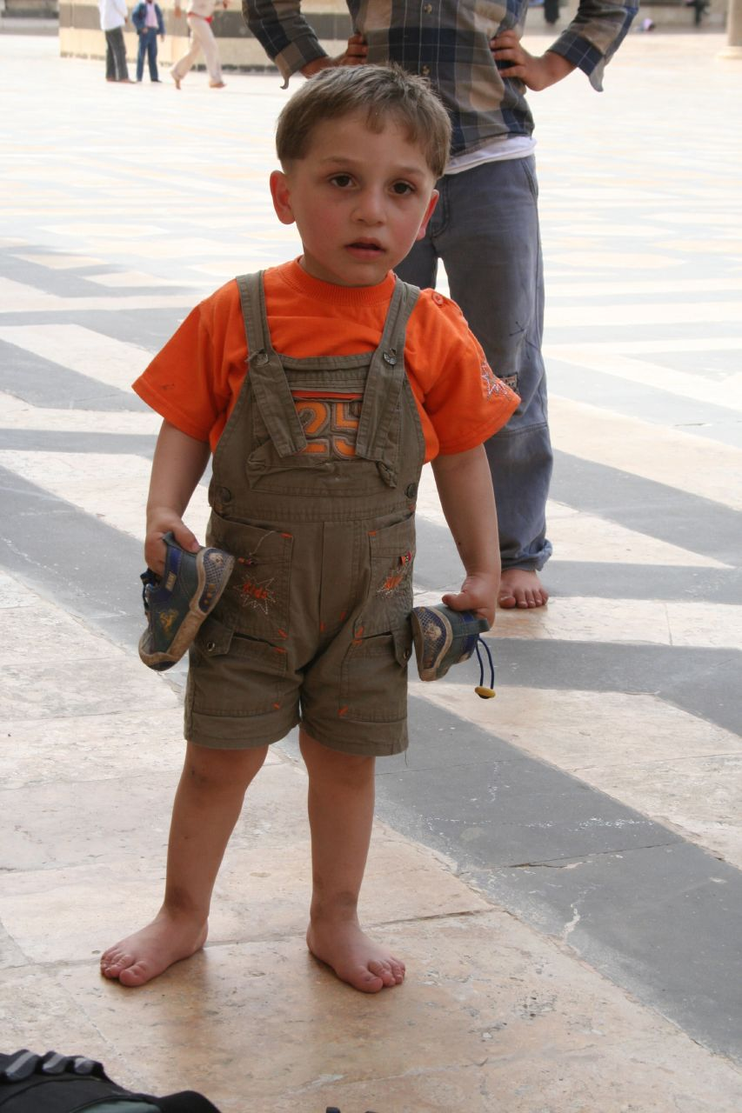
But if you follow your passion and take small steps…
Photos by spdl_n1 and D Sharon Pruitt
Photos by spdl_n1 and D Sharon Pruitt
Notes:
http://www.flickr.com/photos/spdl_n1/506745677/sizes/o/in/photostream/
D Sharon Pruitt

Slide 17
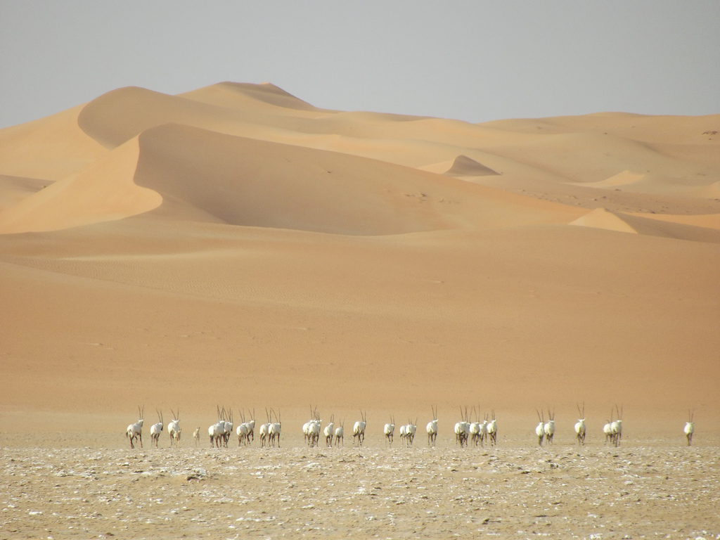
You will be successful realizing your social media goals!
Notes:
http://www.flickr.com/photos/gordontour/6406122219/sizes/l/in/photostream/

