Slide 1
Workshop 02 : How to recruit and maintain good profiles for your start-up
Fintech Catalyst 2eme édition

Slide 2
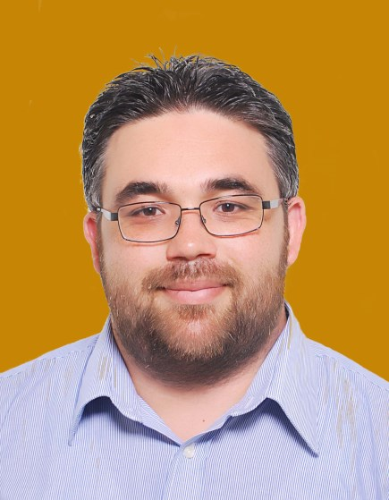
Ahmed Assalih
HR Transformation Manager at Sopra HR Software

Slide 3
Recruiting Strategy
Treat candidates like customers
Create compelling job descriptions
1
4
Make titles as specific as possible.
Open with a captivating summary.
Include the essentials.
Keep descriptions concise.
Be respectful of their time.
Be hospitable.
Make yourself available.
2
Implement an employee referral program
5
Make use of sponsored jobs to
stand out
3
6
Use Social media
Check resumes posted online

Slide 4
Recruiting Strategy
7
Consider past candidates
10
Include peers in the interview process
8
Claim your company page
9
Attend industry-related meetups

Slide 5
HR Best practices
Providing security to employees
Selective hiring: Hiring the right people
Self-managed and effective teams
Fair and performance-based compensation
Training in relevant skills
Creating a flat and egalitarian organization
Making information easily accessible to those who need it

Slide 6
thank you

