Slide 1
How to improve your Product Market Fit
B2B-B2C

Slide 2
Product/Software
Market Fit
B2B

Slide 3
Mohamed
Benboubker
Co-founder & Co-CEO of Mobiblanc

Slide 4
How to achieve the notion of Product Market Fit?

Slide 5
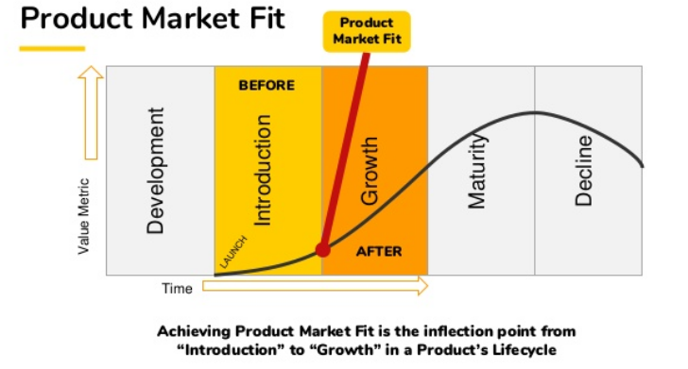

Slide 7
Yassir Houmane
Co-Founder of Caciopee

Slide 9
Experiment…. Learn & Fail
Experiment…. Learn & Fail
Experiment…. Learn & Fail
Experiment…. Succeed & Learn

Slide 10
Doha Benjelloun
Digital Learning expert & General Manager at Proatech

Slide 11
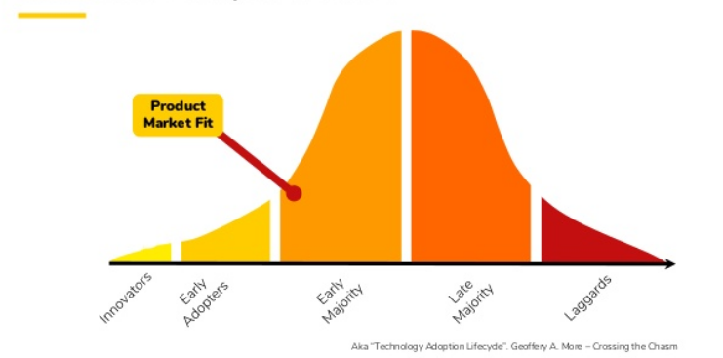
Customer Adoption Curve

Slide 12
Impact of Covid-19 on the market

Slide 13
Product Market Fit
B2C

Slide 14
Nicolas Neveu
Chief Executive Officer at Dreamline Studio

Slide 15
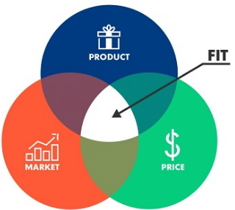
How to obtain Product Market Fit?

Slide 16
To Get Product Market Fit
Find a sizeable Market
Identify a problem
Develop an MVP to solve it
Find a business model to support it
Test, Measure, Learn
Repeat !

Slide 17
THANK YOU

