Slide 1
New Media for the Networked NGO
Integrated Content Strategy
Presenter: Beth Kanter
E-Mediat is funded by the Middle East Partnership Initiative of the United States Department of State with support from Microsoft Corporation and craigslist Charitable Fund and administrated by the Institute of International Education
Notes:
IIE and publicly acknowledge funding by the U.S. Department of State Middle East Partnership Initiative (MEPI).
Integrated Content Strategy: 8:15 – 9:15 a.m.

Slide 2
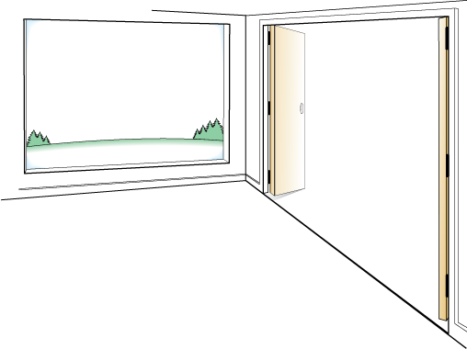
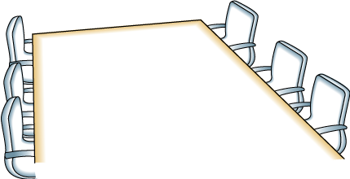
Day Two: Integrated Content Strategy Jordan Dead Sea
AGENDA
OUTCOMES
Make connections to people who can help you move your social media work forward
Be ready to apply at least one or two things you learned to you make your social media more effective
Introduction and Overview
Integrated Content Strategy
Creating Great Content for Blogs
Content and Measurement for Facebook
Mini-World Cafe
Closing Circle and Reflection
Lunch and Departure
FRAMING
Balance of peer learning & expert sharing
Content Creation and Coordination
Ask Questions, Use Sticky Notes
Have Fun! Don’t Be Shy!

Slide 3
Day Two: Integrated Content Strategy Fez, Morocco
AGENDA
OUTCOMES
Make connections to people that can help you move your social media work forward
Be ready to apply at least one or two things you learned to you make your social media more effective
Introduction and Overview
Integrated Content Strategy
Creating Great Content for Blogs
Content and Measurement for Facebook
Mini-World Cafe
Closing Circle and Reflection
Lunch and Departure
FRAMING
Balance of peer learning & expert sharing
Content Curation
Ask Questions, Use Sticky Notes
Have Fun! Don’t Be Shy!

Slide 4
Day One: Learning Objectives
To provide an opportunity for NGOs from different countries to network with each other and inspire them to continue networking after the conference
To understand how to create, organize, and repurpose engaging content to integrate across social media channels
Specific content tips for Facebook and Blogging
Notes:
This are the learning objectives for today.
Today, we will be sharing a lot more content – about content creation.

Slide 5
What is Content?
Spreadsheet Aerobics
Notes:
http://quickhoney.com/#vector/icons/PCmag-content-icons
Image Source: Quick Honey
Content: Information that a nonprofit curates or creates to share with their audience. This includes web pages, news releases, newsletter articles, emails, videos, digital photos, white papers, webinars, posters, flyers, annual report, brochure, music, podcasts, tweets, Facebook status updates, blog posts, reports, etc.

Slide 6
Integrated Content Strategy
Integrated Content Strategy: The coordinated process of distributing created and curated content through different channels to reach your audience, and move them to action to reach your goals
Creation
Channels
Audience
Coordination
Curation
Notes:
http://www.contentmarketinginstitute.com/2011/09/food-pyramid-for-content-marketing/
http://www.flickr.com/photos/oberazzi/974939987/in/photostream/
A content strategy is the process of distributing created and curated content through different channels to reach your audience and move them to action to reach your goals.
coordination, creativity, and curation.

Slide 7
Content Strategy: 3 Simple Steps
3
2
Organize
Create
Repurpose
1
Notes:
Give a brief introduction

Slide 8
Content Strategy: Share Pair
What step do you find the most challenging?
What step to you find the least challenging?
Notes:
You can mix it up. You don’t have to create new content for every channel!

Slide 9
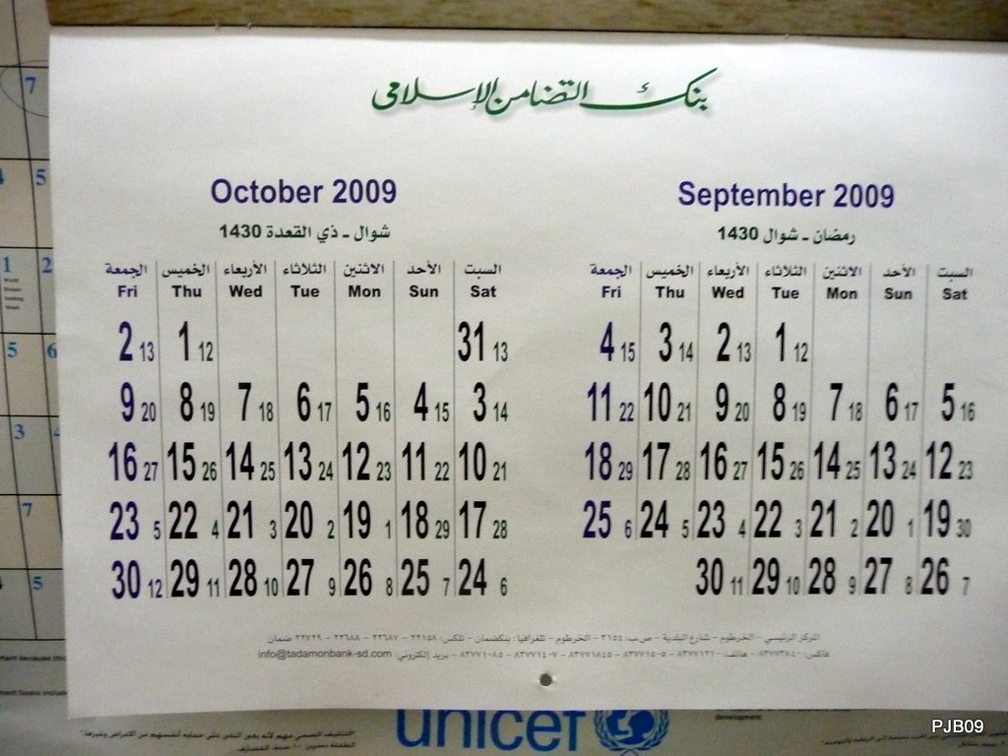
Content Strategy: Organize
Audience
Channel
Frequency
Tool: Editorial Calendar
What will you say?
What does your audience want?
Notes:
You need to plan out your content, ideally on a monthly basis.
Many NGOs use an editorial calendar that is a simple spreadsheet that lists:
-Date -Channel
-Frequency
-Content Idea
The can be curated or created, but it has to be what your audience will respond to meet your objectives.
Photo Source:
http://www.flickr.com/photos/peejeebee/4042966090/sizes/o/in/photostream/

Slide 10
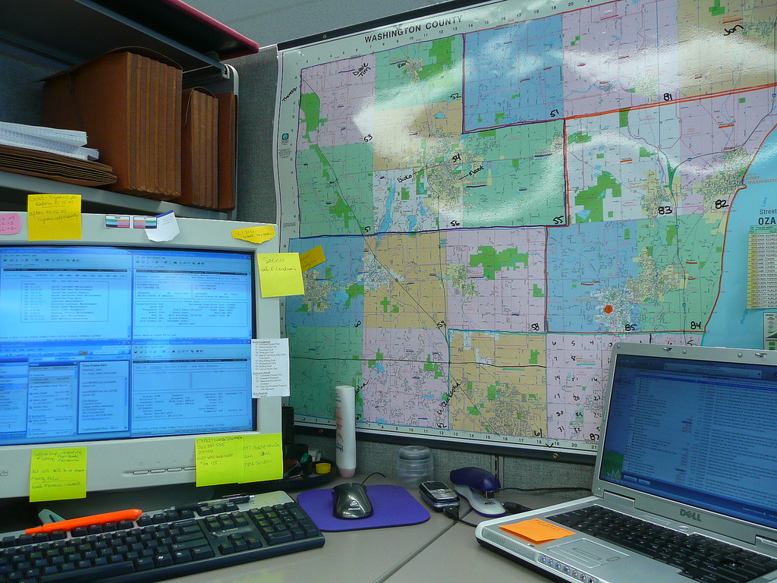
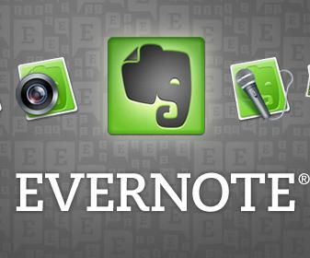
Content Strategy: Plan
You must be organized!
A few tools ….
Notes:
http://www.flickr.com/photos/drydens/2349707107/sizes/l/in/photostream/
You have to organize your ideas in a way that makes it easy to curate or create content

Slide 11
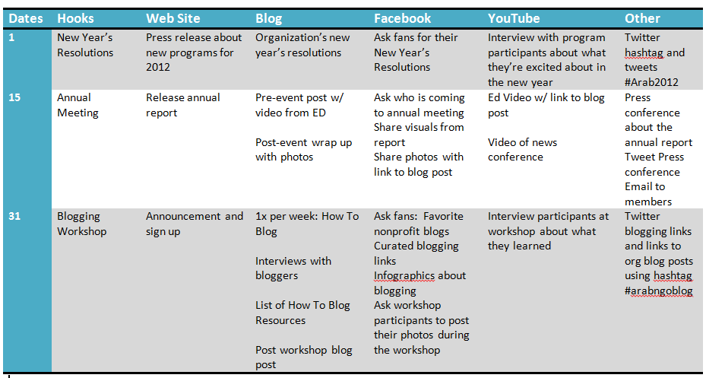
Content Strategy: Organize
Notes:
This a simple example of what an editorial calendar may look at. You can use a spreadsheet, word document, or keep it online so several people can help.
The secret behind an editorial calendar is the way in which it allows a publisher to create content that’s in tune with readers' expectations—what’s happening in their own lives and, therefore, what they’re in the right frame of mind to hear.
You need to plan out your content, ideally on a monthly basis.
Many NGOs use an editorial calendar that is a simple spreadsheet that lists:
-Date -Channel
-Frequency
-Content Idea
The can be curated or created, but it has to be what your audience will respond to meet your objectives.
Spreadsheet you can modify – it is based on US holidays
https://docs.google.com/spreadsheet/ccc?key=0AjOK16EGb79NdHYtcFhqODhUT1A0UTl0bUZDaWM2eWc&hl=en_US#gid=0

Slide 12
Content Strategy: Create
Curate and create your content!
Notes:
Next step is to create your content:
Make videos
Take Photos
Write blog posts
Write articles
Write press releases
Do interviews
Look for content to curate
Create a list of links

Slide 13
Content Strategy: Topic Ideas
Features
News
Highlights Reviews
Stories
Case Studies
Breaking News
NGO News
Data
Reports
How To
Opinion
Tips
Tutorials
Lists
Resources
Idea Pieces
Interviews
Opinion
Notes:
It is important think about your content in terms of what you can plan ahead and what you need to be ready for when there is breaking news ..
Breaking news – have to publish with short lead time – but you don’t have to be first. Quality comes first. There is a technique called “news-jacking”
Newsjacking is piggy-backing on timely news or Meerman points out “the second paragraph of a news story.” It is done by creating original content that takes advantage of timely events that are getting mainstream media attention and providing your organization’s view or take on the topic and sharing it with your audience, including journalists.
Timely – Holidays, programs, events, and regular features “Facebook Fridays” – These should be in your editorial calendar
Anytime – This is content related to your organization’s mission, can be about your organization or your topic area – but linked to a specific event. You can create this during slow times or have it on hand so it is efficient to share your content.
Campaigns – This is content to support a specific organizational campaign.

Slide 14
Content Strategy: Formats
Type | Ideas
Web Site and email | Longer reports News releases Newsletter Formal announcements Descriptions Photos/Videos
Blog | Shorter, timely posts Stand alone posts Series of posts Incorporate videos and photos Curated resources lists
Visuals | Stand alone photos/videos Collections of photos/videos (Created/curated) Infographics
Micro- Content | Status Updates Tweets Questions Annotated Links

Slide 15
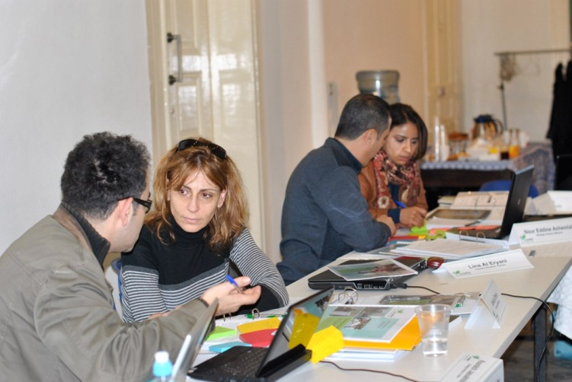
Content Strategy: Get Ideas from Others
Notes:
Get ideas and input from others, you don’t have to do it alone!

Slide 16
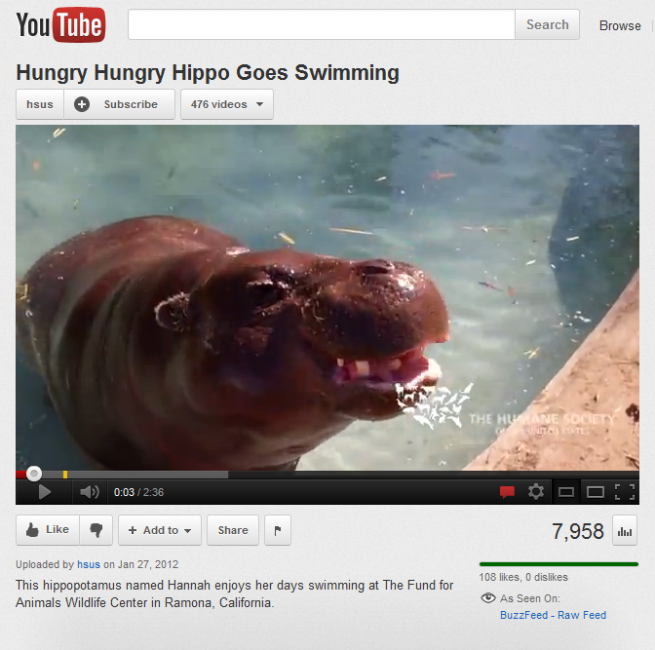
Content Strategy: Repurpose
Notes:
You can mix it up. You don’t have create new content for every channel!

Slide 17
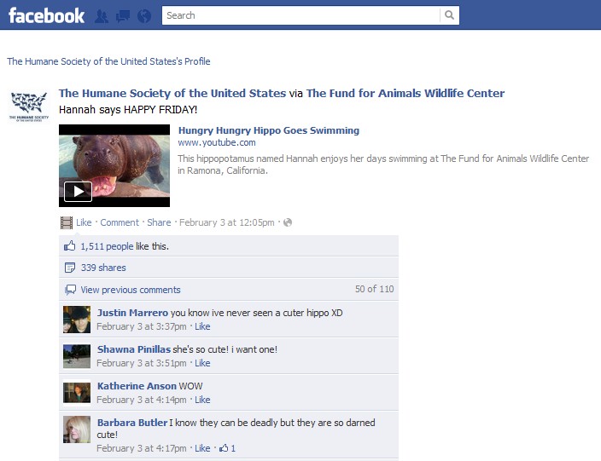
Content Strategy: Repurpose
Notes:
You can mix it up. You don’t have create new content for every channel!

Slide 18
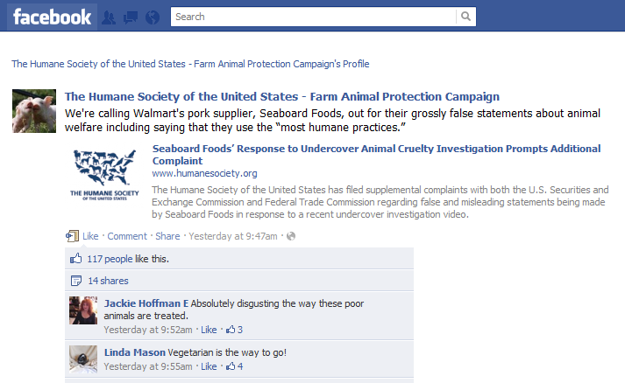
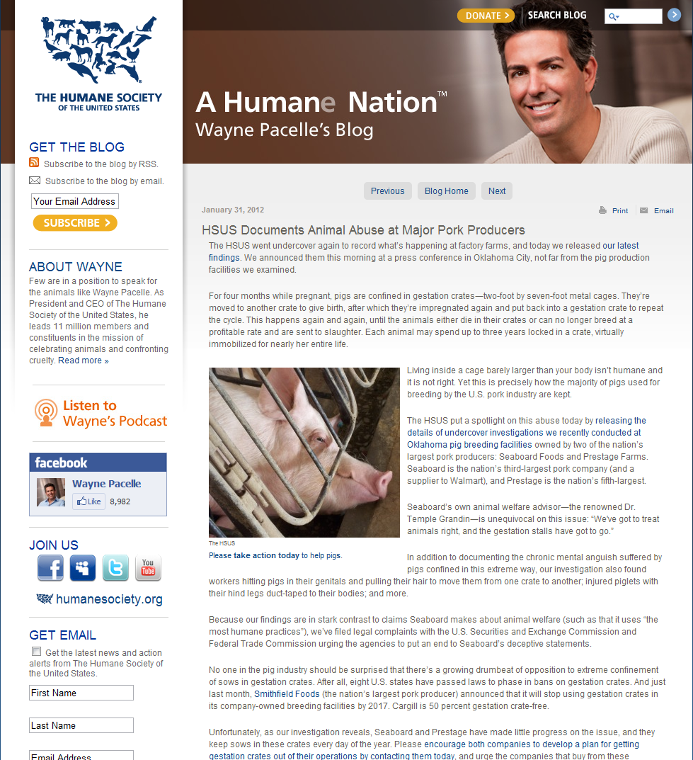
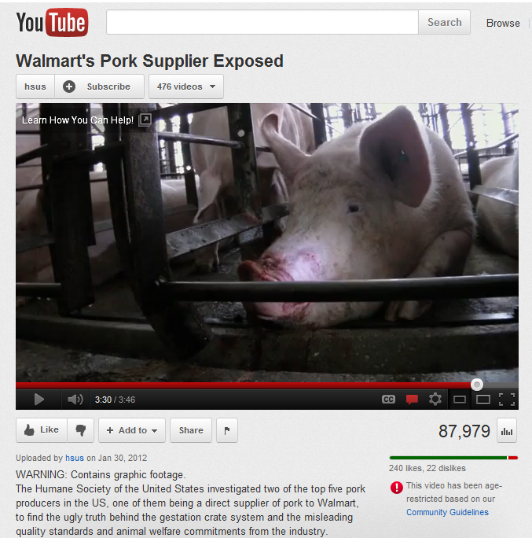
Content Strategy: Remix It and Mix it Up
Notes:
You can mix it up. You don’t have create new content for every channel!

Slide 19
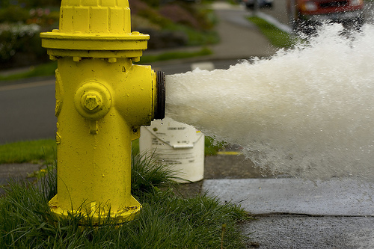
Content Strategy: Quality, Quality, Quality
The quantity and speed does not matter …..
Notes:
You can mix it up. You don’t have create new content for every channel!

Slide 20
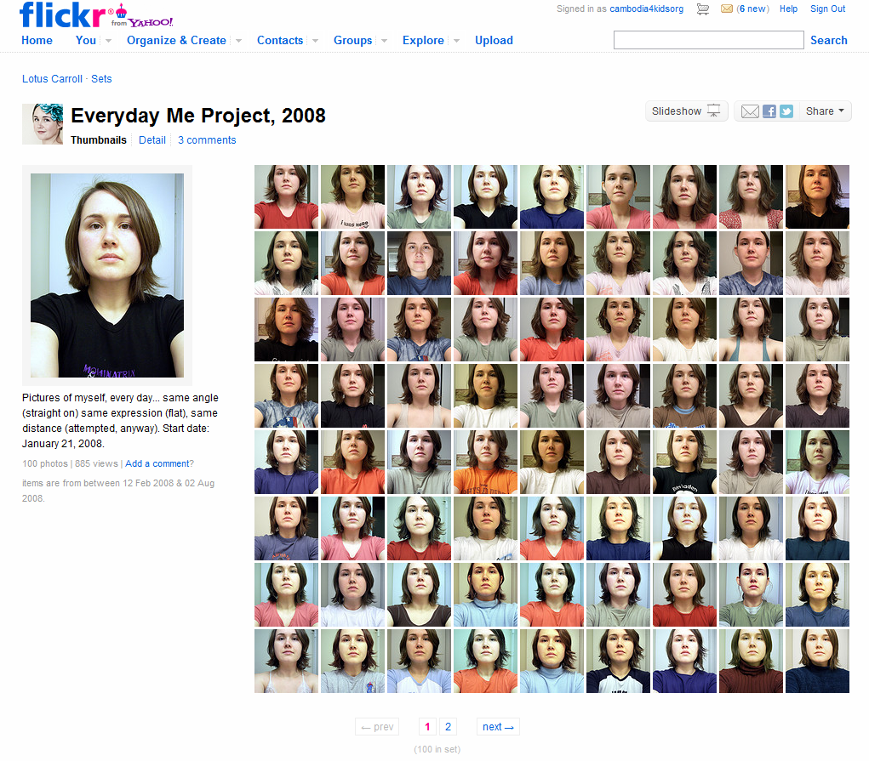
Content Strategy: Consistency
Notes:
http://www.flickr.com/photos/thelotuscarroll/sets/72157603809711727/with/2339070093/
Be consistent – don’t share a bunch of content one day or one week and then stop for several weeks.

Slide 21
Small Group Exercise:
Editorial Calendar for April, 2012
1. Each table has a different focus area – go sit at a table that matches your NGO’s focus area
2. Use the editorial calendar template to brainstorm ideas for content
3. First step is to identify holidays in April, 2012
4. Share campaigns, events, and other activities that your organization has planned for April, 2012
5. Brainstorm some content ideas for web site, blog, Facebook, YouTube, visuals, and other channels
FOCUS AREAS:
Women’s Issues
Youth
Poverty Reduction
Civil Society
Civic Participation
All Others

Slide 22
Reflection: Think and Write
What is one step you can take to start using an editorial calendar to help you organize your content strategy?
What is one idea for content that you can implement when you get home?
Notes:
Focus Areas:
Youth
Women’s Issues
Education
Poverty Reduction
Civil Society
All Other
Additional Resources Online (these are written in English but you can use Google translate)

Slide 23
Resources
Spreadsheet you can modify – based on U.S. Holidays:
https://docs.google.com/spreadsheet/ccc?key=0AjOK16EGb79NdHYtcFhqODhUT1A0UTl0bUZDaWM2eWc&hl=en_US#gid=0

