Slide 1
New Media for the Networked NGO
Making Trainings Interactive
Presenter: Beth Kanter
E-Mediat is funded by the Middle East Partnership Initiative of the United States Department of State with support from Microsoft Corporation and craigslist Charitable Fund and administrated by the Institute of International Education
Notes:
IIE and publicly acknowledge funding by the U.S. Department of State Middle East Partnership Initiative (MEPI).
Making Trainings Interactive: 3:15 – 5:00
Description: This session will share and demo techniques on how to make training session more interactive and give participants a chance to practice and get peer help on training they are working on. The session will debrief on some of the techniques used during Day 1 and share others.
Why active learning is more effective
Icebreakers: Use for participants to get to know each other or for you to get to know the group’s level of experience and attitudes – Networking exercises, Spectragrams, and more
The Interactive Presentation or Lecture
Facilitating Small Group Exercises
Great endings
Preparation: Participants should come prepared with a session they are designing and want to make it more interactive or bring an interactive exercise they’ve designed and used for a training to share with the group.
Materials: Brief handout – 3-5 pages with instructions on how to use different techniques and links for additional resources from: http://www.bethkanter.org/connect-inspire-engage/
Plus resource here: http://socialmedia-for-trainers.wikispaces.com/Facilitation+Tips+and+Resources
briefly acknowledge funding by the U.S. Department of State Middle East Partnership Initiative (MEPI).

Slide 2
Learning Objectives
To understand why interactive training is more effective
To model and debrief on different interactive techniques
To discover ways to apply interactive techniques to your own training

Slide 3
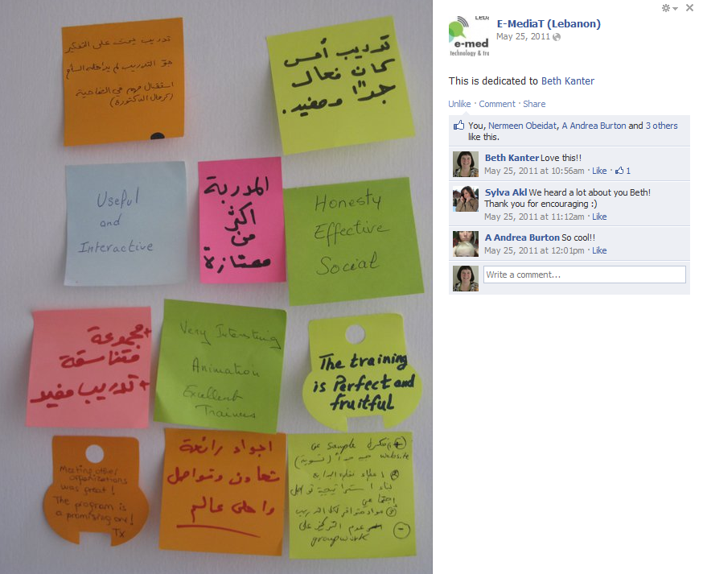
Energize From the Start:
Share Pairs and Networking Activities
Write on Index Cards or Sticky Notes:
What was the best learning experience you ever had in a training that inspired you to put the knowledge or skills into practice?
Notes:
When you begin a training, you want create energy from the moment people walk in the door.
This exercise works like this:
Participants think about this question. They write down on four index cards the elements or strategies that made the learning experience a good one for them.
Facilitator collects the index cards and randomly distributes them
Participants are asked to circulate and trade cards with other participants until they end up with at least two cards that matches what they need to be able to learn in a technology workshop
Facilitator asks for themes
This can be done with Sticky notes.

Slide 4
Energize From the Start:
Reflection on Activity
The goal of the exercise was to get participants to interact with each other about the topic
To connect and discover similarities and differences
To draw on their own knowledge before the content is presented

Slide 5
Energize From the Start:
Reflection on Activity
How did the exercise make you feel about learning about the topic?
Are you ready to learn about interactive training techniques?
Did it help you think about questions or some of your own experiences to share?
Would the experience have been different if I had started with a lecture/presentation?

Slide 6
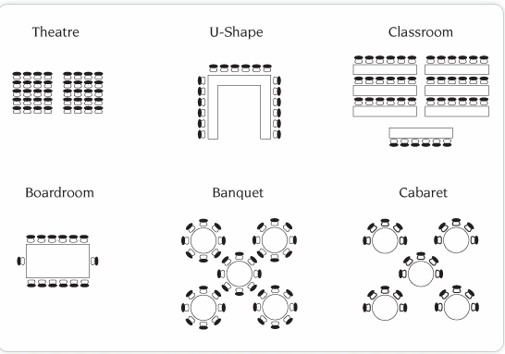
Energize From the Start:
Planning for Interactivity
Things to think about before people arrive:
Room layout
Physical Space
Participant Assessment
Reflection Questions
Notes:
When you begin a training, you want create energy from the moment people walk in the door.
Things to think about before people arrive:
Room layout: Should not be fixed seating or desks in rows. The ideal set up is small round tables.
Space: There should be enough room to move around and walls should be accessible for posting notes, sticky notes, posters, and other learning products
Participant Assessment: This may not always be possible, but you want to do a survey to learn as much as you can about your participants related to your learning goals. What is their experience and level with the topics being taught? What are their attitudes and expectations? What do they want to learn? If you are using the “Living Case Study” method described later, you will need to survey to learn of good case studies to share.
Reflection Questions: Depending on the participants and the topics you are training, you share some reflection questions in advance of the session before they arrive. This can also be done as the first learning activity like we are doing here. The idea is for participants to make a connection to what they already know about the topic.
Image Source
Source: http://www.deverevenues.co.uk/locations/the-studio-manchester/business/layouts-and-dimensions/main/01/sampleImgBinary/sample-room-layout.gif

Slide 7
Participant Assessment As Icebreaker: Human Spectragram
Interactive activity or “Icebreaker” that allows you to understand participant attitudes about what you will be training on
Let’s do the exercise
Notes:
If you do a survey in advance of the session, you should include some questions to cover the participants attitudes about the topic. For example, with social media, I want to know if people are skeptical or open to learning and ask some questions like, “What is your organization’s biggest point of skepticism about social media?”
If you have different views and attitudes related to your topic, you can use this exercise to allow people to share their opinions. Once they’ve expressed their point of view, it won’t slow down your delivery of the training later on.

Slide 8
I love lemonade!
Strongly Agree
Strongly Disagree
Notes:
http://www.flickr.com/photos/nep/2284817865/
http://www.flickr.com/photos/nep/2284817865/
Human Spectragram: This is a group face to face exercise to help surface similarities and differences in a group, help people to get to know each other and to do something together that is active.
In a large open space put a long piece of tape on the floor. It should be long enough for the full group present to spread itself out over. Alternately, use a long piece of rope or ribbon.
Ask everyone to stand up and gather around the tape. Explain that the tape is a continuum between two answers to questions they will be asked. Then kick off with a simple, fun question to demonstrate the method.
Walk up and down the tape and take a sampling response from people as to why they positioned themselves on the tape the way they did. Usually it is good to sample from both ends and somewhere in the middle. If, upon hearing other people's responses, people want to move, encourage them to do so. This is about meaning making, not about an absolute measure of peoples' opinions.
Then move on to "serious" questions.
As you ask questions, encourage people to notice who is where on the line - this helps people find people in common or who have different views that could be useful discussion starters.
Depending on time, use between 2- 5 questions. You can tell it is time to quit when people stop moving and are talking to each other more than participating. This means either they are bored, or they have become deeply engaged with each other. And the latter is a good thing!
Human Spectragram http://www.kstoolkit.org/Human+Spectrogram

Slide 9
When training is interactive, participants pay better attention to the what is being taught
Strongly Agree
Strongly Disagree

Slide 10
When training is interactive, participants are more likely to apply what they’ve learned after the training
Strongly Agree
Strongly Disagree
Notes:
Who would like to do practice leading a spectragram?

Slide 11
Human Spectragram: Debrief
Debrief Technique
Why would this be useful?
Notes:
If you do a survey in advance of the session, you should include some questions to cover the participants attitudes about the topic. For example, with social media, I want to know if people are skeptical or open to learning and ask some questions like, “What is your organization’s biggest point of skepticism about social media?”
If you have different views and attitudes related to your topic, you can use this exercise to allow people to share their opinions. Once they’ve expressed their point of view, it won’t slow down your delivery of the training later on.

Slide 12
The Interactive Lecture
The interactive lecture delivers the key points, principles, frameworks, and stories
Instructor does not talk the entire time
Orient: Key points up front
Handouts: Have a place for people to take notes
Variety: Visuals, different questions, different activities
Pacing: Opportunities for participants to digest the information
Modeling: Clear demonstrations of what you are talking about
Summary

Slide 13
The Interactive Lecture
Share Pair:
Think about the Principles of Social Media presentation I gave this morning.
What techniques did I use to make it interactive? What worked well for you? What didn’t?

Slide 14
Modeling The Interactive Lecture:
Why Interactivity Is Important
Notes:
When I first doing training, I only focused on myself. I was at the front of the room, I had to be the expert. I had to learn the content and deliver it perfectly. I would research content, put together slides, and practice my presentations for hours and hours. Then I would get to the training, and most of the day I would be the one doing all the talking. If my participants talked, it was to ask me questions and I’d give them long answers.

Slide 15
What do learners want most from a training?
Hate Most | Want Most
Too much information | Clarity
Lack of interaction | Interaction & Connection
Lifeless presenter | Enthusiasm
Notes:
When I asked for feedback on surveys, here’s what I learned.
I was shocked!
I knew I needed to do something different. So, I started thinking about how I could deliver what my participants wanted most: interaction and connection!

Slide 16
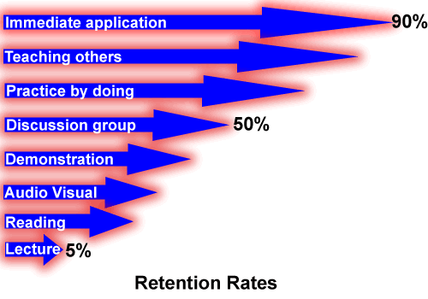
Straight Lecture Is Least Effective
Notes:
I still didn’t believe what I saw from my participant evaluations and I started to research teaching techniques and retention rates.
This is what I learned – that straight lecture or presentation is the least effective!
While many participants are comfortable with the method because, no doubt, they have sat through countless lectures and presentations from school through to the workplace. On the negative side, lectures and presentations can be totally ineffective and downright boring if it one-way conversation.

Slide 17
Four Corners of the Room
If you were listening to a 60 minute lecture, how many minutes would go by before your mind starts to wander?
60 minutes
45 minutes
30 minutes
15 minutes
Notes:
Four Corners: This is an activity to get people to review key content by walking to a place in the room and standing by answers. If you have four possible answers, tape those up on the wall in the four corners. Then ask the question and have participants go to the location of their choice and discuss the answer.

Slide 18
Attention Span Study
Length
0 5 10 15 20 25 30 35 40 45 50 55 60
Notes:
Richard Mayer‘s educational research in his book, The Handbook of Multi-Media Learning did a study of medical school lectures. They gave the students tests based on content and scored them. The questions were keyed to when the content was explained. And the resulting graph is the analysis of 1200 students. It shows that attention is the sharpest during the first 10 minutes of the lectures, then plummets, and then gradually goes back up but not to the same level. That means talking non-stop for more than 10 minutes, people start to tune out. If your true goal is inspire people to learn, then you need to incorporate techniques so people can process the information every ten minutes.

Slide 19
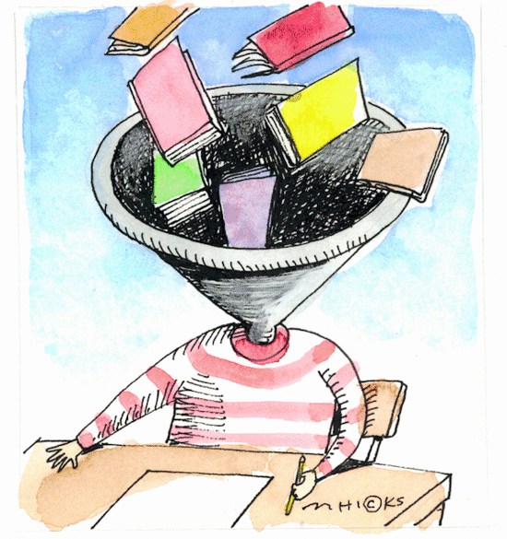
Rethink my role as a trainer to
“co-learner”
Notes:
What did that mean for me as a trainer? I had to rethink my role.
Learners are not "empty vessels" waiting to be filled with content pushed into it by a trainer. As trainers, we cannot take information as if it were a liquid and pour it into someone’s head as if the head were a receptacle. My job was not to fill my participants’ heads with knowledge, but to be a co-learner – and allow them to teach me.
I embraced a new teaching philosophy:
Cover the content
Engage the participants in a co-learning exercises
Reflect on content and exercise experience
Send them off ready to apply what they just learned or use the skills they have just acquired.
Training became less about me as the expert, and more about making sure that participants are ready to put the skills and knowledge into practice.
I now look at every training workshop as a good opportunity to have a conversation with others about something we both care about – the topic of the training!

Slide 20
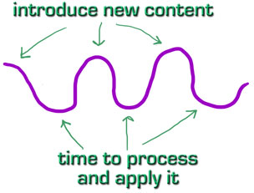
Interactive Lecture: Pacing Is Important
Introduction
Content
Interaction
Content
Interaction
Content
Interaction
Summary
Notes:
Learning doesn't happen at an even pace. Brains--or especially parts of brains--get tired and lose focus. By varying the pace--and type--of learning content, you give a user's brain the chance to let one part rest while the other part takes over. For example, follow a big-picture example/story with a step-by-step technical procedure that covers the same topic. This helps the learner's memory in two different ways--the redundancy means two different chances to save the information, and the fact that you gave one part of the brain a break while shifting to a different part keeps their brain working longer without fatigue.
If you want someone to remember something, you must give them a chance to process that memory. Relentlessly presenting new, tough information (like tons of code and complex concepts) without also including chances to reflect, process, think, apply, review, etc. virtually guarantees that much of the learning will be forgotten. That’s why it is essential to vary your delivery approach, incorporate ways for your learners to digest information – small groups, share pairs, Q&A, self-assessments, role playing, etc.
It's far more important they are given the key concepts than be exposed to everything. Be brutal in what you leave out. Knowing what NOT to include is more important in learning design than knowing what TO include.

Slide 21
Interactive Lecture:
Ask Powerful Questions
Think and Write: What are some powerful questions that you can ask related to the content you are training on?
Notes:
Source: Michelle Martin - http://michelemmartin.wikispaces.com/Reflective+Practice+for+TAFE

Slide 22
Interactive Lecture:
Different Learning Styles
Learning Style | Learner Interaction With Content
Word | Handouts with written bullet points with space to take notes
Visual | Use the diagram or pictures in your slides to reinforce points Use Sticky Notes for brainstorming Analyze video
Movement | Stand Up, Sit Down SpectraGram Four Corners of the Room Game
Self | Reflective questions: Think and Write Assessments
People | Share Pairs or Table Shares to discuss reflective questions related to content Full Group discussion
Notes:
People learn in different ways. It is called learning styles. Here’s summary of five different types and interactive activities that lend themselves to that style of learning.

Slide 23
Summary: Why Interactivity Is Important
Improves effectiveness of training
People will pay more attention
Pacing is important
Use different techniques to help participants apply and digest information every 10-15 minutes
May require you to rethink the way you teach and prepare in a different way

Slide 24
Learning Activities to Apply to the
Real World
The heart of your training will be an exercise that allows your participants time to apply the information to the real world.
Mini-Plan
Scenarios/Case Studies
Role Playing
Cross-Training
Notes:
In the last sections, I modeled icebreakers and the interactive lecture. I shared some research on why interactive trainings are more effective. I gave you some tips and methods to think about how to design an interactive lecture. If you want your training to stick, you need to also give them time to work on applying the ideas and concepts.
Designing activities:
Activity should help the participant gain knowledge, practice or learn a skill, or change an attitude
Reinforce your lecture content
Participants should have the minimum skills to contribute and learn from the experience
Methods:
Mini-Plan: Participants use the lecture content and a planning worksheet and apply to something they’re working on or will be working on
Scenarios or Case Studies: Participants use a case study or scenario and apply the lecture content to that
Role Playing: Participants experiment with immediately applying what they learned Cross-Training: Participants teach other

Slide 25
Learning Activity: Mini-Plan
Identify discussion questions for group to discuss
Using a worksheet, each participant works with a partner or themselves to create a mini-plan
Full group report out
Notes:
Step 1:
The questions should help participants share from their own experience
Step 2:
Create a worksheet with simple planning questions that participants can use to create their mini-plans. You can have the table work on one person’s plan or each do their own. Another variation is to provide a case study or scenario that participants can use. For example, a lecture in the form slides and participants would have to make the lecture more interactive.
As the facilitator, you have to make sure that the participants don’t get stuck trying to pick something to work on. Give them 20-30 minutes to work on the task.
Step 3:
Full group report out.

Slide 26
Mini-Plan: Design An Interactive Lecture
Table Share: Identify a lecture or presentation that you are working on or have recently delivered at a training
What techniques did you use to make it interactive?
What techniques might you use to make it more interactive?
Share your powerful questions
Use the worksheet to think through how you can make your lectures more interactive
Full group report out
Notes:
Discuss at your table for 15 minutes
Share with group
Use worksheet

Slide 27
Debrief: Learning Activity
Reflection:
This exercise was modeling a learning activity to apply the skill of designing an interactive lecture to the real world. How would you improve it?
If you were designing a longer training – a full day or over several days – what other activities would you incorporate to deepen the learning of the audience?

Slide 28
Great Closers
A closer is an exercise that lets participants sum up their learning or takeaways, commit to putting ideas or skills into action, and to say good bye to one another and express appreciation.
Notes:
To close out this segment and the day we’re going to do an easy closing exercise.
We’re going to do some share pairs – but I want you pay attention to me because when I raise my hand, I want you to raise your hand and be quiet.
1. Pair Share #1: Find someone you have not talked to today and discuss:
What did you learn about making training interactive? What was your big takeaway?
Pair Share #2: Find a different partner and share again
What did you learn about social media, content curation, or wikipedia? What was your big takeaway?
Popcorn and Twinkle: This is a technique to get people to share a few themes that emerged and not take up too much time. You ask people to share briefly what they heard and if other people agree they can “Twinkle” with their fingers. This avoid redundancy.
Pair Share #3: What is one thing you can do when you get back home to make your trainings more interactive?
It is also good to end with some celebration and acknowledge from the trainer. I will model that.
We will pick the winner for networking game raffle and take a group photo and formally end the session.

Slide 29
Evaluations
Formal Survey
Ask questions to determine how well you met your learning objectives
Ask questions to find out what people liked most and what could be improved: content, materials, pacing, environment, room, food, etc.
Ask questions to get feedback about you: teaching style, facilitation skills, responsiveness to group, content knowledge
Informal Verbal Debrief
Ask for: keep, change, delete
3x5 card – write down what they will implement

Slide 30
Resources
Additional resources
http://www.bethkanter.org/connect-inspire-engage/
http://socialmedia-for-trainers.wikispaces.com/Facilitation+Tips+and+Resources
Human Spectragram
http://www.kstoolkit.org/Human+Spectrogram
Additional Ice Breakers
http://www.kstoolkit.org

