Slide 1
Workshop 1: Social Media and Networked NGOs for Civil Society Overview and Strategic Planning
Day 1: Introduction to Social Media Day 2: Creating a Social Media Strategy Plan Day 3: Coaching and Online Community Site
This project is managed by Institute for International Institute for Education (IIE) Sponsored by the U.S. Department of State Middle East Partnership Initiative (MEPI)
Notes:
IIE and publicly acknowledge funding by the U.S. Department of State Middle East Partnership Initiative (MEPI).
Workshop 1: Social Media and Networked NGOs Overview and Strategic Planning * Day 1: Introduction to Social Media for Civil Society and Networked NGOs: Principles of Best Practices in Social Media Day 2: Creating Your Social Media Strategy Plan Day 3: Coaching in small groups and one-on-one for NGOs and CSOs, Training on How To Use OLC

Slide 2
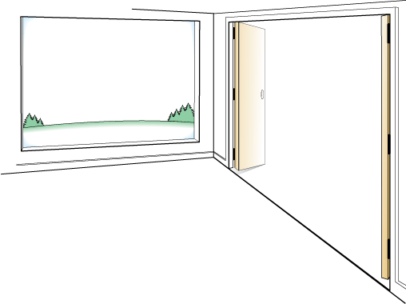
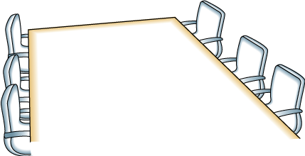
Day One
OUTCOMES
AGENDA
Leave the room with a basic understanding of your current level of social media practice and the next step for improvement need to realize civil society goals as Networked NGO
Introduction, Overview, and Icebreaker
Networked NGOs
Crawl, Walk, Run, Fly
Introduction to the Tools
Network Building Primer
Reflection
FRAMING
Small steps work best
Don’t have to implement all social tools deeply to be successful
Wide range of skills and knowledge in the room
Everyone will participate

Slide 3
Day One: Learning Objectives
To provide an overview of the Networked NGO concept and network building techniques to understand how they can use social media for civil society goals
To have participants self-assess their current level of social media practice and understand the basic principles for success (Crawl, Walk, Run, Fly)
To provide an overview of the program and give participants the opportunity to get to know one another

Slide 4
Program Overview
Notes:
Give a verbal overview of the program
http://www.emediat.org/main/program-overview/
The program outcomes are:
Increase CSO/NGO knowledge, access and skills to use new media effectively to advance their unique missions and strengthen their organizations
Improve communication between CSO/NGO leaders and key stakeholders and between CSO/NGOs and their communities of peers around the world
Improve communication between CSO/NGOs and governments in the MENA region
The five-workshop agenda is an intense schedule and a lot to cover and implement in a very short time frame. While you will be exposed to many tools, and techniques, it is not an expectation that every organization will implement all tools presented in the workshops at the deepest level to reach the above outcomes.

Slide 5
Day 1: Trainer Introductions
Day One: Trainer Introductions
Insert your photos and names here
Notes:
Give a brief introduction

Slide 6
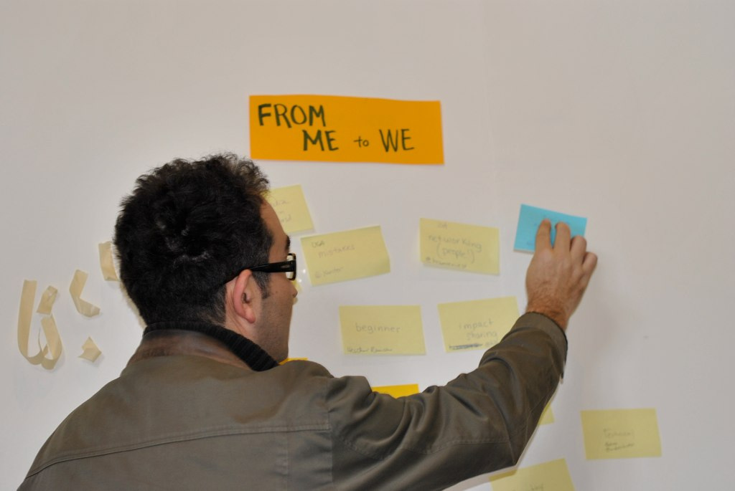
Three Things About Me: Creating A Social Network Based on Our Individual Knowledge
Notes:
If you want to cover more content, you can replace with an icebreaker that takes less time and move some of the afternoon content into the morning.
Adjust the number of words you want people to share based on the total number of participants and the amount of time you have available.
From Me To We: Creating A Social Network Based On Our Individual Knowledge
Concept: We are going to be talking about Networked NGOs. Networked NGOs understand how to use social networks to reach their goals using social media. Social networks are collections of people and organizations who are connected to each other in different ways through common interests or affiliations. Social networks have different patterns and structures to them and the glue that holds networks together and makes them effective is relationships If NGOs understand and apply the basic building blocks of social networks, their social media plans will get more impactful results.
Three Things About Me: It allows individuals to introduce themselves and share something about their experience, expertise, or knowledge related to the project. The exercise will help learn what knowledge we can share with other. We will have created a social network on the wall that allows us to visualize our shared points of connection and reciprocity. The trainers will document the activity to post to their blogs.

Slide 7
Three Things About Me: Instructions
Share three (Trainers-you may change this number as needed) things about you that are important for others to know for this project (skills, knowledge, interests)
Write one word per sticky note
Include your name and organization
Notes:
- You can use the color coding if you want to distinguish between different types of NGOs or budget size or not

Slide 8
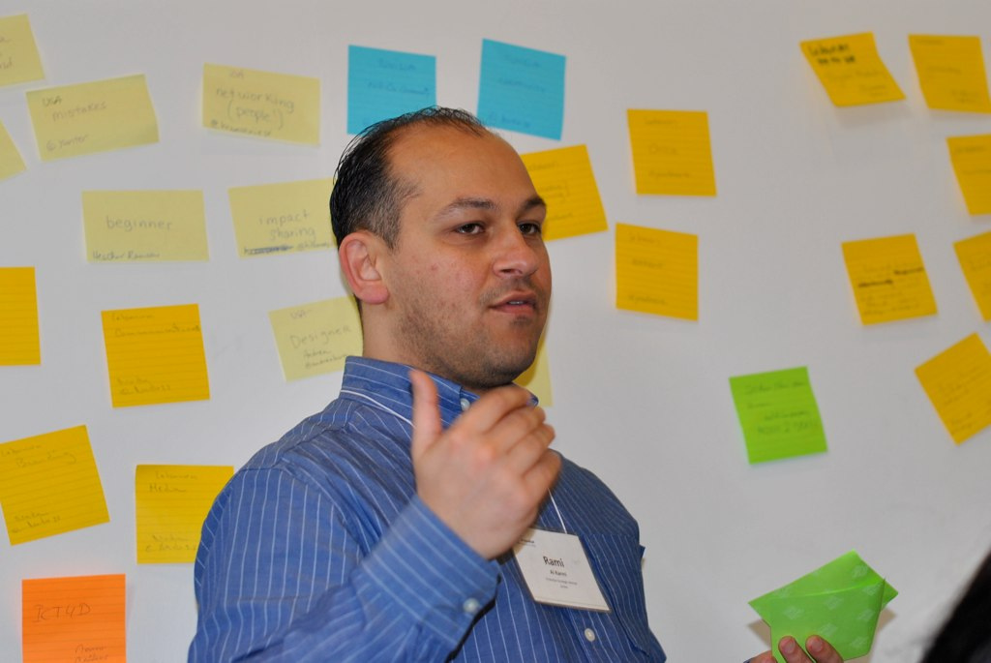
Three Things About Me: Instructions
Each person should introduce themselves to the group and place their sticky notes on the wall.

Slide 9
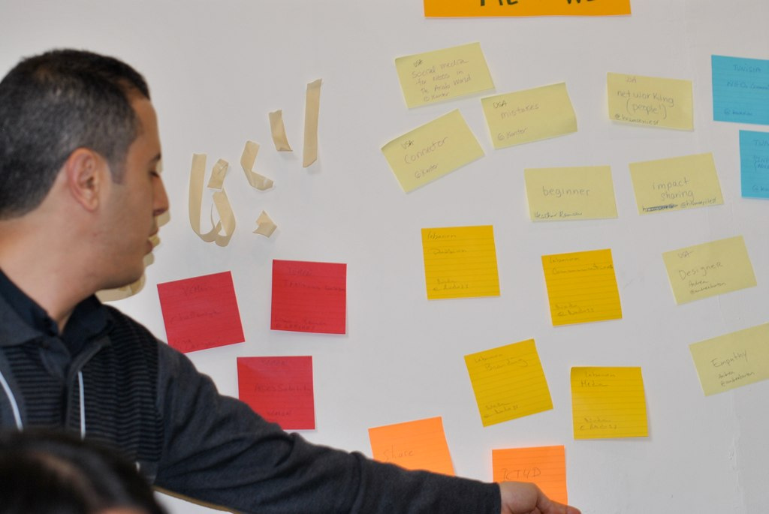
Three Things About Me: Reflection
Notes:
Reflection
What points of connection or common interests did you hear or see?
What opportunities for reciprocity?
How can we mutually support one another in our social media learning journey?

Slide 10
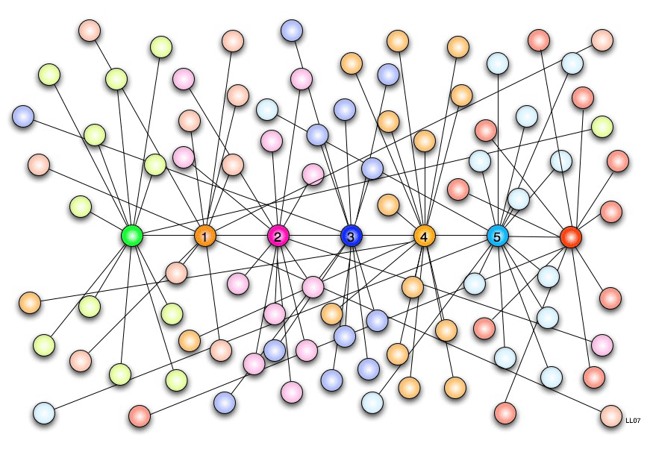
The Power of Networks
We have now created a social network around our shared interests. This is what happens when we use online social networks like Facebook. The glue that holds them together is relationships: connections and reciprocity. If NGOs understand the basic building blocks of social networks and apply to their work, they can achieve better results within civil society.
Notes:
Image Source: Wikipedia/Map of Six Degrees Theory of Social Connectivity
http://commons.wikimedia.org/wiki/File:Six_degrees_of_separation.png Text: Chapter 2: Understanding Networks – The Networked Nonprofit by Beth Kanter and Allison Fine

Slide 11
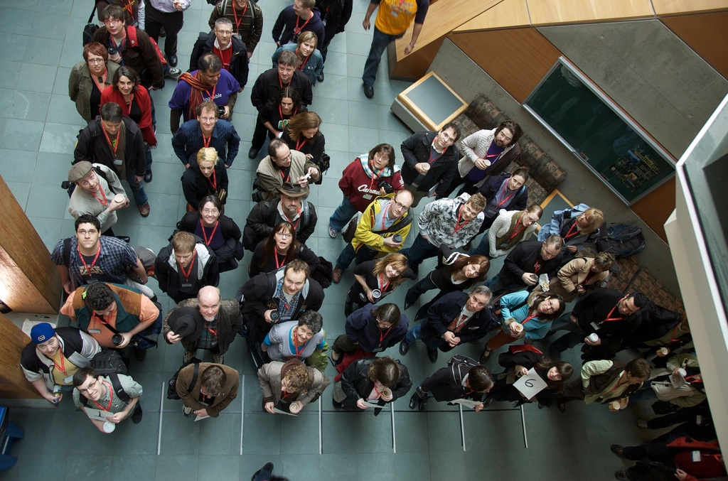
None
How many time zones did you travel to get here?
10 or more
How comfortable are you personally using social media? (very/not at all) Online social networks can help us achieve results that support civil society goals. (agree/disagree)
The Networked Nonprofit concept is relevant to our NGO’s work. (agree/disagree)
Human Spectrogram
Notes:
http://www.flickr.com/photos/nep/2284817865/
How comfortable are you personally social media? Very/Not at All
Social media can help us achieve results that support civil society goals
Social media can help us reach our audiences
Human Spectragram: This is a group face to face exercise to help surface similarities and differences in a group, help people to get to know each other and to do something together that is active.
In a large open space put a long piece of tape on the floor. It should be long enough for the full group present to spread itself out over. Alternately, use a long piece of rope or ribbon.
Ask everyone to stand up and gather around the tape. Explain that the tape is a continuum between two answers to questions they will be asked. Then kick off with a simple, fun question to demonstrate the method.
Walk up and down the tape and take a sampling response from people as to why they positioned themselves on the tape the way they did. Usually it is good to sample from both ends and somewhere in the middle. If, upon hearing other people's responses, people want to move, encourage them to do so. This is about meaning making, not about an absolute measure of peoples' opinions.
Then move on to "serious" questions.
As you ask questions, encourage people to notice who is where on the line - this helps people find people in common or who have different views that could be useful discussion starters.
Depending on time, use between 3- 7 questions. You can tell it is time to quit when people stop moving and are talking to each other more than participating. This means either they are bored, or they have become deeply engaged with each other. And the latter is a good thing!
Questions How many time zones did you travel to get to Beirut? (None/more than 10) How comfortable are you personally using social media? (very/not at all) How much experience do you have training or coaching NGOs or civil society organizations that have a campaign or cause? (a lot/not at all) (Raise hands if the campaign used social media) How much experience do you have delivering social media trainings? (no experience/a lot of experience) How much experience do you have creating training materials? (no experience (only use as is)/a lot (create my own from scratch) The Networked Nonprofit concept is relevant to NGOs in my country (agree/disagree) Digital activism campaigns need both strategy and tactics (agree/disagree) Human Spectragram http://www.kstoolkit.org/Human+Spectrogram

Slide 12
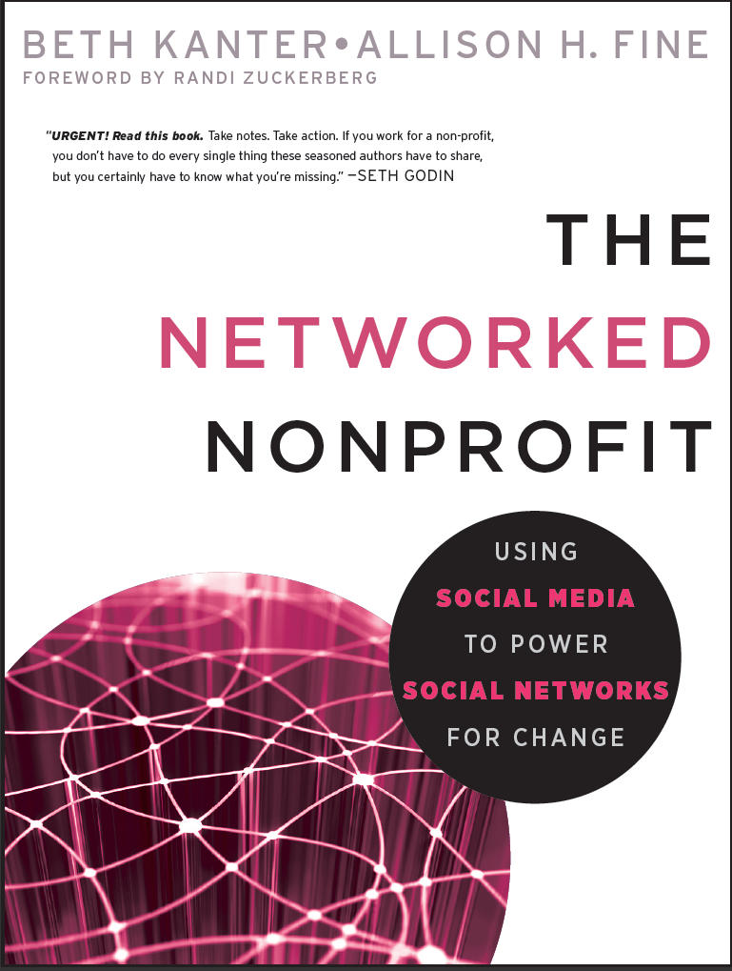
Definition: Networked Nonprofits
Networked Nonprofits are simple, agile, and transparent NGOs. They are experts at using social media tools to make the world a better place. Networked Nonprofits first must be before they can do. For some NGOS, it means changing the way they work. Others naturally work in a networked way so change is not as difficult.

Slide 13
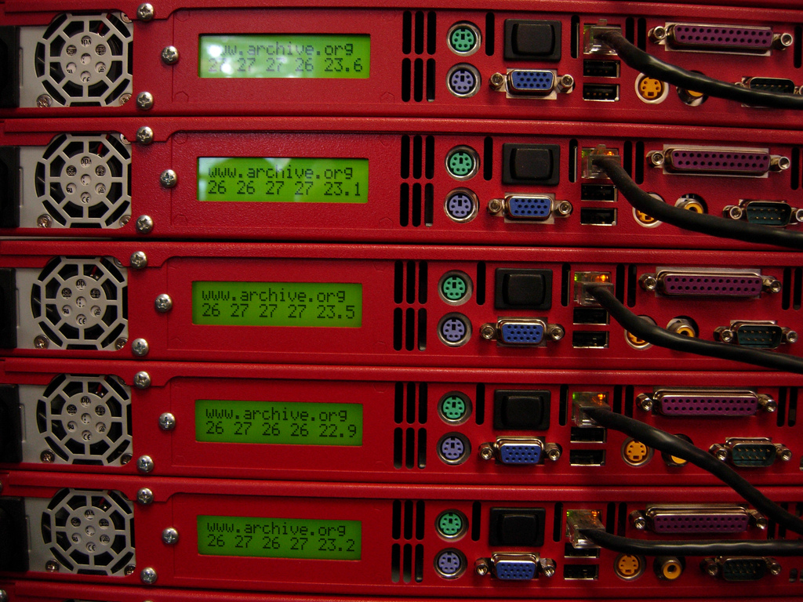
Being a Networked Nonprofit means not just having an internet connection or a Facebook profile.
Notes:
Photo: http://www.flickr.com/photos/future15/2036935569/

Slide 14
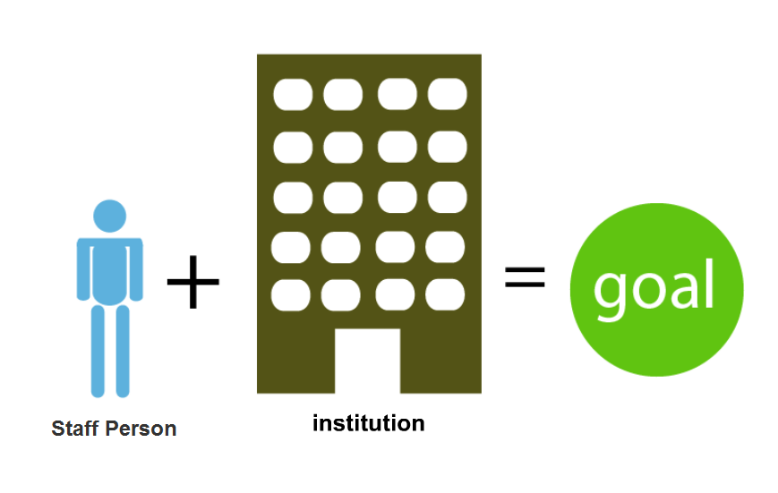
Example of a Non-Networked NGO
NGO
Modified illustration by David Armano The Micro-Sociology of Networks
With apologies to David Armano for hacking his visual! Source: The Micro-Sociology of Networks

Slide 15
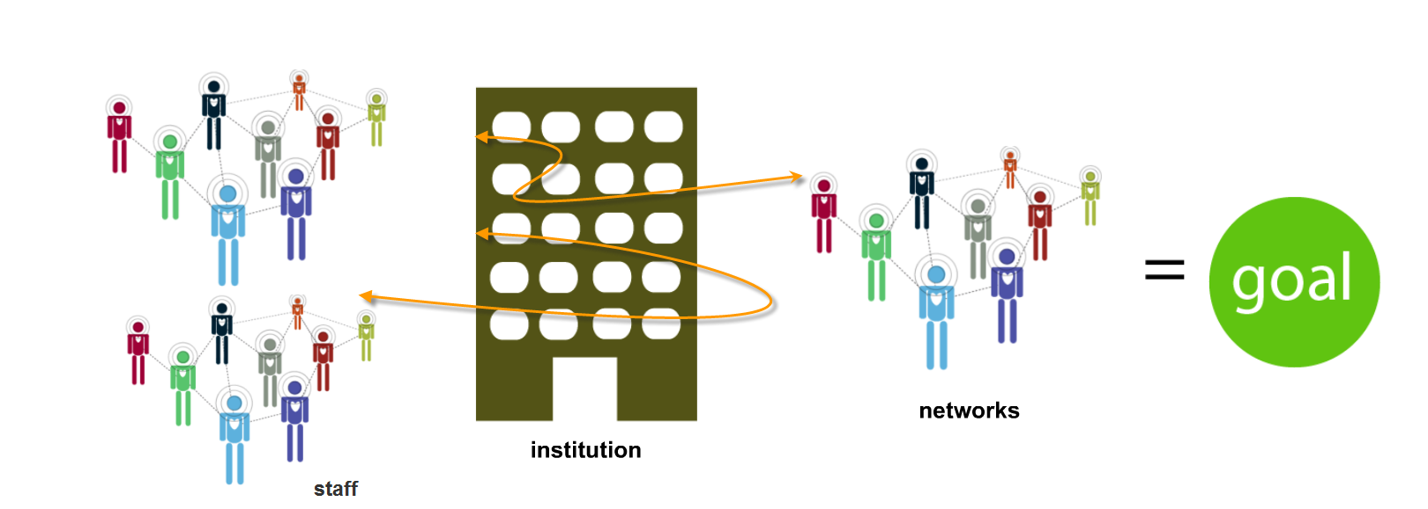
Example of a Networked NGO
NGO
Staff
With apologies to David Armano for hacking his visual! Source: The Micro-Sociology of Networks
Notes:
The transition from working like this to this – doesn’t happen over night, can’t flip a switch

Slide 16
Global Examples of Networked NGOs
Notes:
http://www.flickr.com/photos/33945754@N07/3297244979/\
http://www.flickr.com/photos/33945754@N07/
maartanF

Slide 17
Remove this slide:
You will may not have time to cover all of the following examples. Pick and choose the ones that resonate most and feel free to find and add your own.
Notes about the case studies are in the notes of each slide as well as links to a story or video.

Slide 18
Notes:
-----------
If you are on a good Internet connection, clicking the link will take you to the YouTube Video, but make sure you play it before you present so you don’t have to wait for it.
Another option is to embed the video in the slide, but you must have an Internet connection –
Instructions
http://beth.typepad.com/beths_blog/2010/03/embedding-a-youtube-video-in-power-point.html) No Internet connection?
You can download YouTube Videos and play them offline using one of these programs: http://keepvid.com/ FireFox Plugin: http://www.web-video-downloader.com/ Bear in mind, that KeepVid uses a Java applet that you have to allow to run, there's a possibility it doesn't work well in some browsers but on Chrome it's fine. You can save the file in mp4 (and link to it from your ppt) or save as a .flv and open it in your browser (as long as you have the right plugin/player - on my computer I'm using Real Player and QuickTime. I put a link “Play Video Offline” and link to the video file on the hard drive in the same folder as the ppt. Then you click it and it will ask you confirm the player and it will play.
Story of Electronics, an environmental-themed short film, as a case study and jumping off point for a workshop exercise to create a digital campaign. The Story of Electronics is part of a series of short films created and released by the Story of Stuff project since 2007. The first film, The Story of Stuff, shows the devastating consequences of our (American) consumerism in the environment, developing countries, personal health and happiness. The Story of Stuff site was created to leverage and extend the film’s impact by creating a network of people who are discussing the issue and hope to build a more sustainable and just world. Their online network includes over 250,000 activists and they partner with hundreds of environmental and social justice organizations around the world to create and distribute the film, curricula, and other content.
Last week at the TechSoup Global Summit, I had an opportunity to meet Annie Leonard and do a quick interview about their lessons learned working as a networked. As I listened to her speak about their experience, I knew this would be a terrific case study to share in Beirut as an example of working in a networked way. Annie was kind enough to give me her notes so I could write this case study and hopefully, I’ve captured it correctly.
The first thing to point out is that Story of Stuff project is not an independent nonprofit (as far as I could tell) and is fiscally-sponsored by the Tides Center. This organization is one that was born as networked nonprofit, in part, because of the experience and vision of its leader, Annie Leonard.
Here’s some basic points she made about working effectively in a networked way compared to working in a traditional organization.
Source: Leadership for a New Era
To Be Successful You Need both A Network Mindset and Networking Tools
A Networked organization is more than just the electronic infrastructure and tools that facilitate communication. It isn’t a matter of a Facebook profile or using Twitter. It is a collaborative way of working. It is about sharing. When you have a group of people working together in a network-culture and are facile with the tools, it can be unstoppable.
She described the networked mindset as different from working in a conventional nonprofit institution. These conventional nonprofits, what we label “Fortresses” in our book, The Networked Nonprofit, are all about command and top down control. Annie pointed out that these organizations have many rigid rules. It means that no one on staff or the outside can do anything without permission and had to be done a prescribed way. For example, everyone had to use the same font.
What’s more she described how difficult this way of working is and makes it almost impossible to collaborate with other organizations working on similar issues. In traditional organizations, they approach activism as “It is our issue.” These traditional organizations feel that power comes for their expertise and their institution.
In Networks, Information and Connections Flow in Many Directions
Annie talked about how networks focus on collaboration and action, rather than institution building. She noted, “In networks, the goal isn’t a big staff, but inspiring lots of people to do the good work through making connections and taking action.” She also observed that in networks, power and decision-making propagates outwards – rather than being consolidated in the center.
How and Why The Story of Stuff Is Successful As A Network
Annie credits the above ways of working as the secret to their success. She made the film because she was frustrated that the mainstream media and culture had ignored the underside of the American consumer economy. When she posted the short film online in 2007, it exploded. It turned up the volume on this important conversation.
In the three years since the film has been out there, there are still 10K views a day and 12 million views online. There are more than 220 countries have viewed the film in an unknown number of group settings. It’s been translated into dozens of languages, inspired curriculum for high school, inspired a ballet in Boston, a puppet show in Palestine, floats in parades and the list goes on. People have spray painted the URL on bus stops.
Building Relationships
Annie suggests that one reason they were successful is that the film wasn’t just hers. It was conceived and created in a network context. Instead of doing everything herself, she engaged other people. She spent an entire decade building relationships with groups all over the world and building a network of organizations to address the issues in the film. She also got lots of feedback about the film while it was being created.
When the film launched, it was already on the web site of hundreds of groups all over the world. Hundreds of advocates and allies helped create it and had a stake in it. She says it was “network-held” resource.
Inspiring Others To Take Action: Credit Free Zone
Annie also mentioned that their focus was to inspire new thinking and conversations, rather than getting credit or making money. They used a creative commons license – allowing anyone to use their films, put them on their sites, and do anything they wanted except sell it.
While Annie isn’t suggesting that we bury the old-school, centralized, command and control model of organizing, she feels that different times demand evolving models. Annie says working as network offers these advantages:
(1) Networks are more resilient and flexible and can bigger risks because they don’t have to worry about the longevity of a big institution.
(2) Networks are participatory. They can get millions of people to help, not just paid staff.
(3) Networks offer many different ways to get involved. It’s a buffet of ways to engage people that fits them. Networks value people on whatever terms they want to participate.
(4) Networks are a reflection of where the world is going. There’s a big paradigm shift in everything from our relationship to material goods to organizational models. We’re moving from a “mine” to “ours” environment.
(5) Networks make us all smarter. By sharing information freely and welcoming input and feedback, learning is accelerated. Networks evolve faster because of this.
(6) Networks are more fun. Annie said that she had spent many years trying to get people to talk about the issues that she cared about, thinking her experience and expertise were enough. It wasn’t until she learned to let go of control and shift from lecturing people to inviting them in that conversation exploded.
As Annie said in her closing remarks, the Story of Stuff is about building a better world. In the story, the network is the hero.

Slide 19
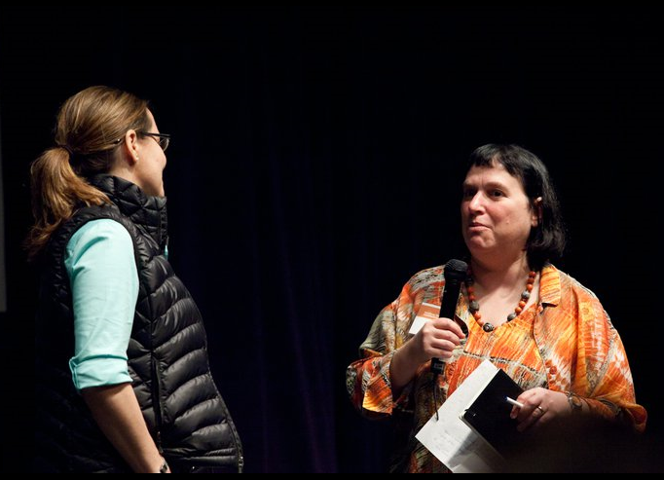
In the three years since the film has been out there, there are still 10K views a day and 12 million views online.
People in 220 countries have viewed the film in an unknown number of group settings.
Translated into dozens of languages, inspired curriculum for high school, inspired a ballet in Boston, a puppet show in Palestine.
Notes:
To Be Successful You Need both A Network Mindset and Networking Tools
A Networked organization is more than just the electronic infrastructure and tools that facilitate communication. It isn’t a matter of a Facebook profile or using Twitter. It is a collaborative way of working. It is about sharing. When you have a group of people working together in a network-culture and are facile with the tools, it can be unstoppable.
She described the networked mindset as different from working in a conventional nonprofit institution. These conventional nonprofits, what we label “Fortresses” in our book, The Networked Nonprofit, are all about command and top down control. Annie pointed out that these organizations have many rigid rules. It means that no one on staff or the outside can do anything without permission and had to be done a prescribed way. For example, everyone had to use the same font.
What’s more she described how difficult this way of working is and makes it almost impossible to collaborate with other organizations working on similar issues. In traditional organizations, they approach activism as “It is our issue.” These traditional organizations feel that power comes for their expertise and their institution.
In Networks, Information and Connections Flow in Many Directions
Annie talked about how networks focus on collaboration and action, rather than institution building. She noted, “In networks, the goal isn’t a big staff, but inspiring lots of people to do the good work through making connections and taking action.” She also observed that in networks, power and decision-making propagates outwards – rather than being consolidated in the center.
How and Why The Story of Stuff Is Successful As A Network
Annie credits the above ways of working as the secret to their success. She made the film because she was frustrated that the mainstream media and culture had ignored the underside of the American consumer economy. When she posted the short film online in 2007, it exploded. It turned up the volume on this important conversation.
In the three years since the film has been out there, there are still 10K views a day and 12 million views online. There are more than 220 countries have viewed the film in an unknown number of group settings. It’s been translated into dozens of languages, inspired curriculum for high school, inspired a ballet in Boston, a puppet show in Palestine, floats in parades and the list goes on. People have spray painted the URL on bus stops.
Building Relationships
Annie suggests that one reason they were successful is that the film wasn’t just hers. It was conceived and created in a network context. Instead of doing everything herself, she engaged other people. She spent an entire decade building relationships with groups all over the world and building a network of organizations to address the issues in the film. She also got lots of feedback about the film while it was being created.
When the film launched, it was already on the web site of hundreds of groups all over the world. Hundreds of advocates and allies helped create it and had a stake in it. She says it was “network-held” resource.
Inspiring Others To Take Action: Credit Free Zone
Annie also mentioned that their focus was to inspire new thinking and conversations, rather than getting credit or making money. They used a creative commons license – allowing anyone to use their films, put them on their sites, and do anything they wanted except sell it.
While Annie isn’t suggesting that we bury the old-school, centralized, command and control model of organizing, she feels that different times demand evolving models.
Annie says working as network offers these advantages:
(1) Networks are more resilient and flexible and can bigger risks because they don’t have to worry about the longevity of a big institution.
(2) Networks are participatory. They can get millions of people to help, not just paid staff.
(3) Networks offer many different ways to get involved. It’s a buffet of ways to engage people that fits them. Networks value people on whatever terms they want to participate.
(4) Networks are a reflection of where the world is going. There’s a big paradigm shift in everything from our relationship to material goods to organizational models. We’re moving from a “mine” to “ours” environment.
(5) Networks make us all smarter. By sharing information freely and welcoming input and feedback, learning is accelerated. Networks evolve faster because of this.
(6) Networks are more fun. Annie said that she had spent many years trying to get people to talk about the issues that she cared about, thinking her experience and expertise were enough. It wasn’t until she learned to let go of control and shift from lecturing people to inviting them in that conversation exploded.
As Annie said in her closing remarks, the Story of Stuff is about building a better world. In the story, the network is the hero.

Slide 20
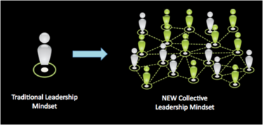
To Be Successful You Need both A Network Mindset and Networking Tools
Information and Connections Flow in Many Directions
Building Relationships
Inspiring Others To Take Action: Credit Free Zone
Notes:
To Be Successful You Need both A Network Mindset and Networking Tools
A Networked organization is more than just the electronic infrastructure and tools that facilitate communication. It isn’t a matter of a Facebook profile or using Twitter. It is a collaborative way of working. It is about sharing. When you have a group of people working together in a network-culture and are facile with the tools, it can be unstoppable.
She described the networked mindset as different from working in a conventional nonprofit institution. These conventional nonprofits, what we label “Fortresses” in our book, The Networked Nonprofit, are all about command and top down control. Annie pointed out that these organizations have many rigid rules. It means that no one on staff or the outside can do anything without permission and had to be done a prescribed way. For example, everyone had to use the same font.
What’s more she described how difficult this way of working is and makes it almost impossible to collaborate with other organizations working on similar issues. In traditional organizations, they approach activism as “It is our issue.” These traditional organizations feel that power comes for their expertise and their institution.
In Networks, Information and Connections Flow in Many Directions
Annie talked about how networks focus on collaboration and action, rather than institution building. She noted, “In networks, the goal isn’t a big staff, but inspiring lots of people to do the good work through making connections and taking action.” She also observed that in networks, power and decision-making propagates outwards – rather than being consolidated in the center.
How and Why The Story of Stuff Is Successful As A Network
Annie credits the above ways of working as the secret to their success. She made the film because she was frustrated that the mainstream media and culture had ignored the underside of the American consumer economy. When she posted the short film online in 2007, it exploded. It turned up the volume on this important conversation.
In the three years since the film has been out there, there are still 10K views a day and 12 million views online. There are more than 220 countries have viewed the film in an unknown number of group settings. It’s been translated into dozens of languages, inspired curriculum for high school, inspired a ballet in Boston, a puppet show in Palestine, floats in parades and the list goes on. People have spray painted the URL on bus stops.
Building Relationships
Annie suggests that one reason they were successful is that the film wasn’t just hers. It was conceived and created in a network context. Instead of doing everything herself, she engaged other people. She spent an entire decade building relationships with groups all over the world and building a network of organizations to address the issues in the film. She also got lots of feedback about the film while it was being created.
When the film launched, it was already on the web site of hundreds of groups all over the world. Hundreds of advocates and allies helped create it and had a stake in it. She says it was “network-held” resource.
Inspiring Others To Take Action: Credit Free Zone
Annie also mentioned that their focus was to inspire new thinking and conversations, rather than getting credit or making money. They used a creative commons license – allowing anyone to use their films, put them on their sites, and do anything they wanted except sell it.
While Annie isn’t suggesting that we bury the old-school, centralized, command and control model of organizing, she feels that different times demand evolving models.
Annie says working as network offers these advantages:
(1) Networks are more resilient and flexible and can bigger risks because they don’t have to worry about the longevity of a big institution.
(2) Networks are participatory. They can get millions of people to help, not just paid staff.
(3) Networks offer many different ways to get involved. It’s a buffet of ways to engage people that fits them. Networks value people on whatever terms they want to participate.
(4) Networks are a reflection of where the world is going. There’s a big paradigm shift in everything from our relationship to material goods to organizational models. We’re moving from a “mine” to “ours” environment.
(5) Networks make us all smarter. By sharing information freely and welcoming input and feedback, learning is accelerated. Networks evolve faster because of this.
(6) Networks are more fun. Annie said that she had spent many years trying to get people to talk about the issues that she cared about, thinking her experience and expertise were enough. It wasn’t until she learned to let go of control and shift from lecturing people to inviting them in that conversation exploded.
As Annie said in her closing remarks, the Story of Stuff is about building a better world. In the story, the network is the hero.

Slide 21
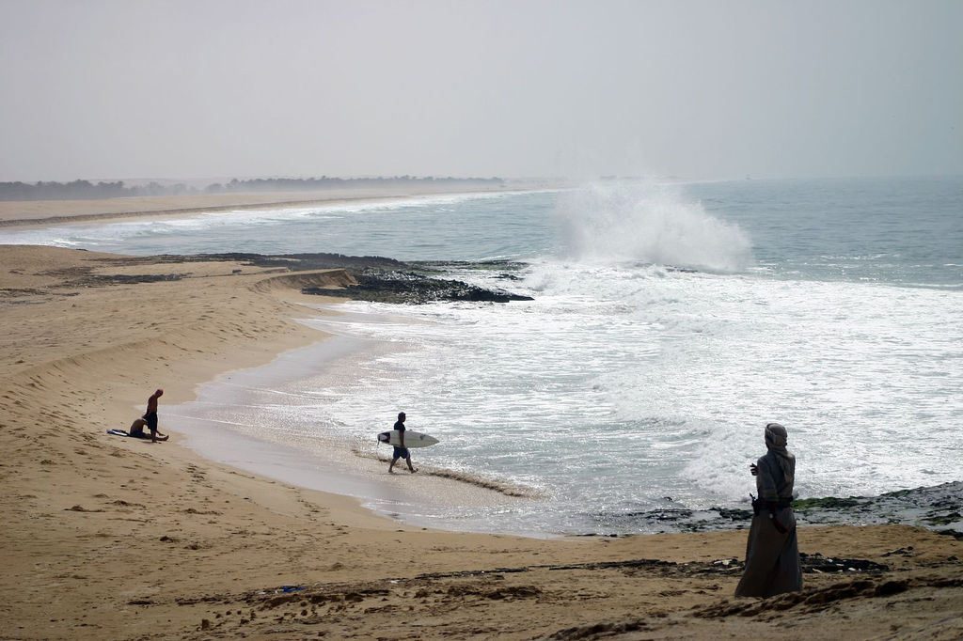
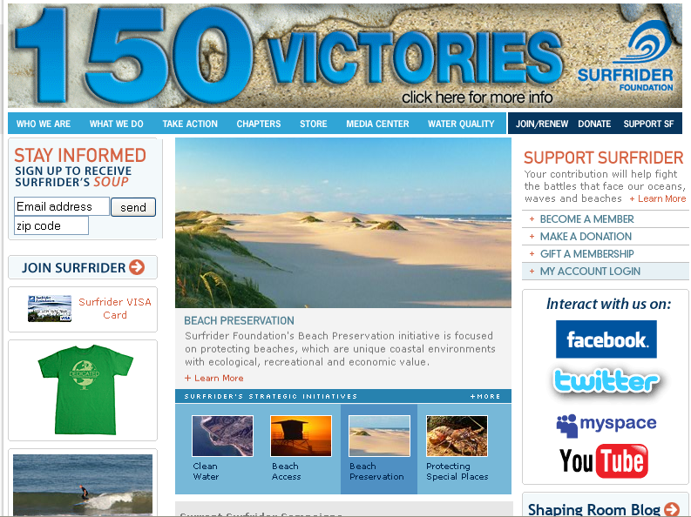
Surfrider Foundation: Networked Nonprofit
Notes:
http://www.flickr.com/photos/localsurfer/21448206/sizes/l/in/photostream/
The Surfrider Foundation is a non-profit grassroots organization dedicated to the protection and enjoyment of our world’s oceans, waves and beaches. Founded in 1984 by a handful of visionary surfers in Malibu, California, the Surfrider Foundation now maintains over 50,000 members and 90 chapters worldwide
They have members and chapters around the world – and they use social media to mobilize people online to have impact offline – for “beach victories” For example, they get their members to show up a local hearings to block projects that might destroy wetlands as well as miles of sandy coast.

Slide 22
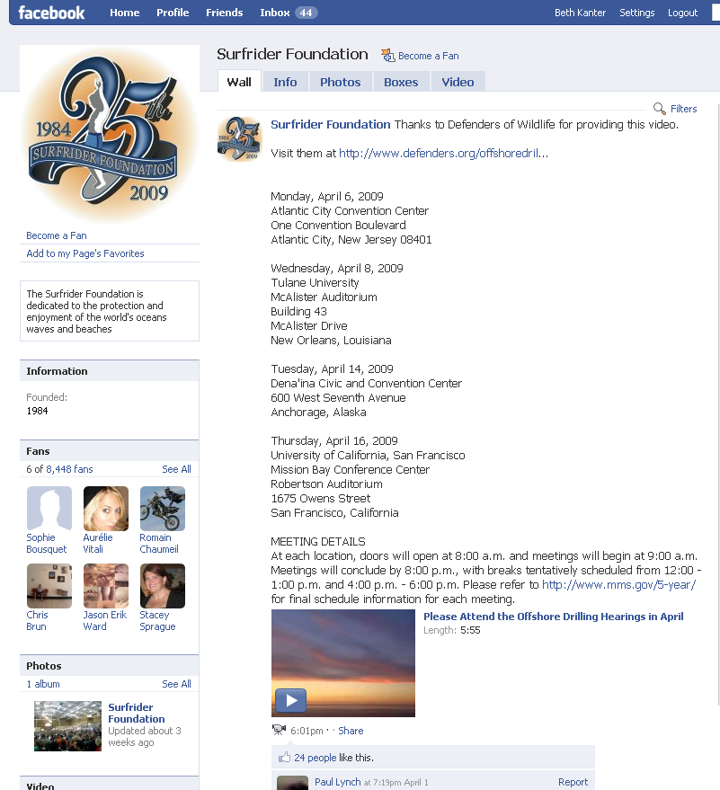
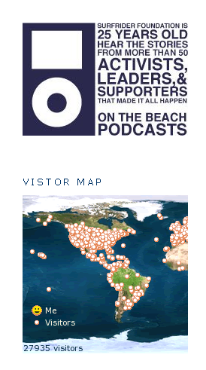
Not Afraid of Letting Control Go

Slide 23
Notes:
SHABAKAT youth integrate information and communication technologies in the day-to-day lives of their communities to positively transform our families, education, businesses, environment and community. Rami Al-Karmi will share a few words.
Founder and CEO of Shabakat, Al Ordon (JordanNet) and is serving as the E-Mediat Strategic Adviser for the Jordan In-Country Team shared some lessons about working as networked ngo. His organization’s name, Shabakat, translates into the word “network.”
Shabakat Al Ordon trains young people in technical, professional and facilitation skills who then go out and create programs to train people in their communities. Rami shared how his organization works in a transparent way, open sourcing its program materials and processes. They also work many different partners to spread the program so that his organization isn’t doing everything. They’ve simplified and focused on what they do best.

Slide 24
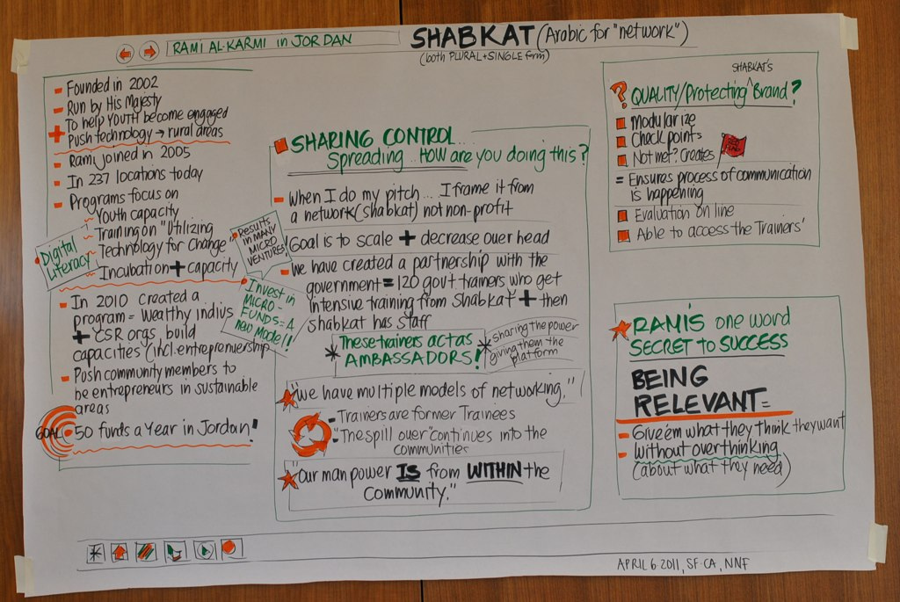
Notes:
http://www.bethkanter.org/emediat-day2/
Founder and CEO of Shabakat, Al Ordon (JordanNet) and is serving as the E-Mediat Strategic Adviser for the Jordan In-Country Team shared some lessons about working as networked NGO. His organization’s name, Shabakat, translates into the word “network.”
Shabakat Al Ordon trains young people in technical, professional and facilitation skills who then go out and create programs to train people in their communities. Rami shared how his organization works in a transparent way, open sourcing its program materials and processes. They also work many different partners to spread the program so that his organization isn’t doing everything. They’ve simplified and focused on what they do best.

Slide 25
Networked NGOs Understand the Difference
Traditional Media
Social Media
Brand in control
One way / Delivering a message
Repeating the message
Focused on the brand
Educating
Organization creates content
Audience in control
Two way / Being a part of a conversation
Adapting the message/ beta
Focused on the audience / Adding value
Influencing, involving
User created content / Co-creation
Notes:
Networked Nonprofits understand the difference and nuances between traditional media and social media are the ones that being the most effective

Slide 26
Networked NGOS understand the role of Social Networks in Civil Society
Social networks allow people to have direct involvement in civil society rather than action by proxy. Social networks allow people to be part of an active community, rather than a passive individual isolated from their fellow citizens.
NGOs can use social tools to provide an environment for conversation, it allows individuals to easily come together to discuss and solve shared problems.
Notes:
Civil society is often defined as the self-generating and self-supporting community of people who share core values and voluntarily organize political, economic, or cultural activities independent of the state. Civil society groups come in many sizes, with different goals, and exist both online/offline around the world. Civil Society groups represent a breath of expressed views and contributes to the defining of national goals and the shaping of policies.
The role of social technology in civil society. People have been congregating in online social spaces, such as Twitter, Facebook, YouTube and Flickr for years. But these tools are not just being used for day-to-day socializing and content sharing, they are also being used as news filters, platforms for collaboration, and opportunities for NGOs to make the world a better place. Information and requests for action can ripple quickly through such networks as people forward on interesting or important messages to their peers.
Civil society associations, by using social tools, can extend the reach of their web presence and the strength of their network, and form direct relationships with the individuals in their constituency. Social tools can also provide website visitors with something immediate to do, even if it is a small action. Establishing these one-to-one relationships and facilitating immediate action both increase engagement, which in turn increases the likelihood that the member/supporter will become a more active and valuable participant in the community.
Increasingly, people want direct involvement in civil society, rather than action by proxy, and social tools can help them experience that direct involvement. That may mean that they want to be a part of an active community, rather than a passive individual isolated from their fellow supporters. Civil society associations can use social tools to provide an environment for conversation, whether that’s on a blog or a social network or on Twitter, which will then allow a vibrant community to grow.
Social media allows individuals to easily come together to discuss and solve shared problems. Associations can either tap into that, facilitating self-organisation that benefits the association, or can ignore it. But if they do ignore the opportunity provided by the internet to engender collective action, they risk sidelining themselves as individuals bypass existing organizations and structures to achieve their goals.
Civil Society and Social Media http://www.america.gov/st/democracyhr-english/2010/January/20100126140433mlenuhret0.8288081.html
Why Is Social Media Important In Civil Society http://www.socialmediamarketingcompanyusa.com/resources/why-is-social-media-important-to-civil-society.html
Public Media 2.0 http://www.centerforsocialmedia.org/future-public-media/documents/white-papers/public-media-20-dynamic-engaged-publics

Slide 27
Social Networks allow IIE to share videos
Notes:
The Global Initiative for Breast Cancer Awareness has allowed IIE to share videos and has been a powerful way to communicate impact of our work, as well as share ideas among participants/teams in the ten countries for how to raise awareness.

Slide 28
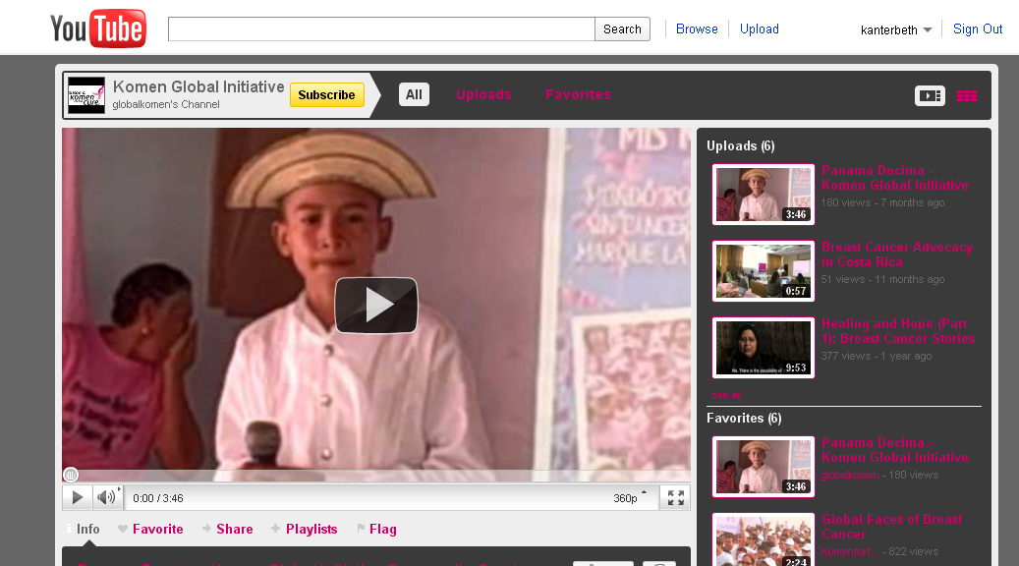
Play Video Online
Notes:
http://www.youtube.com/watch?v=fJ9l6uFpo84
If you are on a good Internet connection, clicking the link will take you to the YouTube Video, but make sure you play it before you present so you don’t have to wait for it.
Another option is to embed the video in the slide, but you must have an Internet connection –
Instructions
http://beth.typepad.com/beths_blog/2010/03/embedding-a-youtube-video-in-power-point.html) No Internet connection?
You can download YouTube Videos and play them offline using one of these programs: http://keepvid.com/ FireFox Plugin: http://www.web-video-downloader.com/ Bear in mind, that KeepVid uses a Java applet that you have to allow to run, there's a possibility it doesn't work well in some browsers but on Chrome it's fine. You can save the file in mp4 (and link to it from your ppt) or save as a .flv and open it in your browser (as long as you have the right plugin/player - on my computer I'm using Real Player and QuickTime. I put a link “Play Video Offline” and link to the video file on the hard drive in the same folder as the ppt. Then you click it and it will ask you confirm the player and it will play.

Slide 29
Not all NGOs are born as Networked NGOs or can easily transform…
Some take a longer time…

Slide 30
The Networked Nonprofit
BE | DO
Understand Networks | Work with Free Agents
Create Social Culture | Work with Crowds
Listen, Engage, and Build Relationships | Learning Loops
Trust Through Transparency | Friending or Funding
Simplicity | Govern through Networks

Slide 31
Small Group Exercise: Networked Nonprofits
What resonated?
What have you thought about before?
What does your NGO need change in
order to become more “networked”?

Slide 32
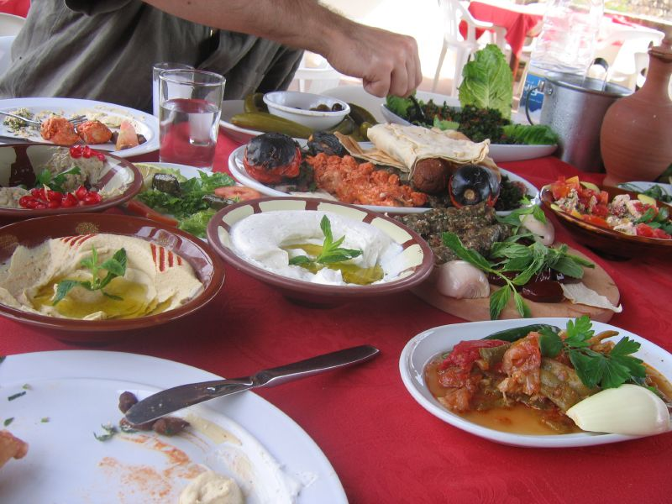
Lunch
Flickr photo by Littlelakes
Notes:
http://www.flickr.com/photos/littlelakes/54251489/

Slide 33
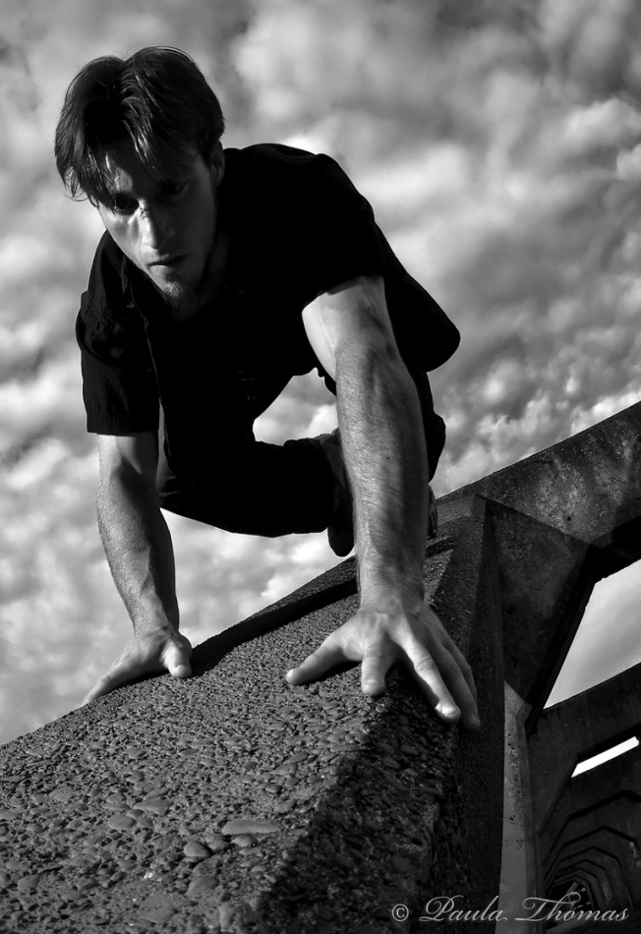
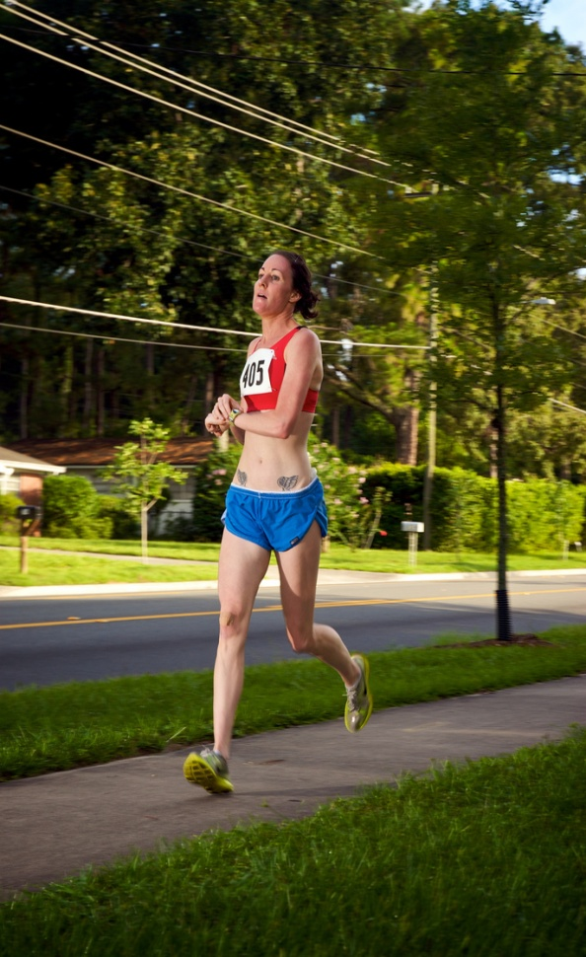
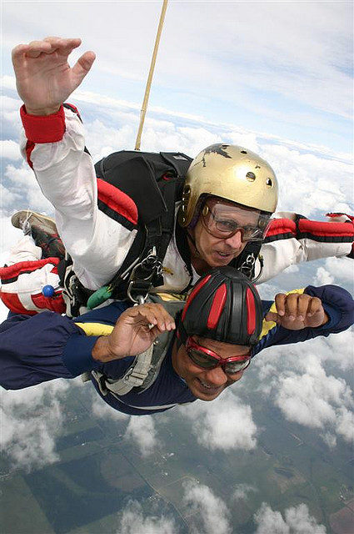
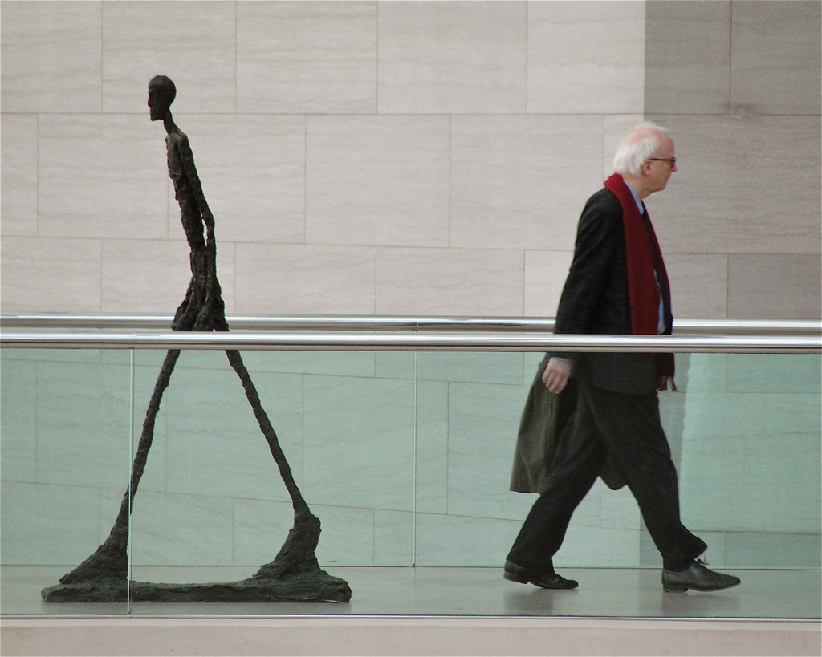
CRAWL | WALK | RUN | FLY
Effective Social Media Practice for NGOs
Notes:
Effective social media strategy isn’t about using as many tools as possible. What does it take to succeed is the ability to improve practice in small steps. Crawl, Walk, Run, and Fly is a maturity of practice model that can help NGOs get to the next level and improve how they’re using social media to reach civil society goals.
Many NGOs in other parts of the world are not successful using social media because:
They don’t have a methodical, well-thought out communications plan that links to their social media strategy
They try to be on too many different social media sites without the capacity or strategy to support it
Staff do not have the time or skills to implement a social media plan on an ongoing basis
People in the organization do not see the value of using social media or have the desire to want to learn a different way of
working
Social media requires sharing control of your organization’s branding, having conversations with stakeholders online, and other ways of working that are new and may be uncomfortable
They lack a way to measure their social media strategy success, document results, and reflect on how to improve upon what they’re doing
At the Train the Trainers workshop, we discovered that many of the challenges are true for NGOs in the Arab World (http://www.bethkanter.org/emediat-day2/)
That’s why this curriculum is based on the idea that NGOs can be successful in using social media if they take small, incremental and strategic steps. As a social media trainer, you need to identify what stage of practice the participants are in and help them get to the next level. In this model, there are four different levels of social media practice. These are classified as “Crawl, Walk, Run, and Fly.” One level is not better than another, it is just where the organization is at in its social media usage.
Be aware, that it takes months if not years to reach the highest level of practice. Not every nonprofit will go through the levels at the same pace due to organizational culture, capacity, or communications objectives and target audiences. The goal of training and technical assistance is to help NGOs improve by getting to the next level. If they can’t fly, then run. If they can’t run, then walk. If they can’t walk, then crawl. The idea is to keep improving.
Also as with all frameworks, when you apply the model, you see that the reality is messy. It might hard to categorize NGOs. And, it is a very subjective placement. The framework is a way to structure your thinking about delivering social media capacity building and training.

Slide 34
Crawl
Notes:
The NGO is not using social media or is not using it consistently. They lack a strategic communications plan and may not have a website or a website that has kept updated with content. They need to see inspiring stories of other NGOs from their context and in other places of the world. The first step is to develop a basic communications strategy, particularly identifying a SMART objective, audience, messaging, web presence, tactics, and implementation. The first social media step should be listening and setting up a web presence. In some cases, the NGO may need to develop a basic communications plan.

Slide 35
Walk
Notes:
The NGO is using one or more social media tools consistently, but it is not strategic and they’re not using best practices or techniques for the tools.
They have a basic web presence that represents their communications goals and is up to date.
Their social media presence isn’t linked to a campaign, communications objective, or civil society outcome.
They need assistance developing a social media strategy to support short and long-term “SMART” objectives. They will need to focus on listening, engagement, and content best practices.
The NGO’s leadership may not understand social media or be open to its use. There may not be a designated person(s) responsible for social media implementation.
The NGO needs to focus on one or two social media tools and improve practice and avoid doing too much on too many tools.
The NGO needs to incorporate ways to build capacity. For example, staff members may need to evaluate their current job tasks and identify tasks that can be deleted in order to make time to do social media. Or, the organization may need to consider how to reach out volunteers, interns, or others who can assist. In some cases, it may mean hiring an additional staff person.
The NGO may also need to develop a social media policy, in part, as an opportunity for people in the organization to understand the value and vision for social media use.
The other skill that is important is for the NGO to learn and use simple measurement techniques to improve practice and document results.

Slide 36
Run
Notes:
Uses one or more social media tools, is strategic but techniques could be improved or networked nonprofit concepts integrated. Organizations in this category also need to focus on using measurement techniques.
Assist with how to identify and use best practices with social media tools against metrics and campaign or other SMART objectives.
Introduce concepts of networked approaches and strategies.
Share stories of similar organizations successes.
Identify ways to expand capacity through the network or staffing.

Slide 37
Run
Notes:
NGO uses two or more social media tools strategically, applies network concepts, and regularly uses best practices, measurement, and improvement strategies. These NGOs will be good case studies and mentors to others in the group. They will need assistance with reflection techniques and improvement. They can learn advanced techniques for social media best practices and should work closely with social media strategy advisor.

Slide 38
Where to focus …
CRAWL | WALK | RUN | FLY
Internet Presence: Blog or Website
Communications Strategy
Social Media Strategy Plan
Engagement Content
Best Practices
Basic Measurement
Advanced Measurement
Network Building
Notes:
These are different levels of nonprofit social media practice – they go from beginner to advanced
As you move to the right through different levels, the NGO will need to invest more time, but they will yield greater returns as a result.
The idea is that the NGO is always moving forward and improving capacity.

Slide 39
If you are crawling, what does it look like? What do you need to get to the next level?
If you are walking, what does it look like? What do you need to get to the next level?
If you are running, what does it look like? What do you need to get to the next level?
If you are flying, what does it look like? How can you keep flying?
Discussion
If you are crawling, what does it look like? What do you need to get to the next level?
If you are walking, what does it look like? What do you need to get to the next level?
If you are running, what does it look like? What do you need to get to the next level?
If you are flying, what does it look like?
How can you keep flying?
Notes:
If you are crawling, what does it look like? What do you need to get to the next level?
If you are walking, what does it look like? What do you need to get to the next level?
If you are running, what does it look like? What do you need to get to the next level?
If you are flying, what does it look like? How can you keep flying?

Slide 40
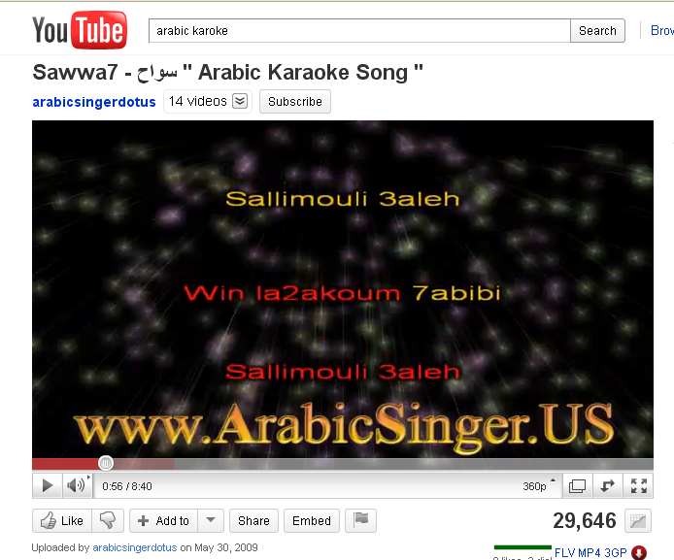
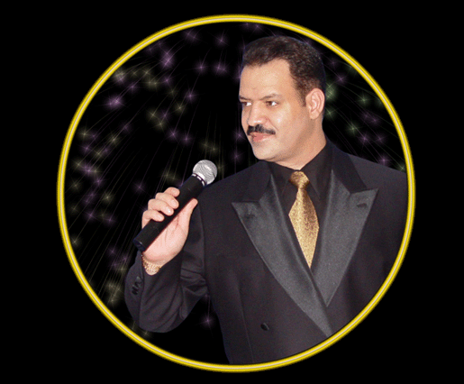
Notes:
http://www.youtube.com/watch?v=L_0e933eSpA
Ask if anyone has done Karaoke – tell them you’re going to play a game of “PowerPoint and Social Media Karoke”- that you’ve looked at everyone’s website (if they have one) and social media use. Let them know that you will be sharing screen captures with some notes and that you will invite them up with you and answer some questions about what they do. Remember, participants are not obligated to come up in front of the group and can decline.

Slide 41
Insert screen capture of NGO’s website or social media site Summarize the description
Use 2 - 5 examples, depending on what you discover during your work and how much time you have
Notes:
The slide decks will provide examples from the US, but you can also include examples from your countries. The Workshop Day 1 will use the “living case studies” method as part of the assessment process.
Here’s how it works.
Identify one example from each category or pick out 2 or 3 of the NGOs that are at the highest level
Take a screen capture of their website and social media channels
Include a brief description from the application of their communications objective and target audience
Invite them to the front of the room and do an interview:
What is your organization’s purpose?
Who is the audience?
How are you using social media – tell us a success story?
What are your challenges?
What advice would you give to others?

Slide 42
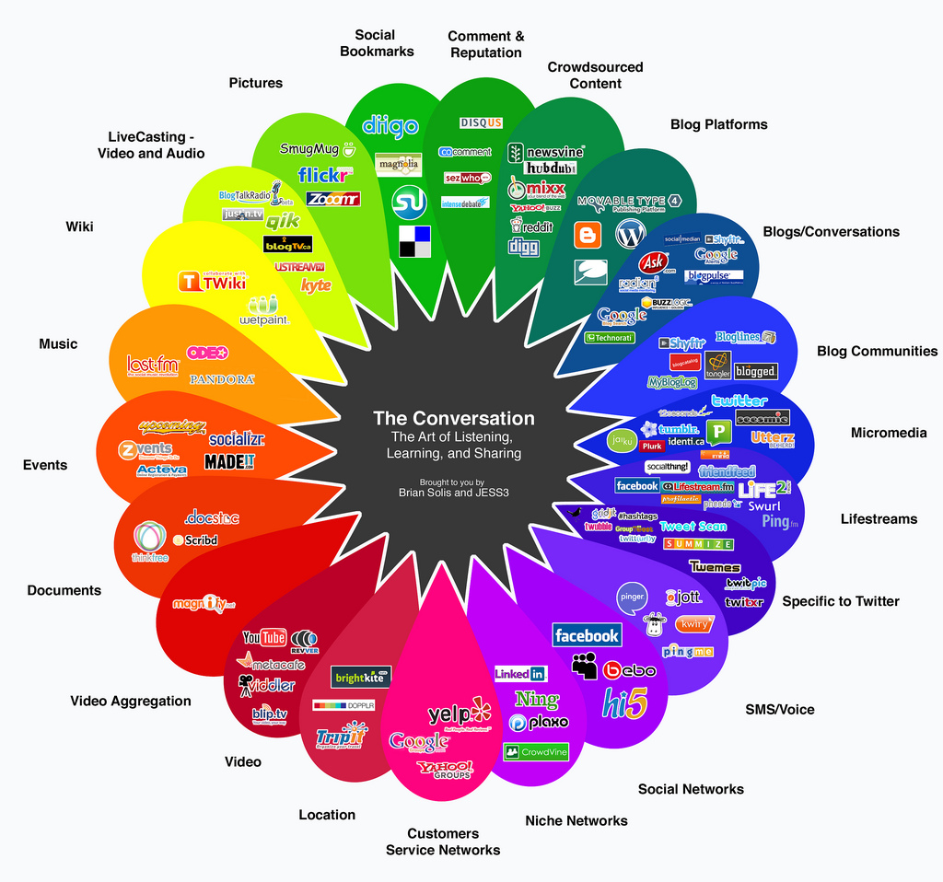
Introduction to Social Media Tools

Slide 43
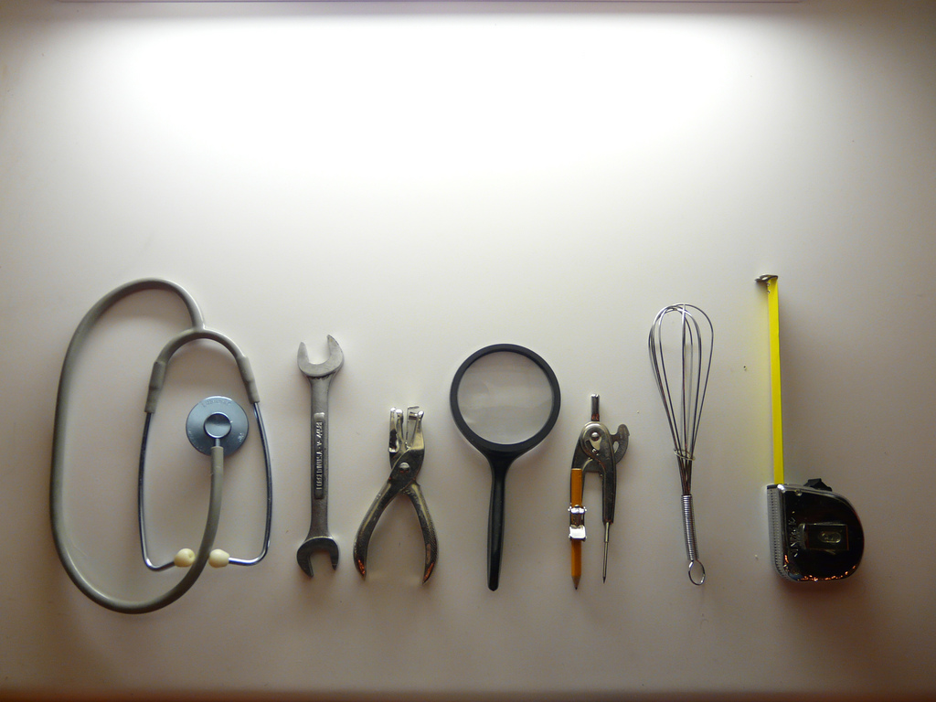
There are many social media tools that you can use, but for E-Mediat, we will be VERY selective!
Remember: Success isn’t about how many tools you use.

Slide 44
Introduction to Social Media Tactical Approaches
Listen
Share
Participate
Publish
Build Network
No Engagement
Broadcast/promote
Low Engagement
Content Intensive
High Engagement
Workshop 2
Workshop 2
Workshop 3
Workshop 2
Workshop 3
Workshop 4
Workshop 5
Original concept by Beth Kanter – remix by Aliza Sherman
Notes:
Let’s look at the model in terms of tools that you might use at each level. This is a high level overview of these tools. We will be spending a lot of time in the coming workshops on how to use the tools strategically – so what we’re sharing now is just an introduction and a few examples.
I know these next slides are bound to bring up lots of questions. As such, I’m going to ask you to jot down questions as we go and put them on 3 x 5 index cards or sticky notes.
(Alternatively, you use a poster sheet as a “Parking Lot” – and say you’ll take the questions into consideration to make sure they are addressed in the appropriate workshop)

Slide 45
Definition: Listening
Networked NGOS are skilled at listening to people and organizations in their networks. Rather than just talking to, or worse, at people on social networks, organizations first should listen to what people are talking about, what interests or concerns them, and how they view the organization. Listening is a terrific way for NGOs to orient themselves online once they have mapped their network. It also helps organizations who are nervous or concerned about opening themselves up online to ease their way in.
Notes:
http://www.flickr.com/photos/poritsky/2349613851/sizes/l/

Slide 46
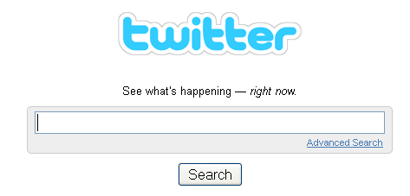
Tools for Listening
Most Important is to learn about keywords. These are words or phrases that are important to your NGO.
Notes:
The first step is knowing what key words you need to scan on your topic.
http://beth.typepad.com/beths_blog/2009/01/listening-literacy-skills-keywords-are-king-what-keywords-or-phrases-have-brought-you-some-insights.html
We’ll be spending more time on the how-tos in Workshop 2. For planning, you will need to think about your keywords.
Ask if anyone is already using these tools and how they are using them.

Slide 47
Definition: Share
Sharing is promoting your own messages and tools like Twitter make it easy to do. Your messages and information about your program is shared by you or others through social media channels. It is an easy way to get started, but Networked NGOs understand that to get results, they need more engagement with their audience.
Notes:
http://www.flickr.com/photos/poritsky/2349613851/sizes/l/
Ask if anyone is already using social media. If they are, ask them to share information about their programs.

Slide 48
Notes:
This is an example of a group in Lebanon sharing information about their program on Twitter-http://twitter.com/#!/nasawiya/status/55732329200615424
If you have internet access or if participants have their laptops and internet access, you can pull up the list of Tweets from people in the E-Mediat program (http://twitter.com/#!/list/kanter/emediat) and look for examples of people sharing information about their programs.

Slide 49
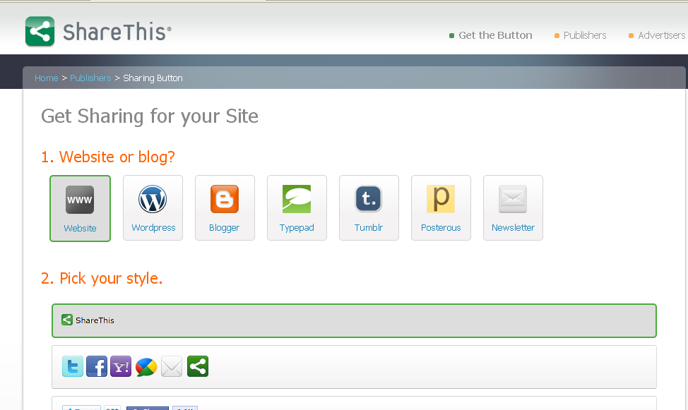
Notes:
The “Share This” button provides code that can be added to blogs or websites and makes it easy for your organization’s audience to share content with their friends.
When people share, they make digital stuff worth reading, worth reacting to, worth knowing. According to research, consumers trust recommendations from friends more than any other form of marketing, such as TV ads, emails or even editorial articles. It’s this trust that makes sharing the core of the social web.
We’ll talk more about how to do this in Workshop 2 when do blogs/websites.
http://sharethis.com/publishers/get-sharing-button

Slide 50
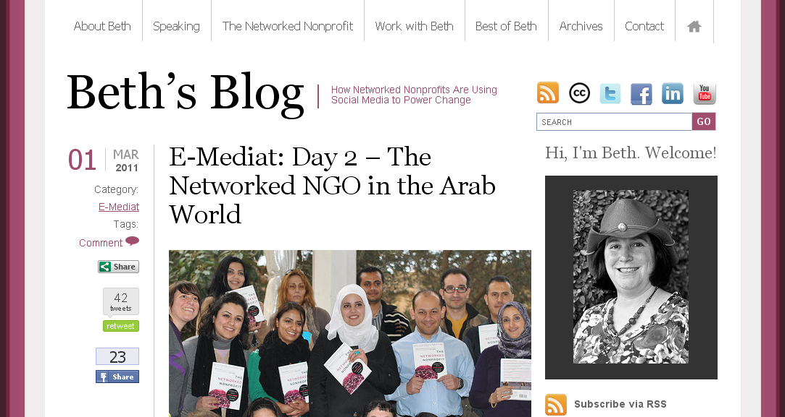
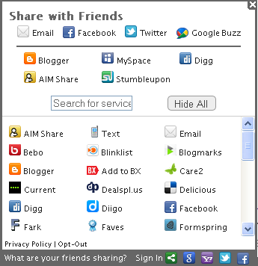
Different Options for Adding Sharing to Your Website
Notes:
Here is an example of the “Share This” button – it is the top one
When someone reads this post, they can click the “Share This” button and share with their friends on many different social networks. The nice thing is that you don’t need to know technical code, it is cut and paste into your blog.
These two next buttons show that 42 people have tweeted this link to their friends and 23 people have shared the link on their Facebook profiles. This gets your message out to more people through a network approach.

Slide 51
Definition: Participate
Participate is about engaging in conversations online with people who care about your NGO’s program and mission. It includes leaving comments on blogs, “liking” or “commenting” on Facebook, or asking questions on Twitter. Networked NGOs are experts in participating on conversations online about their issue or program areas. They are not left out of the conversation.
Notes:
http://www.flickr.com/photos/poritsky/2349613851/sizes/l/

Slide 52
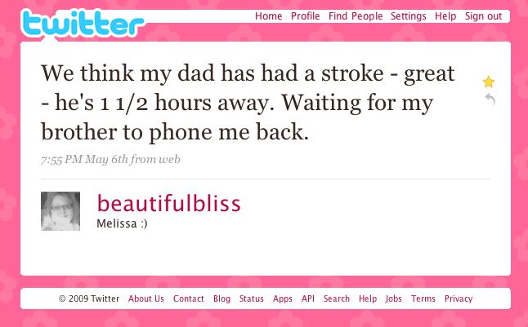
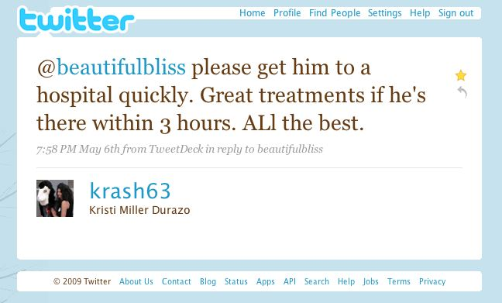
Notes:
Here is an example from a U.S. health organization (The American Heart Association)
@krash63 works for the American Heart Association and uses Twitter Search to scan for people using the word “stroke” in their tweets. When it’s appropriate she responds quickly with useful information -- which in this case could save a life.
Twitter can be a great way to find and connect with people who are interested in a particular topic, and to have conversations with them.

Slide 54
Definition: Publish
Social Media lets you share your story with your audiences in words, photos, or videos. The key to success is understanding storytelling concepts and creating small pieces of content known as “micro content.” Creating content for social media needs to be integrated with web, print, and across other social media channels. A social media content strategy needs an editorial calendar or plan to be efficient, but more importantly must be linked to your communications strategy.

Slide 55
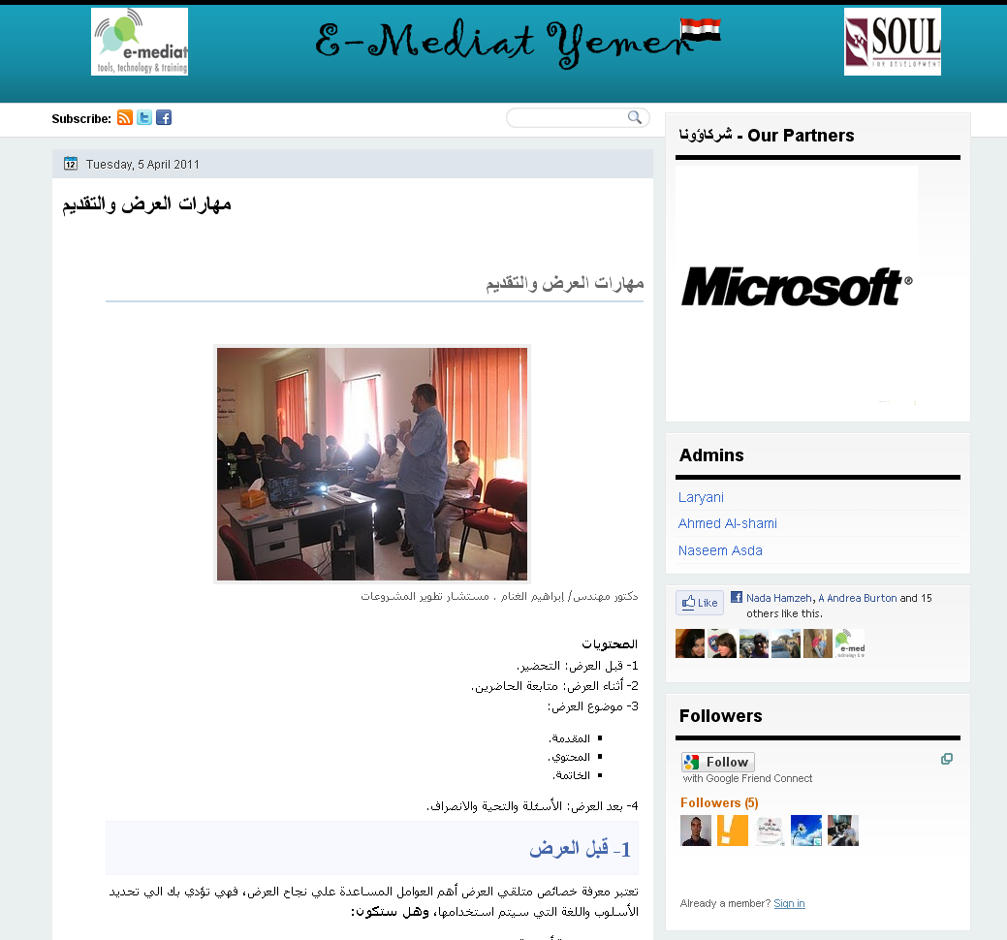
Notes:
For example for the E-Mediat program, each of the country teams is using a blog to let people know about the program.

Slide 56
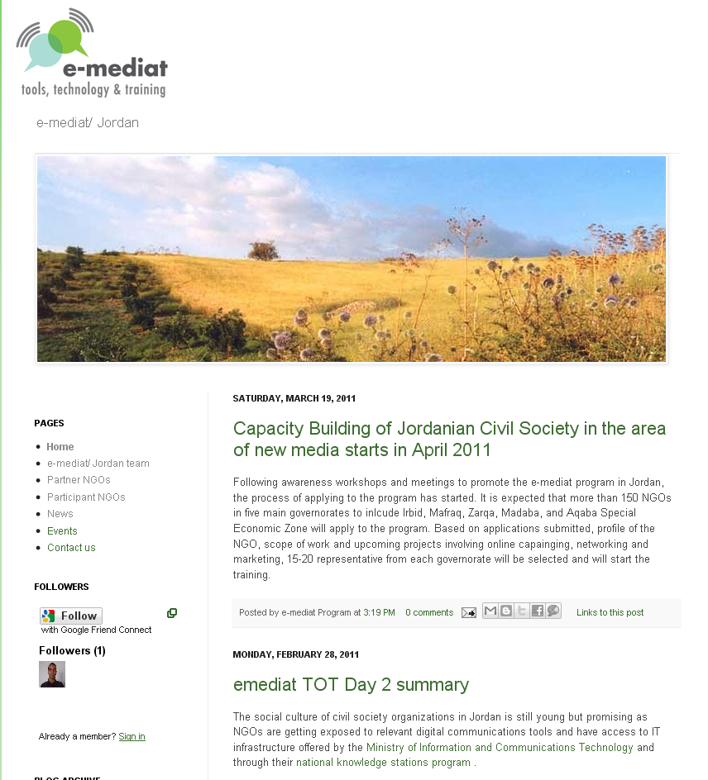
Notes:
We’re using blogs because the program did not have an existing website, and it is easy for us to keep it updated.

Slide 57
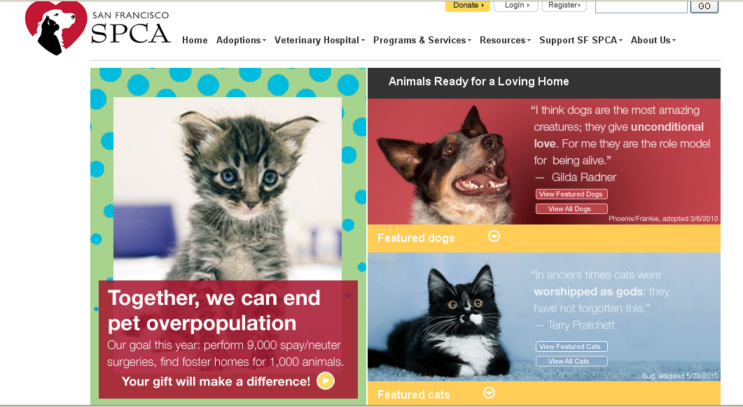
Notes:
Some NGOs already have a website as their home base, but they also use social media. They can link the content or storytelling by using the same material.
For example, The SFSPCA uses it’s site to share information about animals available for adoption (programs), fundraising, and other uses. They have lots of stories about cute cats or dogs available for adoption.

Slide 58
A quick scan of your social media ant trails …
Notes:
They have a blog called “Litter Did You Know” that is all about how to adopt cats from the shelter.
(Litter sounds like Little… get it?)

Slide 59
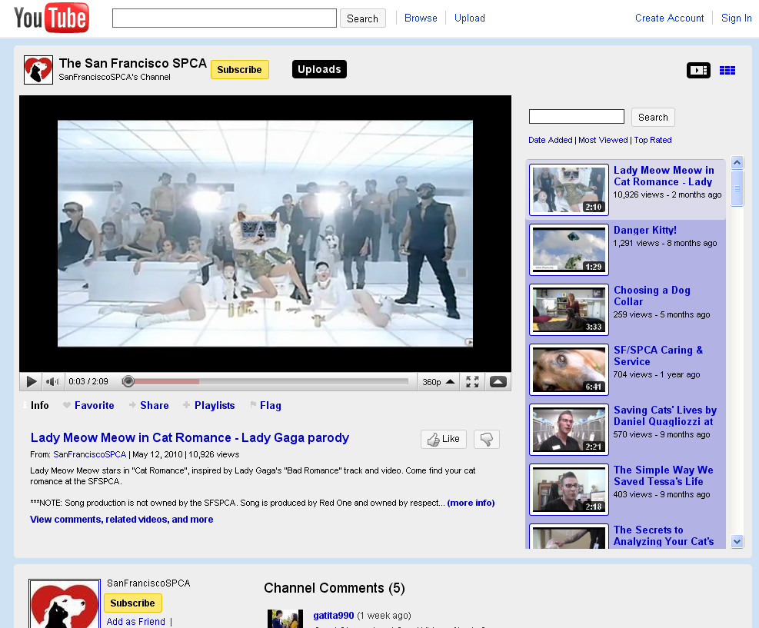
Notes:
They also use their YouTube channel. This particular video was created by volunteers of the organization who happen to like cats.
http://www.youtube.com/watch?v=9hfHphaT9mw

Slide 60
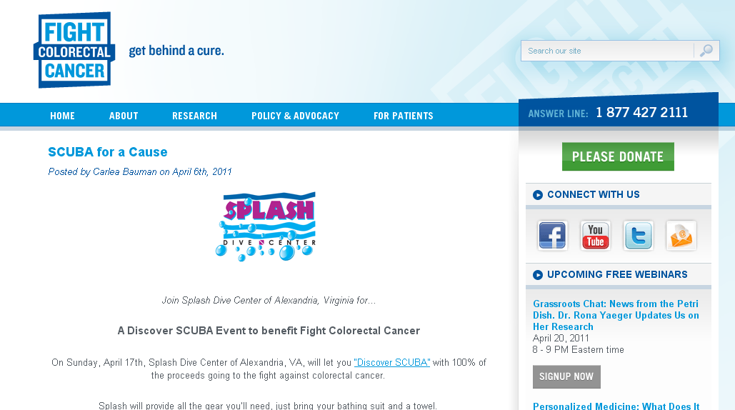
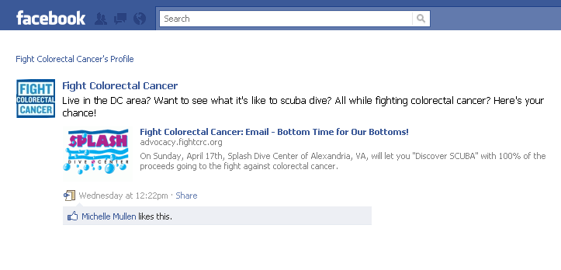
Notes:
Fight Colorectal Cancer advocates for finding a cure for this type of cancer, funds research, and provides information to people with the disease. Their social media use is at a “Run” level because they are using many channels and sharing content between the channels.
They use a blog to easily update the content on their site. They link to their social media channels from the site, but more importantly, the are able to link across channels.
http://fightcolorectalcancer.org/c3_news/2011/04/scuba_for_a_cause

Slide 61
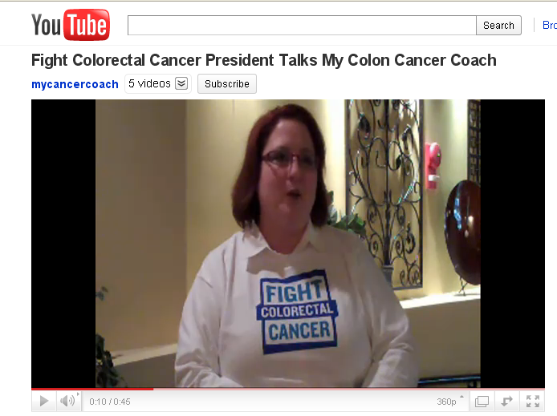
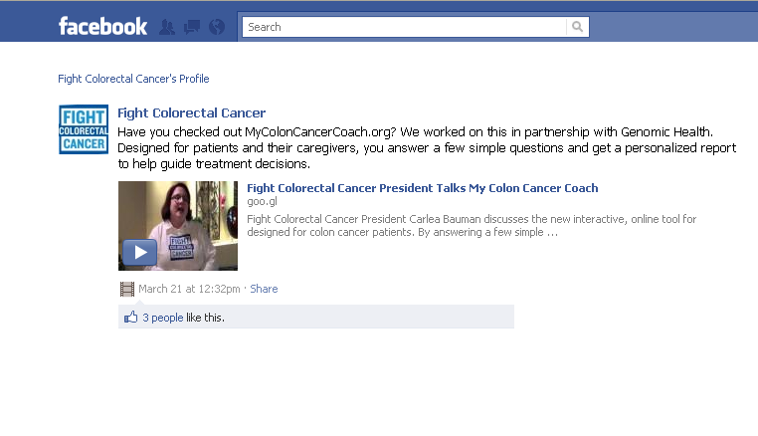
Notes:
They have a YouTube Channel and their videos have been created with a simple FLIP Camera (show the FLIP camera). We’ll be learning how to use these cameras in Workshop 4. What’s nice is that you have the videos automatically posted onto Facebook.
http://www.facebook.com/FightCRC#!/FightCRC/posts/111954275550513
http://www.youtube.com/watch?v=hqH-MsehoKs&feature=related

Slide 62
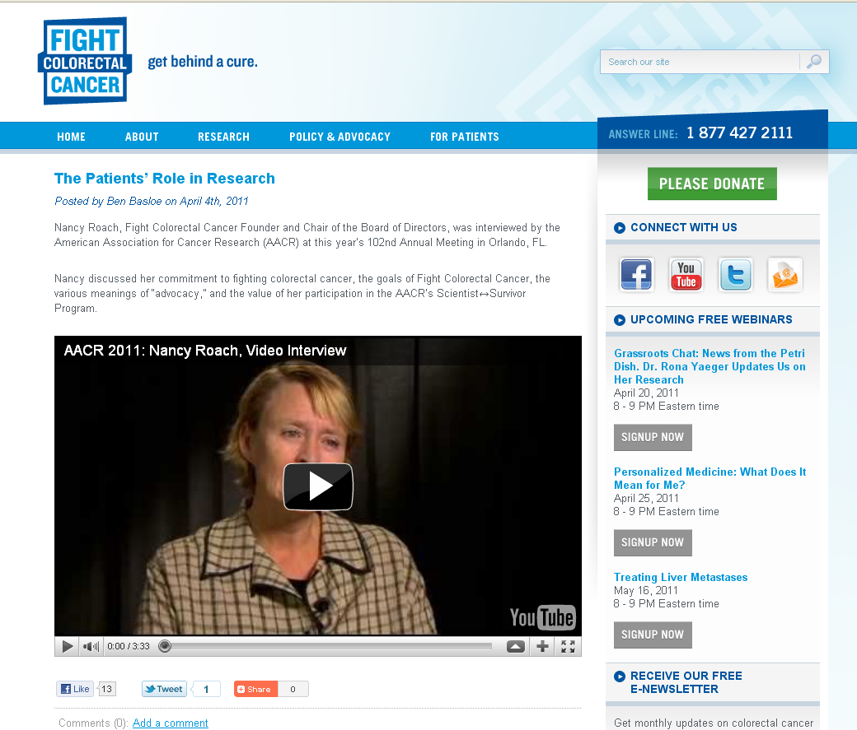
Notes:
The blog also makes it easier to share content from other organizations that have a similar mission. The YouTube Video is from another cancer organization. Once they have an editorial calendar and have lined up content that they want to post on different channels, it is easy for them to use Twitter to share their content with others.

Slide 63
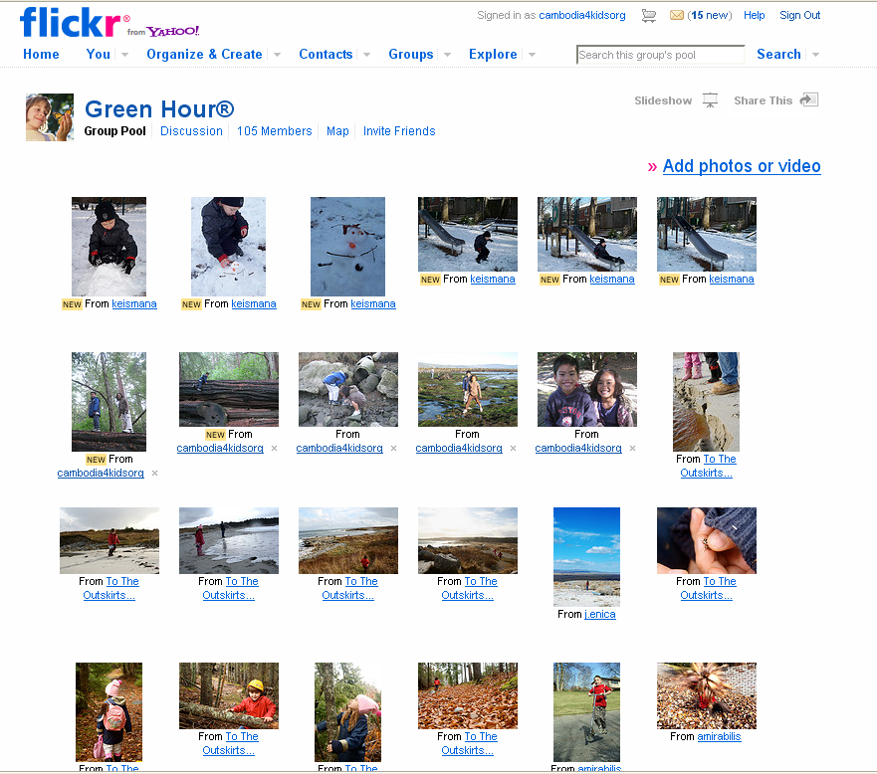
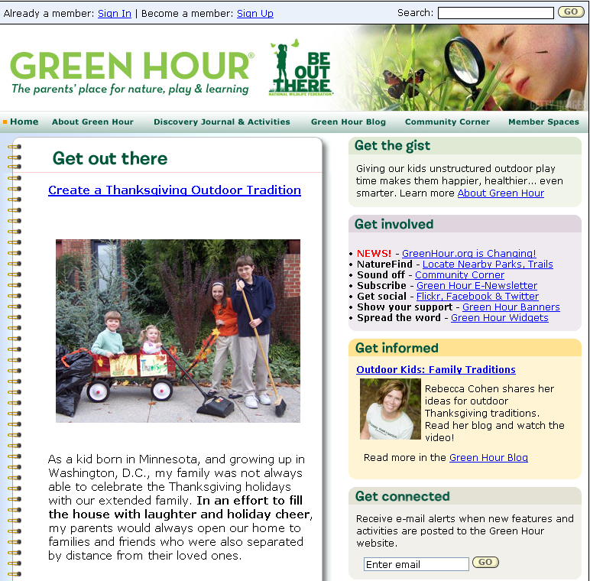
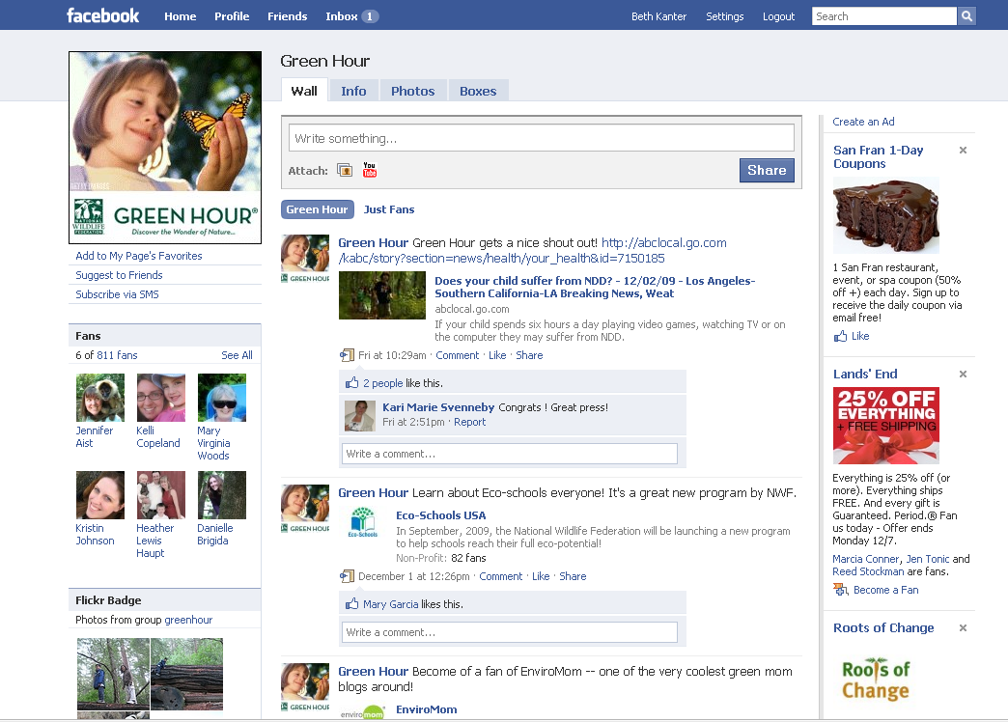
Share Across Channels
Notes:
The National Wildlife Federation has its website as their homebase, but they use social media for a program “Kids Outside” that encourages kids to play outside. They encourage their audience to share photos of kids playing outside on Facebook and Flickr – and then use that as content on their blog. This is a large organization with a full-time staff person working on it.

Slide 64
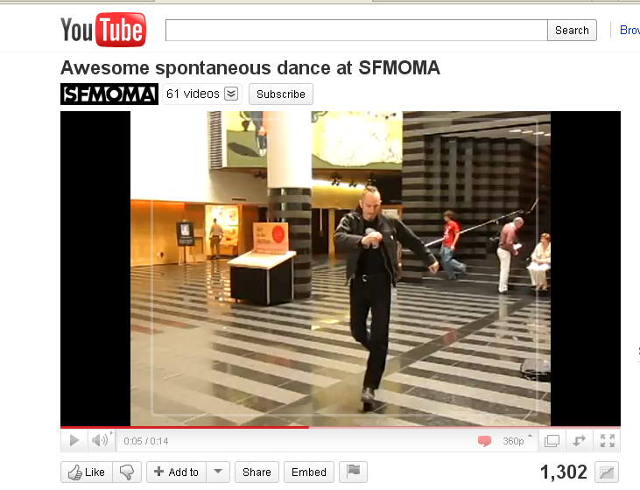
Microcontent Does Not Have to be New Content
Notes:
http://www.youtube.com/watch?v=frMZwxhyKaA
This video from the San Francisco Museum of Modern Art was used to promote an event in March, 2010 on YouTube.

Slide 65
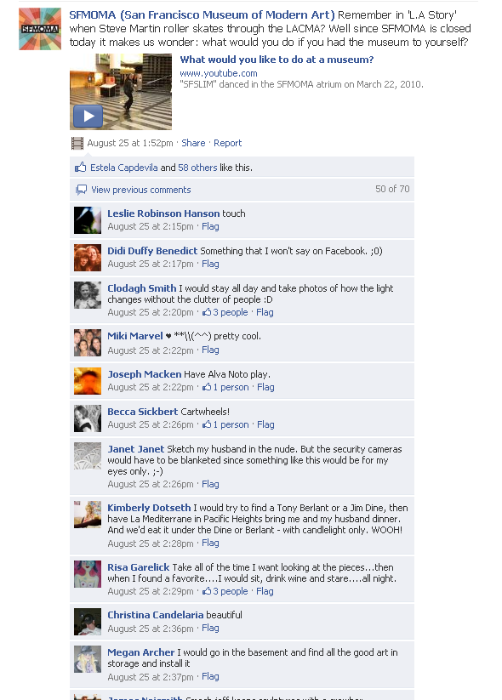
Play Video
Notes:
http://www.youtube.com/watch?v=frMZwxhyKaA
They creatively recycled the video as part of their Facebook Page content

Slide 66
Definition: Network Building
Networked NGOs use social networks to build relationships with stakeholders and leverage a network effect. By investing in relationships, they get people to share their mission and messages with their friends.
Notes:
http://www.flickr.com/photos/poritsky/2349613851/sizes/l/

Slide 67
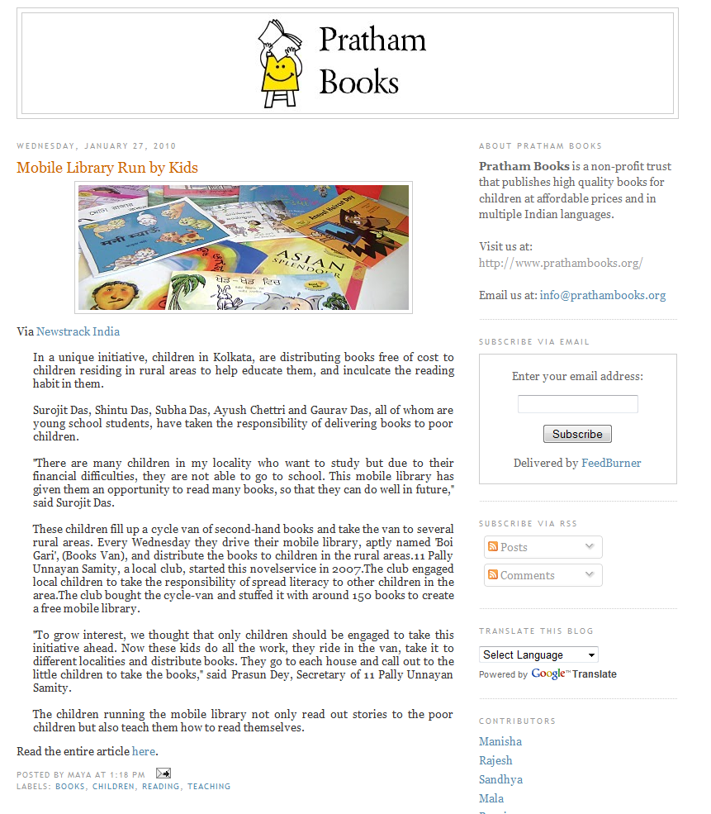
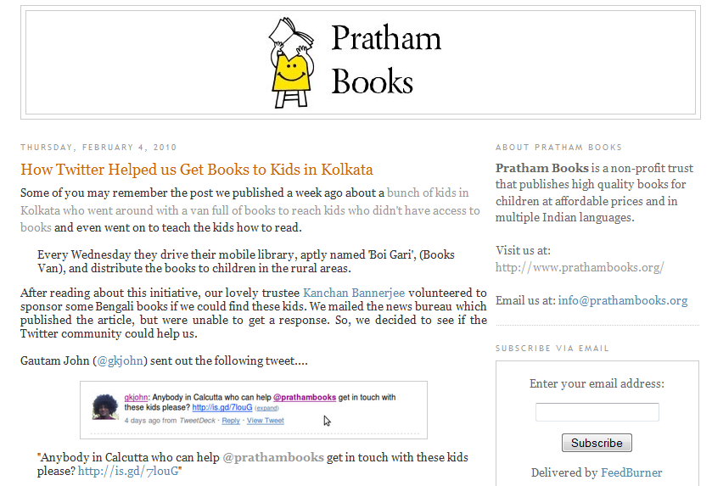
Notes:
Pratham Books is a small civil society NGO in India. Its mission is to get high quality children’s books to rural villages. They publish their books and materials under a creative commons license. Everyone in the organization uses social media to spread their mission and serve as a bridge between the bottom of the pyramid and others. Recently, they wrote a blog post about a newspaper article on how some teenagers collected books and took them to a rural village. Someone left a comment and offered to purchase more books for the kids to take to the village. But, the newspaper did not know how to get in touch with them. So everyone at Pratham Books used Twitter and within a few hours they had the cell phone number.

Slide 68
Notes:
http://www.tudiabetes.org/profiles/blogs/big-blue-test-2010-the-numbers
http://www.johnhaydon.com/2010/11/social-medi-case-study-big-blue-test/
The Diabetes Hands Foundation did an event on Diabetes Awareness Day. A donor was willing to donate $1 per view on the video up to 75,000 views. The got 123,000 views in a 24 hour period. They also got almost 1200 people to test their blood sugar on the day and tweet the scores.
The money raised was for two organizations:
Half will go to Insulin For Life.
The other half, to International Diabetes Federation, earmarked for their Life for a Child program.
Both are humanitarian programs that assist children with diabetes in need in third world countries (at times, Insulin For Life works with Life For a Child to source particular needs). Based on their past record track and their past financial reports, we estimated that roughly each of the first 100,000 views (the ones that counted towards the donation) translated into approximately one week's worth of insulin given to a child in need.

Slide 70
Notes:
They partnered with many other diabetes organizations around the world who engaged their networks in this campaign.

Slide 71
Network Building Primer
Basic Definitions
Network Terms
Methods for Network Mapping
Techniques to Strengthen Networks: Network Weaving
Notes:
Now that we have created a social network based on interests between in-country teams, we can build on this and create a network of our professional networks. This session will introduce the basic vocabulary of networks and how to visualize a network using low-tech tools and use it to achieve project goals. The networking exercise is also of value to nonprofits who are becoming networked nonprofits (Day 2) or plan and implement a networked campaign (Day 3).

Slide 72
Networks: Definitions
What: Social networks are collections of people and organizations who are connected to each other in different ways through common interests or affiliations. A network map visualizes these connections.
Why: If we understand the basic building blocks of social networks, and visually map them, we can leverage them for our work and NGOs can leverage them for their campaigns. We bring in new people and resources and save time.

Slide 73
Basic Building Blocks of Networks
Cluster
Periphery
Core
Hubs or Influencers
Ties
Node
Source: Working Wikily
Notes:
Now that we have created a social network based on interests between in-country teams, we can build on this and create a network of our professional networks. This session will introduce the basic vocabulary of networks and how to visualize a network using low-tech tools and use it to achieve project goals. The networking exercise is also of value to nonprofits who are becoming networked nonprofits (Day 2) or plan and implement a networked campaign (Day 3).

Slide 74
How NGOs Visualize Their Networks:
Activism Strategy
National Wildlife Federation
Brought together team that is working on advocacy strategy to support a law that encourages children to play outside.
Team mapped their 5 “go to people” about this issue.
Look at connections and strategic value of relationships and gaps
Notes:
Mapping Networks
Social network mapping tools help you visual your network. Use to draw your network because it helps you see the connections and identify strategy. There is a range from simple to complex, free to expensive, and low-tech to high-tech.
Example: Draw Network: http://www.flickr.com/photos/cambodia4kidsorg/4002466674/
Example: National Wildlife Federation: Low Tech and High Tech - Twitter Network Map How Networked Nonprofits Visualize Their Networks http://www.bethkanter.org/network-mapping/
http://twitpic.com/3p4b4y
http://www.flickr.com/search/?s=rec&w=58428285%40N00&q=twitter+map&m=text

Slide 75
How NGOs Visualize Their Networks:
Ecosystem

Slide 76
Strengthening the NGO Network:
Social Capital & Network Weaving
Social Capital: The benefit from building relationships with people in your network through trust and reciprocity.
Network Weaving: A set of skills that help build your network by introducing people together, facilitating conversations, being a bridge, and sharing resources, information, and contacts.
Social media makes it easy to strengthen networks because it is easy to find or connect with people online.
Notes:
Social capital makes relationships meaningful and resilient. Trust and reciprocity. Social media can help build social capital because:
Social networks make it easy to find people online
Serendipity is enhanced by social networking sites where people connect based on their interests or friends
Reciprocity is easy

Slide 77
Example: Network Weaving Techniques
Notes:
Here is an example using online tools for network weaving. We hope to do a lot of network weaving with our online community site.
(If you’re going to use Day 3 to get people set up with Facebook or Twitter, this might be a good way for you to communicate between sessions.)

Slide 78
Map Your Network
Goal: This exercise will provide an opportunity for participants to map their network to visualize, develop, and weave relationships with others to help support their program or communications goals.
Description: We will debrief standing up as group and looking at each team’s map. One person from each team should be prepared to explain the map to the whole group and share insights.
Notes:
Mapping Your Network Exercise
Steps:
Put the NGOs into small groups with similar programs or areas
Use sticky notes and paper tapped to the wall or markers and paper – they can map their network in the local area, their topic area, or each do their own maps. Whatever works
Each person on the team is part of the “core” and will be working together in a “networked way” to reach organizations or people that are connected to their program area
Have each person add the “go to” people, organizations, and others in the topic area
Have each person identify influencers that they may or not know to help them reach their objective
Identify and discuss specific ties between the core and the nodes – identify overlaps
Using the reflection questions below, look for different patterns or clusters – do you know the same or different people?
Who do you need to build relationships with? Who can you introduce in your network?
Some reflection questions to generate insights. You’ll need to revise this so they specifically support your objective.
What people, resources, and organizations are in your ecosystem?
What are the different roles?
Are you connected or not connected?
If connected, how are you connected?
Think about the touch points in your network? How do you appreciate, thank, and celebrate important people in your network?
Think about reciprocity: What have you given people in your network before they have asked?
Debrief: Gather everyone together as a full group standing. Walk as a group to the first map, and ask:
How does this idea translate?
How can you use your professional network to support your work on this project?

Slide 79
Map Your Network: Steps
Work together with the members of your group. Use sticky notes or markers and poster paper. Pick a civil society area to map.
Brainstorm a list of “go to” people, organizations, and others.
Decide on different colors to distinguish between different groups and write the names on the sticky notes.
Put them on the poster paper on the wall and as a group, identify influencers and discuss specific ties and connections. Draw the connections.
Reflection questions.

Slide 80
Reflection & Closing
Share Pairs
Circle Closing
Notes:
Do a series of “Share Pairs” where people ask and answer these questions:
What did you learn today?
What is still isn’t clear?
What do you need to move forward?
What is the most important thing you want to learn tomorrow?
Then gather in a circle, and have everyone share one word about they are feeling and why.

Slide 81
Workshop 1: Social Media and Networked NGOs for Civil Society Overview and Strategic Planning
Day 2: Creating a Social Media Strategy Plan
This project is managed by Institute for International Institute for Education (IIE) Sponsored by the U.S. Department of State Middle East Partnership Initiative (MEPI)

Slide 82
Day Two
OUTCOMES
AGENDA
Leave the room with a good understanding of how to complete the “Social Media Strategy Plan” template.
Principles of Effective Social Media Strategy
Participants Work on Social Media Plan
Social Media Game
Implementation Steps
FRAMING
Small steps work best
Tools come and go, strategy sustains
Wide range of skills and knowledge in the room

Slide 83
Day Two: Learning Objectives
To understand and think through the basic steps of creating a social media strategy plan
To connect social media tools to strategy
(Blogs, YouTube, Facebook, Twitter, and Mobile)
To understand what is needed for culture change, staffing, and measurement to support the implementation of the plan.

Slide 84
Write on a sticky note and place on the wall when done:
What was your key reflection yesterday?
What are you most curious about for today?
Overnight Reflections
Notes:
Photo by: http://www.flickr.com/photos/ninjawil/2205949982/

Slide 85
Social Media Strategy Plan Template
Notes:
Have a hard copy available to participants.
This is the strategy template we’ll be using to help you create your social media plan.
Today, during the workshop, we will explain a lot of the sections in detail and you will be given time to work on your plan today and tomorrow.
Plus, you will have time over the next six months to revise and enhance your plan.

Slide 88
Social Media Strategy
Integrate your social media channels with your program and communications objectives:
Who do you want to reach?
What do you want to accomplish?
Where can social improve or supplement programs,
services, or communications?
What is your available budget/timeline?
What opportunities to pilot?

Slide 89
Notes:
MomsRising is an organization of activists who are mothers and want to encourage better working conditions for mothers and benefits for their children. In the U.S., they used social media to implement a campaign to demonstrate that there was a groundswell of support for healthcare reform. The campaign had a social media component – where they had people put a pin on their Facebook Page.

Slide 90
S | Specific | Focus on encouraging the wearing of pacifier pins, both virtual and real, to signal support for healthy kids and families
M | Measurable | How many pins are distributed to MomsRising supporters and to policymakers?
A | Attainable | Pins both virtual and real are relatively inexpensive and the ask (wear a pin) is easy.
R | Relevant | The healthcare bill increasingly dominated coverage and was high priority for lawmakers. Pins signaled symbolic support from mothers.
T | Time Bound | The healthcare bill was almost certain to be passed or die in the first half of 2010
To get 15,000 Facebook advocates to put a virtual pin on their profile to signal support for healthy kids and families by January 2010; To document virtual activity and place pins on x number of legislators to signal support for healthy kids and families by January 2010.

Slide 91
What is the SMART Objective?
Notes:
Qwitter is a support group on Twitter that helps people stop smoking. If you are about to light up a cigarette, you can tweet on your phone and the support group will encourage you to not.
You can replace this example with a localized example.

Slide 92
S | Specific
M | Measurable
A | Attainable
R | Relevant
T | Time Bound
Notes:
Exercise: Let’s create a SMART objective as a group for Qwitter.
Break them into five small groups on each of these areas – have a group work on “Specific,” another one work on “Measurable” etc. Then have each group help you fill in the section for that word.
Alternatively, you may do the entire exercise as a full group.

Slide 93
S | Specific | Focus on getting target audience to know that Qwitter can help stop smoking and encourage them to sign up
M | Measurable | X number of smokers sign up for the service
A | Attainable | X number of smokers stop smoking for 6 months because they use the service
R | Relevant | Trying to stop smoking is difficult to do by yourself and Twitter let’s you get support from other people on your mobile phone. Outreach should focus on audience that is using Twitter.
T | Time Bound | To get 100 people to stop smoking for six months because they used the service

Slide 94
Your Turn:
Work in Pairs.
What’s your SMART social
media objective?
Notes:
Have them work in pairs for 10-15 minutes on identifying a SMART objective. Use the handout “SMART Social Media Objective Worksheet”

Slide 95
Social Media Strategy
Identify the audience segments you hope to reach for your social media objective:
Who do you want to reach?
What do you know about them?
What messages or information will influence them?
What are they saying about your issue or organization
on social media?
What social media tools do they use?

Slide 96
Who?
Audience
Journalists
Government
Donors
Students
NGOS
Youth

Slide 97
Who is the Audience?
Notes:
Who is the audience?
People who want to stop smoking and use Twitter on their mobile phones and may already be signed up for a stop smoking program at the hospital.
Find a local example.

Slide 98
Who is the Audience?

Slide 99
Who is the Audience?
Notes:
http://www.theglobeandmail.com/news/world/doug-saunders/arab-social-capital-is-there-its-young-and-connected/article1930770/
Ask Rami to fill in more
This is an organization with an Arabic name that translates into “Speak Up.” The organization used social media as part of an outreach strategy to 250,000 to encourage them to register to vote. They had impressive results.
http://www.facebook.com/album.php?aid=41760&id=107275642660006

Slide 100
You can add more examples – some sites discussed at the TOT are included in the notes
Notes:
http://emediat.wikispaces.com/Day+5+Session+1+Notes
http://emediat.wikispaces.com/Other+sites

Slide 101
What Social Media Channels is Your
Audience Paying Attention To?
Audience
Attention
Organization’s Access
What tools to select: Flyer, Twitter?

Slide 102
Look at Secondary Research, Survey Your Audience, Listening on Social Channels
Notes:
http://www.dsg.ae/NEWSANDEVENTS/UpcomingEvents/ASMRHome.aspx

Slide 103
What Social Media Channels is Your
Audience Paying Attention To?

Slide 104
Your Turn:
Work in Pairs.
Who is the Audience You
Want To Reach?
Notes:
Have them work in pairs for 10-15 minutes on identifying a SMART objective. Use the handout “SMART Social Media Objective Worksheet”

Slide 105
Social Media Strategy
Identify where social media integration can improve or supplement programs, services, or communications:
Where can social improve or supplement programs, services, or communications?
What is your available budget/timeline?
What opportunities to pilot?

Slide 106
Charting: What are your planned events, program, content, or opportunities for the year, month or quarter?
Notes:
http://www.flickr.com/photos/yandle/844341197/
Lay out all planned communication and marketing events and opportunities for the year and determine which ones you want to socialize.

Slide 107
Notes:
Nasawiya has an inventory their upcoming events, programs, and web content – and their social strategy is integrated.
Here’s an example for International Women’s Day.

Slide 108
Your Turn:
Work in Pairs.
Where Does it Make Sense to Integrate
Social Media in Your Programs?
Notes:
Have them work in pairs for 10-15 minutes on identifying a SMART objective. Use the handout “SMART Social Media Objective Worksheet”

Slide 109
Social Media Strategy
Use actionable listening to understand your target audience
– includes listening on social media channels and other research.

Slide 110
Actionable Listening

Slide 111
Do It Yourself Listening Dashboard
Ego Searches | Basics
Persistent Searches | Key words/phrases
Influencers | Blog Feeds
Other | Where else does your audience hang out?
Notes:
http://www.flickr.com/photos/paulgi/280789933/

Slide 112
What’s in Wendy’s Tool Box?
We will learn how to use these tools during Workshop 2.

Slide 113
Your Turn:
Work in Pairs.
What Key Words Do You Need To
Search?
Where Can You Research Your Audience
on Social Channels?
Notes:
Have them work in pairs for 10-15 minutes on identifying a SMART objective. Use the handout “SMART Social Media Objective Worksheet”

Slide 114
Social Media Strategy
Engagement: Translate your messaging and framing into conversation starters based on listening

Slide 115
Engagement: Conversation Starters
Audience Twitter |  | O B J E C T I V E | Audience Facebook
What are they saying that is relevant to/engages? LISTENING |  |  | What are they saying that is relevant to/engages? LISTENING
How can you rework your message as a response or conversation starter? |  |  | How can you rework your message as response or conversation starter?
Follow up points | Content |  | Follow up points | Content

Slide 116
It’s All About Asking Questions!

Slide 117
Your Turn:
Work in Pairs.
Brainstorm conversation starters
related to the messaging that you
will respond to.
Notes:
Have them work in pairs for 10-15 minutes on identifying a SMART objective. Use the handout “SMART Social Media Objective Worksheet”

Slide 118
Lunch
Flickr photo by Littlelakes
Notes:
http://www.flickr.com/photos/littlelakes/54251489/

Slide 119
Social Media Card Game
3 - 5 Volunteers
Break into 3-5 small groups
Each volunteer shares their objective, audience, integration, and engagement ideas
Pick Tools – Use the cards to brainstorm ideas
Report out to full group
Notes:
119

Slide 120
Digital Media Tools
Blog
Mobile Social Network
Internet Social Network
Video
Photos
Email List
Mobile Application
Example
Blogger
Twitter
Facebook
YouTube
Flickr
Google Groups
SMS
Notes:
http://emediat.wikispaces.com/file/view/Social-Media-Cards-Basic1-no-text.jpg
http://emediat.wikispaces.com/file/view/Social-Media-Cards-Basic2-no-text.jpg
Add the Arabic Words for the tools, add points
You can give prizes for the best strategy – have someone serve as the judge
You’ll need to explain https or not use the card

Slide 121
Who Will Do The Work?
Free
Intern
Volunteer
Integrated
Tasks in Job
Staff
Full-Time
Part-Time
Fans
Notes:
http://www.bethkanter.org/category/capacity/

Slide 122
How Much Time Will You Spend Doing The Work?
Social Culture
Listen
Promote
Participate
Publish
Build Community
No Engagement
Broadcast/Share
Low Engagement
Content Intensive
High Engagement
15 min/day
+
20 min/day
+
30 min/day
+
3-5 hrs/wk
+
5-10 hrs/wk
Original concept by Beth Kanter, revised by Aliza Sherman
Notes:
How much time will participants spend doing the work once they learn the skills?
http://www.bethkanter.org/category/capacity/

Slide 123
What Are The Job Tasks?
Account Creation/Customization
Social Media Research
Template Creation
Blog Monitoring
Write Blog Posts
Create Video Take Photos
Post Facebook Content
Answer comments on Facebook
Collect measurement data
Notes:
http://disruptology.com/10-social-media-tasks-for-summer-interns/

Slide 124
Doing The Work: Schedule Daily Work
9:00
Read Blogs
9:30
Post on Facebook
9:45
Twitter Office Minutes
10:00
Write Blog Post
Notes:
124
http://www.bethkanter.org/time-manage-tip/

Slide 125
Integrate Into Job Description

Slide 126
Definition: Social Culture
Many people in NGOs use social media to engage people inside and outside the organization to improve programs, services, or reach communications goals.
Notes:
http://www.bethkanter.org/trust-control/

Slide 127
Don’t Run Away
Example: Fujairah Bullfighting
Loss of control over their branding and marketing messages
Dealing with negative comments
Addressing personality versus organizational voice
Make mistakes
Perception of wasted of time and resources
Safety and security concerns
Notes:
http://www.bethkanter.org/wallow-in-fear/
Fujairah bullfighting is a bloodless event where weight classed farmer bulls come together in a sumo-wrestling style clash every Friday by the Fujeirah corniche.
http://www.flickr.com/photos/sashdc/5277171909/

Slide 128
Ways to Begin Change Inside
Talk about the issues
Write down the rules
Notes:
http://www.bethkanter.org/trust-control/
http://www.bethkanter.org/wallow-in-fear/

Slide 129
Talk About The Issues

Slide 130
Write Down The Rules
Encouragement and support
Why policy is needed
Cases when it will be used, distributed
Oversight, notifications, and legal implications
Guidelines
Identity and transparency
Responsibility
Confidentiality
Judgment and common
sense
Best practices
Tone
Expertise
Respect
Quality
Additional resources
Training
Press referrals
Escalation
Policy examples available at
wiki.altimetergroup.com
Source: Charlene Li, Altimeter Group
Notes:
http://www.bethkanter.org/trust-control/

Slide 131
Measurement & Reflection
Notes:
http://www.bethkanter.org/get-your-social-media-strategy-in-shape-with-spreadsheet-aerobics/

Slide 132
Measurement & Reflection
Notes:
Joyful Funerals: This is a term I first heard from MomsRising about how they give themselves permission to fail and stop doing something that doesn’t work with social media. And that through this comes learning and insight.
http://www.youtube.com/watch?v=-Vo4M4u5Boc&feature=player_embedded

Slide 133
Time To Work On Our Strategy Plans!
Spreadsheet Aerobics

Slide 134
Reflection & Closing
Share Pairs
Circle Closing
Notes:
Do a series of “Share Pairs” where people ask and answer these questions:
What did you learn today?
What is still isn’t clear?
What do you need to move forward?
What is the most important thing you want to learn tomorrow?
Then gather in a circle, and have everyone share one word about they are feeling and why.

Slide 135
Workshop 1: Social Media and Networked NGOs for Civil Society Overview and Strategic Planning
Day 3: Coaching & Online Community Site
This project is managed by Institute for International Institute for Education (IIE) Sponsored by the U.S. Department of State Middle East Partnership Initiative (MEPI)

Slide 136
Rules For Using This Content
Creative Commons Attribution License
You are free to use this work as long you attribute the author Beth Kanter and include link: http://www.bethkanter.org

