Slide 1

New Media for the Networked NGO
Principles of Successful Networked NGOs
Presenter: Beth Kanter
E-Mediat is funded by the Middle East Partnership Initiative of the United States Department of State with support from Microsoft Corporation and craigslist Charitable Fund and administrated by the Institute of International Education
Notes:
State that E-Mediat is funded by the Middle East Partnership Initiative of the United States Department of State with support from Microsoft Corporation and craigslist Charitable Fund and administrated by the Institute of International Education
Principles of Successful Networked NGOs: 11:30 a.m. – 12-30 p.m.

Slide 2
The Principles
Aligns social media with their communications strategy and objectives
Scales social media by empowering everyone in the organization and integrating social into work flow
Monitors, listens, and researches the people in their network
Gets feedback and start conversations about their work
Work with brand ambassadors to spread their mission
Learn from experience and data

Slide 3
Principle #1
Aligns social media with their communications strategy and objectives

Slide 4

SMART Social Media Objectives
What is your result?
Who do you want to reach?
What do you want them to do?
How will you measure success?
Results
Awareness
Engagement
Action
Education
S | Specific
M | Measurable
A | Attainable
R | Relevant
T | Timely
1. How many?
2. By when?

Slide 5
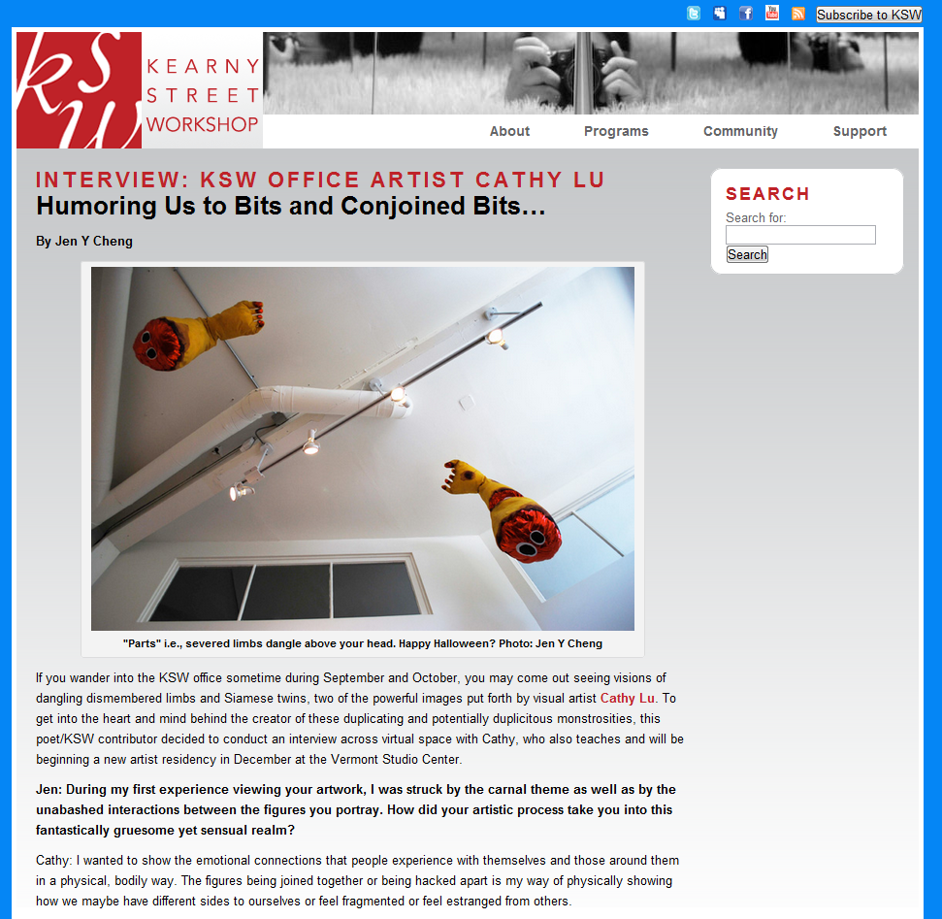
KSW's mission is to produce, present, and promote art that empowers Asian American artists and communities.
Notes:
It takes a unique person to recognize the correlation between adding personality to Facebook posts and an increase in exhibit attendance, but that is exactly what Lisa Leong, Program Manager at the Kearny Street Workshop (KSW), discovered as she poured over her monthly social media metrics spreadsheet. She regularly analyzed all the comments on KSW’s Facebook page and categorized them by topic. She compared those results to her Facebook Insights metrics to figure out what content resonated with their audience. “Who knew we could inspire all those online conversations about our artists, just by adding a bit of our own personality to our posts?”
KSW’s mission is to produce, present, and promote art that empowers Asian American artists and communities. Founded in 1972 in San Francisco's Chinatown/Manilatown, its artistic programs both honor the community’s cultural heritage and nurture emerging artists and contemporary practices. The organization offers educational workshops, performances, and exhibitions that showcase stories of diverse individuals and communities in the Bay Area. It uses its website, email, print, local, and ethnic media channels to promote its programs. It had recently started to experiment with social media.
Like any good measurement maven, Leong started out with clear objectives. “Our goal was to increase awareness, engagement, and participation in our programs both for audiences and artists. But we are a small nonprofit, with a two-person staff,” Lisa explained. “I am the social media manager, but it isn’t 100% of my job. We started with identifying our objectives and metrics that would help us improve our content and engagement strategy.

Slide 6
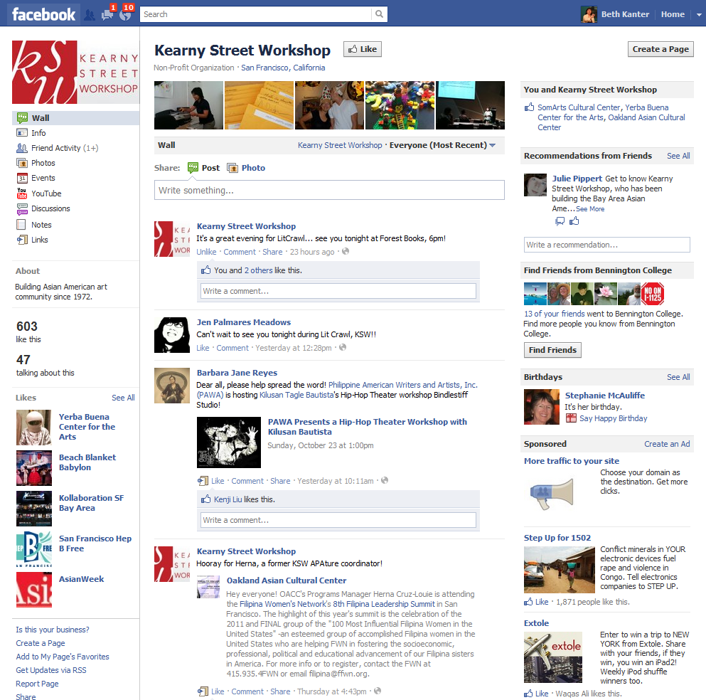
Notes:
Focused on one channel (Facebook) to use best practices to:
We tracked results by collecting several metrics from Facebook Insights, tracking participation in our events, and by adding some questions to our event surveys.”
Their goals and metrics were:
Increase exposure as measured by the number of likes on Facebook.
TOOL: Facebook Insights
RESULT: We increased our fan base by 72%
Increase engagement by doubling comments/likes per post.
TOOL: Facebook Insights
RESULT: Our post feedback went up 269%
Increase participation of new people in classes and events.
TOOL: Event Survey
RESULT: 10% new students /attenders say they heard about us through Facebook
“We had to think carefully about the workflow,” Lisa adds. “I spend an hour a month planning our editorial calendar with my executive director. It’s a simple spreadsheet that lists the different types of content, topics, and, of course, our success metrics. We look at that data to help us make more effective decisions the next month. In addition, I spend two hours per week on social media. I gather my data weekly so it isn’t overwhelming.”

Slide 7
Kearny Street Workshop SMART Objectives
Focused on one channel (Facebook) to use best practices to:
Increase brand awareness
RESULT: We went from 343 to 593 fans
Increase engagement
  RESULT: Our post feedback went up 269%
Increase participation of new people in classes and events
RESULT: 10% new students /attenders say they heard about us through Facebook
Audience: Artists and community
Strategy:
Show the human face of artists and remove the mystique
Get audience to share their favorites
Connect with other organizations

Slide 8
Figure Out What Resonates with Your Audience
Photos
What Worked:
  Showing our faces
  Looking behind-the-scenes
What Didn’t Work:
  Posting on evenings/weekends
  Links to event albums
AH-HA! Our FB page needed a personality makeover; we needed to be ourselves
Questions
What Worked:
  Fun, easy to answer questions that tapped into our fans’ expertise
What Didn’t Work:
  Anything too personal and open-ended questions.
AH-HA! We needed to engage our audience in a two-way conversation

Slide 9
Figure Out What Resonates With Your Audience
Partnerships
What Worked:
  Mutually supporting another page
  Using that page as a source of content
What Didn’t Work:
  Last-minute giveaways
AH-HA! Partnering with another org can expand our audience and provide interesting content.
Other things that worked:
  Multiple posts per day
  Weekly editorial calendaring
  Commenting on other pages
  Tagging
  Enlisting board members to invite friends (result: +40 fans)

Slide 10
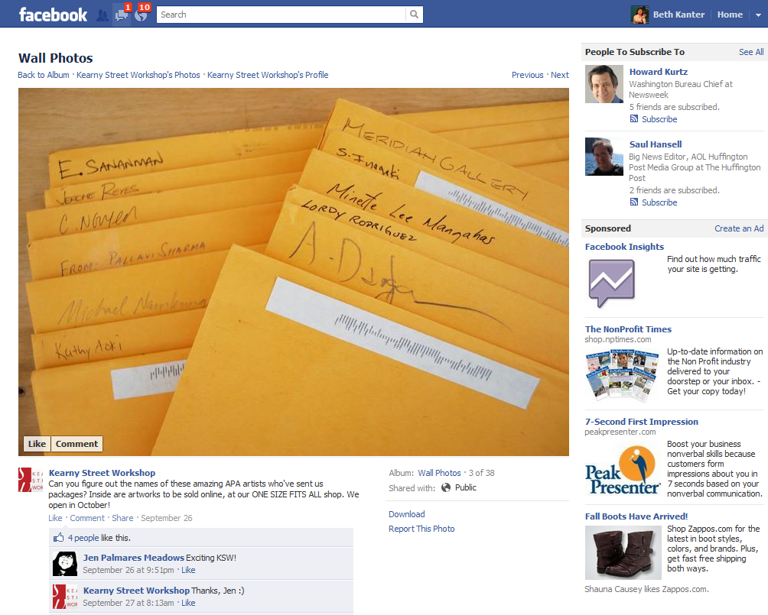
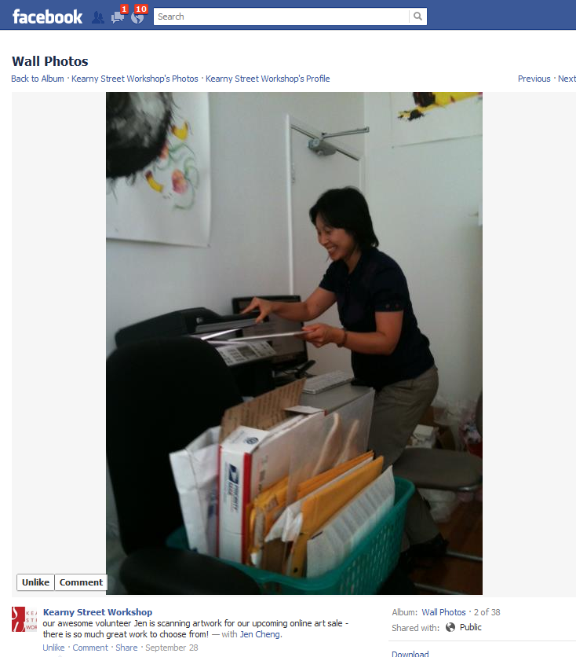
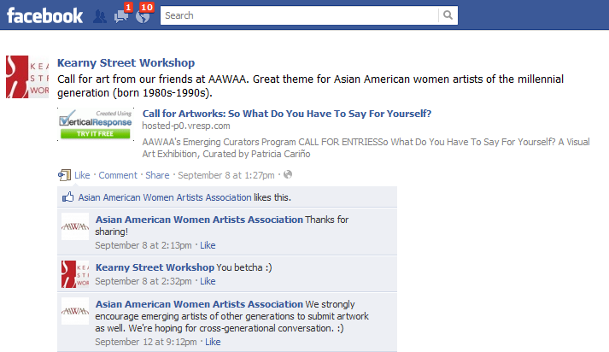

Slide 11
Principle #1:
Share Pair
Aligning social media with your communications strategy and objectives
Write down one of your SMART social media objectives
Share it with the person next to you
Test to make sure it is SMART

Slide 12
Principle #2
Scales social media by empowering everyone in the organization and integrating social media into work flow

Slide 13
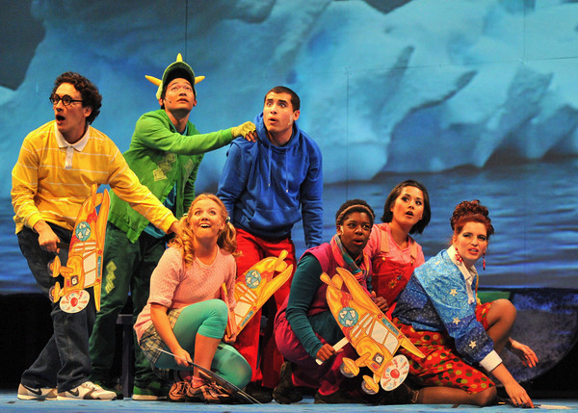
Small NGOs share the work load across staff
3 person staff
Social media responsibilities in all three job descriptions
Each person 2-4 hours per week
Weekly 20 minute meeting to coordinate
Three initiatives to support SMART objectives
  Weekly video w/Flip
  Blogger outreach
  Facebook
Notes:
This is a very small NGO in the US. The have 3 people on staff. Each staff person is responsible for one area of their social media related to a SMART objective.
Increase awareness by producing one FLIP camera video per week and posting on YouTube
Increase engagement by reaching out to and encouraging bloggers to write about the organization’s programs
Increase engagement and conversation about the organization’s program by posting content and engaging with fans on Facebook
They have a weekly 20 minute meeting to discuss their plans of what they’re going to do and evaluate how they did last week

Slide 14
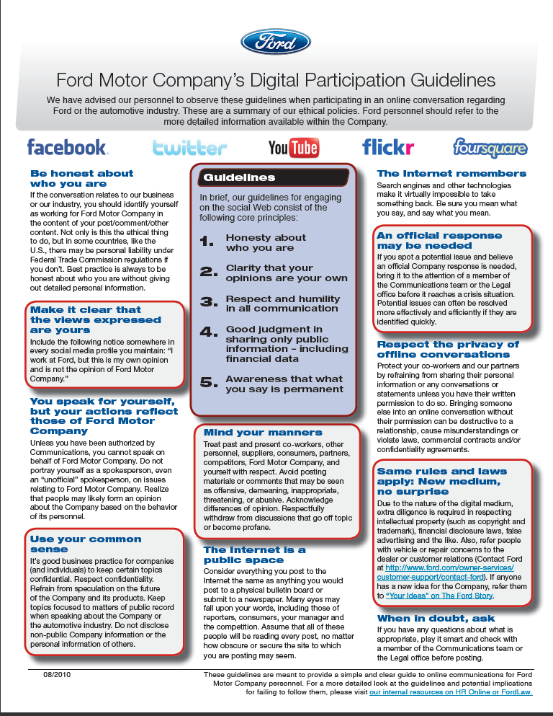
The Rule Book: Social Media Strategy
Participation Guidelines for Everyone
http://www.bethkanter.org/trust-control/
Notes:
If your NGO is larger, you can develop a social media policy and encourage all staff and volunteers to participate as ambassadors of your NGO. Here’s an example from FORD for guidelines for individual participation on social networks. This protects your staff and volunteers. Also, it should be encouraging. Because if they can participate as individuals and talk about your NGO, that helps your social media strategy scale with less effort.
The policy has five principles:
Honesty about who you are
Clarity that your personal opinions are your own
Respect and humility in all communication
Good judgment in sharing only public information
Awareness that what you post is permanent
Would these principles work for your NGOs social media policy? Why or why not? If you have a social media policy, what is in it?

Slide 15
Principle #2:
Full Group
How can your NGO integrate social media tasks into staff’s work flow? How would you divide the work?
What principles would your NGO include in its social media policy for all staff or volunteers?

Slide 16
Principle #3
Monitors, listens and researches the people in their network

Slide 17
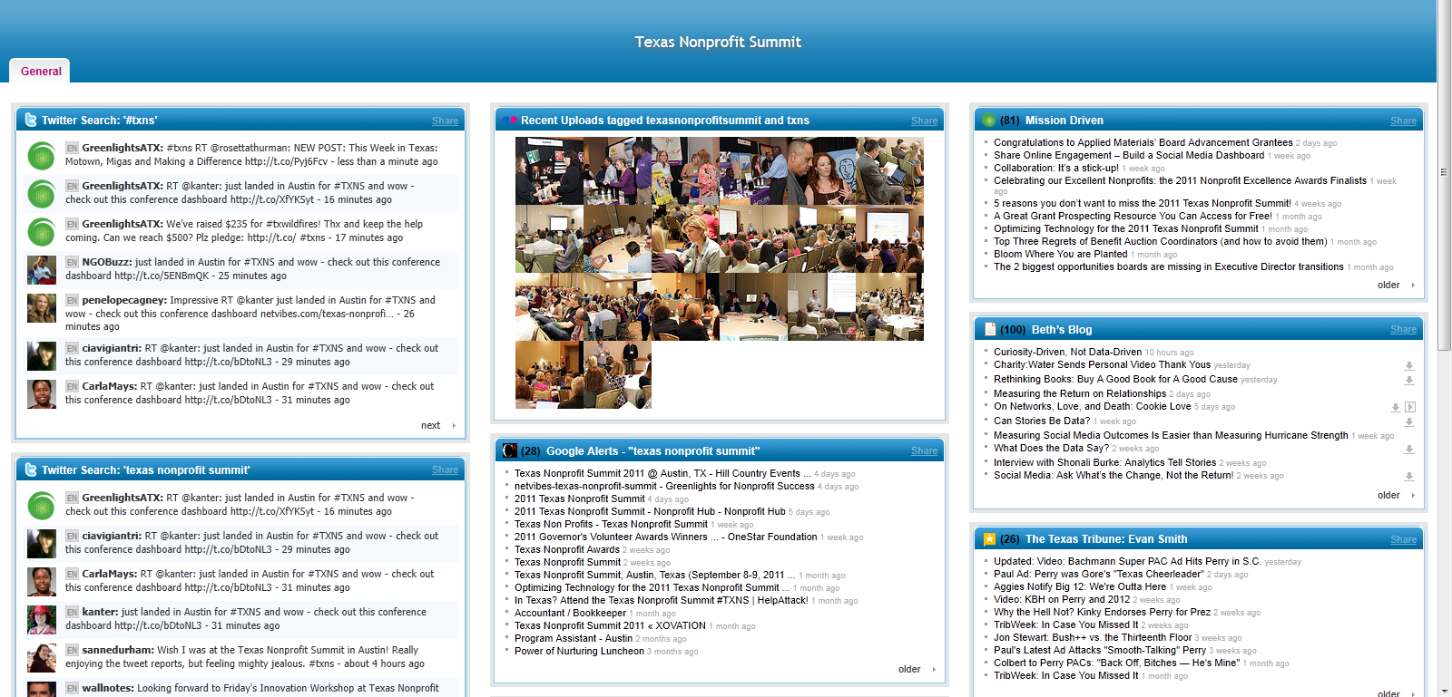

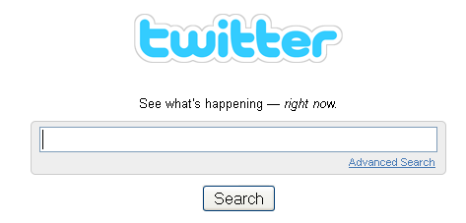
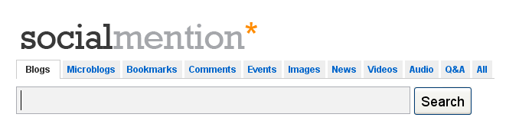

DIY – Listening Dashboard
Notes:
During workshop 2, you learned how to set up a couple of simple tools to monitor and track what people are saying about you and create a simple dashboard on iGoogle or NetVibes – like this example for a conference.
This was a conference that was using a hashtag and they wanted to track who was talking about the conference before, during, and after and to be able to respond.

Slide 18
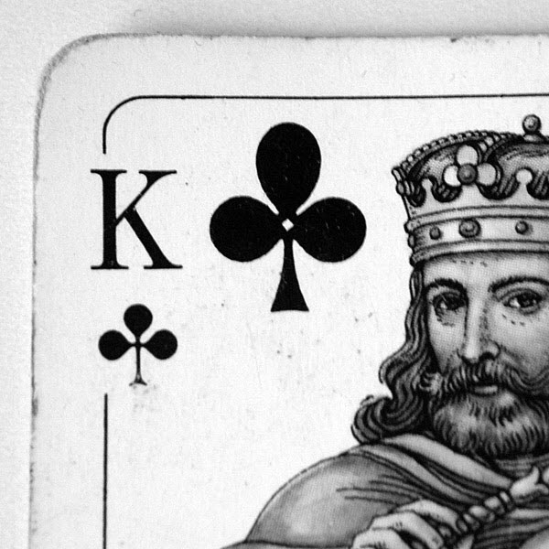
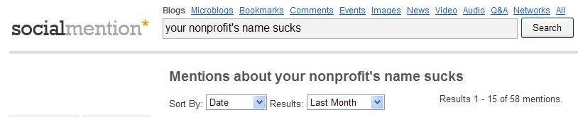
  Brainstorm Keywords
  Brainstorm Keywords
Nonprofit Name
Other nonprofit names in your space
Program, services, and event names
CEO or well-known personalities associated with your organization
Other nonprofits with similar program names
Your brand or tagline
URLs for your blog, web site, online community
Industry terms or other phrases
Issue area, synonyms, geography
Your known strengths and weaknesses.
Notes:
http://www.flickr.com/photos/evaekeblad/2389240224/
The tools for tracking will not produce results unless you have the right keywords. Here is a list of different ideas that you can track for keywords.
Remember it is best to have fewer keywords so you don’t get overwhelmed.

Slide 19
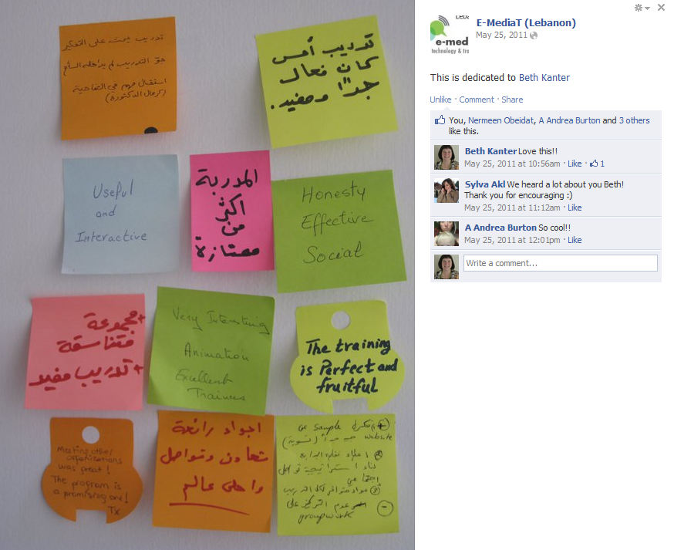
Principle #3:
Sticky Note Brainstorm
Notes:
Use the sticky notes on the table to brainstorm and share different keywords that your NGO has used to track its brand on social media or would like to use.

Slide 20
Principle #4
Gets feedback and start conversations about their work

Slide 21
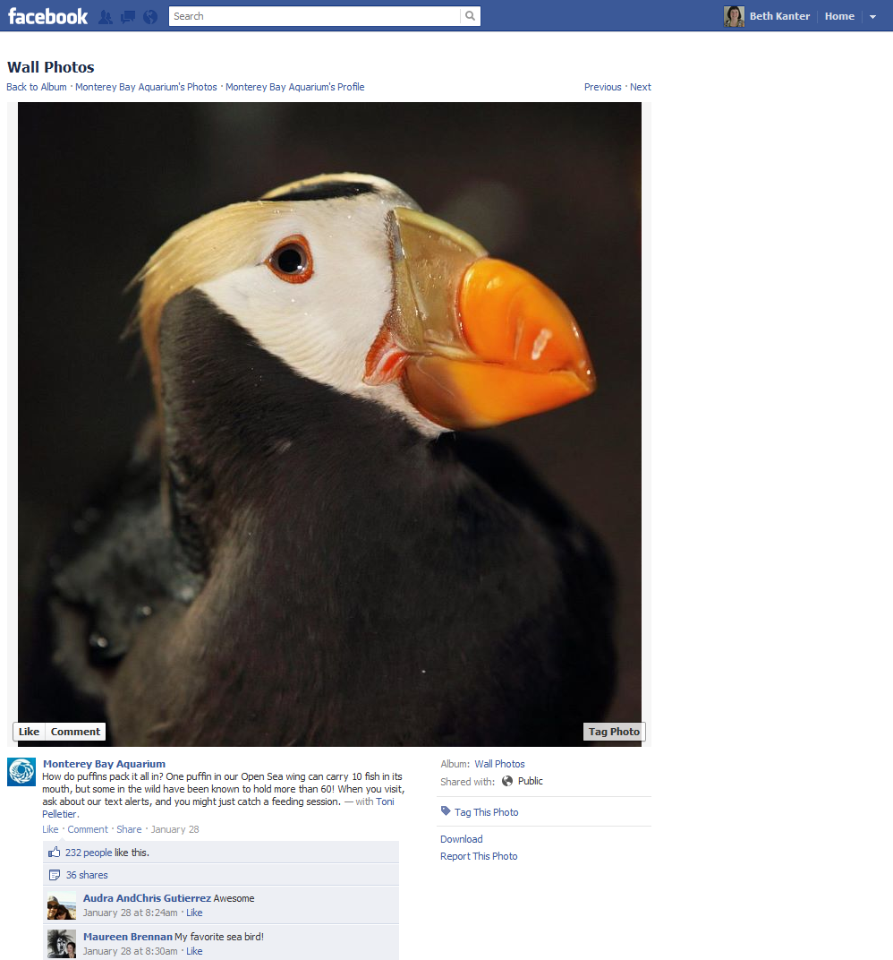
Example
Notes:
This example is from the Monterey Bay Aquarium. They posted a photo of a bird with a question. This type of bird is in an exhibit they were doing. Notice how many people commented and shared the photo on Facebook with their friends?
https://www.facebook.com/photo.php?fbid=10150560215187482&set=a.80376692481.78273.5835757481&type=1

Slide 22
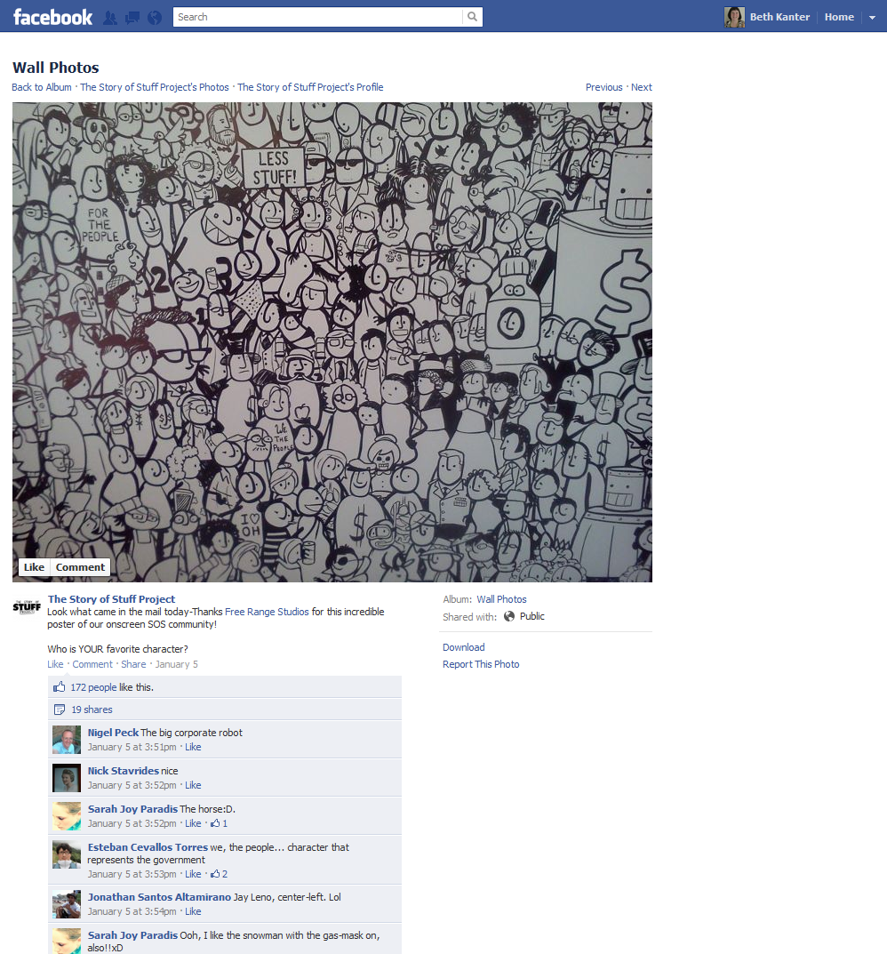
Example
Notes:
This example comes from the story of stuff. They showed an photo of a poster they made for one of their films, and ask their fans who was their favorite character?
https://www.facebook.com/photo.php?fbid=10150678680750884&set=a.219639005883.174012.104834210883&type=1

Slide 23
Principle #4:
Think and Write
Think and Write:
What content have you shared on social media that inspired conversation about your organization’s work?
What is a good example of a question, link, video, photo, or other visual that might spark conversation about your organization’s programs?

Slide 24
Principle #5
Works with brand champions and influencers to help implement strategy

Slide 25
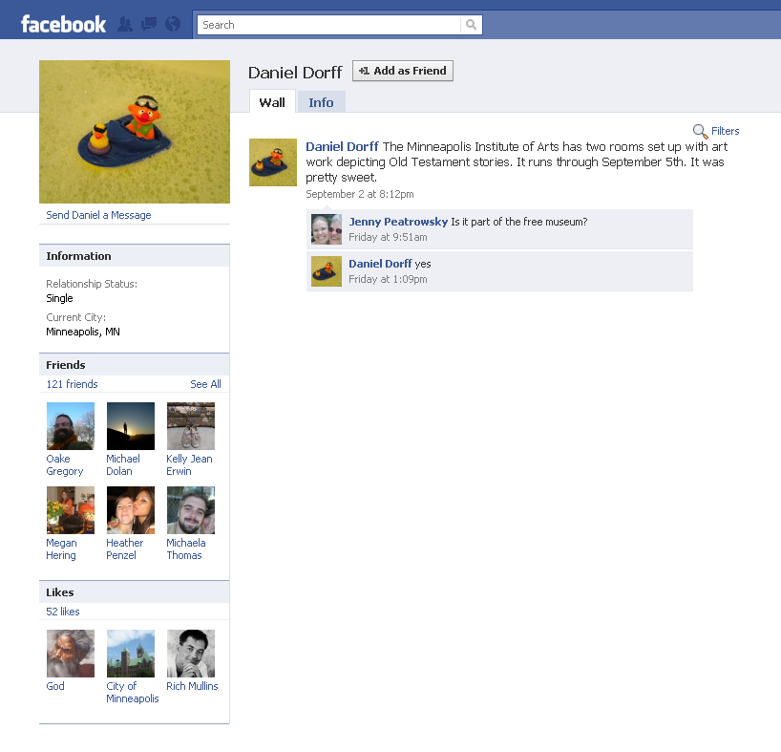
Principle #5:
How To Work With Champions
Track:
Who Are They?
Recognize:
Shout Outs, Tagging
Cultivate:
What do they want to do?
Proposal/Tools:
Ways to participate
Engage and Amplify:
Make it fun
Notes:
Brand champions are people who are the most passionate about your work that you’ve been able to connect with through social media channels or even offline. Influencers are people who other people listen to and are associated with your topic or field. These can be experts, well-known people, or people who have done a lot of work in this subject matter area.
You probably already know who your champions are offline and it is fairly easy to identify them online as well. Who is responding to you on Facebook or your blog? Do you know them? Recognize them and then developed a formal way to work with them.

Slide 26
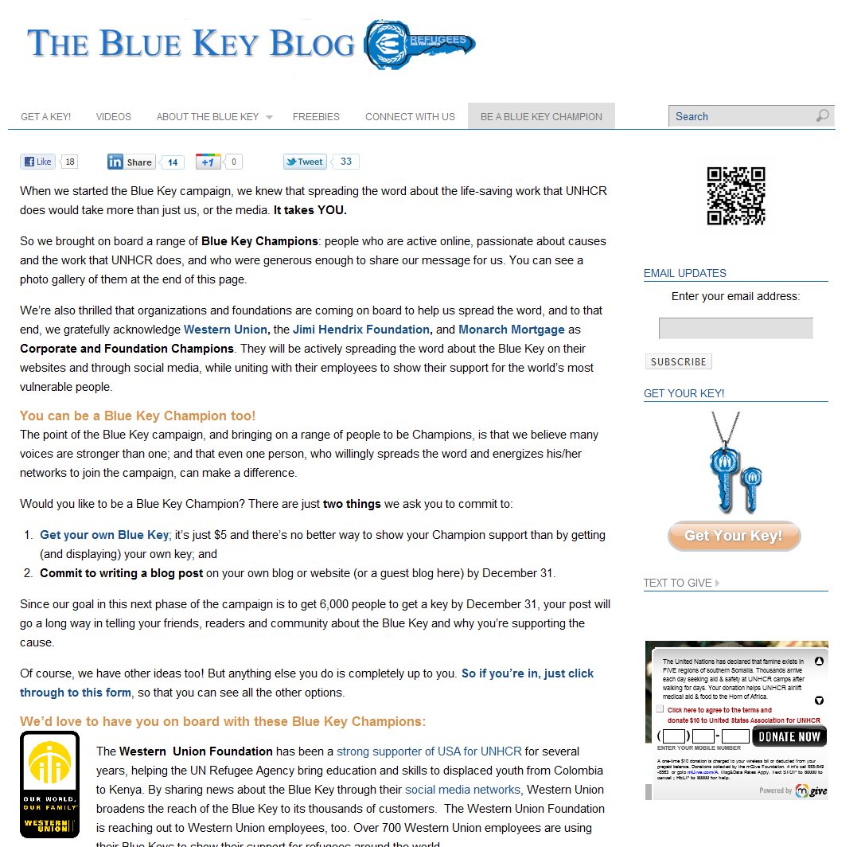
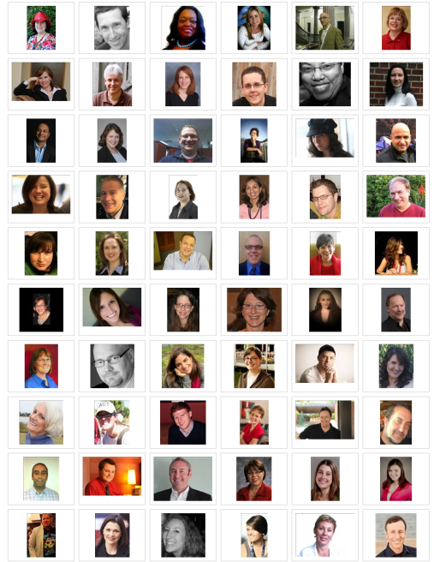
Notes:
This story is about a large NGO but your organization doesn’t have to be large to use these techniques.
USA for UNHCR is a 501(c)(3) headquartered in Washington, D.C. They raise funds and awareness in the United States for the lifesaving work that more than 6,000 staffers of Geneva-based UNHCR undertake for refugees around the world, 24/7. USA for UNHCR created the Blue Key campaign as a way to drive awareness of this global issue in the US. The $5 blue key pin or pendant symbolizes the one thing most of us have and that refugees don’t: a key to their own home.
The Blue Key site was only launched in December 2010, and its social/digital aspects were relatively new, so there was not a lot of data to base KPIs on. Overall, when we went into the first phase of the campaign, we had two goals: to secure at least three Blue Key Champions, and to get 6,000 keys ordered between May 9 and June 20 (World Refugee Day).
These goals were important to USA for UNHCR first, because the entire Blue Key campaign revolves around more people purchasing keys, and second, because with a limited budget for traditional outreach, they relied on willing bloggers to help us get the word out.
They recruited bloggers who write about this topic. They set up a private FB group to communicate with them and coordinate the campaign, share content, etc.

Slide 27
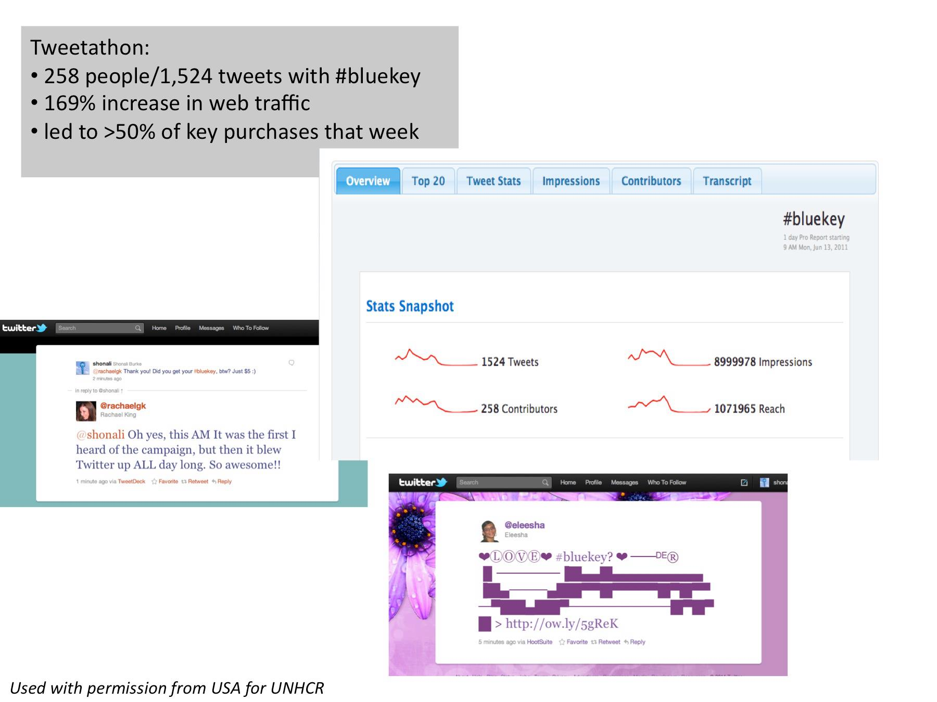
A Tweetathon was held on June 13th, a week before World Refugee Day on June 20th. Champions signed up to Tweet about the refugee crisis and #bluekey. Roya Hosseini did a Twitter Chat.
Notes:
They organized a “Tweetathon” – an online event on Twitter. They asked their Champions signed up to tweet about the refugee crisis and #bluekey (the campaign hashtag) from 9 a.m. – 9 p.m. on World Refugee Day In addition, Roya Hosseini, who manages the Khaled Hosseini Foundation’s Twitter account, signed on as a “special guest” between 1 & 2 p.m. (Khaled Hosseini is the author ofThe Kite Runner.)
Each of their Champions helped get the message about the campaign out to their networks and it was very efficient and effective for the organizations.
All told, there was a 169% increase in web traffic that day, compared to the previous high point a few weeks prior. We get real time confirmations every time someone orders a key, so we knew it was working. Finally, via campaign URLs in Google Analytics, we saw that Twitter was the main driver of traffic (for May 9 – June 20). This was not the case before the tweetathon.

Slide 28
Principle #5:
Consider the Pros and Cons
Concerns
Rogue Fan
May move on
Control Issues
Benefits
Testimonials
Open Door
It’s genuine
Notes:
http://www.socialmediaexaminer.com/3-rewards-and-3-risks-of-making-customers-brand-ambassadors/
Benefits
#1: The power of a testimonial will outperform anything a marketer can develop.
Having some who supports your organization talk about you is far more effective than you talking about yourself.
#2: Your supporters can open doors faster than you can.
If you are approaching bloggers to write about your organization, they may not immediately be open. But when one of your supporters approaches a blogger about the difference you made in their life, it’s different. It feels like a case study that must be shared.
#3: It’s genuine, it’s real, and it isn’t marketing.
It’s such a crowded marketplace that it has become really tough to break through the clutter. And we’re seeing this extend into the social space. By having a group of customers who are your brand ambassadors, you can easily break through with an authentic voice because it will sound different—ultimately its human and real.
Concerns
#1: Fear of the rogue customer.
Giving up brand control is a difficult proposition because organizations are terrified that their supporter may turn on them at some point. But there is not control. Anyone could turn on our organization. If you embrace brand ambassadors or champions, your organization is more likely to have a positive influence – and help if someone does turn on your organization.
#2: Concern over losing a brand ambassador because they move on.
This is a reasonable concern. As you work with customers and they develop their own following, it can be tough to manage a transition if they decide they don’t have time for it anymore. I would recommend that you structure your brand ambassador channels in a way that allows for multiple customers to participate in a single channel so you aren’t too strongly aligned with an individual personality.
#3: Brand ambassador may move on to another organization
This is why you want to cultivate a small group of people to help you.

Slide 29
Principle #5
Share Pair
How might your NGO use champions as part of its strategy?

Slide 30
Principle #6
Curates content to capture attention from people in their network in an age of information overload

Slide 31
Definition
Content curation is the organizing, filtering and “making sense of” information on the web and sharing the very best content with your network

Slide 32
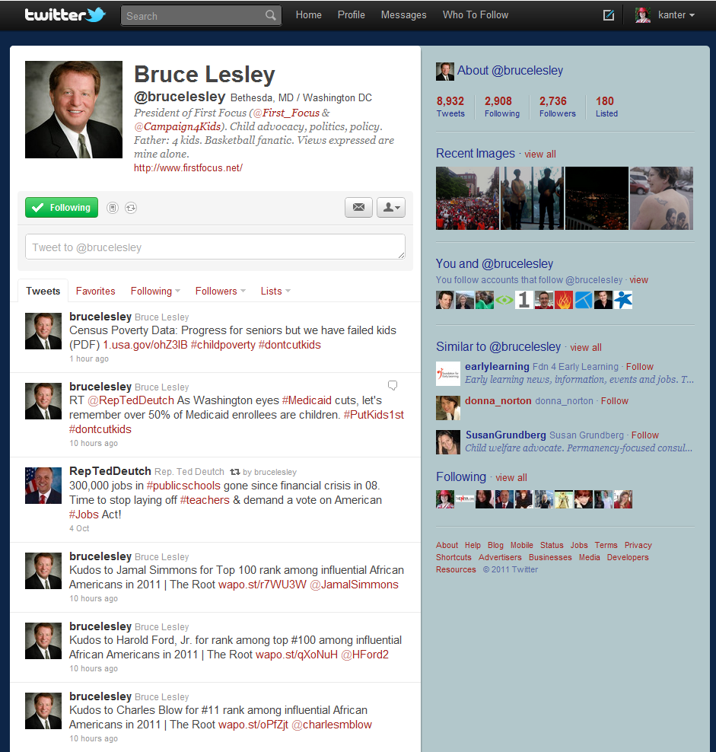

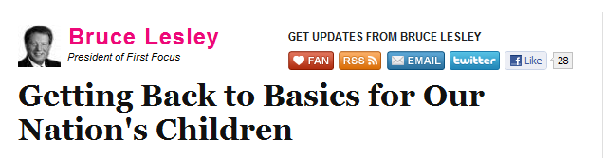




He curates content related to his organization’s mission as an advocacy organization dedicated to making children and families a priority in federal policy and budget decisions. He writes blog posts using the links he curated.
Notes:
You can get started with curating on your organization social media presences – like Facebook or blogging. This example is from Twitter.
Bruce Lesley is the CEO of Children First an child welfare organization. His curates content on his personal Twitter profile. He uses Twitter to curate information related to his organization’s mission and work as a bipartisan advocacy organization dedicated to making children and families a priority in federal policy and budget decisions. He also uses content curation for sources for his guest blogging. His use of Twitter (and his organization’s use of Twitter and all communications channels for that matter) serve this intent:
First Focus is working to change the dialogue around children’s issues by taking a cross-cutting and broad based approach to federal policy making. In all of our work, we seek to raise awareness regarding public policies impacting children and ensure that related programs have the resources necessary to help them grow up in a healthy and nurturing environment.
If you take a look at Bruce Lesley’s Twitter stream, you will see that he is curating information on public policies impacting children. Bruce does his own curating, using Google Reader and FlipBoard. Any individual or nonprofit organization can curate information using these tools. They can make it strategic by linking the information to their mission.
We are going to have a session this afternoon that will tell you more about how to do content curation.

Slide 33
Principle #6:
Sticky Note Brainstorm
Notes:
Use the sticky notes on the table to brainstorm and share different topics for content that your organization would like to curate. We will do more on content curation and content creation in the afternoon and on Day 2.

Slide 34
Principle #7
Learn from Experience and Measurement

Slide 35

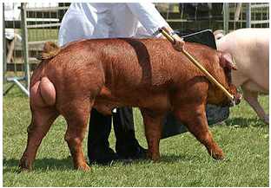
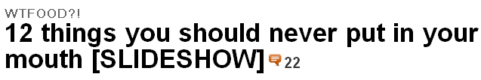

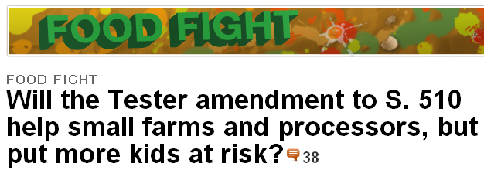

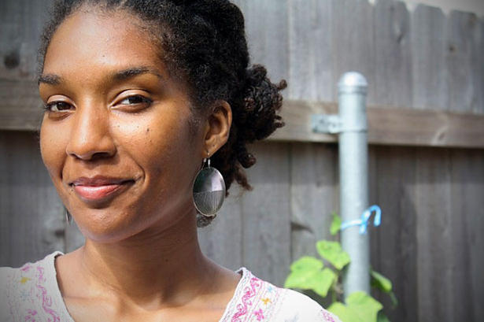
gristastic ladder ‘o engagement
fun on-ramps
stories of people making change
policy level discussions/calls to action
personal calls to action
grist sets the agenda by showing how green is reshaping our world. we cut through the noise and empower a new generation to make change.
Notes:
grist.org is a Seattle-based nonprofit that supports a destination news website for environmental news, reports, and opinion with a wry sense of humor. Chip Giller launched grist.org in 1999 to counter the stereotype that all environmentalists were either dour doomsayers or holier-than-thou tree-huggers.
grist.org’s editorial mission is to publish a new, positive form of green journalism with a comical twist. The vision is to spread independent environmental online content free of charge to a young and growing readership. grist.org reports on everything from climate change to the organic food movement, demonstrating how the environment intersects with critical issues like poverty, health care, and economic growth. What started as a quirky website with a hundred readers has grown to a leading news source that engages millions who might otherwise be turned off by the-bummer-of-the-day environmental news.
Grist.org Uses Measurement to Learn How to Deepen Relationships
grist.org has succeeded in connecting with a younger audience that not only reads its content but is also inspired to take action. It has accomplished this by using measurement to learn what it takes to move readers from being passive consumers of content to taking offline action.
grist.org operates on a modest budget but is highly effective at uncovering real meaning behind green stories and connecting big issues like climate change to daily life. While grist.org constantly attracts new readers, these are not the passive consumers typical of most media. They engage in the comments, share their own stories, take action, and, more importantly, are changing their personal behavior to benefit the environment and, ultimately, to save the planet.
Grist.org Builds Its Own Ladder of Engagement
grist.org is a data-informed organization that uses a ladder of engagement not only to guide its content and social media integration strategy, but uses measurement at each rung of the ladder to ensure that they are getting results.

Slide 36
grist.org’s key results are:
Footprint: The reach of their activities, both online and offline
Engagement: Readers engage with their content
Individual Behavior Change: Impact on users behaviors, purchase decisions, and daily lives that are in line with sustainability
Societal Change: Impact on society, policy discussions, and conversations that advance sustainable practices.
Notes:
grist.org’s ladder of engagement is elegantly simple and illustrates how their audience makes the journey from passive consumers of information to sustainable living champions, see Figure 6.2. The steps include fun on-ramps, sharing stories of personal behavior change, personal calls to action, and calls to action on policy change. grist.org does not consider pageviews or other web traffic stats the end point, but only an indicator of success at the bottom rung of their ladder. Their real goal is higher up the ladder, and that is societal change. If they aren’t successful, the consequences are dire. Or as Giller says, “The planet will get it.”
grist.org’s key results are:
Footprint: The reach of their activities, both online and offline.
Engagement: How readers engage with their content by commenting, contributing content, and sharing their content with other people.
Individual Behavior Change: Impact on users behaviors, including purchase decisions and daily routines that advance sustainable practices.
Societal Change: Impact on society, policy discussions, and conversations that advance sustainable practices.
Grist.org’s Measurement: Engagement, Indices, Surveys
grist.org uses a combination of tools to measure along the ladder of engagement, including Google Analytics, surveys, real-time monitoring tools, and collecting anecdotal stories.

Slide 37
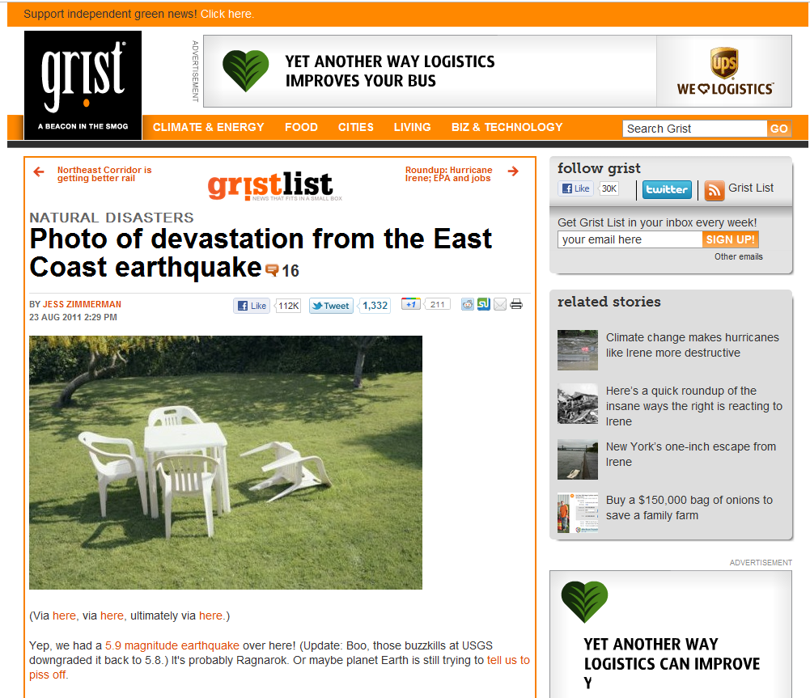
Notes:
For example, in August, 2011, when a freak earthquake hit the east coast, grist.org shared photos of some lawn chairs being turned over with the headline, “Earthquake Damage.” Not only did the photo get shared and liked by thousands of people through emails, on Twitter, and Facebook, but it generated mainstream media attention and even got noticed by prominent climate scientists. Because they had this real-time data available, they knew they should quickly follow up with a series of articles highlighting scientific information about how extreme weather instances are tied to climate change.
To understand what people are doing with their content, grist.org has created an engagement index based on commenting, sharing, and clicks. They use this index to guide decisions about engagement tactics, particularly through social media channels. Perhaps more important is how they measure behavioral change, including taking action as advocates, changing day-to-day behavior, and participating in policy discussions. They have regular surveys on the site as well as an in-depth annual reader survey that includes questions such as, “How has our work impacted your daily life?” To better understand the numbers, they draw insights from anecdotal stories, focus groups, interviews, and comments.
Their survey questions are about their readers’ behavior changes to more sustainable practices: Have they switched from buying bottled water? Are they buying more locally-sourced produce? grist.org also asks about whether a story has inspired them to pursue an issue by contacting a company or local official. They know from interviewing the 10% of readers who have not taken an action that those readers consist of people who say, “I’m already so green, I can’t get any greener.”
Giller acknowledges the huge challenge of measuring societal impact, noting, “We can’t really prove cause and effect and to be honest, it is mostly based on qualitative data. We look at the company we keep and who is asking to be interviewed. Then we use those insights to help drive the conversation about sustainable practices and climate change to people who are not yet aware of the policy issues.”
Says Giller, “We have embraced intelligent decision-making, not excessive data collection. There’s so much data we could collect, but it’s potentially a morass. We pay attention to only a half-dozen key indicators related to our results around footprint, engagement, behavior change, and policy action.”
With its approach of measuring along the ladder of engagement, grist.org has garnered considerable insight from about what works and what doesn’t. Giller shares, “Our content has to meet people where they’re at, so roughly 70% is introductory level. We also know that facts alone do not drive behavior change. It is more important to see those changes modeled in your peer community, whatever that it is. We shine a light on people who do make changes, and that inspires others.”
http://www.bethkanter.org/tweet-huggers/

Slide 38
The Principles
Aligns social media with their communications strategy and objectives
Scales social media by empowering everyone in the organization and integrating social into work flow
Monitors, listens, and researches the people in their network
Gets feedback and start conversations about their work
Curate content to capture attention from their network in an age of information overload
Work with brand ambassadors to spread their mission
Learn from experience and data
Notes:
Aligns social media with their communications strategy and objectives
Scales social media by empowering everyone in the organization and integrating social into work flow
Monitors, listens, and researches the people in their network
Gets feedback and start conversations about their work
Curate content to capture attention from their network in an age of information overload
Work with brand ambassadors to spread their mission
Learn from experience and data

Slide 39
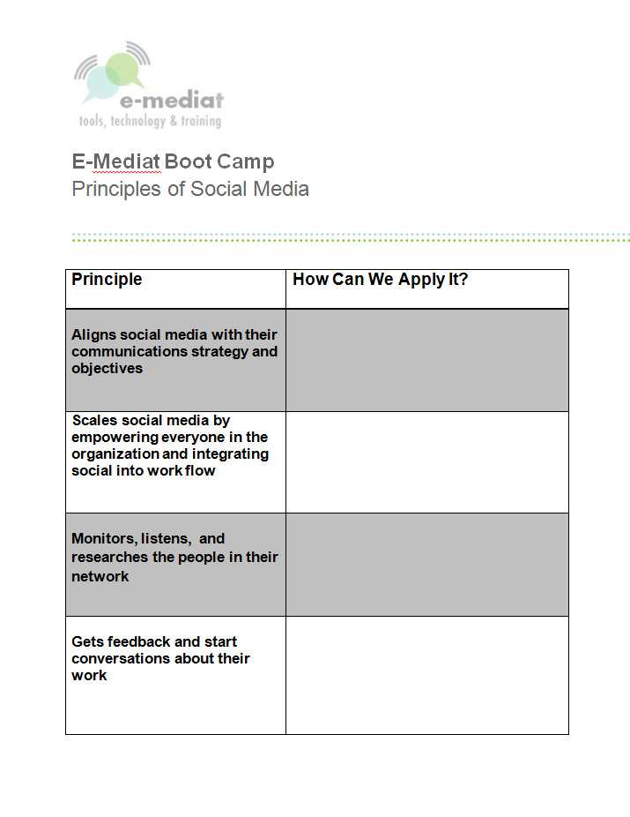
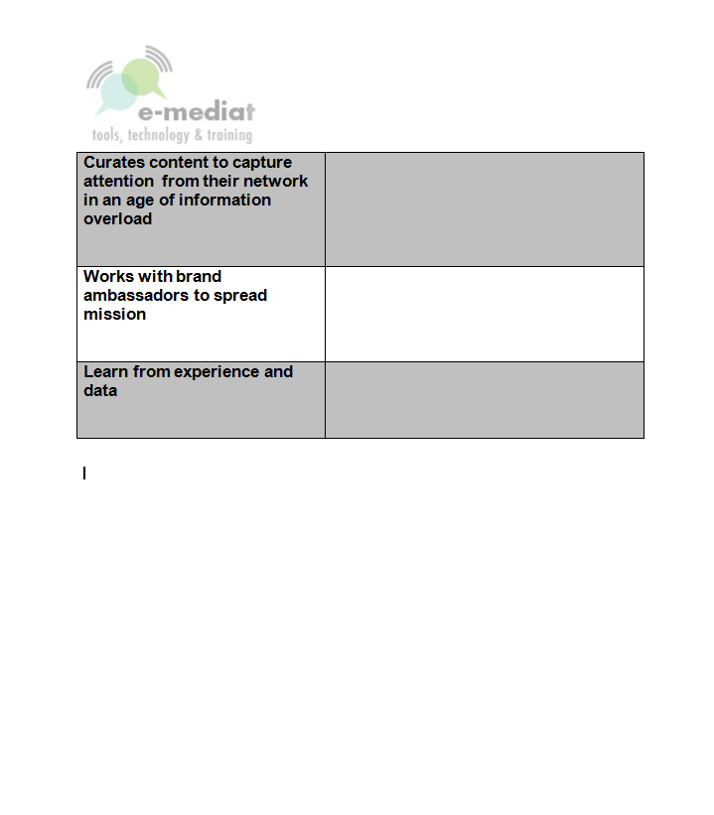
Use Worksheet
Notes:
During lunch, think about these principles and how they apply to your work – and jot down a few notes of next actions that you will do following the bootcamp.

Slide 40
Resources
Kearny Street Workshop
http://kearnystreet.org/
Bay Area Children’s Theatre
http://www.bactheatre.org/
The Blue Key Blog
http://bluekeyblog.org/
Khaled Hosseini Foundation
http://khaledhosseinifoundation.org/
Social Media Examiner
http://www.socialmediaexaminer.com/3-rewards-and-3-risks-of-making-customers-brand-ambassadors/
Grist
http://grist.org/

Slide 41
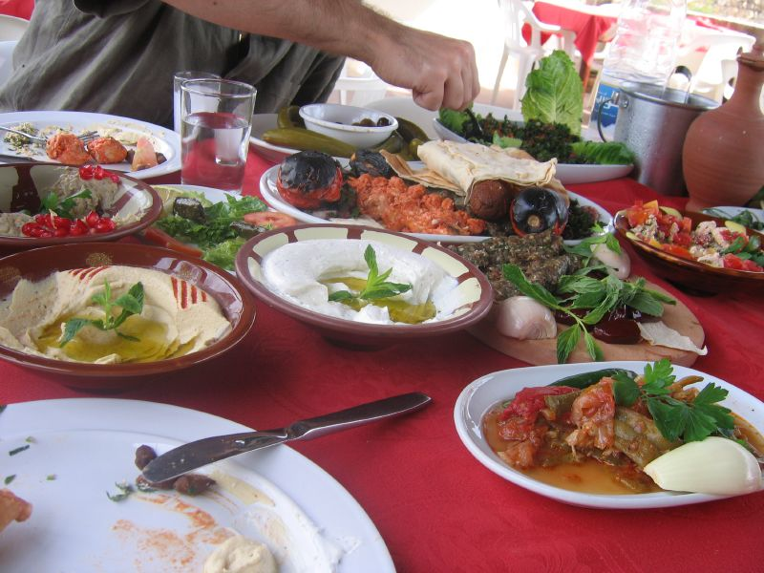
Lunch
Flickr photo by Littlelakes
Notes:
http://www.flickr.com/photos/littlelakes/54251489/

