Slide 1
Where Can We Go? Best Practices from the Arab World
Civil Society Laws: Experiences and Expertise 24 - 25 May 2008
The International Center for Not-for-Profit Law
المركز الدولي لقانون المنظمات غير هادفة الربح

Slide 2
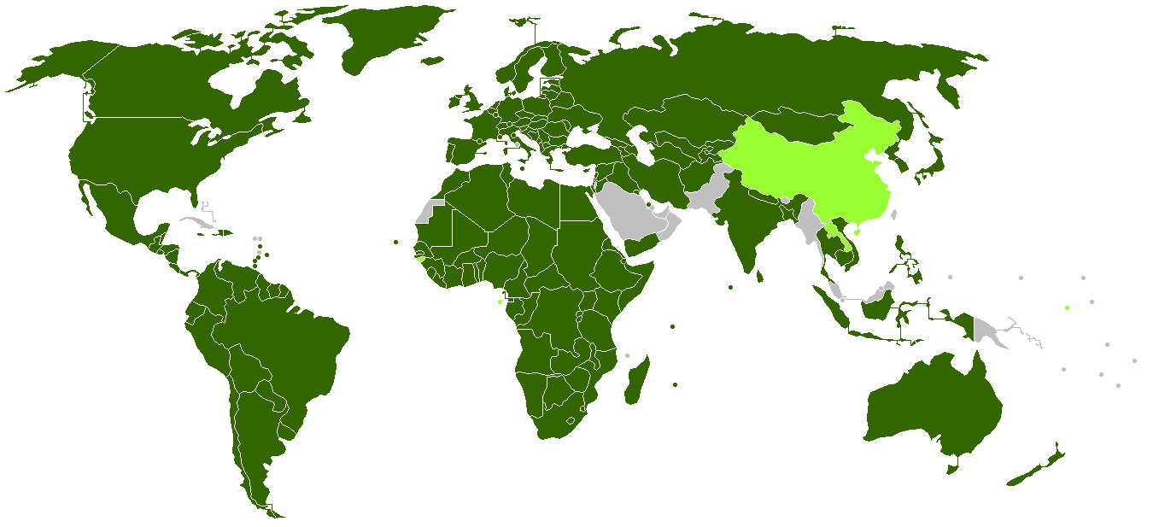
Where do best practices come from?
Article 22 of the International Covenant on Civil and Political Rights:
Everyone shall have the right to freedom of association with others, including the right to form and join trade unions for the protection of his interests.
No restrictions shall be placed on the exercise of this right other than those which are prescribed by law and which are necessary in a democratic society in the interests of national security or public safety, public order, the protection of public health or morals, or the protection of the rights and freedoms of others.
Notes:
Recall that this whole discussion stems out of Article 22 of the ICCPR, which states… When we consider best practices, we ask whether a given law meets the standard that is articulated in Article 22 as it has been understood by international tribunals and the domestic courts of advanced nations. Image behind the text shows all the countries of the world that have ratified the ICCPR.

Slide 3
Where do best practices come from?
Article 28 of the Arab Charter on Human Rights:
All citizens have the right to freedom of peaceful assembly and association. No restrictions shall be placed on the exercise of this right unless so required by the exigencies of national security, public safety or the need to protect the rights and freedoms of others.
Notes:
We are taking a look at the Arab region specifically. As you can see most of the Arab countries have signed the ICCPR, but unfortunately that does not mean they are complying with it. It is interesting to note that the new Arab Charter (took effect on March 15, 2008) contains a similar provision in Article 28 (now applicable in the Arab world after seven ratifications – from UAE, Jordan, Bahrain, Algeria, Syria, Libya, and Palestine).

Slide 4
Essential Issues in the NGO Lifecycle
Registration
Fundraising
Conducting Activities
Affiliating with Others
Dissolving
Notes:
The three countries that come closest to complying with these stringent standards are, in our opinion, Morocco, Lebanon, and Yemen. Now these three countries are not perfect and we will be discussing where they fall short, but because they are Arab countries they provide a model of what is possible in this region. We don’t have enough time to discuss every provision of these laws, so we are going to focus on five essential issues in the lifecycle of every NGO…
International standards are taken from ICNL’s book (available online for free) Guidelines for Laws Affecting Civic Organizations. Yemeni Law is Law No. 1 for the Year 2001; Lebanese Law is 1909 Ottoman Law on Associations (plus amendments and interpretations by Ministry of Interior); Moroccan Law is the Act on the Right of Association (most recently amended by Decree No. 1.02.206 of 23 July 2002). Again all of these are available online.

Slide 5
Voluntary Registration
International Standard: Acquisition of legal status should not be a prerequisite for the exercise of the rights to expression, peaceful assembly, and association.
Lebanon: No permit is initially needed to found an association. However, in all cases the government must be notified of the association after it is founded.. (Article 2)
Morocco: Associations can be freely established without prior permission provided that… (Article 3)
Yemen: Registration is required before any activities can take place. (Executive Statute)
Notes:
As we go through each I will make references to the Egyptian law without actually putting it up on the screen. Needless to say it is awful for every one of these provisions, but nonetheless I will have citations to specific provisions prepared in case anyone asks.
Green-Orange-Red (Good-OK-Bad).
Lebanon: criticized by the ICCPR HR Committee because it was requiring mandatory licensing and control; today this is not happening as much because of a change in Ministry practice and because of the general collapse of the state.
Morocco says no prior permission required but then in practice requires certain documents to be filed first.

Slide 6
Registration Procedure
Registration should require filing a small number of clearly-defined documents.
Registration requires filing a short application and copies of the bylaws. (Morocco, Article 5)
The process should be fast, easy, and cheap.
The application is filed at the local administrative authority office and there is no required charge. (Morocco, Article 5)
Short time limits should be established and failure to act after a certain number of days should result in automatic approval.
The Ministry or its relevant concerned office should process within one month from the date it receives the application, if this period terminates and the processing has not been completed, then the application shall be deemed to have been accepted by force of law… (Yemen, Article 9)
Refusal to register should be written, justified, and subject to appeal.
The Ministry or its relevant office, in the event that the application is refused pursuant to this Law should notify the founders of the decision to reject the application in writing, giving the reason thereof… The concerned people are entitled to appeal the decision to reject the registration of associations and foundations in the court of competent jurisdiction… (Yemen, Article 10 - 11)
There should be relatively little government discretion in the approval process.
Notes:
As we go through each I will make references to the Egyptian law without actually putting it up on the screen. Needless to say it is awful for every one of these provisions, but nonetheless I will have citations to specific provisions prepared in case anyone asks.

Slide 7
Registration Procedure – Government Discretion
The High Evaluation Commission shall deny a registration application for the following reasons:
In case the statute, registration documents and evidence are contrary to the terms set forth in this law;
In case the documents are not complete;
In case the name of the applicant is so similar to a previously registered governmental or non-governmental organization or to the name of a private company or private enterprise that confusion is likely to result;
If two or more organizations submit registration applications under the same name, the application first submitted shall be approved and the later applicant shall be given the opportunity to choose a different name.
Afghanistan – Law on NGOs (Article 19)
Notes:
Yemen, Morocco, and Lebanon all put inappropriate restrictions on activities (Lebanon no Arab nationalism or promotion of individual identities; Morocco nothing contrary to the royal regime) or fail to limit discretion of registering authority (Lebanon, Morocco, Yemen).

Slide 8
Fundraising
International Standard:
Registered organizations should be permitted to engage in any legitimate fundraising activity.
Advance permission is generally inappropriate. The government should not be permitted to screen or require approval of specific grants or sources of funds.
Foreign funding should be permitted so long as organizations comply with applicable customs and foreign exchange rules.

Slide 9
Fundraising
Yemen:
The revenues of the association or foundation consist of the following:
The fees, subscriptions and contributions of the members;
The assistance, aid, contributions, endowments, testate grants and unconditional grants, whether from a government entity or from authorities or organizations, and in a manner that does not conflict with the effective applicable laws;
Proceeds realized from the assets of the association or foundation or from the economic activities in which it is engaged. (Article 39(1))
Any association or foundation may, with the knowledge of the Ministry, obtain assistance from overseas from a foreign person or entity or the representatives thereof… (Article 23)

Slide 10
Permissible Activities
International Standard:
Organizations should be permitted to speak freely on all matters of public significance, including existing or proposed legislation, state actions, and policies.
Organizations should have the right to criticize (or praise) state officials and candidates for public office.
There should be no restriction on the right of organizations to carry out public policy activities, including education, research, and advocacy.
Income-generating activities are appropriate so long as no profits or earning are distributed to founders, officers, board members, employees, or members.

Slide 11
Permissible Activities
Associations and foundations may not engage in any partisan activity or take part in any election campaign or to allocate any of its funds for such purposes directly or indirectly. (Yemen, Article 19)
The associations and foundations may engage in economic and trading activities that are permitted by law in the following cases:
If the purpose is to generate a profit that is consistent with the purposes and objectives of the association or foundation.
If there is no direct or indirect distribution of the profits from these economic activities, whether to the founders or to the Members of the association or foundation, or for its senior officials, the members of the Board of Directors, employees, or the providers of assistance and subsidies thereto.
That such activities do constitute any speculation or financial risk that is not secured for the association or foundation. (Yemen, Article 39(2))

Slide 12
Foreign Affiliations
International Standard: Foreign affiliations should be permitted to the extent permissible under the laws that apply to all legal persons in that country.
Lebanon: Permitted
Morocco: Permitted
Yemen: Any association or foundation may, with the approval of the Ministry, undertake any activity based on a request or assignment from an external entity. (Article 23(2))
Notes:
Lebanon is basically cited where there are appropriate provisions. And as you can see from the lack of any citations whatsoever, the Lebanese law is basically an empty shell. It has no provisions, and this is a “best practice” in our region because that means there is little government interference. However it is not a good practice in the sense that there is very little protection for NGOs should the government wish to introduce a novel interpretation, and that is exactly what happened some years back (although it has since been rescinded).

Slide 13
Dissolution
International Standard: Voluntary dissolution by the organization’s highest governing body should be permitted. Involuntary dissolution should be ordered by or appealable to independent courts.
Yemen: The Ministry may sue for the dissolution of an association of foundation with the court of competent jurisdiction in the event that the association or foundation carried a serious breach of the provisions of this Law and the other applicable effective laws. (Article 44(1))
Notes:
Morocco - Affected person provision is slightly worrisome

