Slide 1
New Media for the Networked NGO
Content and Measurement for Facebook
Presenter: Beth Kanter
E-Mediat is funded by the Middle East Partnership Initiative of the United States Department of State with support from Microsoft Corporation and craigslist Charitable Fund and administrated by the Institute of International Education
Notes:
IIE and publicly acknowledge funding by the U.S. Department of State Middle East Partnership Initiative (MEPI).
Content and Measurement for Facebook; 10:30 – 11:15 a.m.

Slide 2
Facebook: Learning Objectives
To understand how to organize, create, and measure a micro content strategy for Facebook

Slide 3
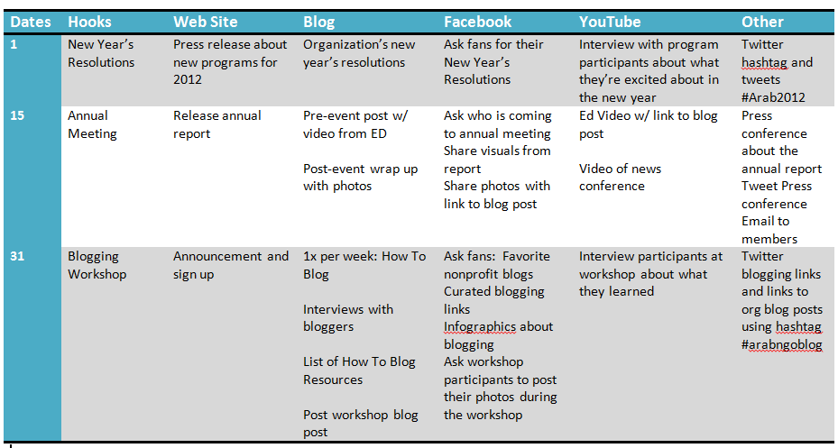
Content Strategy: Organize
Notes:
Now that you have your editorial calendar in place, let’s look at what type of content works on Facebook.

Slide 4
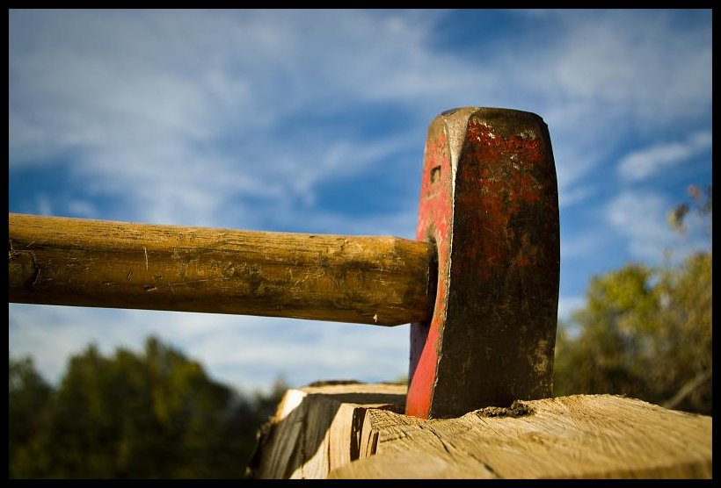
Facebook Micro Content Strategy: Chopping Existing Content Into Smaller Pieces
Chop Shop
Notes:
http://www.flickr.com/photos/civisi/2930794542/sizes/o/in/photostream/
You don’t have to create new content just for Facebook. You are essentially repurposing content from other channels like your web site or blog or photos or links that you’re curating. Think about as chopping up your existing content into smaller pieces.

Slide 5
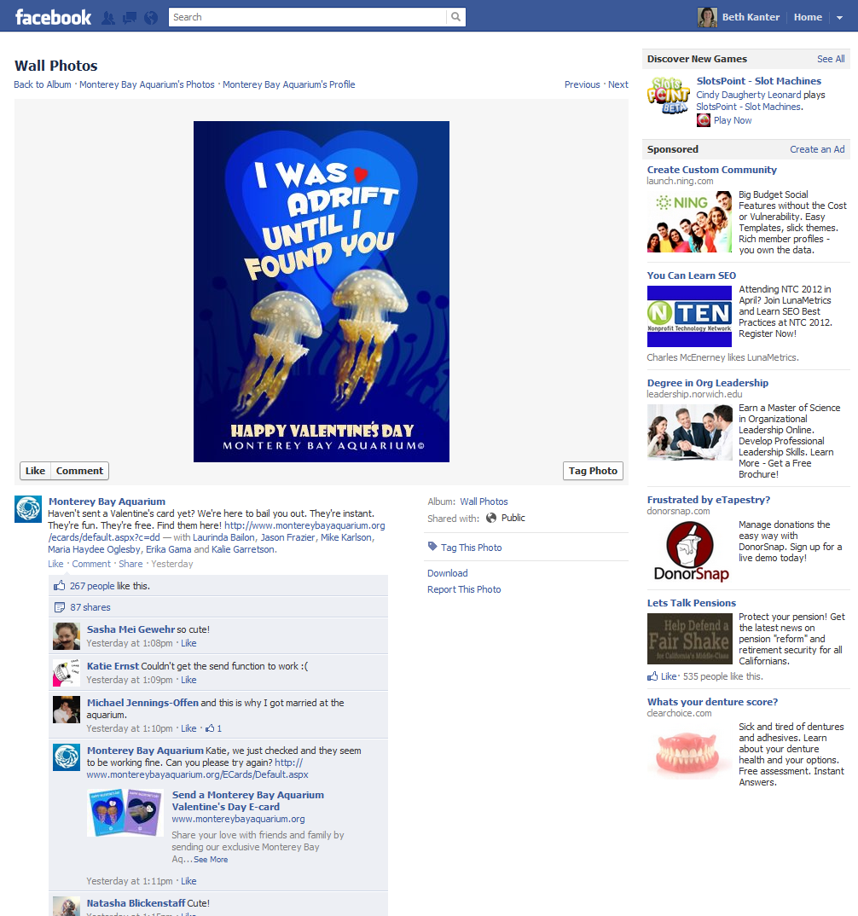
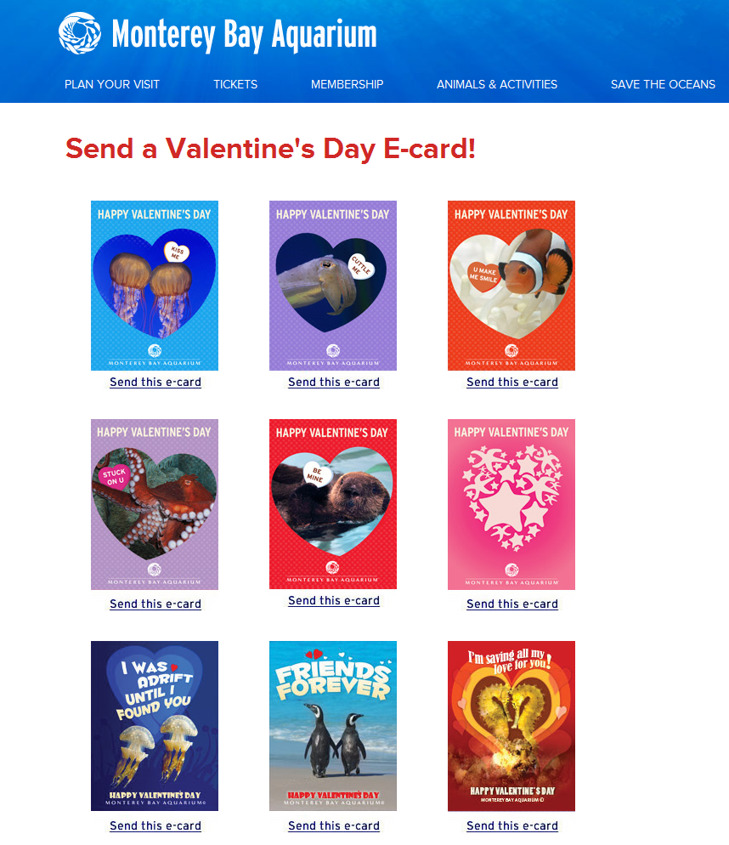
Example
Chop Shop
Web Site Content: Images
Notes:
Here is an example.
The Monterey Bay Aquarium posted these Valentine’s Day images for cards on their web site. For Facebook, they simply selected an image to post onto Facebook with a brief message.

Slide 6
Ten Tips for Creating Content That Gets into the Newsfeed
Variety of content types and consistency
Short: 80 characters or less for status updates
Eye catching images with bright colors and relevant content
Include a call to action: share, like, comment, caption this
Celebrate milestones, share news
Timely topics with the right frame for your audience
Experiment with varying time of day/day of the week/frequency
Repeat proven stuff
Always be commenting
Curate from other similar pages
Notes:
These are suggestions and guidelines.

Slide 7
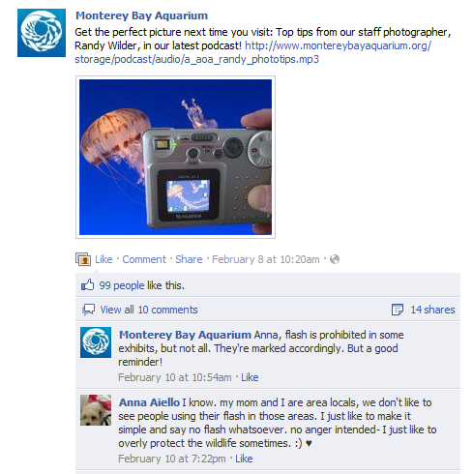
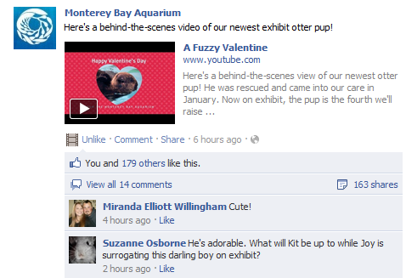
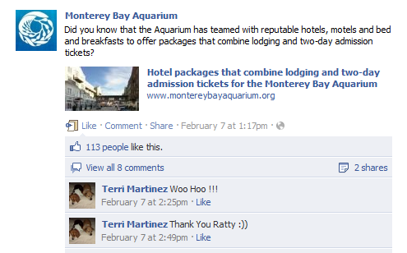
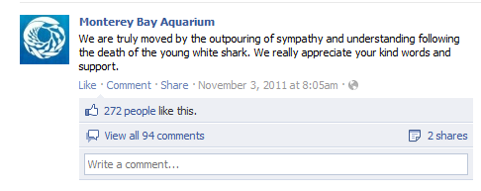
Variety of Formats: Photos, Videos, Status Updates, Links
Videos
Photos
Annotated Links
Status Updates
Questions

Slide 8
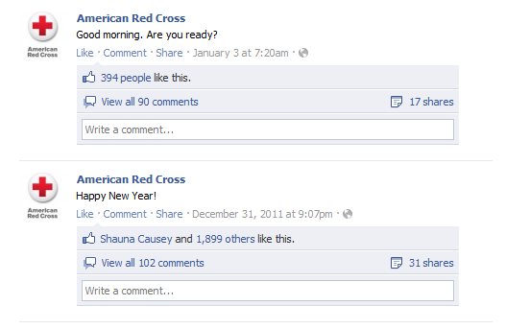
Short: Less than 80 characters
Notes:
Short updates get shared more. These were posted right before and after New Year’s. Notice how many comments and shares and likes.

Slide 9
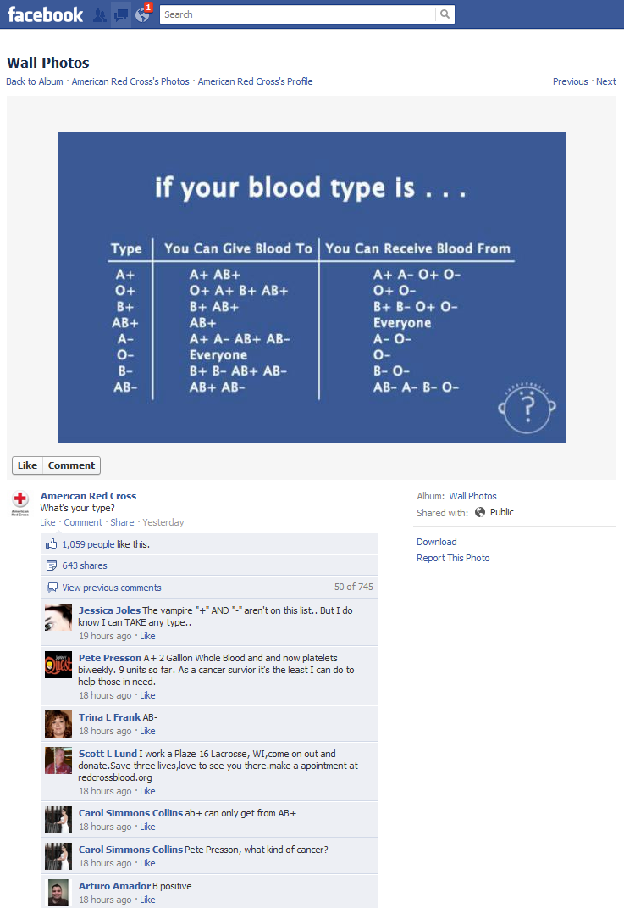
Eye Catching Relevant Images
Notes:
The image the Red Cross is using is a chart about blood types. They’ve posted it with a simple question: What’s your type?

Slide 10
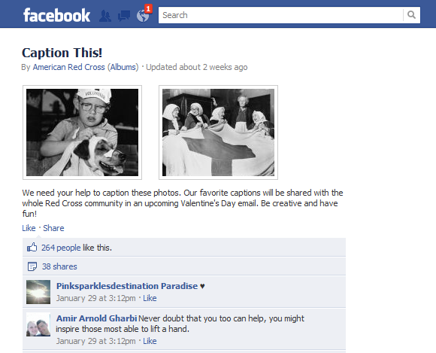
Eye Catching Relevant Images
Notes:
The call to action is to caption the photo. Other calls to action: Share this, comment, or like.

Slide 11
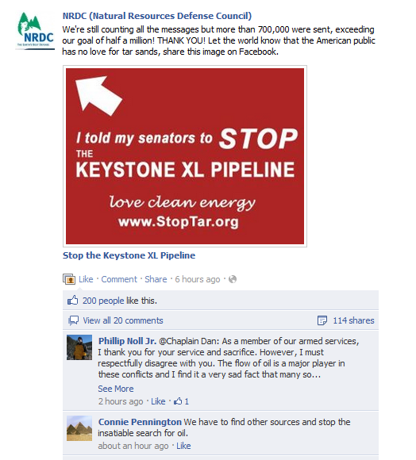
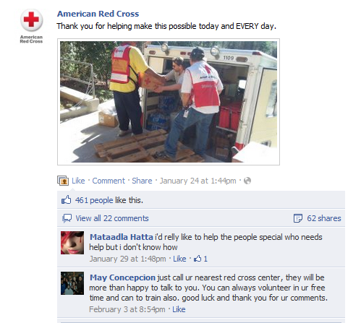
Eye Catching Relevant Images
Notes:
The Red Cross is saying thank you to their community for supporting them. The NRDC is saying thank you for taking action.

Slide 12
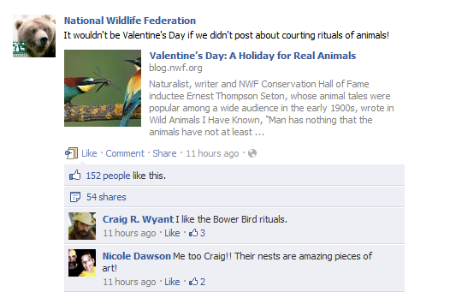
Eye Catching Relevant Images
Notes:
The NWF posted this on Valentine’s Day – timely, but relevant for their community

Slide 13
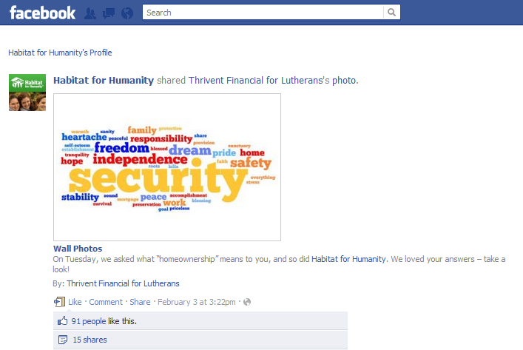
Eye Catching Relevant Images
Notes:
You can easily to this by:
-Log in as your page administrator
-Like similar pages
-Check your newsfeed and pick out something to post
-Share on your page

Slide 14
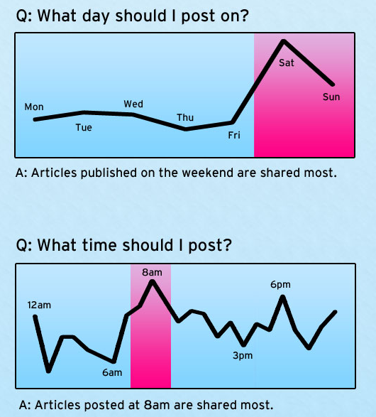
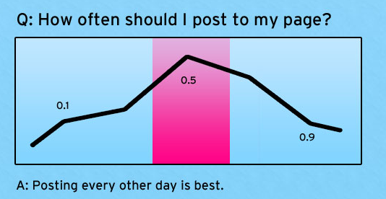
Experiment with Time of Day and Day
Notes:
http://danzarrella.com/infographic-5-questions-and-answers-about-facebook-marketing.html
This comes from extensive research of shared posts and time of day and day from Dan Zarrella.
Test different times of the day and days.
Test frequency. Some research suggests every other day, other research post daily.
The important thing is to test and see how your audience responses. And, don’t just post to post. Make sure that everything you post is high quality. Then your audience will come to depend on you.

Slide 15
Facebook Micro Content Editorial Calendar
Month | Content/Type | Topic | Time
Monday | Question
Tuesday | Photo
Wednesday | Video
Thursday | Link
Friday | Question
Monday | Question
Tuesday | Photo
Wednesday | Video
Thursday | Link
Friday | Question

Slide 16
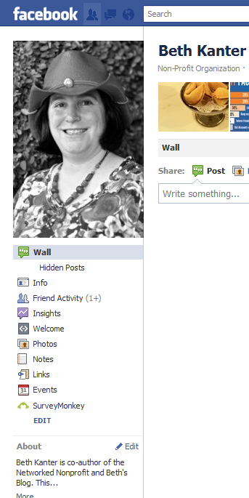
Use the Facebook Insights Tool
Notes:
Facebook comes with an analytic tool that can tell you what content is engaging your audience.
If you are the page administrator, you can click on the purple button that says “insights” and you will be able to look at the data.
Warning, Facebook Insights gives a lot more data that you need. I’m going to show you how to make it easy and simple.

Slide 17
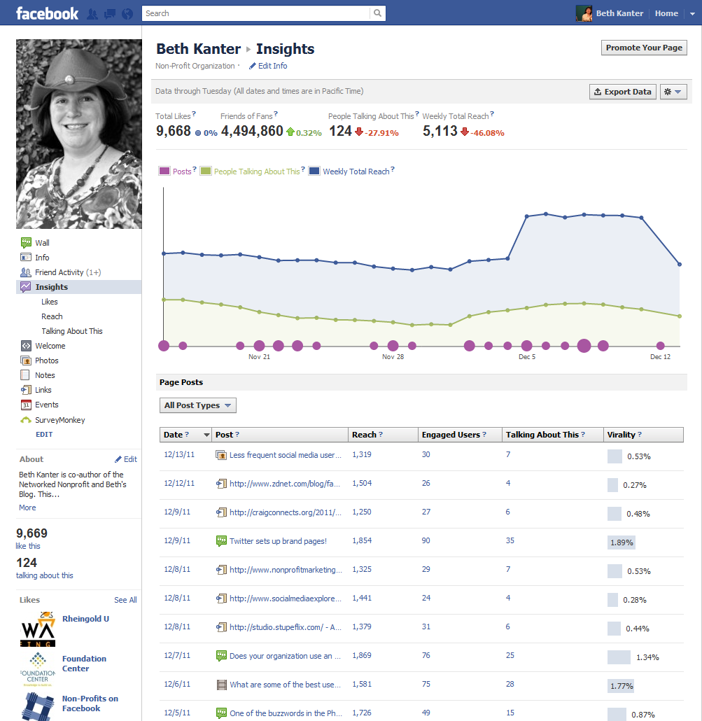
Blue = Reach
Green = Engagement - People Talking About
Purple = Content
Size of circle = frequency
Where are the Mountains and Valleys? What caused them?
Notes:
When you log in, you see a chart. The blue is your reach. Green is your engagement. And Purple is your content – with a larger dot indicating frequency of posts.
I just look for patterns like spikes and lows. I want to know why those happened.

Slide 18
Blue = Reach
Green = Engagement - People Talking About
Purple = Content
Size of circle = frequency
Notes:
Next, I go to the per post metrics. There are four different metrics on this page
Reach: How many people’s newsfeeds did the content get into
Engaged Users: The number of people who clicked
People Talking About: How many people shared, commented, or liked
Virility: The percentage of people who talked about your post compared to the total who saw it in their newsfeeds

Slide 19
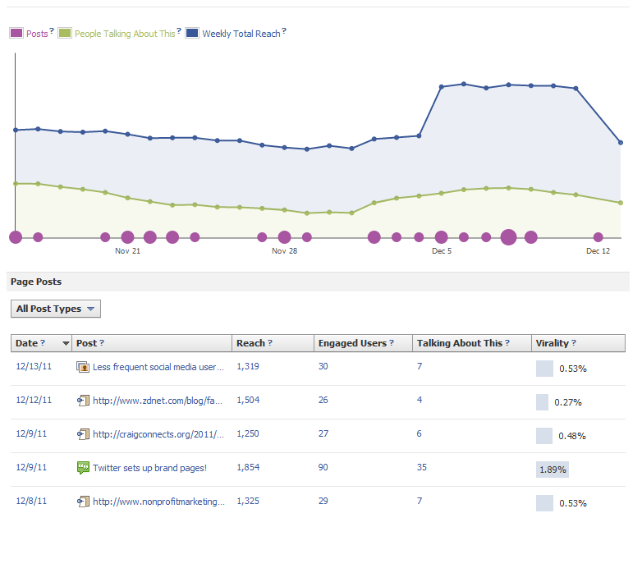
Notes:
Then I explore why certain topics and content received higher percentage of virality

Slide 20
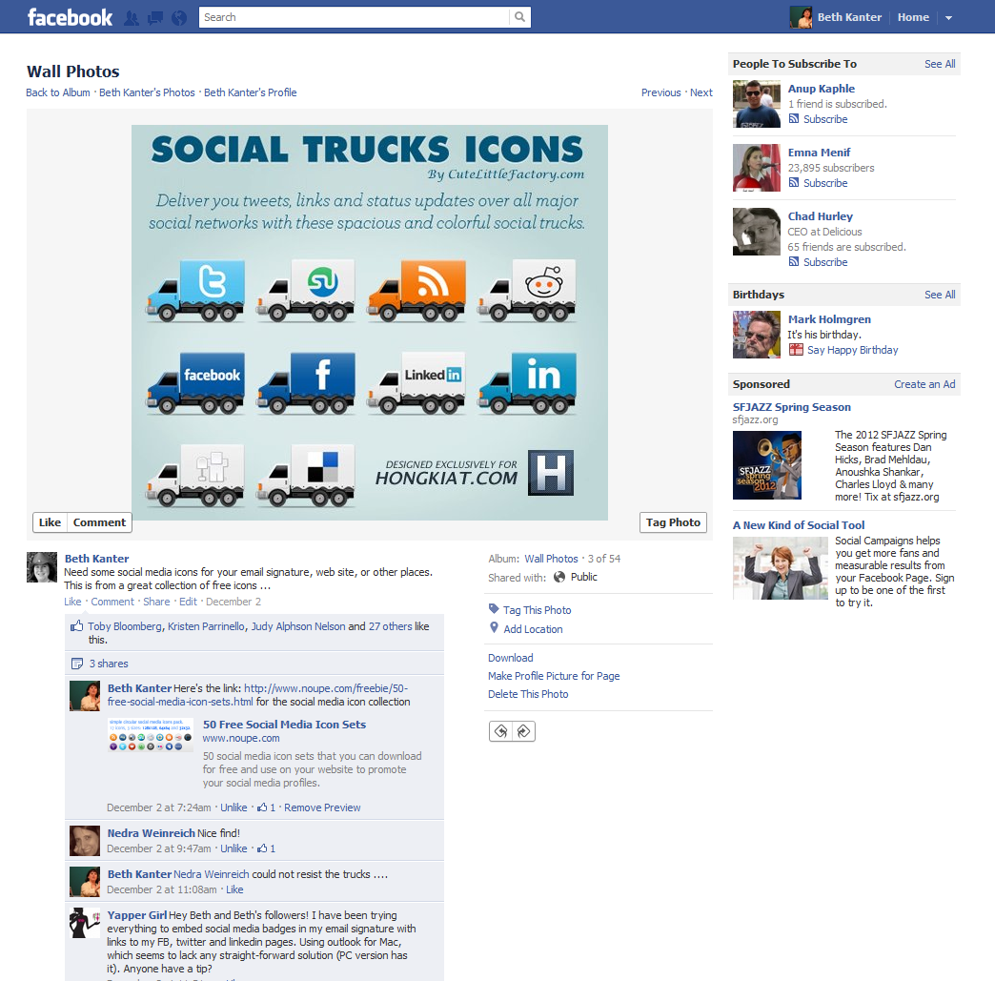
Had highest virility rate
Notes:
Example: This particular post was a fun, geeky, and practical – that is what my audience likes. But visuals seem to capture their attention.

Slide 21
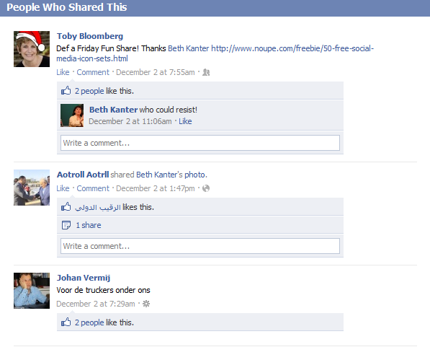
Learning:
Post fun geeky visual stuff that is useful on Fridays
Notes:
I will click through and read all the comments. I happened to share this on Friday – and in the US Friday is the end of the work week and people are looking forward to their time off and in the mood for something fun. So I made this a regular feature

Slide 22
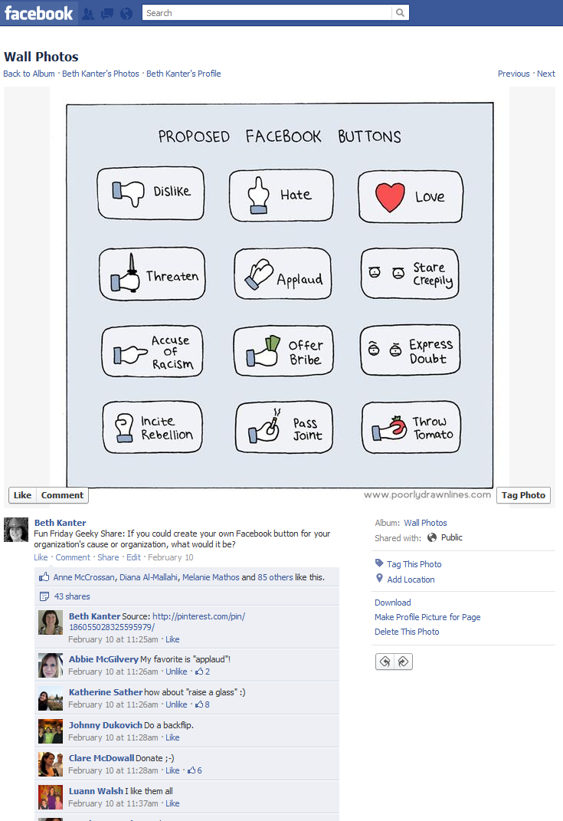
Notes:
Now my audience looks for “Fun Friday Shares”

Slide 23
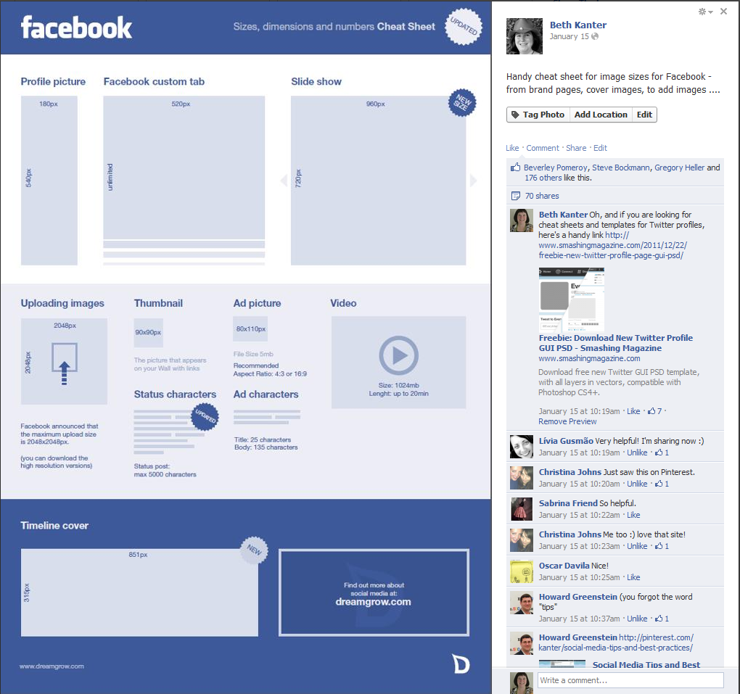
Notes:
So, I discovered through measurement what my audience really wants and I continued to expeirment.
For example, I started to look for visuals that were practical tips. And then experimented with posting on different times. This one was posted on a Saturday. It got my most shares ever.

Slide 24
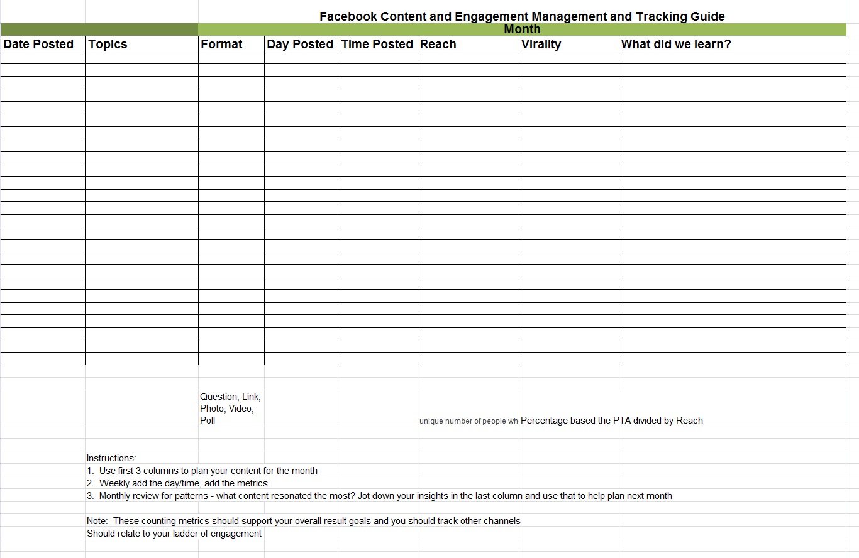
Notes:
I use a spreadsheet to capture this information – and append it to my editorial calendar.

Slide 25
Small Group Exercise: Plan A Month of Facebook Content
Each table has a different focus area – go sit at a table that matches your NGO’s focus area
Focus Areas:
Youth
Education
Women's Issues
Civil Society
Poverty Reduction
All Other
Look at your editorial calendar and the ideas for FB content
Use the tips to further define your Facebook Content
Extra credit: If you have a laptop and can get into your Facebook Page, take a look at your Insights metrics and see if you can notice any patterns about what content your audience likes.
Notes:
Focus Areas:
Youth
Women’s Issues
Education
Poverty Reduction
Civil Society
All Other

Slide 26
Reflection: Think and Write
What are some of the ideas you had for Facebook Content?
If you were able to check your Facebook data, what content did your audience like? Did that surprise you?
What is one step you will take with planning and implementing Facebook content when you get home?
Notes:
Focus Areas
Youth
Women’s Issues
Education
Poverty Reduction
Civil Society
All Other

