Slide 1
Using Social Media
in Education
How Social Media Can Help Teachers
and Their Students in Child-Centered Learning
Notes:
1

Slide 2




Introductions
Vicky Frank
Executive Director
Director of Digital Strategies
Seward Inc.

Slide 3


Introductions
Dr. Greg Sales
CEO/President
Seward Inc.
Matt Finholt-Daniel
Director of Technology
Seward Inc.

Slide 4
Overview of Social Media
Professional Benefit
Research tool – fresh content!
Build professional network
Establish credentials
Contribute to learning community
Student Benefit
Communicate instantly
Teach media literacy
Collaboration and teamwork
Engagement and dialog
Organizing/Synthesizing information

Slide 5
What to expect today
What is Web 2.0? (15 min)
What is social media? (30 min)
Why social media? Goals, plus/minus (30 min)
Group discussion: How can social media benefit your students? (30 min)
Questions & Answers (15 min)
Notes:
5

Slide 6
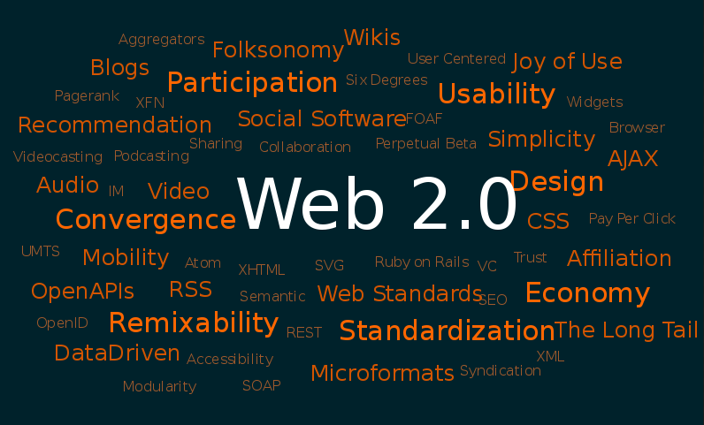
What is “Web 2.0”?
Notes:
6

Slide 7
Web 1.0
Web 2.0
Read-only (Passive) | Read/Write (Participative)
“Professional” content | “Amateur” content
Limited user experience | Rich user experience
Isolated | Social
Control | Trust
Own | Share
Websites | Blogs
Directories (taxonomy) | Tags (folksonomy)
Taxonomy is the practice and science of classification.
Aggregating the tags of many users creates a folksonomy.

Slide 8
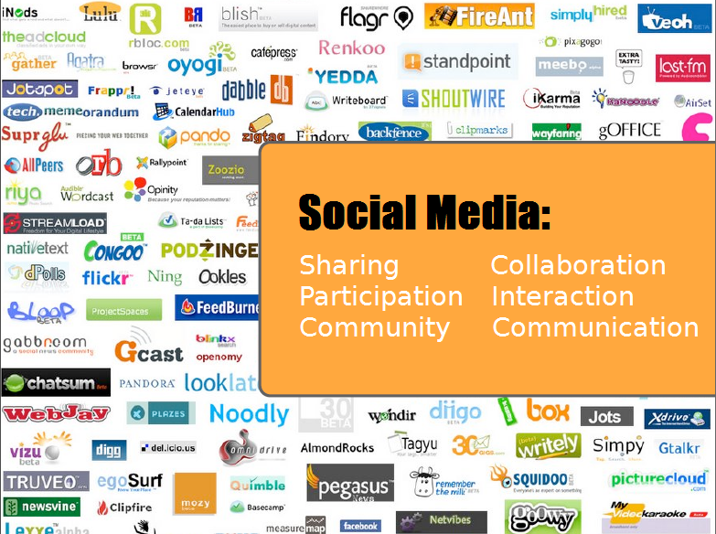
Notes:
8

Slide 9
Social Media Defined
New communication technologies that allow Internet users to easily interact with other users and create and share web content in the form of blogs, video, podcasts, wikis, RSS feeds, etc.

Slide 10
Tools:
Community:
New forms of teacher-to-student communication | Add a channel of communication to teaching
New forms of student-to-student communication | Build a community of learners
New forms of teacher-to-teacher communication | Build a professional development community
New ways to research/find fresh content | Share work
New ways to build an expert network | Solicit feedback
New media literacy | Collaborate on projects

Slide 11




Communications
Social Learning
    Delicious
    Diigo
    Slideshare
    Wikipedia
    Technorati
    YouTube
    Flickr iTunes (podcasts)
    Blogs Audible (books)
    RSS Hulu (TV, movies)
    Twitter
    Email (xobni)
    MS Instant Messenger
    Seward Blog
    Elluminate
    Skype
    Phone
    Google Analytics Google AdWords
    Twitalyzer LinkAnalysis
    Website Grader
    Twitter
    Twitter Mashups
    LinkedIn
    Plaxo
    ZoomInfo
    Facebook (personal)
Measurement/Analytics
Networking

Slide 12
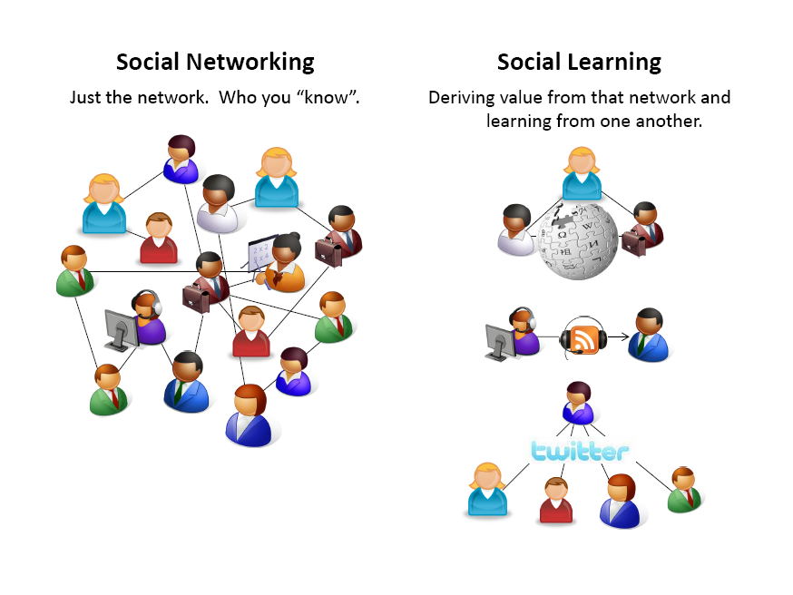
Two Aspects of Social Media
Notes:
12

Slide 13
Social Media in the Classroom
What are some of the leading tools?
What are the benefits of using them?
How are they being used in the classroom?
Let’s try them!
Notes:
13

Slide 14
Wikis
A wiki is a collection of Web pages designed to enable anyone with access to contribute or modify content.
+
knowledge transfer
easy
collaborative
fresh content
-
time-consuming
some wikis use unique markup language
Notes:
14
constructive dialog:
with students & other stakeholders

Slide 15
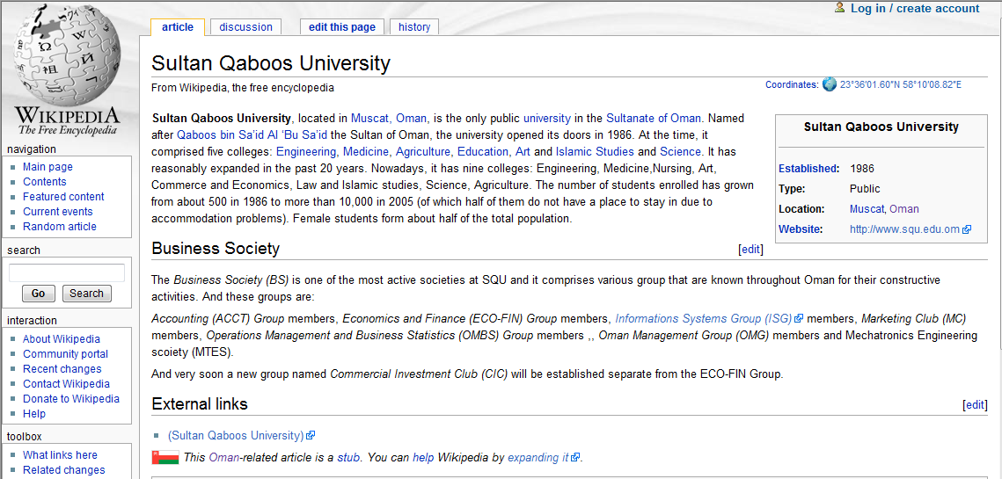
Wiki (facts, collaboration)
Notes:
15

Slide 16
Wikis in the Classroom
Using wikis to support student group work
Use them a to summarize small group discussions
Students encouraged to add to wiki after class and read/comment other students' entries
Base class discussions on wiki reading assignments
Assign groups of students to create wikis on topics to be covered in the class
Notes:
16
constructive dialog:
with students & other stakeholders

Slide 17
Wiki Benefits
Less vocal people can have an equal voice
Serves as a permanent shared record of what is said in class (otherwise lost)
Ensures the teacher can devote time and comment on each group's work
Enhances socialization and communication between students
Notes:
17
constructive dialog:
with students & other stakeholders

Slide 18
Blogs
A blog (short for weblog) is a type of website, with regular entries of commentary, descriptions of events, or other material such as graphics or video.
+
great archive
foster dialog
great exposure
comments
fresh content
comment might need moderation
smaller groups of authors
-
Notes:
18
constructive dialog:
with students & other stakeholders

Slide 19


Blog / Weblog
Seward Inc.’s Blog
http://blog.sewardinc.com
http://technorati.com
Personal directory of blogs
Notes:
19

Slide 20
Blogs in the Classroom
Using blogs to encourage self expression, inform students, and support learning
Have students create personal blogs on child-centered learning or specific methods
Blogs become focal points for analysis and discussion by others in the class
Blogs are used a ePortfolios
Notes:
20
constructive dialog:
with students & other stakeholders

Slide 21
Blog Benefits
Provide more current information to students
Can incorporate video, audio, RSS, links, documents
Students can access information and resources from anywhere with an Internet connection
Blog articles are automatically archived
Blog articles are indexed by search engines and can be shared via social media tools so they find a greater audience than their print counterpart
Notes:
21
constructive dialog:
with students & other stakeholders

Slide 22
Content Bookmarking,
Sharing, and Dissemination

Slide 23

Flickr image/video sharing
knowledge transfer
easy
collaborative
easily shared photo library
self-organizing (tagged) archive
+
Notes:
23
constructive dialog:
with students & other stakeholders

Slide 24

http://www.flickr.com/
ü Search
ü Comment
ü Bookmark
ü Use (with permission)
ü Share!
Try It!
Search: child-centered learning
Notes:
24

Slide 25
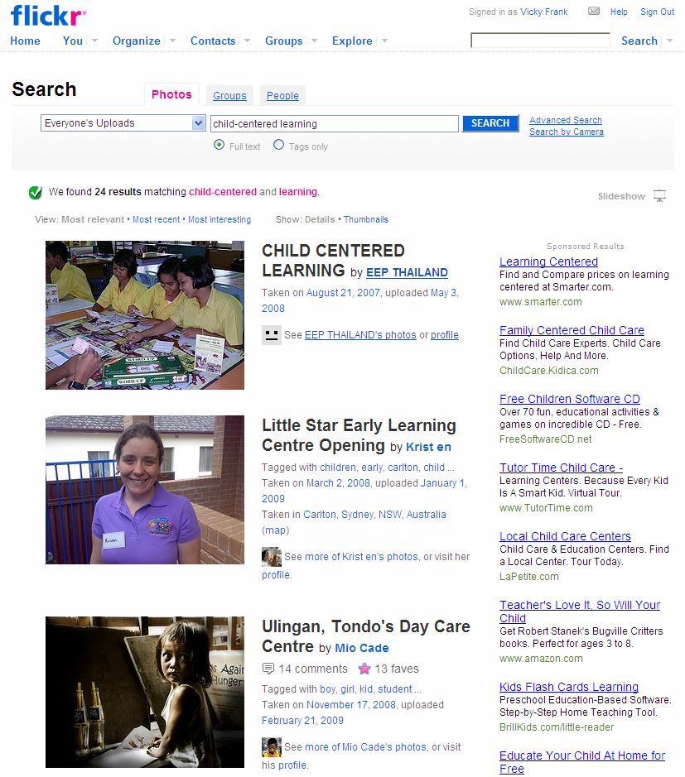
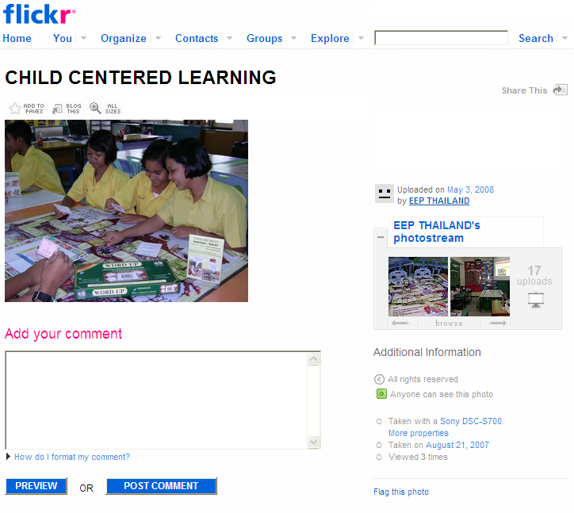
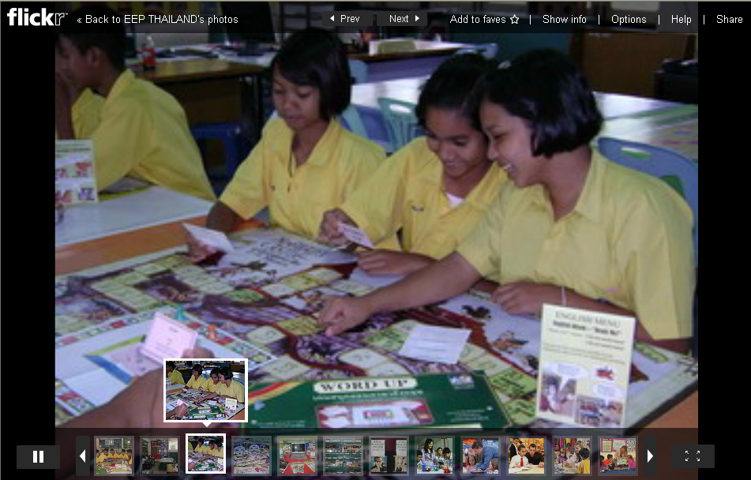
Flickr (image/video sharing)
Search: child-centered learning
View a slideshow.
Interact with photo owners.
Notes:
25

Slide 26
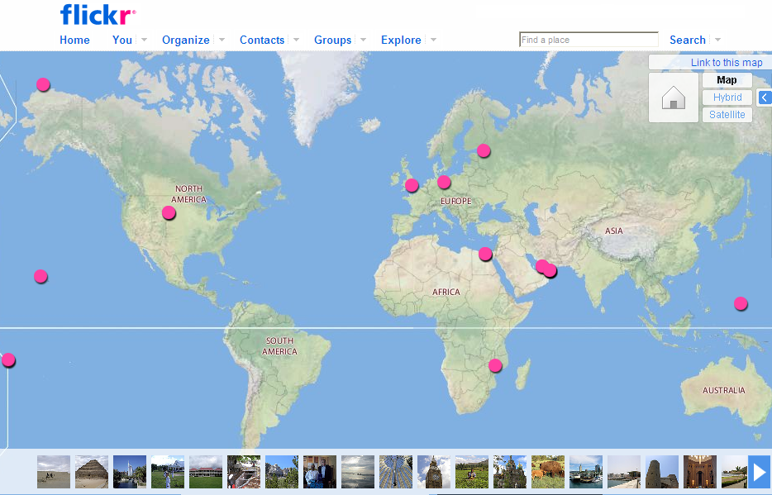
Try It!
Notes:
26

Slide 27









ü Search
ü Comment
ü Bookmark
ü Use (with permission)
ü Share!
Notes:
27

Slide 28
SlideShare
Document/Presentation sharing, network building, adding to the learning community.
share and obtain knowledge
build network
collaborative
find hot topics
self-organizing (tagged) archive
tag
comment
+

Slide 29
http://www.slideshare.com/
ü Search
ü Comment
ü Bookmark
ü Use (with permission)
ü Share!
Try It!
Search: english as a second language

Slide 30

Bookmarking Tools
Bookmarking tools to save, share, categorize, and use via the Internet.
http://delicious.com/vfrank/education
Save/tag websites for later reference. Share.
http://www.diigo.com
Annotate websites and save/tag for reference. Share.
http://www.evernote.com
Clip a webpage, a business card, a picture, class notes,
quotes from a book, a voice recording and more from the Internet. Searchable reference.
Try It!

Slide 31

YouTube (video sharing)
+
simple
video-based
hosted (no bandwidth costs)
questionable content
video is time & labor-intensive
copyright / intellectual property
-
Notes:
31
constructive dialog:
with students & other stakeholders

Slide 32
Rate
Date Stamp
Share
Categorize
Tag
Comment
Link to
http://www.youtube.com/
Try It!
Search: english as a second language
Notes:
32

Slide 33

Twitter
+
powerful networking tool
very simple
great exposure
privacy issues
requires a certain culture
white noise
-
Notes:
33
constructive dialog:
with students & other stakeholders

Slide 34
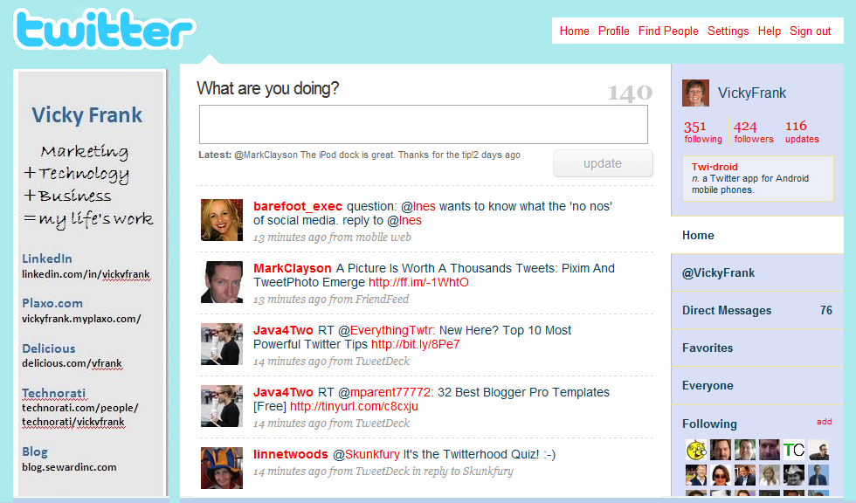
Twitter (really short messages)
Notes:
34

Slide 35




Twitter Mashups
http://nearbytweets.com/ to find Twitters within a specific mile radius of a location. Also can be filtered by keyword.
http://www.tweetizen.com/ to set up a specific group of people to tweet about a subject. Use as a discussion board or focus group tool.
http://search.twitter.com/ (http://www.tweetscan.com/) as a research tool to find out what people are saying about certain topics.
Twittervision (http://twittervision.com) See where in the world people are tweeting.
Try It!
Notes:
35

Slide 36
Twitter in the Classroom
Using Twitter with Students:
Communications tool for collaborating researchers
Get students to focus in a concise way on a topic
Tracking topics (by keyword)
Classroom 'back channel'
Notes:
36
constructive dialog:
with students & other stakeholders

Slide 37
Twitter Benefits
Benefits:
Strengthens a community feeling
Research tool
Instant, informal feedback
Immediate communication with students while not in classroom
Notes:
37
constructive dialog:
with students & other stakeholders

Slide 38

RSS (Really Simple Syndication)
RSS is a way of letting students know about updates to your information.
Also used to acquire information from friendly sources.
Example: Podcasts, blogs, news, Moodle
Notes:
38

Slide 39
Facebook
(FB was founded by/for Harvard students)
privacy controls
real people
strong academic community
distraction
walled garden
+
-
Notes:
39
constructive dialog:
with students & other stakeholders

Slide 40
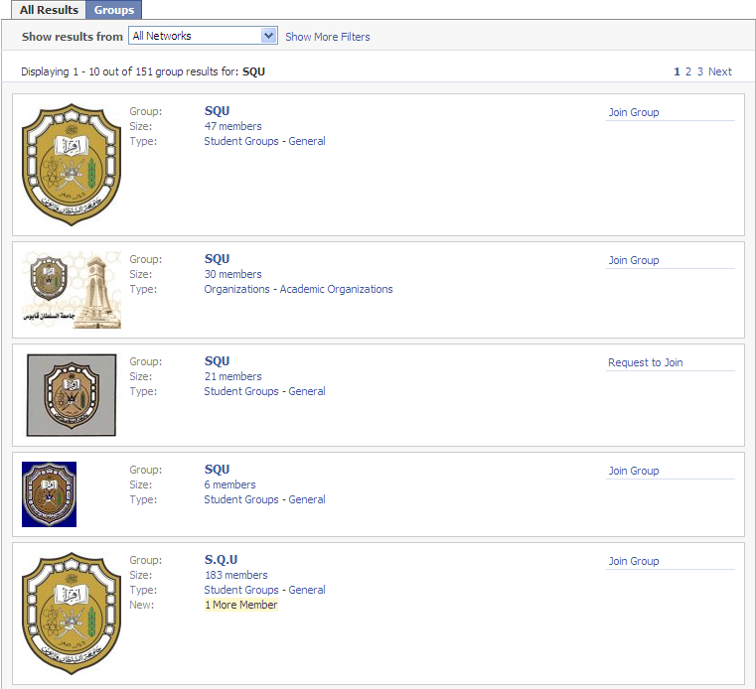
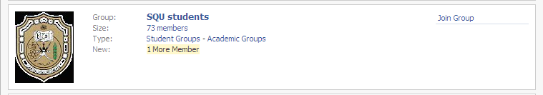
Facebook Search
Allows you to search for Facebook members by "School.“ for SQU:
6 groups
360 members
Ability to review and join group
Notes:
40

Slide 41
Facebook in the Classroom
Use Facebook to introduce class members to one another and share information about the class
Set up a teacher-moderated group in Facebook so that students can add themselves to the group.
Members of the group (class and teacher) can post comments and/or participate in discussion threads.
Members of the group (class and teacher) can augment the discussions with resources outside of Facebook (video, photos, webpages, SMS)
Notes:
41
constructive dialog:
with students & other stakeholders

Slide 42
Facebook Benefits
Helps introduce students to one another (and teacher) so they feel more comfortable when class begins
Students not only get a "jump" on reading lists and requirements, but they get a chance to discuss and ask questions/share viewpoints
Teachers can identify and correct initial problems or misconceptions students may have
Improves social cohesion
Notes:
42
constructive dialog:
with students & other stakeholders

Slide 43
Social Media Outcomes
What can we expect from
social media/Web 2.0?
Notes:
43

Slide 44
Risks (Perception)
Perceived risks:
Loss of authority
High expectations
“Who wants to read all that stuff?”
Notes:
44

Slide 45
Risks (Reality)
Realistic risks:
Information overload
Privacy!
Losing the audience / creating a zombie
Liabilities
Costs: time-consuming!
Notes:
45

Slide 46
Gains
Constructive dialog
Engagement!
Word-of-mouth style promotion
Direct feedback
Increased media literacy
Collaboration & teamwork
Community of learners
Broaden professional network
Notes:
46
constructive dialog:
with students & other stakeholders

Slide 47
What is needed?
Steady commitment
A culture of sharing and openness
Involve the students (and trust them)
Lose control (micro-management & social media don't mix)
Notes:
47
constructive dialog:
with students & other stakeholders

Slide 48
How could we use this to improve your classroom experience?
Notes:
48
constructive dialog:
with students & other stakeholders

Slide 49
Questions?
Notes:
49
constructive dialog:
with students & other stakeholders

Slide 50
Did we meet your expectations today?
Notes:
50

Slide 51
References
Handout
Notes:
51
constructive dialog:
with students & other stakeholders

Slide 52
Thank you!
Questions, Feedback, Resources
Email: vfrank@sewardinc.com
Seward Websites: http://www.sewardinc.com
http://international.sewardinc.com
Seward blog: http://blog.sewardinc.com
Delicious: http://delicious.com/vfrank Tag: education
LinkedIn: http://linkedin.com/in/vickyfrank
Twitter: @vickyfrank
Notes:
52
constructive dialog:
with students & other stakeholders

