Slide 1
Product Discovery
Kareem Nofal

Slide 2
Agenda:
Waterfall VS Agile mindset
What is product discovery
Best practices
Go deeper :
Talk to customers
Define problems

Slide 3
Waterfall VS Agile Mindset
Waterfall
Agile
We understand everything about the problems, the user, and the market.
We can predict the future accurately.
We seek to learn about the Problem, the user, and the market. as FAST as we can.
We have assumptions that we have to test.

Slide 4
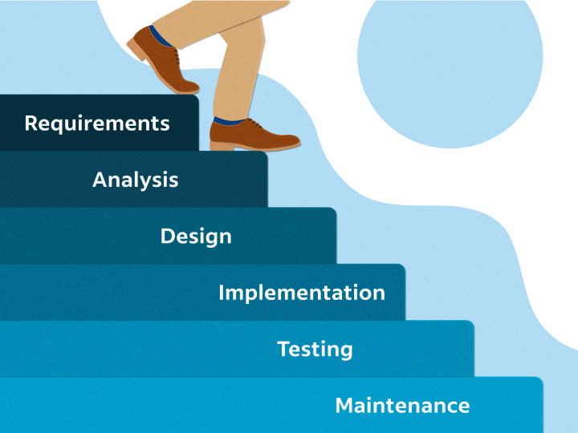
Waterfall

Slide 5
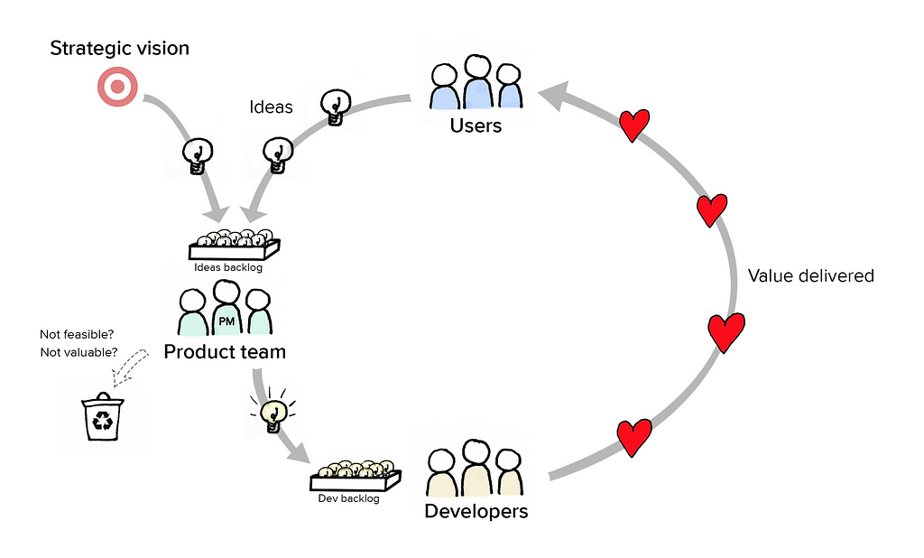
Agile

Slide 6
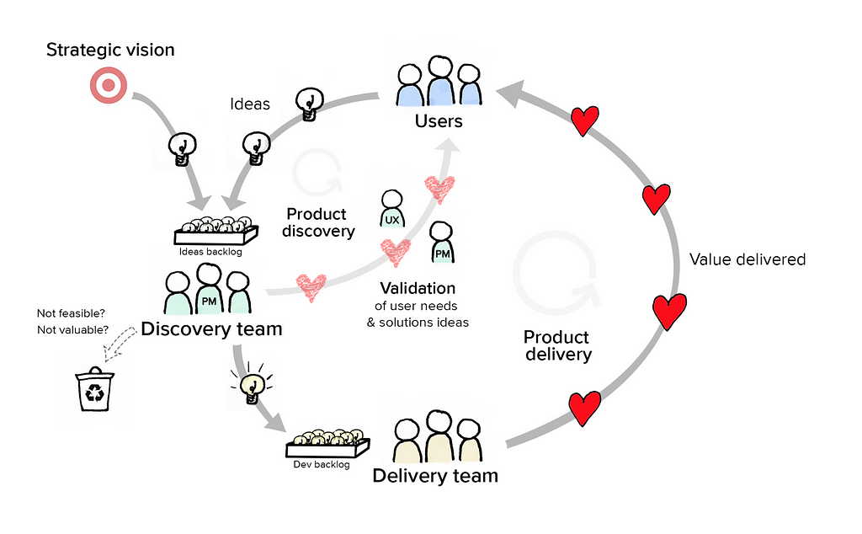
Product Discovery

Slide 7
Product discovery
Product Delivery
Problem Space
Solution Space
Figuring out what’s the right thing to build
Building it the best way possible

Slide 8
Best Practice
Develop a deep understanding of the costumer world so ideas can emerge
Test and iterate those ideas in the cheapest and fastest way possible

Slide 9
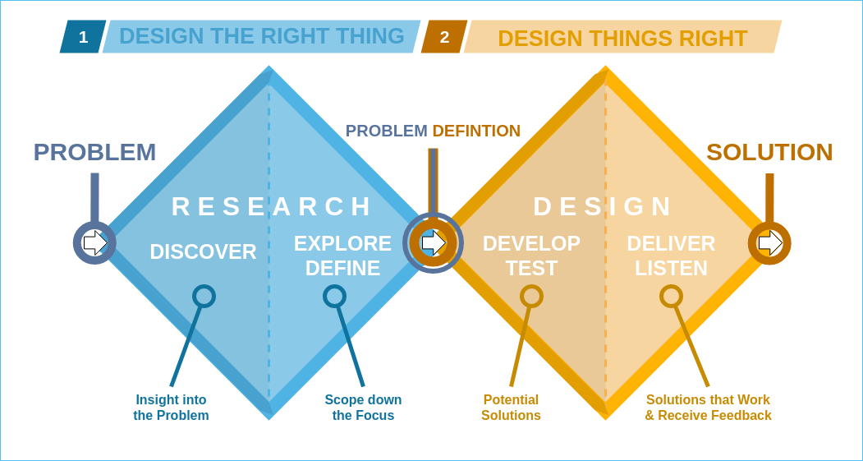
Double Diamond

Slide 10
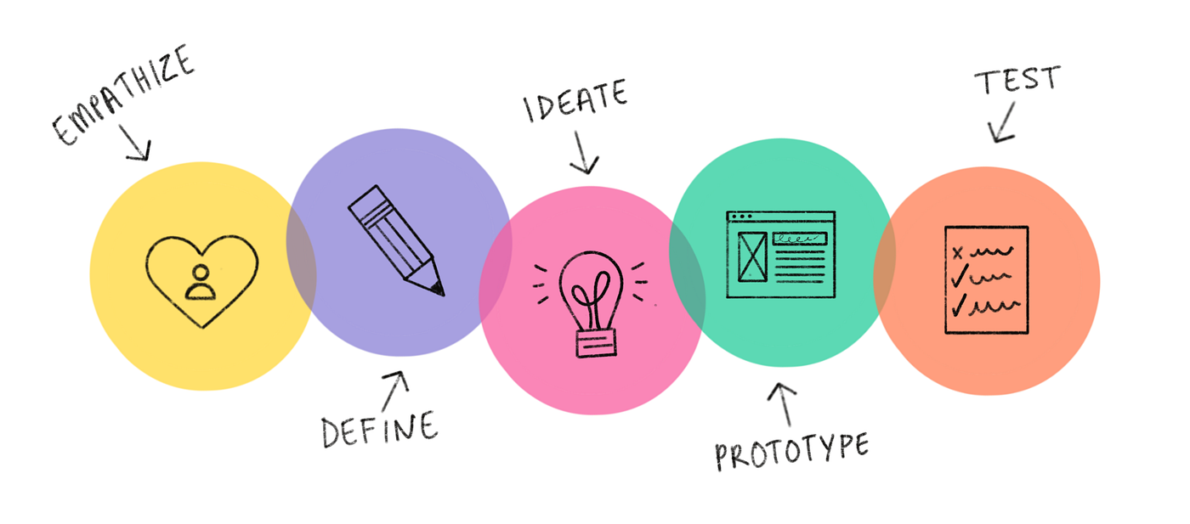
Design Thinking

Slide 11
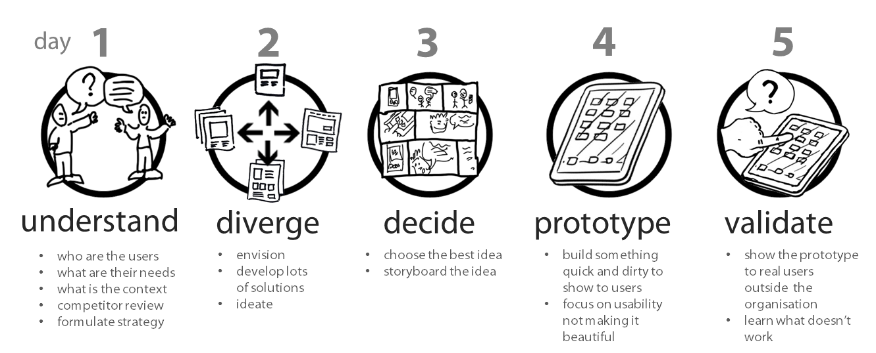
Design Sprint

Slide 12
Talk to customers…. Please

Slide 13
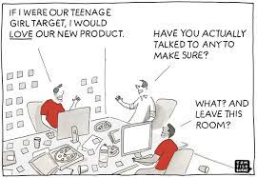

Slide 14
I will talk to my family and friend about my revolutionary AI product for developers
Q

Slide 15
Build customer personas and talk to the right segment

Slide 16
I don’t have much time. I’ll only talk to 5 customers
Q

Slide 17
5 customers is enough in each test round

Slide 18
I will create a google form with all my questions and send it to customers
Q

Slide 19
Survey are not accurate

Slide 20
Do you like using the toaster ?
Q

Slide 21
Ask open ended questions, never yes or no

Slide 22
This is my product. I really hope you will like it.
Q

Slide 23
Never show emotions or direct Answer

Slide 24
If i understand you correctly, you are telling me bla bla ?
Q

Slide 25
Always summarize and make sure you got the right point

Slide 26
I built this great product, I dose Bla bla. You wanna buy it ?
Q

Slide 27
Focus on listening and understanding. You are not a salesperson

Slide 28
If I add this feature, do you think you will use my product ?
Q

Slide 29
We are bad at imagining and predicting the future

Slide 30
I did my first customer interview today, everyone loved my product
Q

Slide 31
Iterate and do it again until you are an expert

Slide 32
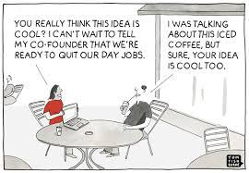

Slide 33
Define the problem
“If I had an hour to solve a problem I'd spend 55 minutes thinking about the problem and five minutes thinking about solutions”
Einstein

Slide 34
Jobs to be done
Talabat Mart has a problem, Let’s solve it together

Slide 35
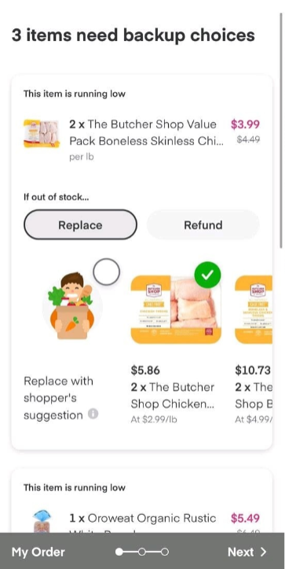
Jobs to be done

Slide 36
What could go wrong If we didn’t do product discovery ?

Slide 37
Thank you
Any questions ?

